Slide 1

The Role of Public Awareness and Education
in building community resilience

Slide 2
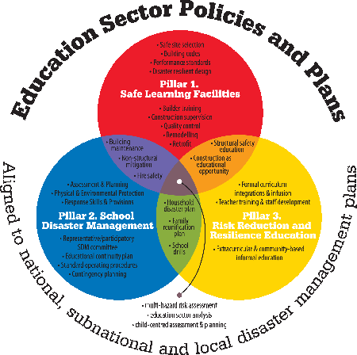
• All-hazards
child-centered
risk assessment
• Education sector analysis
Notes:
From a child rights perspective there are unequivocal commitments to two essential rights: the right to education, and the right to safety
To fulfill these top-level outcomes a comprehensive approach to educational continuity and child protection in the education sector are required.
School safety advocates have collectively adopted a simple framework for understanding this, and refer to this as Comprehensive School Safety.
It recognizes three main pillars:
safe school facilities
school disaster management, and
disaster prevention and risk reduction education.
Safe facilities are measured both by school facilities audits and policies and practices for due diligence in school site selection, construction design, materials procurement and construction oversight, andfor building maintenance guidance and support.
School disaster management is measured by standardized policies and procedures, as well as ongoing site-based implementation and adjustment of plans.
And disaster prevention education is measured by both quality of curriculum integration as well as student learning outcomes in terms of behaviour, skills and competencies. The learning outcomes in turn rest on both key messages for disaster prevention at home, school and work, as well as on community-based disaster risk reduction and climate change adaptation, critical thinking, problem-solving.
It is important to note here that there is NO recommendation to develop any single tool for generalized school safety assessments. While these have been attempted, they have not been shown to be scalable and have thus far minimal effectiveness. The reasons are that each of the three main pillars of school safety involve different processes, different implementing actors and decision-making authorities, different types of resources and expertise, and different types of policies and assessment approaches.

Slide 3
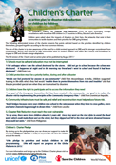
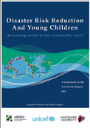
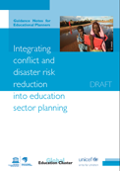
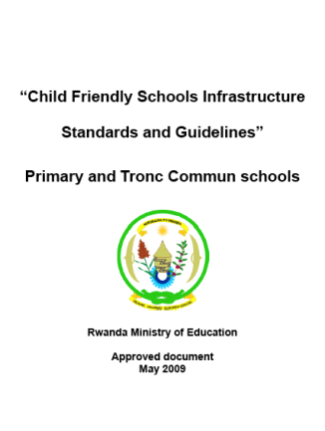
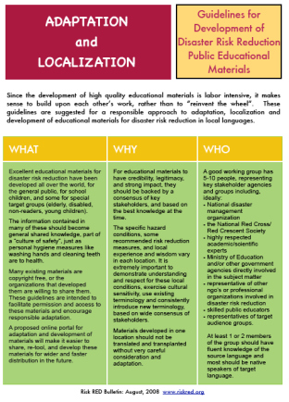
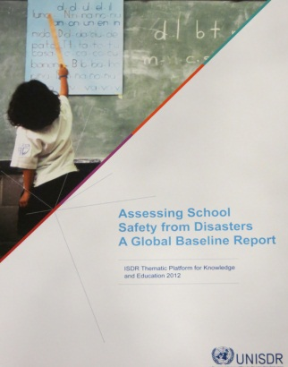
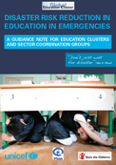
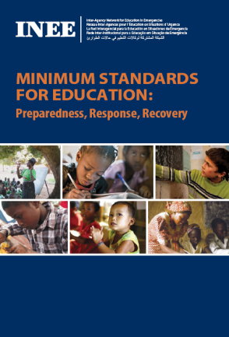

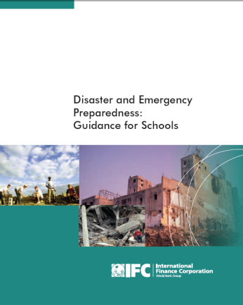
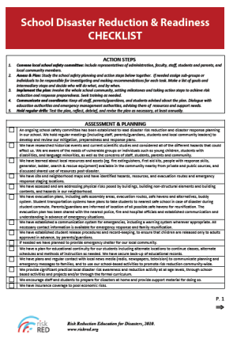
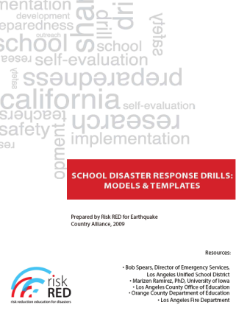
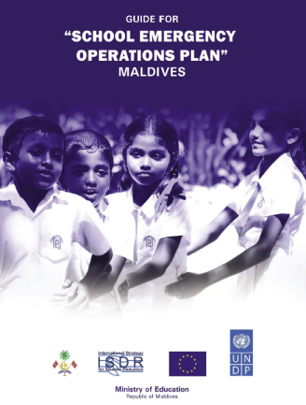
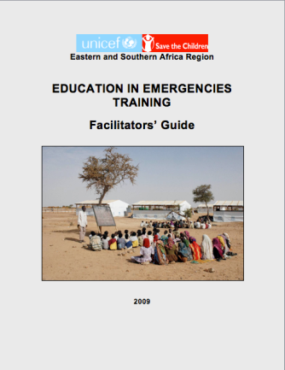
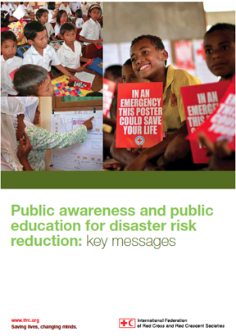
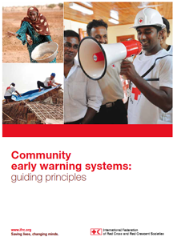
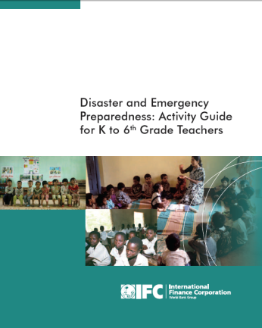
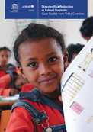
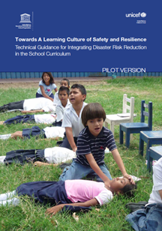
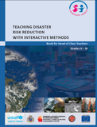
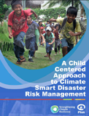
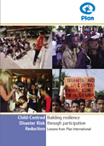

Significant contributions!

Slide 4


Slide 5
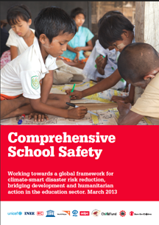
IEC content development checklist
Working towards a global framework for climate-smart disaster risk reduction, bridging development and humanitarian action in the education sector
Notes:
Purpose
The past decade has brought children’s advocates together:
• To promote disaster risk reduction throughout the education sector along with education for sustainable development and
• To assure universal access to quality education.
At the core of these child-centered, and evidence-based efforts are the recognition of children’s rights to survival and protection as well as to education and participation.
The purpose of this framework for Comprehensive School Safety is to bring these efforts into a clear and unified focus in order for education sector partners to work more effectively, as well as to link with similar efforts in all other sectors Hyogo Framework for Action 2005-2015
International Decade for Education for Sustainable Development
Millenium Development Goals, Education for All, Global Partnership for Education, Education First

Slide 6
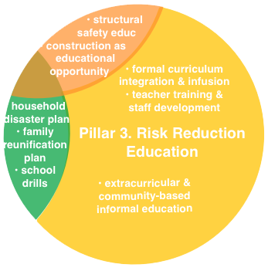
Notes:
3. Risk Reduction & Resilience Education should be designed to develop a culture of safety and resilient communities. Key responsibilities are to:
Develop consensus-based key messages for reducing household and community vulnerabilities, and for preparing for and responding to hazard impacts as a foundation for formal and non-formal education.
Develop scope and sequence for teaching about hazards, disasters, and problem-solving for risk reduction.
Infuse risk reduction throughout the curriculum and provide guidelines for integration of DRR into carrier subjects.
Provide teacher training for both teachers and teacher trainees on risk reduction curriculum materials
Develop strategies to scale-up teacher involvement for effective integration of these topics into formal curriculum as well as non-formal and extra-curricular approaches with local communities.

Slide 7
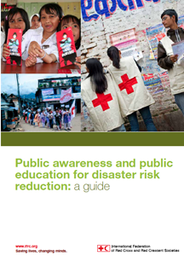
Public awareness and public education for drr: Guide and Key Messages
Notes:
Public Awareness and Education: Guide and Key Messages:
National Red Cross and Red Crescent National Societies have a long history on working with communities and people at disaster risk on the threats they face, how this makes them vulnerable and what steps they can take themselves to increase their safety and resilience.
In 2011, the IFRC published Public awareness and education for disaster risk reduction – a guide, designed to help National Societies scale up their work in DRR campaigning, partnerships and education. Alongside this guide, IFRC carried out research on what activities are going on within National Red Cross Red Crescent Societies, and within the wider sector, to harmonize messages for DRR. In 2013 IFRC launch the Public awareness and education for disaster risk reduction: key messages, is offered as a tool for practitioners internationally to use in a consensus- building validation process. National Societies, national disaster management organizations, governmental and non-governmental organisations and international organizations are invited to be part of a global validation project working to develop a comprehensive multi-regional set of key messages as a contribution for the culmination of the 2005–2015 Hyogo Framework for Action.
Harmonized messaging is a key goal in disaster reduction awareness, and is particularly important when it comes to scaling-up efforts to create a culture of safety. To promote consistent actions to the public, we need key safety and resilience messages. Ensuring that these messages have credibility, legitimacy and strong impact, they need to be harmonized and consistent, backed by a consensus of key stakeholders, and based on the best knowledge available at the time.
FOUNDATION: Multi-hazard Household Disaster Plan
SPECIFIC HAZARDS:
Flood Earthquake
Tropical Cyclone Wildfire
Pandemic Drought
TO BE DEVELOPED:
Landslides, debris flows and glacial breakout
Tsunami and tidal surges
Volcanic eruption
Storms (including lightning, tornadoes and snow, ice or hail)
Chemical, biological, radiological or nuclear materials release
Cold waves and heat waves
Climate change.

Slide 8
Community-based Early Warning
Notes:
Community Early Warning Systems: Guiding Principles
The decline in human and material losses from disasters over the past 30 years is partly due to improved early-warning systems, many of them 'high-tech'. Scientific advances have revolutionized forecasting and the communications technology used for warnings. The International Federation of the Red Cross and Red Crescent Societies advocates, however, for a more people-centred approach that is essential to ensure information and warnings captured by satellites, computer modelling and other technologies reach the most vulnerable communities, who can then act on them. Early warnings alone do not keep hazards from turning into disasters.
Early action, covering all time scales, is also essential. It is an investment in the future, and has been proven effective at attenuating the effects of disasters. The people-centred approach to early warning, promoted by the Hyogo Framework for Action, focuses on how communities must understand threats in order to avoid them. Disasters are partly caused by external hazards, but they also stem from vulnerability: people being in the wrong place, at the wrong time, or without adequate protection or resources to respond to a warning.

Slide 9
Global Lessons for Quality, Sustainability and Scalability
DRR in Curriculum Guidance
Technical Guidance for integrating Disaster Risk Reduction in the School Curriculum: Towards a Learning Culture of Safety and Resilience
Global mapping of the integration of DRR into curricula
Notes:
UNESCO/ UNICEF’s work on DRR in school curricula
UNESCO, together with UNICEF works on an evidence base as well as international technical guidance to support the inclusion of DRR components in school curricula within an ESD framework.
In preparation of this initiative, UNICEF and UNESCO commissioned a global mapping of the integration of DRR into curricula that captures key national experiences and good practices. The study entitled DRR in the curriculum, consists of case studies of 30 countries, identifies approaches to integrating DRR in curricula and analyzes their advantages and disadvantages.
While there are many good practices, the study revealed that DRR, most frequently, is integrated into a narrow band of subjects, typically the physical and natural sciences. Gaps have been identified in particular in the areas of DRR learning assessment. There is rarely a focus on comprehensive DRR learning outcomes. Teacher professional development in DRR was also found to need advancing.
A draft technical guidance document o, entitled Technical Guidance for integrating Disaster Risk Reduction in the School Curriculum: Towards a Learning Culture of Safety and Resilience which currently available as a pilot version, should support a broader integration of DRR in schools.
The document provides a thorough rationale for including DRR into curricula within an ESD framework and give guidance with regard to the relevant knowledge to be acquired by learners at different levels of education. It should guide those with responsibility for curricula regarding appropriate teaching and learning methods for DRR, that is, those methods that empower and motivate learners and support the development of a comprehensive culture of disaster resilience.
The pilot version of the tool is currently used for training and pilot activities organized by UNESCO and UNICEF in approximately 12 countries: By UNESCO in Asia (Laos, Philippines, Nepal and Sri Lanka) and in the Caribbean (Trinidad and Tobago, St. Kitts & Nevis and St. Vincent & the Grenadines and the Dominican Republic). And by UNICEF in Africa and Central Asia. Based on the feedback and results from the pilot testing, a final version of the guidance document will be developed and published later this year.

Slide 10
Next: Key Messages – national localization, contextualization, adoption
Core concept | CONTEXT SPECIFIC DETAILS
URBAN | RURAL
Be able to put out a small fire
• Maintain a fire extinguisher on each floor
• Learn how to use a fire extinguisher, remembering P.A.S.S.
• Keep a bucket of sand nearby any open fire
• Do not use water on an electrical or oil fire

Slide 11
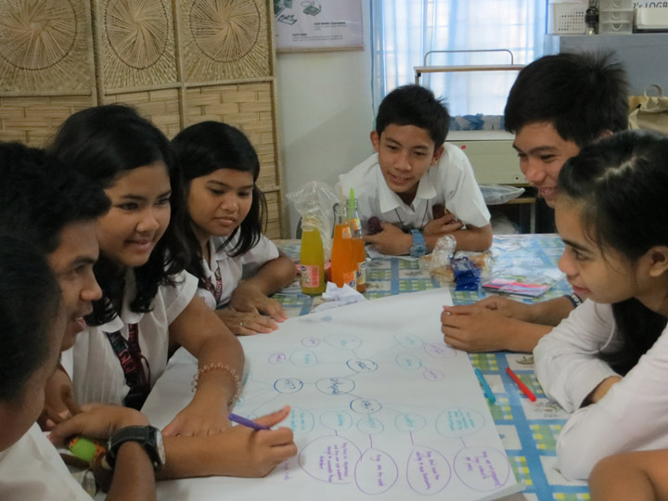
Next: ‘Scope and Sequence’ roadmap for risk reduction and resilience competencies
Who?
Infants and young children
What?
Can’t swim
Flood
Houses built from bamboo
Need floatation devices
Where?
Low-lying areas near the river
Students run a public education campaign

Slide 12
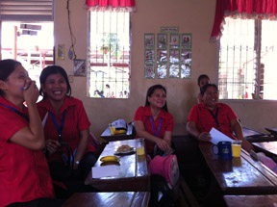
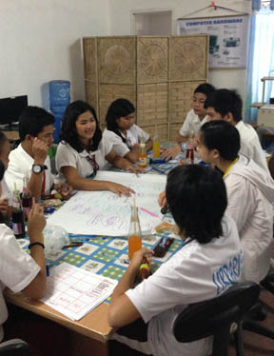
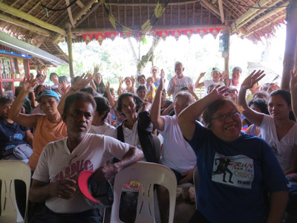
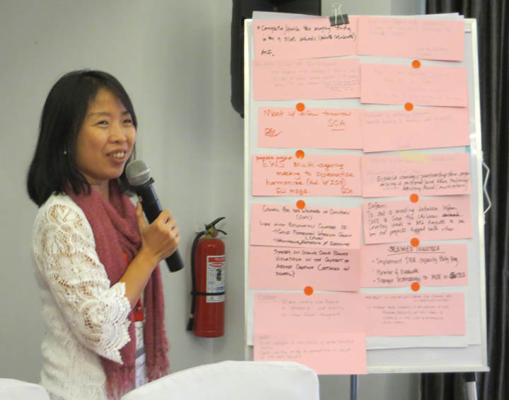
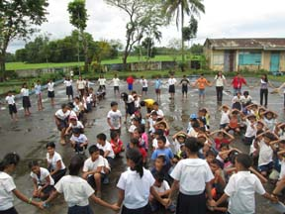
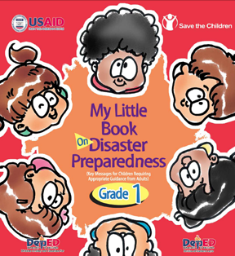
Building an evidence-base for DRR Education
Next: Methods & Implementation of IEC Materials Quality Review, learning outcomes / impact analyses
• Child participatory activities
• Focus groups with teachers
• Dialogue with communities
• National Consultation
• Observation of drills
• Key informant interviews
•Review of IEC materials

Slide 13
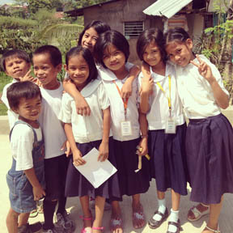
Next: Developing leadership capacity among teachers, children, and youth

Slide 14
Thank you!
Marla Petal
marla.petal@savethechildren.org.au

Slide 15

Department of Disaster Management (DDM)
Ministry of Disaster Management and Relief (MoDMR)
Institutionalization of disaster risk in public education system and raising mass awareness
Professionalizing DM system | DM in Public Education
Professionalize Education in DM as Thematic area Ministry Corporate Plan (2004-2009) with focus on education and awareness with AoB DM Act 2012, SOD, NPDM with specific directions to the relevant Ministry and mandatory provision, SAARC DM Framework Networks consisting 43 training & Educational Inst. DM integrated curricula, bachelor, master’s & diploma course (1500+ received masters, diploma & 6,000+ professional training) | Disaster Management and climate change issues as a topic has been incorporated in the class III to class X school Institutionalization of school safety and awareness drill towards building the culture of safer school countrywide with Ministry of Primary Education Platform on Bangladesh Disaster Management Education Research and Training Network (BDMERT)
Risk Communications & Mass Awareness
Improved access to knowledge sources and establishment of knowledge management centre as decentralized systems of learning DM, (10 E-learning Centre); 2 e-modules, book support to 24 Institutions
Collaboration with Press Institute of Bangladesh for raising awareness thru media ; Support extended to Community Radio Broadcasters for integration of DRR & CCA related content and capacity building
Observation of National Disaster preparedness Day & International Day for Disaster Risk Reduction (IDDR) for raising mass awareness (Regular publication of huge number of IEC materials and being distributed at the community level and vulnerable locations)
Mohammad Munir Chowdhury
For more info: www.ddm.gov.bd;

Slide 16
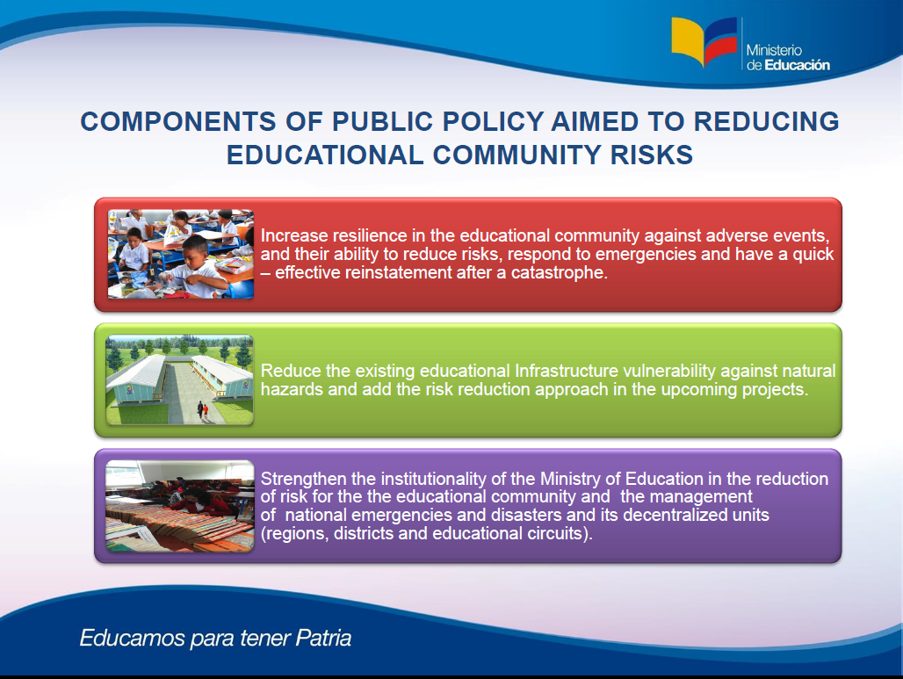

Slide 17

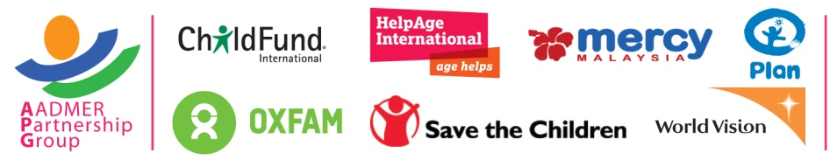
What if...
ASEAN Safe Schools Initiative
10 Governments of ASEAN Countries work together to make sure children in schools are safe from disasters?
All Member States have made progress on Safe Schools but facing common challenges
Spirit of ASEAN to become as One Community
Synergy and Collaboration: using existing mechanism in ASEAN (through ACDM and SOMED)
Building strategic partnerships with private sectors, academia, and media through a collective and unified effort

Slide 18

ARMENIAN RED CROSS SOCIETY
Strengthening Community Capacities and Building Resilience
HVCA/DP&M PoA/community voluntary teams/mitigation measures
Strengthening Local Level Coordination and Building Networks
Public Awareness and Education, focus on families
School based trainings & seminars / quiz & competitions / evacuation drills
Family Emergency Plan Model
awareness & preparedness raising / non structural mitigation at home

