Slide 1
Superstore Sales Dashboard
Prepared by: AVNISH BEDI​
Internship: Data Analyst
Internship – Elevate Labs​
Date: 26 June 2025​

Slide 2
Key Metrics Tracked:
• Total Sales
• Total Profit
• Total Orders
• Sales by Region
• Profit by Category
• Monthly Trend Analysis

Slide 3
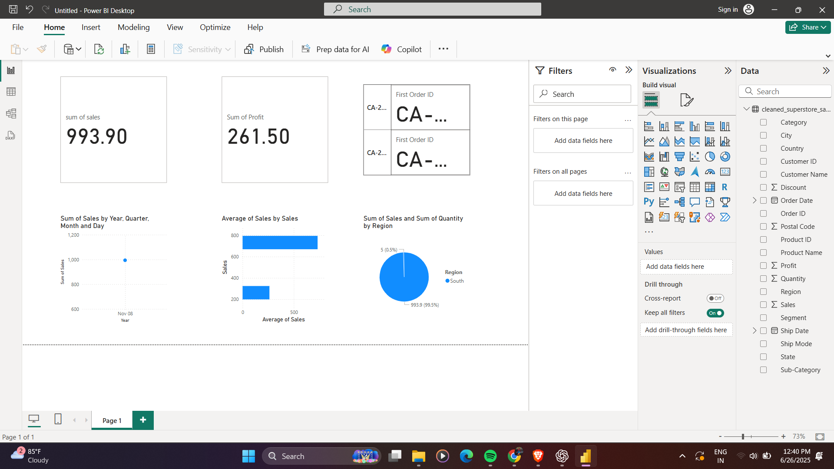
📸 Screenshot of the Interactive Dashboard

Slide 4
Key Insights from Data:
• Technology category has highest sales.
• South region reports lowest profit margin.
• Most orders are from the Consumer segment.
• November 2017 was the peak sales month.

Slide 5
Conclusion:
This Power BI dashboard allows business stakeholders to interactively analyze sales and profit data across different categories, regions, and time periods. The dynamic filters and charts enable better decision-making and quick insights.

