Slide 1

National Transit Pass System (NTPS)
National Portal for Inter-State/Intra-State Movement of Timber, Bamboo and other Forest produce

Slide 2
Objectives
This system will be used for issuing, monitoring and keeping records of transit permits for inter-state and intra-state transportation of timber and bamboo from private lands/government/private depot.
Need
To expedite issuance of transit permits for timber, bamboo and other minor forest produce.
To replace manual paper based transit system by online transit system for ease of doing business.
One permit for whole India for transit of timber , bamboo and other minor forest produce for ease of doing business.
To enhance transparency in obtaining transit permits
To prevent hardships of timber and bamboo producers, farmers and transporters in obtaining permits and at forest check posts
To facilitate agro-forestry activities.

Slide 3
Features and Functionalities
It is a role based and work flow based application
Online registration and submission of the Application for Transit Permit or NOC
Every State have state specific acts and rules regarding transit passes. The system incorporates these in the e-transit system.
Online application for Species grown on private land which are exempted from transit pass regime.
Online application submission for Species grown on private land which are not exempted from transit pass regime.
Online generation of Transit Permit or NOC on the basis of category of species

Slide 4
Features and Functionalities
The probable route of transportation as a part of transit Permit
Driver details can be changed at the time of downloading of Transit Permit
Mobile app : for filling the details by the applicant. It will facilitate the inspecting authority to carry out inspection. TP verifier can verify at barriers or any other officers can verify TP/NOC during the movement.
Dashboard with two different features: First feature for monitoring the status of TP in terms of TP Processing i.e., TP issued, Not recommended, TP Pending. Second feature for Tracking TP for Complete, Incomplete and expired TPs on the basis of crossing the barriers during the movement.
Verifying the movement of the vehicle by scanning the QR Code generated through the system

Slide 5
Applicant Registration
Fill Personal Details
(One time)
Category 1
Category 2
Fill Details
Fill Details
Supportive documents
& Route Details
Supportive documents
& Route Details
Range Officer
Inspection
Decisions
TP Issue
TP sent for Prior Approval
Forwarded to Higher authority
NOC/TP will be available at applicant area
TP not Recommended
Rejected
Verified at check Post
Destination (TP expires)
TP Sent for Issue
forwarded to Higher authority

Slide 6
TP Issuing Authority
TP Processing
Report
Update Profile
Update mobile number
Check post
Assistance
Submitted Application
Inspected Applications
Inspection
TP sent for Prior approval
Recommended / not recommended
TP Sent for issue
TP Approved from Higher Authority
Yes
No
Remarks

Slide 7
Work flow for RFO
Activate user by entering mobile number
[Home page]
login
activate user
Issue Not Recommended Sent for issue Sent for prior Approval
1.OTP verification
2.Upload hammer Approved
3.Fees
Applicant
Activate user by entering mobile no.
login
Home page
Personal profile
Login
1.Application received
Inspection
Activate user
2.Inspected application
Action
Issue
Not Recommended
Sent for issue
Sent for prior approval
1.OTP verification
2.Upload hammer
Approved
3.Fees
4.Route Finalization

Slide 8
(Conservator Of Forest)
( Divisional Forest Officers)
(Assistant Conservator Of Forest)
Approving Authority
TP Processing
Reports
Assistance
Update Profile
Update Profile
Dashboard
Check post
(For Applications Monitoring)
&
(TP Tracking)
TP Received for Approval
TP Received after Approval
TP Sent for Issue to higher Authority
Circle Level
TP Sent for Approval
Division Level
Range Level

Slide 9
Work Flow
Category 1: Species grown on private land which are exempted from transit pass regime
Applicant
NOC

Slide 10
Work Flow
Category 2: Species grown on private land which are not exempted from transit pass regime
Applicant
Range Forest Office
Inspection report
Higher Authority(if RFO does not issue T.P.)

Slide 11
State Administrative Authority
Report
Designation
Mapping
Master
Creation
Language
Species
Exempted
Transit Rule
Assistance
Dashboard
Update
Profile
Update
Mobile
Circle
Division
Range
Check post
(For Applications Monitoring)
&
(TP Tracking)
Total TP Received
TPs Issued
TPs Pending Status
TPs not Recommended
NOC Issued
Circle Level
Division Level
Range Level

Slide 12
Central Monitoring Authority
Report
TP Fee collected
Update Mobile
Dashboard
Update Profile
(For Applications Monitoring)
&
(TP Tracking)
Total TP Received
TPs Issued
TPs Pending Status
TPs not Recommended
NOC Issued
State Level
Circle Level
Division Level
Range Level

Slide 13
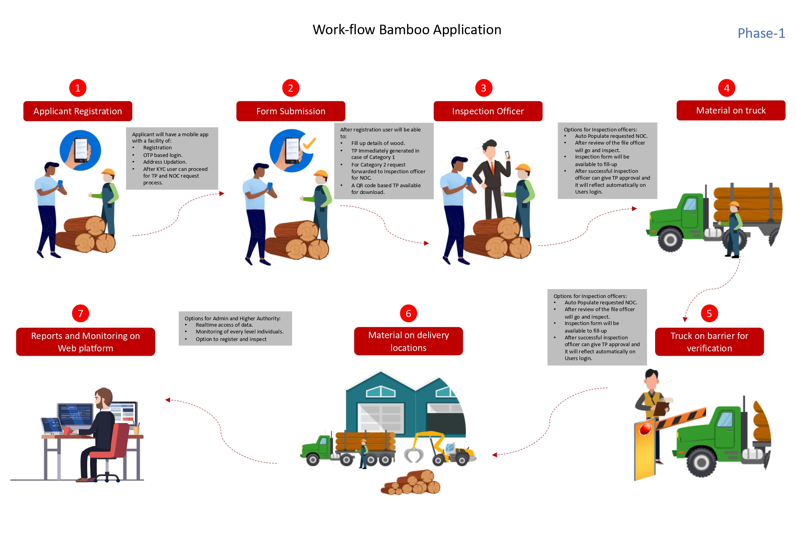
Functionalities of Mobile App

Slide 14

Thank You

