Slide 1

A Presentation on “Rice Classification” Group Param Dalal – 70022000122 Hirak Shah – 70022000204 Swasti Tripathi – 70022000212 Atharva Joshi – 70022000274 Under the Guidance of Prof. Dhananjay Joshi
Department of Computer Engineering
MPSTME, Shirpur Campus
2023-24

Slide 2
OUTLINE
Objective of Project
Literature Survey
Problem Statement
Proposed Solution
Future Prospects
Conclusion
References

Slide 3
OBJECTIVE OF PROJECT
The primary objective of this project is to develop a deep learning-based rice classification system using MobileNetV2/VGG16 architecture to automate the process of identifying different rice varieties from images.
This solution aims to enhance the efficiency and accuracy of rice classification in the agricultural sector, ultimately contributing to improved crop management, quality assurance, and the advancement of precision agriculture practices.

Slide 4
LITERATURE SURVEY
Sr No. | Paper Title | Publishing Year | Models Used | Important Features | Findings | Research Gap
1 | MobileNets: Efficient Convolutional Neural Networks for Mobile Vision Applications | 2017⁴ | MobileNets | Depth-wise separable convolutions | MobileNets are efficient models for mobile and embedded vision applications. They are based on a streamlined architecture that uses depth-wise separable convolutions to build lightweight deep neural networks. They introduce two simple global hyper-parameters that efficiently trade off between latency and accuracy12. They show strong performance compared to other popular models on ImageNet classification2. | The paper does not compare the MobileNets with other state-of-the-art models that are designed for mobile and embedded vision applications, such as ShuffleNet, SqueezeNet, and NASNet. It only compares them with some conventional models, such as VGG, Inception, and ResNet. A fair comparison with other models that have similar goals and constraints would be more informative and convincing.

Slide 5
LITERATURE SURVEY CONTINUED
Sr No. | Paper Title | Publishing Year | Models Used | Important Features | Findings | Research Gap
2 | Identification of Rice Varieties Using Machine Learning Algorithms¹ | 2022⁴ | VGG16 CNN with logistic regression classifier¹ | The paper discusses the use of machine learning algorithms for distinguishing rice data into continuous real values instead of using classes or discrete values⁴. It also identifies the distribution movement depending on the historical data¹. | The classification success rates were 99.7% for VGG16 CNN with logistic regression classifier⁴. A total of 106 features were extracted from the images¹. | The paper discusses the use of machine learning algorithms for distinguishing rice data into continuous real values instead of using classes or discrete values. A potential research gap could be exploring how these algorithms perform when distinguishing between more than two classes or using different types of data.
3 | Classification of rice varieties with deep learning methods¹² | 2021¹ | PointNet¹, ResNet50, CNN² | The paper discusses the use of point cloud data combined with deep learning for rice variety classification¹. Another paper discusses the use of ResNet50 and CNN for image dataset². | The improved PointNet model had an average classification accuracy of 89.4% for eight varieties of rice¹. The models achieved high classification success rates, with 99.44% for CNN, and 97.62% for ResNet50². | While the paper discusses the use of point cloud data combined with deep learning for rice variety classification, there could be a gap in exploring other types of data such as spectral data or combining multiple data types for improved classification.

Slide 6
LITERATURE SURVEY CONTINUED
Sr No. | Paper Title | Publis hing Year | Models Used | Important Features | Findings | Research Gap
4 | Determination of Effective and Specific Physical Features of Rice Varieties by Computer Vision In Exterior Quality Inspection³ | 2021³ | Not specified | The paper discusses feature extraction processes based on image processing techniques using morphological, shape, and color features for five different rice varieties³. | A total of 106 features were inferred from the images; 12 morphological features, 4 shape features, and 90 color features³. The 5 most effective and specific features were roundness, compactness, shape factor 3, aspect ratio, and eccentricity³. | The paper focuses on morphological, shape, and color features for five different rice varieties. A potential research gap could be exploring other features or using these features for other grain types.
5 | Classification of Rice Varieties Using Artificial Intelligence Methods⁶ | 2019⁶ | LR, MLP, SVM, DT, RF, NB and k-NN machine learning techniques⁶ | The paper discusses a computerized vision system developed to distinguish between two proprietary rice species. A total of 3810 rice grain’s images were taken for the two species, processed and feature inferences were made. Seven morphological features were obtained for each grain of rice⁶⁷. | Success rates in the classification were obtained as follows: LR (93.02%), MLP (92.86%), SVM (92.83%), DT (92.49%), RF (92.39%), NB (91.71%), k-NN (88.58%)⁶⁷. | The paper discusses a computerized vision system developed to distinguish between two proprietary rice species. A potential research gap could be exploring how this system performs with more than two species or with non-proprietary species.

Slide 7
PROBLEM STATEMENT
The classification of rice varieties is a crucial task in the agricultural industry. It helps in maintaining the quality of rice and aids in the process of breeding new varieties. However, manual classification is time-consuming and prone to errors.
Therefore, there is a need for an automated system that can accurately classify different rice varieties based on images.

Slide 8
PROPOSED SOLUTION
We propose to develop a deep learning model for rice image classification using MobileNetV2/VGG16 architectures.
These model have shown excellent performance in image classification tasks due to its depth and ability to extract complex features.

Slide 9
FUTURE PROSPECTS
Real-time Application: Adapt the model for real-time use, potentially integrating it with mobile apps or drones for on-field rice variety classification.
Multimodal Sensing: Combine image data with other sensory data such as infrared and hyperspectral data to create a more comprehensive classification system.
Crop Health Monitoring: Extend the system's capabilities to assess the overall health and growth stages of rice plants, aiding in precision agriculture.
Localization and Segmentation: Implement object localization and segmentation to identify not only the rice variety but also the disease, pests, or growth abnormalities in the crop.

Slide 10
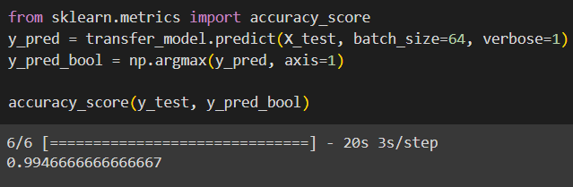
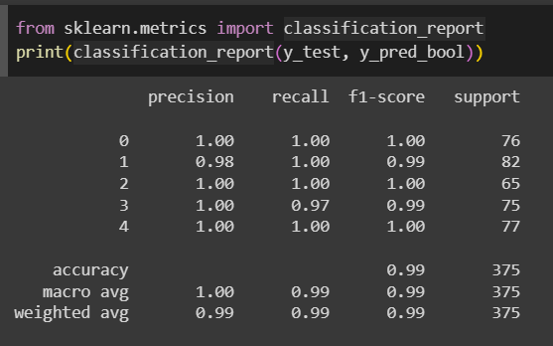
RESULT

Slide 11
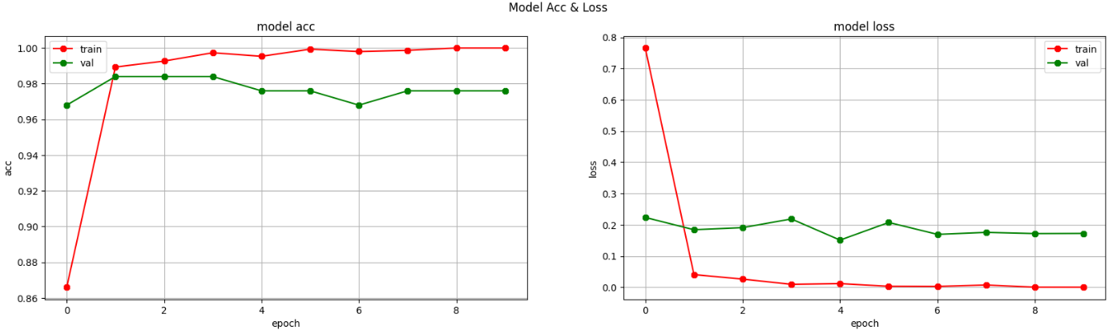

Slide 12
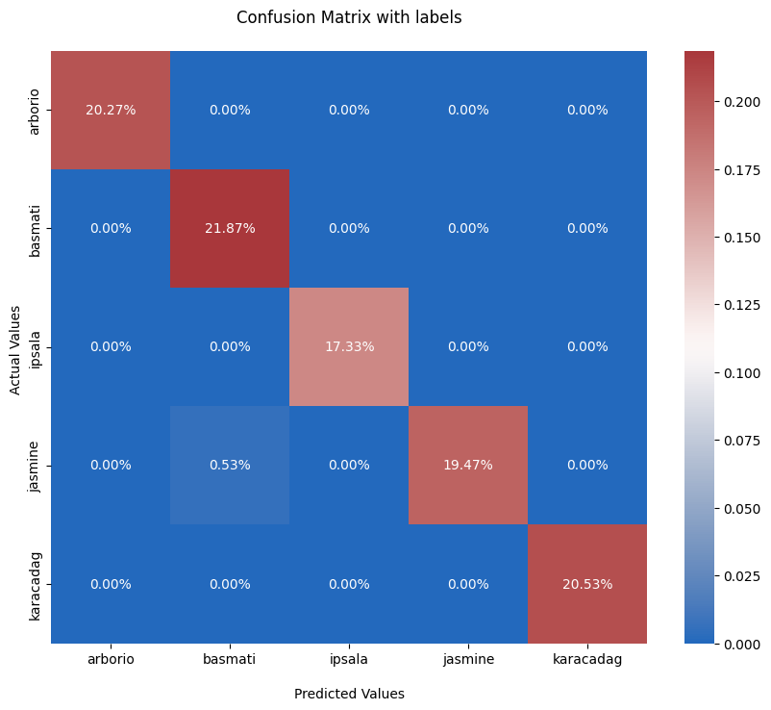

Slide 13
CONCLUSION
In conclusion, our deep learning-based rice classification system using the MobileNetV2 architecture holds great promise for the agricultural industry.
It offers a swift, accurate, and cost-effective solution to the longstanding problem of rice variety classification. As we look to the future, the possibilities are vast.
With continued research and development, our system could revolutionize not only rice classification but also broader agricultural practices.
By harnessing the power of deep learning and artificial intelligence, we're taking a significant step towards sustainable, efficient, and technologically advanced agriculture.

Slide 14
REFERENCES
Howard AG, Zhu M, Chen B, Kalenichenko D, Wang W, Weyand T, Andreetto M, Adam H. Mobilenets: Efficient convolutional neural networks for mobile vision applications. arXiv preprint arXiv:1704.04861. 2017 Apr 17.
Cinar I, Koklu M. Identification of rice varieties using machine learning algorithms. Journal of Agricultural Sciences. 2022 Jan:9-.
Qian Y, Xu Q, Yang Y, Lu H, Li H, Feng X, Yin W. Classification of rice seed variety using point cloud data combined with deep learning. International Journal of Agricultural and Biological Engineering. 2021 Oct 13;14(5):206-12.
Cinar I, KÖKLÜ M. Determination of Effective and Specific Physical Features of Rice Varieties by Computer Vision In Exterior Quality Inspection. Selcuk Journal of Agriculture and Food Sciences. 2021 Dec 12;35(3):229-43.
Cinar I, Koklu M. Classification of rice varieties using artificial intelligence methods. International Journal of Intelligent Systems and Applications in Engineering. 2019 Sep 30;7(3):188-94.

Slide 15
THANK YOU

