Slide 1
ENPM 673 : FINAL PROJECT
HUMAN POSE ESTIMATION
Team Members:
ADITYA VARADARAJ (117054859)
NISHAD KULKARNI (117555431)
PARAM DAVE (117476323)
PRATEEK VERMA (118435039)
SAURABH PALANDE(118133959)
PS: Don’t give away our location to itachi or tobirama

Slide 2
INTRODUCTION
One of the key research areas in computer vision apart from visual slam and robotics is human pose estimation.
Human Pose estimation is a computer vision technique that predicts and tracks the orientation of a person.
Its applications range from Human activity and movement recognition , Augmented reality (metaverse) experiences , Animation & Gaming ,Robotics.

Slide 3
LITERATURE REVIEW
Pose estimation involves estimation of human pose be it 2D or 3D.
Estimation is basically predicting 2D or 3D locations of joints of single person or multiple people.
A single-person pipeline is classified into two types depending on the way they predict keypoints: direct regression-based approaches and heatmap-based approach
The former utilize the output feature maps to regress key points directly, whereas the latter generate heatmaps

Slide 4
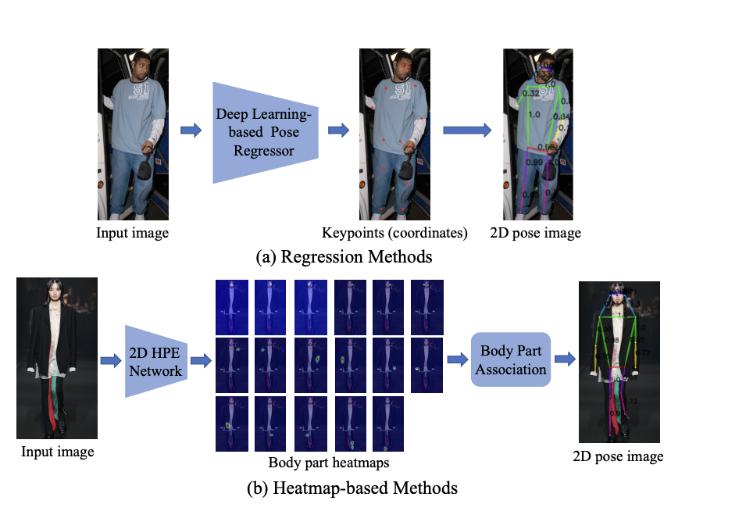

Slide 5
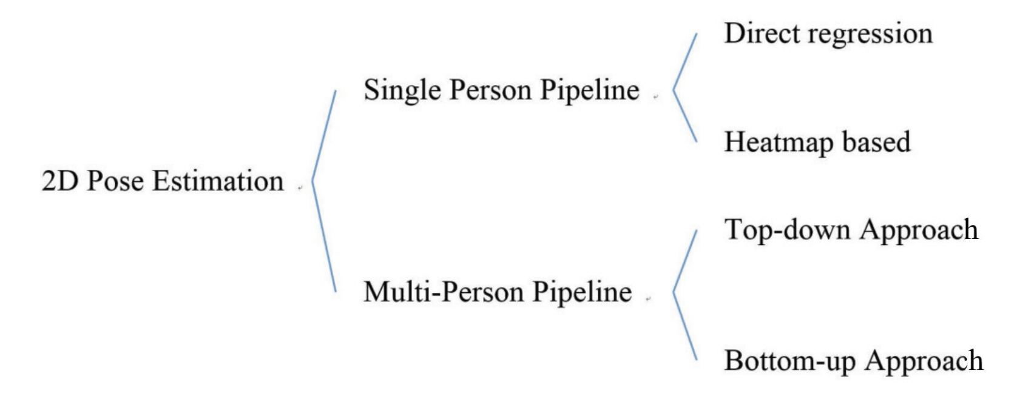

Slide 6
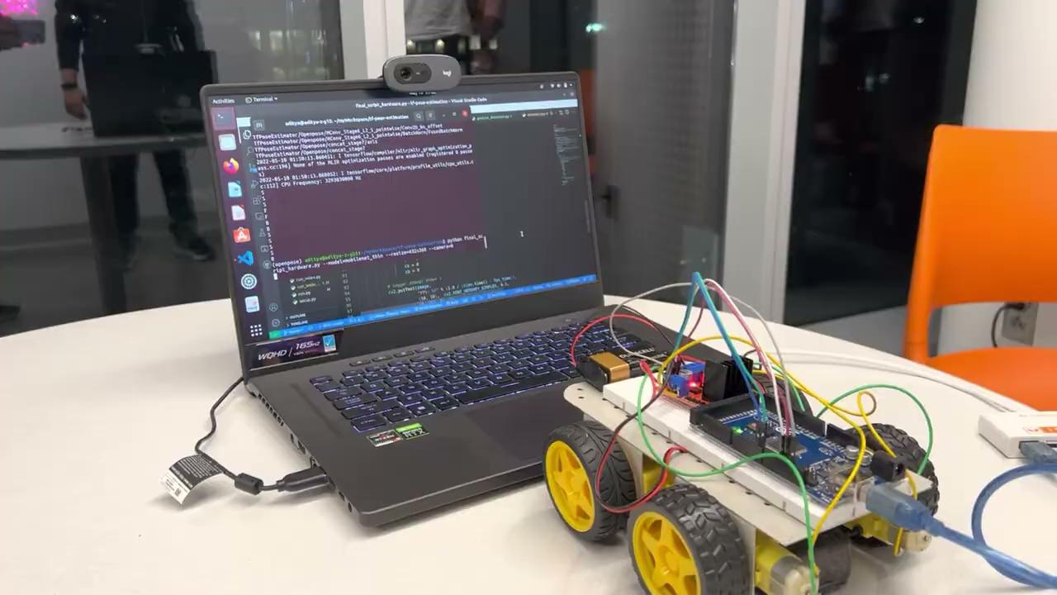

Slide 7
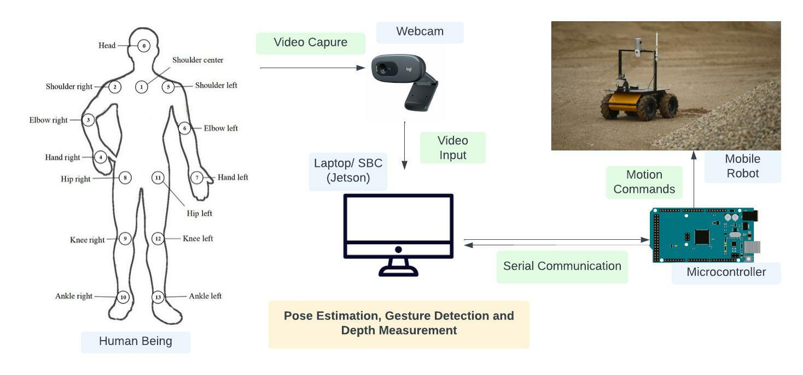
System Architecture

Slide 8
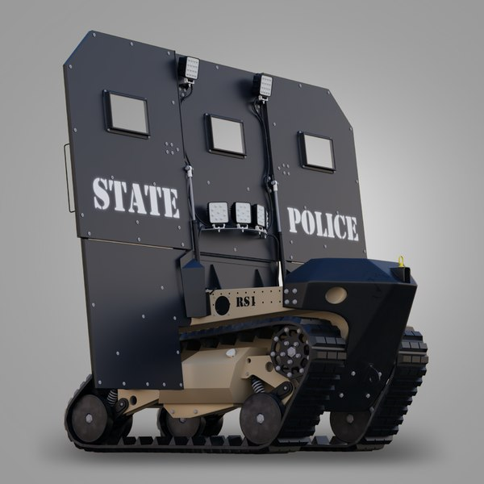
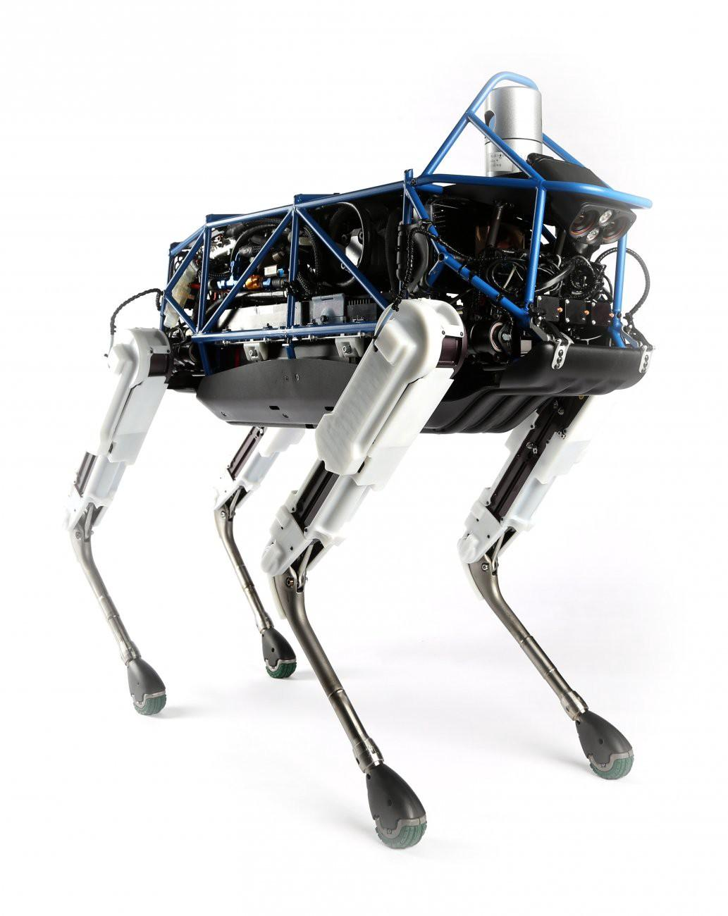
Applications
Human Assisted Mobile Robots
Warfare Mobile Robots

Slide 9
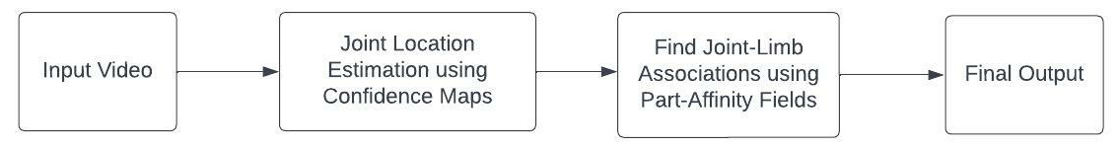
OpenPose Parsing Pipeline
Use Case
One of the use case is for
The parsing process can be summarized into three steps:
Step 1: Find all joints locations using the confidence maps.
Step 2: Find which joints go together to form limbs (body parts) using the part affinity fields and joints in step 1.
Step 3: Associate limbs that belong to the same person and get the final list of human poses.
using the robot as a helper robot in law enforcement rescue missions.
It will act as a initial shield or as a part of squad and will receive signals using non verbal means of communication i.e Pose Estimation.
Also this system can be used in a service robot which acts as a service dog.

Slide 10
Confidence Map Code Output
Joints_list: a list of joint locations of size J where each item is a list of peaks (x, y, probability).
For example, joints_list length is 18 for 18 joint locations (nose, neck, etc.) and items in joints_list are lists of different lengths which stores the peak information (x, y location and probability score) for each joint location.

Slide 11
Part Affinity Fields
Finding which joints go together to form limbs (body parts) using the part affinity fields and joints in previous step
Outputs :
Connected limbs :a list of connected limbs of size C where each item is a list of all limbs of that type found.
Each limb information contains: id of source joint, id of target joint and a score of how good the connection is

Slide 13
Final Result
Associate limbs that belong to the same person and get the final list of human poses.
Inputs:
joints_list: from input of confidence map output set S.
connected_limbs: from Part Affinity Map Fields set L.
Outputs:
poses: a list of human poses for each person in the image. Each item contains the joint locations for that person.

Slide 14
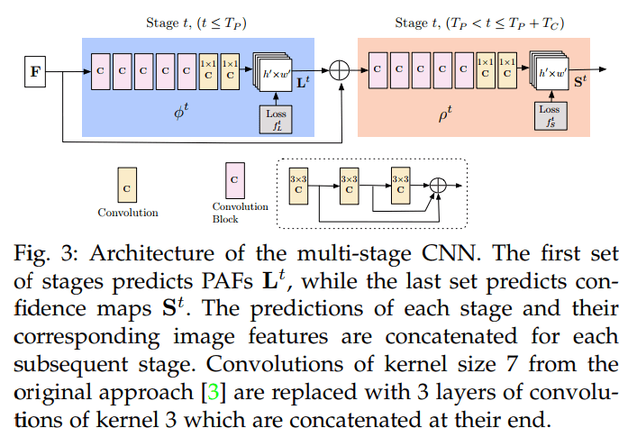

Slide 15
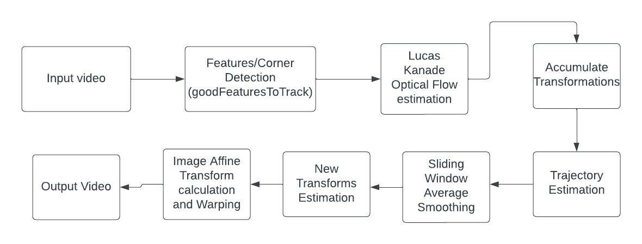
Methodology: Video Stabilization
We attempted sliding window average method of smoothing the image trajectory.

Slide 16
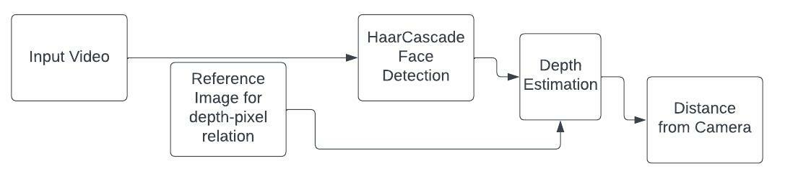
Depth Estimation Pipeline

Slide 17
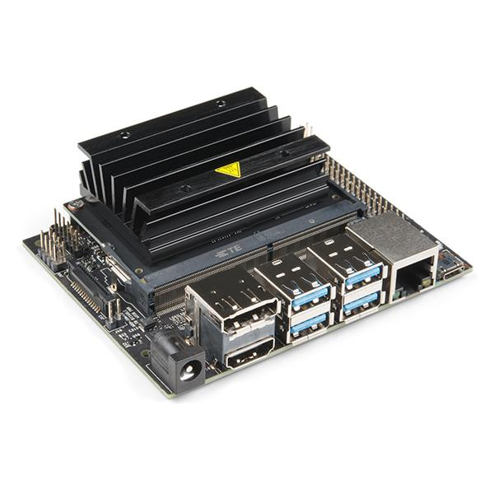
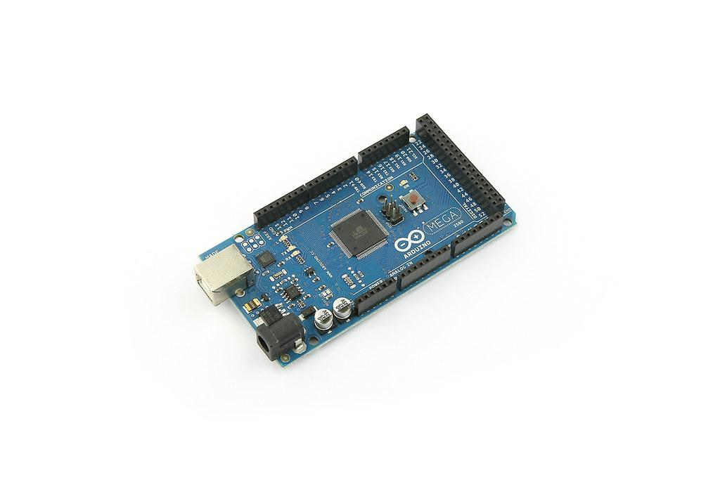
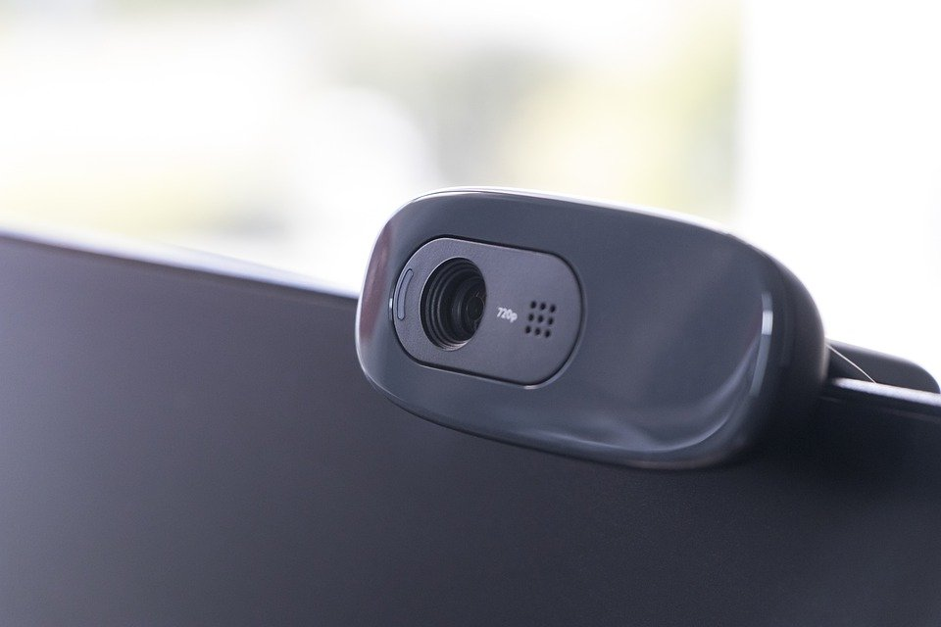
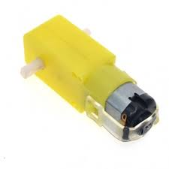
Hardware Specifications
Computer -
Razer Blade Advanced 15” (2020) - 10th Gen i7-10875H 8-Core, RTX 2070, 16GB RAM
Nvidia Jetson Nano Developer Kit - Quad-core ARM A57, 4GB RAM; Ubuntu 18.04 Based
Motor Controller - Arduino Mega 2560 Microcontroller Development board
Motor Driver - L298D Motor Driver board
Motors - 100 RPM B/O Motors
Camera - Logitech C270 Webcam
Others -
2.5 inch Wheels
Metal Bot Chassis (Generic)
Jumper Wires
9V Battery
Improvised housing using household items

Slide 18
Main Pipeline Details
In first step the frame is passed through baseline CNN network to extract the feature maps using API of openpose and estimated joint coordinates for each frame in Jetson Nano using a camera attached to the microcontroller.
From Joint we are estimating a gesture based on threshold values of the joint angles
From gesture we are giving command to the robot using arduino connected to the Jetson Nano.
Finally commands from arduino moves the motors and thus moves the robot

Slide 19
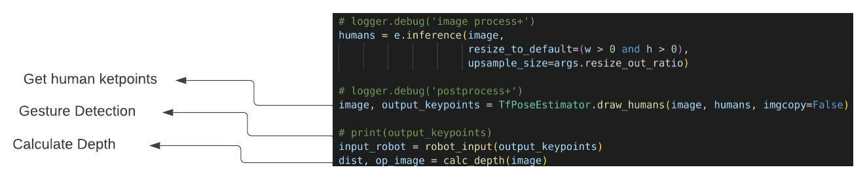
Pseudocode - OpenPose
If right hand is up → forward
If right hand is straight at shoulder level → backward
If right hand is down → Stop

Slide 20
References
“Deep Learning-Based Human Pose Estimation: A Survey” Ce Zheng .et.al. 2020.
“OpenPose: Realtime Multi-Person 2D Pose Estimation using Part Affinity Fields” Zhe C. et.al

