Slide 1
WORLDS WORKSHOP · IEEE/RSJ IROS 2026 · SPOTLIGHT
Modeling What Changes
Sparse, Residual World Models for Object-Centric Manipulation
Param Thakkar Veermata Jijabai Technological Institute
Parsika Paresh Shah Arizona State University
Manisha Sushant Gote ZuiGO Private Limited
Notes:
[~10 s] Hi, I'm Param. Our paper is about one simple idea for world models of manipulation
scenes: model what changes, and copy everything else.

Slide 2
THE IDEA
One push moves one object. So gate what changes, copy the rest.
Dense world models regress every pose, every step, and so inject error into objects that never moved.
shared weights, applied to every object
gate net
gᵢ ∈ {0, 1} · straight-through
per-object features
φᵢ(sₜ, aₜ)
×
p̂ᵢᵗ⁺¹ = pᵢᵗ + gᵢ · Δᵢ
masked residual added to current pose
delta head
Δᵢ ∈ ℝ³ · pose residual
gate off ⇒ object copied verbatim
– Hard gate at inference: un-gated objects get exactly zero update
– Shared per-object heads, nothing sized to N: train on 3 objects, run on 8 with no retraining
Modeling What Changes · WORLDS Workshop @ IEEE/RSJ IROS 2026
2
Notes:
[~25 s] When a robot nudges one block, one pose changes and everything else stays put. Yet
the standard recipe re-predicts every pose at every step, so it perturbs objects that never
moved.
Our model has a per-object gate that decides whether each object changes, and a delta head
whose residual is applied only where the gate fires. Gate off: the object is copied exactly.
The heads are shared, so one model runs at any object count.

Slide 3
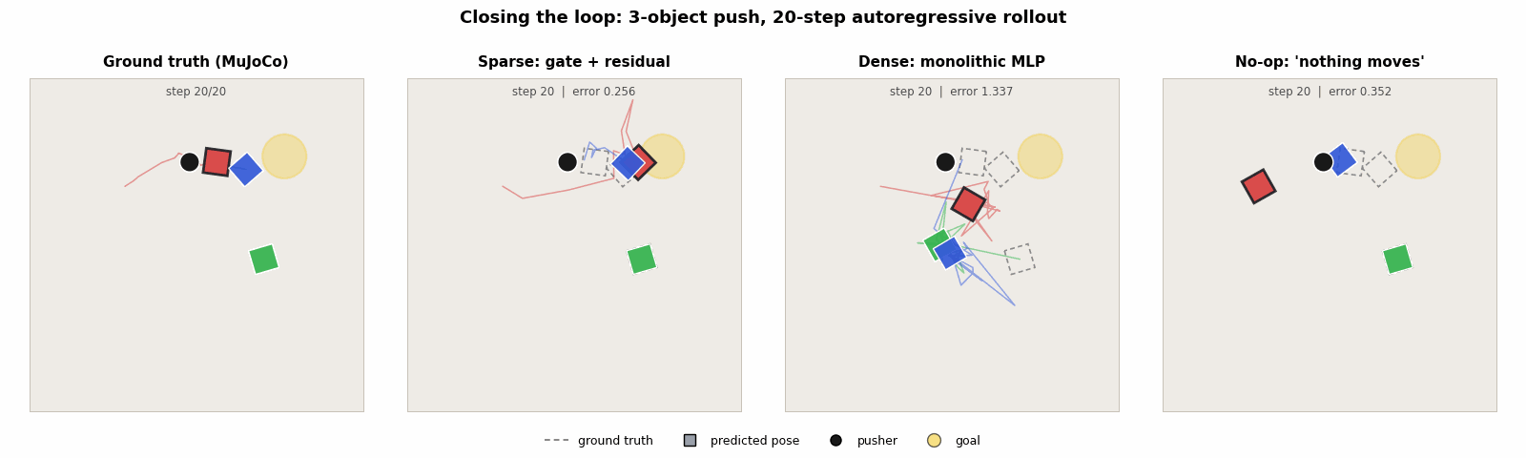
SEE IT
Dense moves everything. Sparse moves only what was pushed.
Held-out 3-object push, 20-step closed-loop rollout, half speed. Dashed outlines are the ground truth, so the gap is the error. Final error: sparse 0.26, dense 1.34, no-op 0.35.
Window picked by a fixed rule (median sparse error among active pushes), not by hand. Averaged over all rollouts, no-op is still lower overall (Table III).
Modeling What Changes · WORLDS Workshop @ IEEE/RSJ IROS 2026
3
Notes:
[~15 s] Here it is running on a held-out push. Dashed outlines are the truth. The dense model,
third panel, scatters every box, even the ones the pusher never touched. Ours moves the boxes
that were pushed and leaves the green one exactly where it was.

Slide 4
RESULTS
Far less drift than dense, at a tenth of the parameters
2.5 – 4.6×
lower one-step error than dense, with 8.6–11.1× fewer parameters (Table I)
0.211 → 0.001
error on objects that did not move, dense → sparse (3 objects)
99.4%
of change-detection F1 kept on an unseen object count, no retraining
Per-object pose L2 after a 20-step closed-loop rollout on held-out trajectories, lower is better (Table III, mean of 3 seeds). No-op, which predicts no motion, is lower still: 0.277 / 0.180 / 0.108.
Modeling What Changes · WORLDS Workshop @ IEEE/RSJ IROS 2026
4
Notes:
[~30 s] Across all held-out rollouts, after 20 steps the dense model's error is three to six
times higher than ours, with about a tenth of the parameters. The reason is the objects that
did not move: their error drops from 0.21 to almost zero. And a model trained on one object
count keeps 99 percent of its detection quality on another.

Slide 5
READING IT HONESTLY
What the headline is, and what it is not
IT IS
IT IS NOT
– A change detector (F1 0.80–0.87) that stops error injection into the static majority
– Clearly better than dense one-step, in rollout, and in planning (0.23 vs 0.00 success)
– An accurate predictor of the movers: an oracle gate barely helps; they sit at no-op quality
– Better than predicting no motion, overall: it only matches it. Planning is not clearly beyond random either
Lesson: always report the no-op baseline, and split error into changed vs. unchanged objects.
Modeling What Changes · WORLDS Workshop @ IEEE/RSJ IROS 2026
5
Notes:
[~25 s] Now the honest part. The win is change detection: it avoids corrupting the static
majority. It is not accurate dynamics on the movers. Even with a perfect gate, error on
moving objects sits at the do-nothing baseline, and overall the model only matches no-op.
So our advice: always report no-op, and split error into changed and unchanged objects.

Slide 6

TAKEAWAY
Model what changes. The delta head is the lever.
– A per-object gate plus a masked residual is a one-line bias that stops a world model corrupting the static scene
– Detection works; regressing contact deltas does not yet. That is the next thing to fix
– Everything is open: code, data generators, checkpoints, and a live in-browser demo
Code + demo
github.com/ParamThakkar123/
sparse_world_models
Come find us at the poster. Thank you!
Modeling What Changes · WORLDS Workshop @ IEEE/RSJ IROS 2026
6
Notes:
[~15 s] So: model what changes. Detection works; predicting the push itself is the next thing
to fix, and the delta head is the lever. Code, checkpoints and a live
in-browser demo are at the QR code. Come find us at the poster. Thank you!
(Repository: https://github.com/ParamThakkar123/sparse_world_models)

