Slide 1
WORLDS WORKSHOP · IEEE/RSJ IROS 2026
Modeling What Changes
Sparse, Residual World Models for Object-Centric Manipulation
Param Thakkar Veermata Jijabai Technological Institute
Parsika Paresh Shah Arizona State University
Manisha Sushant Gote ZuiGO Private Limited
Code, data generators, checkpoints: https://github.com/ParamThakkar123/sparse_world_models
Notes:
Good afternoon. I'm going to talk about a very simple idea for world models of manipulation
scenes: model what changes, and copy everything else.
(Title, authors and venue. Repository: https://github.com/ParamThakkar123/sparse_world_models)

Slide 2
THE OBSERVATION
Physical scenes are sparse in change
One push. One object moves.
Every other object is exactly where it was.
stays exactly put
moves
– Dominant recipe: encode the scene, regress the entire next state every step
– It has to re-produce the static majority at every step, for every object
– The change structure of the world is thrown away before learning starts
pusher
Modeling What Changes · WORLDS Workshop @ IEEE/RSJ IROS 2026
2
Notes:
Start with the observation. When a robot nudges one block on a cluttered table, exactly one
pose changes. The rest of the scene is not approximately the same; it is identical.
The dominant world-model recipe ignores that. It encodes the scene and regresses the whole
next state, monolithically, at every step. So it spends its capacity reproducing objects that
did nothing.

Slide 3
THE PROBLEM
Re-predicting everything has three costs
1
2
3
Capacity
Error injection
No handle on “what”
Parameters and operations are spent on the static majority, not on the few objects that matter.
A regressor that outputs every pose perturbs objects it should have copied. Closed loop, that error accumulates on objects that never moved: the predicted world drifts.
A monolithic predictor never says which objects it expects to move. For control and debugging, that belief is entangled in one regression output.
The second cost is the insidious one: it is exactly the objects that never moved that drift.
Modeling What Changes · WORLDS Workshop @ IEEE/RSJ IROS 2026
3
Notes:
Three costs. Capacity is the obvious one. Error injection is the insidious one: a regressor
that has to output every pose will inevitably perturb the objects it should have left alone,
and in a rollout that error compounds precisely on the objects that never moved. And third,
interpretability: a monolithic model has no explicit belief about what will change.
We ask whether explicitly modelling what changes addresses all three.

Slide 4
OUR MODEL
Gate what changes, copy the rest
shared weights, applied to every object
gate net
gᵢ ∈ {0, 1} · straight-through
per-object features
φᵢ(sₜ, aₜ)
×
p̂ᵢᵗ⁺¹ = pᵢᵗ + gᵢ · Δᵢ
masked residual added to current pose
delta head
Δᵢ ∈ ℝ³ · pose residual
gate off ⇒ object copied verbatim
– Per-object gate decides which objects move; a residual delta head predicts a pose increment applied only to gated objects
– Hard at inference: exactly zero update for un-gated objects. Trained end-to-end with a Gumbel straight-through gate
– Count-agnostic: heads are shared across objects and no layer is sized to N, so one model runs at any object count
Modeling What Changes · WORLDS Workshop @ IEEE/RSJ IROS 2026
4
Notes:
The model is deliberately simple and object-centric. For each object we build a feature
vector from its pose, velocity, relative goal and pusher positions, the action, and a
permutation-invariant aggregate over the other objects.
A gate network emits a change decision, zero or one. A delta head emits a pose residual in
R^3. The next pose is the current pose plus the masked residual. If the gate is off, the
object is copied verbatim: not approximately, exactly.
The gate is discrete, trained with a Gumbel straight-through estimator, so it is hard at
inference. And because the heads are shared and nothing is sized to the object count, a
model trained on 3 objects runs on 8 with no retraining.

Slide 5
TRAINING
One loss, three terms
ℒ = BCE(g, m*) + λΔ · m* · ‖Δ − Δ*‖² + λs · ḡ
Change detection
Residual regression
Sparsity
Class-balanced binary cross-entropy against the ground-truth changed mask m*. This is what the gate learns from.
L2 on the delta, supervised only on objects that actually changed. Un-gated objects contribute nothing.
Penalty on the mean gate activation ḡ. Trades recall for precision: λs 0 → 1 moves precision 0.94 → 0.97, recall 0.81 → 0.71.
Small by design: gate and delta heads are 2-layer, width-128 MLPs. Under 0.1M parameters, trains and plans on a laptop CPU.
Modeling What Changes · WORLDS Workshop @ IEEE/RSJ IROS 2026
5
Notes:
Three terms. A class-balanced BCE on the gate against the ground-truth changed mask. An L2 on
the residual, supervised only where something actually changed. And a sparsity penalty on the
mean gate activation.
The sparsity weight is a precision-recall knob. A five-point sweep moves precision from 0.94
to 0.97 and recall from 0.81 to 0.71; F1 degrades only gently. We use 0.2 for prediction.
(Appendix D of the paper.)
Everything is tiny: two-layer, width-128 heads, under 0.1 million parameters.

Slide 6
SETUP
A controlled tabletop pushing benchmark
– Environment procedural MuJoCo tabletop, N ∈ {3, 5, 8} free 5 cm boxes, scripted pushing policy
– State pusher position, per-object planar pose (x, y, θ) and velocity, goal. Structured state, not pixels
– Action end-effector Δxy to a position-controlled pusher
– Data 250 episodes × 100 steps per (N, seed), filtered to a hard subset with real motion; 80/10/10 split with a configuration-leakage guard
– Seeds headline tables are mean ± std over 3 training seeds
BASELINES
Dense MLP regresses all poses; width 256, 3 layers
No-op predicts no change at all. The floor every world model must beat
METRICS
Per-object pose L2, split into changed and unchanged objects
Change-detection precision, recall, F1
Parameters, operations, latency
Modeling What Changes · WORLDS Workshop @ IEEE/RSJ IROS 2026
6
Notes:
The setup is deliberately controlled and I want to state its bounds up front: structured
per-object state, not pixels; three to eight rigid boxes; small MLPs.
Two baselines. A dense MLP that regresses every pose. And no-op, which predicts that nothing
moves. No-op matters: on a scene that is mostly static it is a strong floor, and I will come
back to it.
The metric that matters most today is per-object pose L2 split into changed and unchanged
objects. That split is what lets us say where a win comes from.

Slide 7
PREDICTION ACCURACY
Lower error at a fraction of the parameters
2.5 – 4.6×
lower overall L2 than dense, at every N
8.6 – 11.1×
fewer parameters (6.9k–10.8k vs 77k–92k)
F1 0.80 – 0.87
change detection, precision 0.92–0.97; dense is degenerate (recall ≈ 1)
Overall per-object pose L2 on held-out transitions, lower is better (Tables I and II; 3 seeds).
Modeling What Changes · WORLDS Workshop @ IEEE/RSJ IROS 2026
7
Notes:
Here is the headline comparison, Table I of the paper. At every object count the sparse
model's overall L2 is 2.5 to 4.6 times lower than the dense MLP, with 8.6 to 11.1 times fewer
parameters. Change detection holds F1 0.80 to 0.87 at precision 0.92 to 0.97, where the dense
model is degenerate: it says everything moves.
Now look at the blue bars. That is no-op, and sparse essentially matches it. Hold that
thought; it is the most important thing on this slide.
Efficiency caveat, stated honestly: the win is parameters, not wall-clock. Per-object heads
scale with N, and the dense model's single matmul is faster in latency (Appendix C).

Slide 8
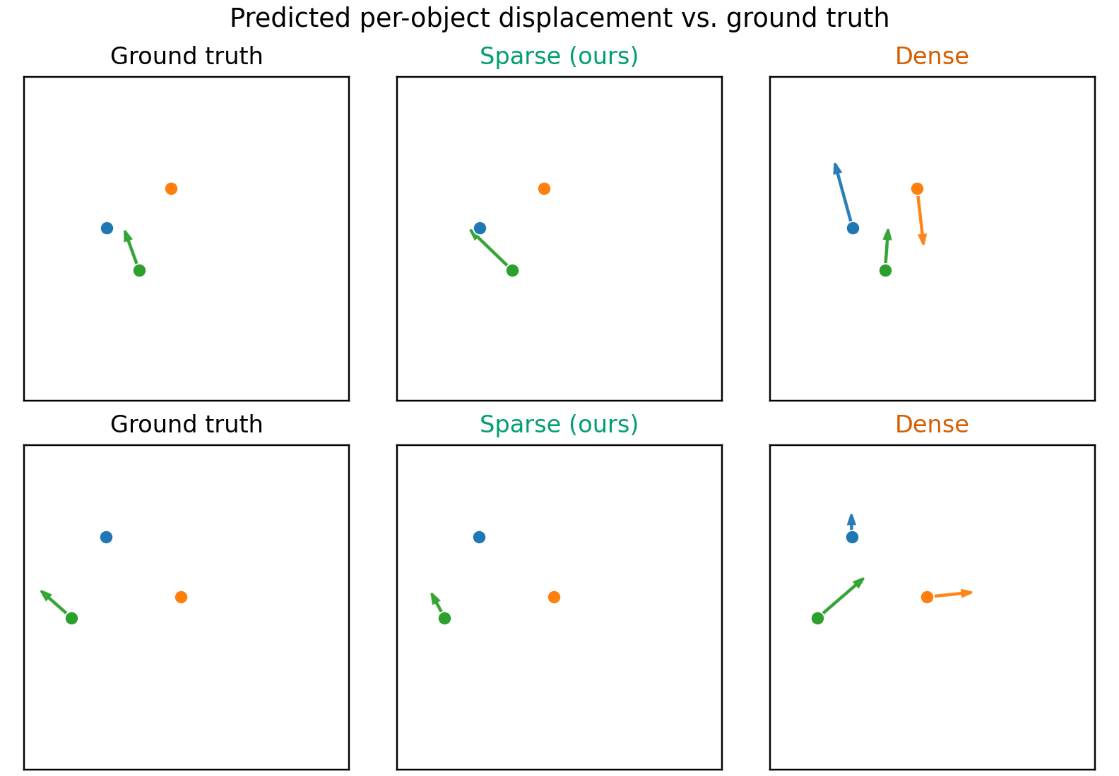
PREDICTION ACCURACY
Sparse moves only what moves
– Arrows are predicted displacement, current to next position
– Ground truth: one object moves per step
– Sparse (ours): the gate fires on that object alone; the other two are copied
– Dense: hallucinates motion on every object, including the ones that should stay put
Fig. 2 of the paper, two held-out scenes.
Modeling What Changes · WORLDS Workshop @ IEEE/RSJ IROS 2026
8
Notes:
Qualitatively this is what it looks like. Two held-out scenes, arrows are predicted
displacement. Ground truth on the left: one object moves. Sparse in the middle: the gate fires
on that object and only that object. Dense on the right: it hallucinates motion on all three.
That is error injection, and it is what the gate removes.

Slide 9
WHY IT WINS
Where the win actually comes from
Changed-object L2 with a perfect gate
N
predicted gate
oracle gate
no-op
3
0.312
0.314
0.348
5
0.426
0.432
0.446
8
0.466
0.474
0.470
Feeding the delta head the ground-truth mask barely moves the number.
So the win is detecting what changed and not corrupting the static majority. On the movers themselves, sparse is at roughly no-op quality: the bottleneck is delta regression, not detection.
Capacity-matched ladder, 3 objects, seed 0 (Table II). Each rung adds one ingredient.
Unchanged-object L2 down the ladder: 0.211 → 0.111 → 0.086 → 0.001
The gate is the largest single step (1.7–2.0× at every N) and the only rung that reaches below no-op.
Modeling What Changes · WORLDS Workshop @ IEEE/RSJ IROS 2026
9
Notes:
This is the slide I care most about. Why does it win?
First, it is not just smaller: a dense MLP shrunk to the same parameter budget is still 3 to
5 times worse (Appendix E). Second, the ladder on the left adds one ingredient at a time:
object-centric featurization, then an always-on residual, then the gate. Featurization earns a
third to a half of the gap, residual a bit more, but the gate is the largest single step and
the only rung that gets below no-op. The unchanged-object column shows the mechanism: error on
static objects goes from 0.211 to 0.001.
Now the table on the right, our oracle-gate diagnostic (Appendix F). If we give the delta head
the ground-truth changed mask, changed-object error barely moves. And it sits right at the
no-op floor. So, stated plainly: the win is not accurate dynamics on movers. It is change
detection that avoids injecting error into everything else. One-step contact deltas,
especially rotation, are simply hard, and the delta head is the highest-leverage thing to fix.
One missing rung we flag in the paper: a dense, non-object-centric model predicting residuals.
That is immediate future work.

Slide 10
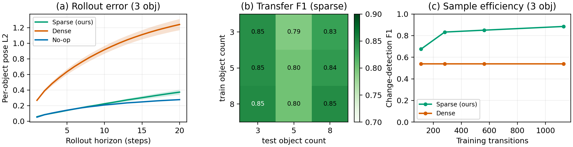
IT IS A WORLD MODEL
Rollout, transfer across counts, sample efficiency
(a) Rollout, 20 steps closed loop
(b) Zero-shot transfer
(c) Sample efficiency
Sparse compounds 3.4–6.4× less error than dense at every N, but stays above no-op overall: it wins on static objects and only ties on movers.
One checkpoint, any object count. Off-diagonal F1 0.827 vs 0.832 on the diagonal: 99.4% retention. Dense cannot even be run off-count.
Sparse reaches about 90% of its full-data F1 with 25% of the data. Dense is flat at every budget.
Modeling What Changes · WORLDS Workshop @ IEEE/RSJ IROS 2026
10
Notes:
Three world-model properties, Figure 3 of the paper.
Rollout: close the loop for twenty steps. Dense drifts, sparse compounds far less error, 3.4 to
6.4 times less at horizon 20 (Table III). But be honest with the blue line: sparse is above
no-op at every horizon. The decomposition says why: sparse wins on unchanged objects and only
ties no-op on movers, consistent with the one-step result.
Transfer: because nothing is sized to N, a model trained on 3 objects runs on 8 with zero
retraining. Off-diagonal F1 retains 99.4 percent of the diagonal. The dense model cannot even
be executed off-count; its input dimension is wrong.
Sample efficiency: sparse reaches about 90 percent of full-data F1 with a quarter of the data.
(b and c are seed 0.)

Slide 11
DOWNSTREAM PLANNING
Can it plan? Separated from dense, not yet from random
Round 1: prediction-trained models cannot plan
Both learned models: 0.00, worse than random. The planner visits teleported, near-rest states far from the training data. Dense hallucinates 5–10 cm of motion with no contact; the sparse gate goes silent.
Round 2: fix the diagnosed cause
Contact-aware, velocity-free features and diverse mixed-policy training data. Same planner. Sparse goes 0.00 → 0.23 ± 0.06 and halves final distance. Dense stays at 0.00 at every seed.
Robust finding: separation from dense at every seed. Not robust: the margin over random (weakest seed is exactly 0.15).
Push-target-to-goal, 3 objects, success = target within 5 cm of goal. CEM planner (256 samples × 3 iterations, horizon 15, replan every step); only the model is swapped. Learned models: mean of 3 seeds × 20 episodes (Table IV).
Modeling What Changes · WORLDS Workshop @ IEEE/RSJ IROS 2026
11
Notes:
Does any of this help control? Each model is the forward simulator inside the same CEM
planner on a push-to-goal task; the model is the only thing that changes.
Round 1 was a clean negative result. The oracle solves every episode, so the planner and task
are fine. Both learned models score zero, worse than random. The cause is out-of-distribution
querying: the planner visits near-rest, teleported states the models never saw. Dense
hallucinates motion with no contact; sparse's velocity features leave its gate silent.
Round 2 fixes the diagnosed cause: contact-aware, velocity-free features and diverse data. With
the planner unchanged, sparse goes from zero to 0.23 and halves its final distance, while dense
stays at zero at every seed.
But I will not oversell it. 0.23 against random's 0.15 is not significant; the weakest seed
is exactly 0.15. The robust claim is separation from dense at every seed, not that sparse
"begins to plan".

Slide 12
READING THE RESULTS HONESTLY
What the headline is, and what it is not
IT IS
IT IS NOT
– A change detector that avoids error injection: F1 0.80–0.87 where dense is degenerate; unchanged-object error 0.211 → 0.001
– Far better than dense one-step (2.5–4.6×), in rollout (3.4–6.4×), and in planning (0.23 vs 0.00 at every seed)
– Count-invariant and sample-efficient, with an inspectable per-object change mask
– 8.6–11.1× fewer parameters
– An accurate mover predictor: changed-object L2 sits at or barely above no-op; overall L2 only matches no-op at N = 5, 8
– Better than no-op in rollout: worse than no-op overall at every N and horizon
– Significantly better than random at planning: 0.23 ± 0.06 vs 0.15, one planner, one task, 3 objects
– Faster in wall-clock, or pixel-space: structured state only
Modeling What Changes · WORLDS Workshop @ IEEE/RSJ IROS 2026
12
Notes:
Let me put both halves side by side, because the paper does.
It is a change detector that avoids error injection. That is a real and durable win over
dense, one-step, in rollout, and in planning, at a tenth of the parameters, with a mask you
can inspect.
It is not an accurate predictor of the objects that move. On those, it is at no-op quality.
Overall it matches no-op; in rollout it is worse than no-op; in planning it is not
significantly better than random. Phrases like "predicts dynamics far more accurately" invite
a reading the data do not support, and we retired them from the paper.
Also: F1 is partly a property of the metric (thresholding a dense regressor forces recall to
1), so we foreground the changed / unchanged L2 split instead. And the ladder is missing a
dense-residual rung, which confounds residual against object-centricity.

Slide 13

CONCLUSION
Takeaways
1
Model what changes.
A per-object gate plus a masked residual is a one-line bias that stops a world model from corrupting the static majority of a scene.
2
Decompose the metric.
Overall L2 hid the story. Splitting error into changed and unchanged objects, and always reporting no-op, is what made the claim honest.
Code, data generators, checkpoints, result tables
github.com/ParamThakkar123/
sparse_world_models
Live in-browser demo runs the real checkpoints
3
The delta head is the lever.
Detection is solved to F1 0.8+; regression of contact deltas is not. Next: a dense-residual baseline, a distributional delta head, DAgger on planner states, multi-step training, slot-based encoders.
Thank you. Questions welcome.
Modeling What Changes · WORLDS Workshop @ IEEE/RSJ IROS 2026
13
Notes:
Three takeaways. Model what changes: the gate plus masked residual is a one-line bias that
stops error injection. Decompose the metric: the changed / unchanged split and the no-op
column are what turned a headline into an honest claim. And the delta head is the lever:
detection is solved, regression of contact deltas is not.
Code, data generators, checkpoints and machine-readable tables are at https://github.com/ParamThakkar123/sparse_world_models. The QR code
also reaches an in-browser demo that runs the real checkpoints on live physics.
Thank you.

Slide 14
POSTSCRIPT (OPTIONAL)
Since the camera-ready: run the trivial baselines
We asked what a one-parameter rule scores on our own change-detection benchmark. It beats the learned gate.
– With one point-like pusher, the changed label is recoverable from a single scalar: speed, or distance to the pusher
– Filtering the data harder just changes which one-liner wins
– The error-suppression mechanism stands; the benchmark does not. Every “our model predicts what changes” claim needs a trivial-baseline audit
Motion-filtered benchmark, 3 objects, F1 on held-out transitions.
Follow-up work in preparation. Audit battery and benchmarks in the repository.
Modeling What Changes · WORLDS Workshop @ IEEE/RSJ IROS 2026
14
Notes:
OPTIONAL SLIDE. Use it if you want to end on the strongest possible note of scientific
honesty; drop it if the talk is short or you prefer to keep the follow-up for its own venue.
After the camera-ready we asked a question we should have asked earlier: what does a trivial
rule score on our own benchmark? "The object is moving, or it is near the pusher": one
parameter, F1 0.927. Our learned gate: 0.823.
The reason is structural. With a single point-like pusher the changed label is recoverable
from one scalar, so the benchmark is degenerate. Filtering harder only changes which one-liner
wins. The error-suppression mechanism in this paper still holds; what does not hold is any
claim that a learned gate is needed to get it on this benchmark. Our follow-up is a
trivial-baseline audit battery, and our recommendation to this community is: run it.
(Numbers: README / experiments/RESULTS.md, motion benchmark, best trivial rule vs best learned gate.)

Slide 15
APPENDIX C
Backup: efficiency in full
N
sparse params
dense params
param ratio
sparse FLOPs
dense FLOPs
latency ms (sparse / dense)
3
6 916
76 809
11.1×
39 936
152 576
0.19 / 0.04
5
8 452
82 959
9.8×
81 920
164 864
0.20 / 0.04
8
10 756
92 184
8.6×
167 936
183 296
0.20 / 0.04
Parameter efficiency is the durable win. The operation-count advantage erodes from 3.8× to 1.1× as per-object heads scale with N, and the dense model's single matmul is faster in CPU latency. We claim capacity efficiency, not speed.
Modeling What Changes · WORLDS Workshop @ IEEE/RSJ IROS 2026
15
Notes:
Backup. Appendix C, Table V: parameters, FLOP estimate and CPU latency (Intel i7-12650H).

Slide 16
APPENDICES D AND G
Backup: sparsity weight and per-seed planning
Sparsity weight λs (3 objects, seed 0)
Contact-aware planning, per seed
λs
F1
precision
recall
changed L2
overall L2
model
seed 0
seed 1
seed 2
mean ± std
0.0
0.873
0.941
0.814
0.389
0.146
sparse success
0.25
0.15
0.30
0.23 ± 0.06
0.05
0.865
0.940
0.801
0.389
0.146
dense success
0.00
0.00
0.00
0.00 ± 0.00
0.2
0.849
0.938
0.776
0.388
0.145
sparse final dist.
0.188
0.231
0.193
0.204 ± 0.019
0.5
0.845
0.967
0.750
0.387
0.144
1.0
0.815
0.965
0.705
0.385
0.143
Parameter-matched dense (Appendix E): shrinking dense to the sparse budget gives L2 0.363 / 0.363 / 0.415 and F1 0.538 / 0.388 / 0.294 at N = 3 / 5 / 8. Sparse still wins on every metric at every count, so the degeneracy is not a capacity artifact.
Modeling What Changes · WORLDS Workshop @ IEEE/RSJ IROS 2026
16
Notes:
Backup. Appendix D (Table VI), Appendix G (Table IX, 20 episodes per seed) and Appendix E (Table VII).

