Slide 1

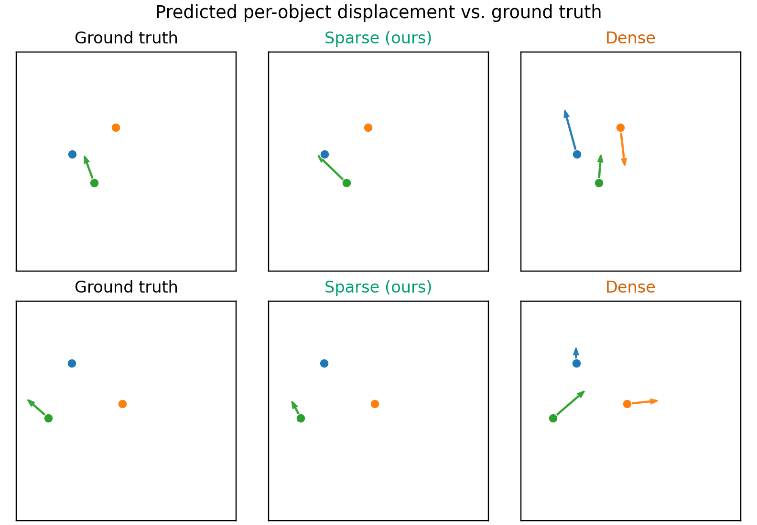
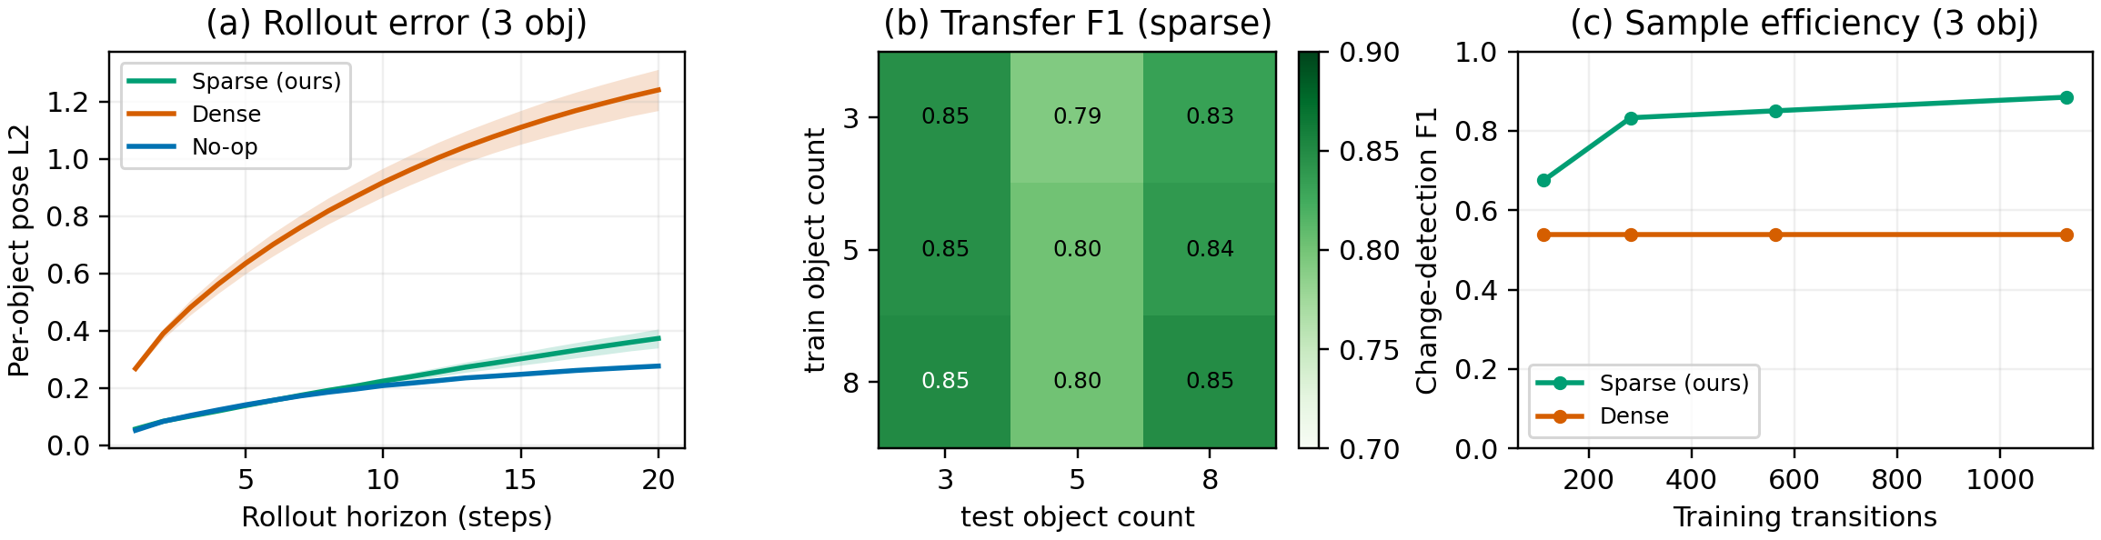
WORLDS WORKSHOP · IEEE/RSJ IROS 2026 · PITTSBURGH · SPOTLIGHT 1, PAPER 7
Code, data, checkpoints
and a live in-browser demo running the real models
github.com/ParamThakkar123/
sparse_world_models
Modeling What Changes
Sparse, Residual World Models for Object-Centric Manipulation
Param Thakkar Veermata Jijabai Technological Institute Parsika Paresh Shah Arizona State University Manisha Sushant Gote ZuiGO Private Limited
A push moves one object; the rest of the scene is identical. A per-object gate that copies unchanged objects exactly stops a world model from corrupting the static scene, at a tenth of the parameters.
1
Scenes are sparse in change
3
Controlled tabletop pushing
5
Where the win comes from
7
Planning: beats dense, not yet random
One push. One object moves.
Every other object is exactly where it was.
Dense world models still regress every pose, every step.
– MuJoCo tabletop, N ∈ {3, 5, 8} boxes, scripted pusher; structured state, not pixels
– Baselines: Dense MLP regresses all poses; No-op predicts no change, the floor to beat
– Metric: per-object pose L2, split into changed vs. unchanged objects; 3 seeds
4
Lower error, a tenth of the parameters
– Capacity is spent re-producing the static majority
– Error injection: a regressor perturbs objects it should copy; in rollout the error piles up on objects that never moved
– No handle on “what”: no explicit belief about which objects will change
Capacity-matched ladder, one ingredient per rung (Table II, 3 objects).
Unchanged-object L2: 0.211 → 0.111 → 0.086 → 0.001
The gate is the largest single step, and the only one below no-op.
Push-to-goal success, same CEM planner, only the model swapped; 3 seeds × 20 episodes (Table IV).
– Round 1: both learned models score 0.00; the planner queries off-distribution states
– Round 2: contact-aware features + diverse data: sparse 0.23 ± 0.06, dense 0.00 at every seed. Margin over random (0.15) is not significant
2
Gate what changes, copy the rest
Changed-object L2 with a perfect (oracle) gate
N
predicted gate
oracle gate
no-op
per-object features
φᵢ(sₜ, aₜ): pose, velocity, goal, pusher, action
3
0.312
0.314
0.348
8
What it is, and is not
5
0.426
0.432
0.446
Overall per-object pose L2, held-out, lower is better (Table I).
8
0.466
0.474
0.470
2.5–4.6×
8.6–11.1×
F1 0.80–0.87
A perfect gate barely helps. The win is detecting what changed and not corrupting the rest. On the movers themselves the model is at no-op quality: delta regression is the bottleneck.
IT IS
a change detector that avoids error injection
far better than dense one-step, in rollout and in planning
count-invariant, with an inspectable mask
IT IS NOT
an accurate predictor of the movers
better than no-op in rollout
significantly better than random at planning, or faster in wall-clock
gate net
gᵢ ∈ {0, 1}, straight-through
delta head
Δᵢ ∈ ℝ³ pose residual
lower L2 than dense
fewer parameters
change detection; dense is degenerate
6
A world model: rollout, transfer, data
×
p̂ᵢᵗ⁺¹ = pᵢᵗ + gᵢ · Δᵢ
masked residual added to the current pose
9
Takeaways
gate off ⇒ object copied verbatim, exactly
– (a) Rollout: 3.4–6.4× less 20-step error than dense, still above no-op
– (b) Transfer: one checkpoint, any N; 99.4% of F1 kept off-count. Dense cannot run off-count
– (c) Data: ~90% of full-data F1 from 25% of the data
– Model what changes: a gate + masked residual is a one-line bias
– Decompose the metric: always report no-op and the changed / unchanged split
– The delta head is the lever: detection is solved, contact-delta regression is not
shared weights, applied to every object
ℒ = BCE(g, m*) + λΔ · m* · ‖Δ − Δ*‖² + λs · ḡ
– Hard at inference: un-gated objects get exactly zero update
– Count-agnostic: shared heads, nothing sized to N; train on 3 objects, run on 8
– Tiny: 2-layer width-128 heads, under 0.1M parameters
Held-out scenes. Sparse moves only the pushed object; dense hallucinates motion on all three.

