Slide 1


Slide 2

IPL VISUALISATION
ASSIGNMENT
CONSOLIDATE DATA FOR ALL SEASONS 2008 - 2018
By Paramesh E

Slide 3

The Indian Premier League, or IPL, is a T20 cricket league, which was founded in 2008 and is held every year. It sees participation from both national and international players, and eight teams representing eight Indian cities compete with each other in a double round-robin format in the league stages, which are followed by playoffs. Over the years, IPL has become one of the most-watched and most attended live sporting events all over the world. You work as a data analyst at IFP, a nationally recognized news agency, which is based out of New Delhi, and provides news reports and feeds to magazines, newspapers and TV broadcasters all over the country. The Sports Editor of the agency has approached you to build a Tableau dashboard of IPL statistics over the years since its inception in order to create an infographic for a newsletter that their team is working on. For this newsletter, in some cases, they will use the visual representations as you have created in Tableau directly for their infographic, and in a few other cases, they will use important statistics after trying out the different filters and customizations that you have provided for interactivity. Therefore, you are expected to build an interactive dashboard in Tableau for this purpose
Problem Statement

Slide 4
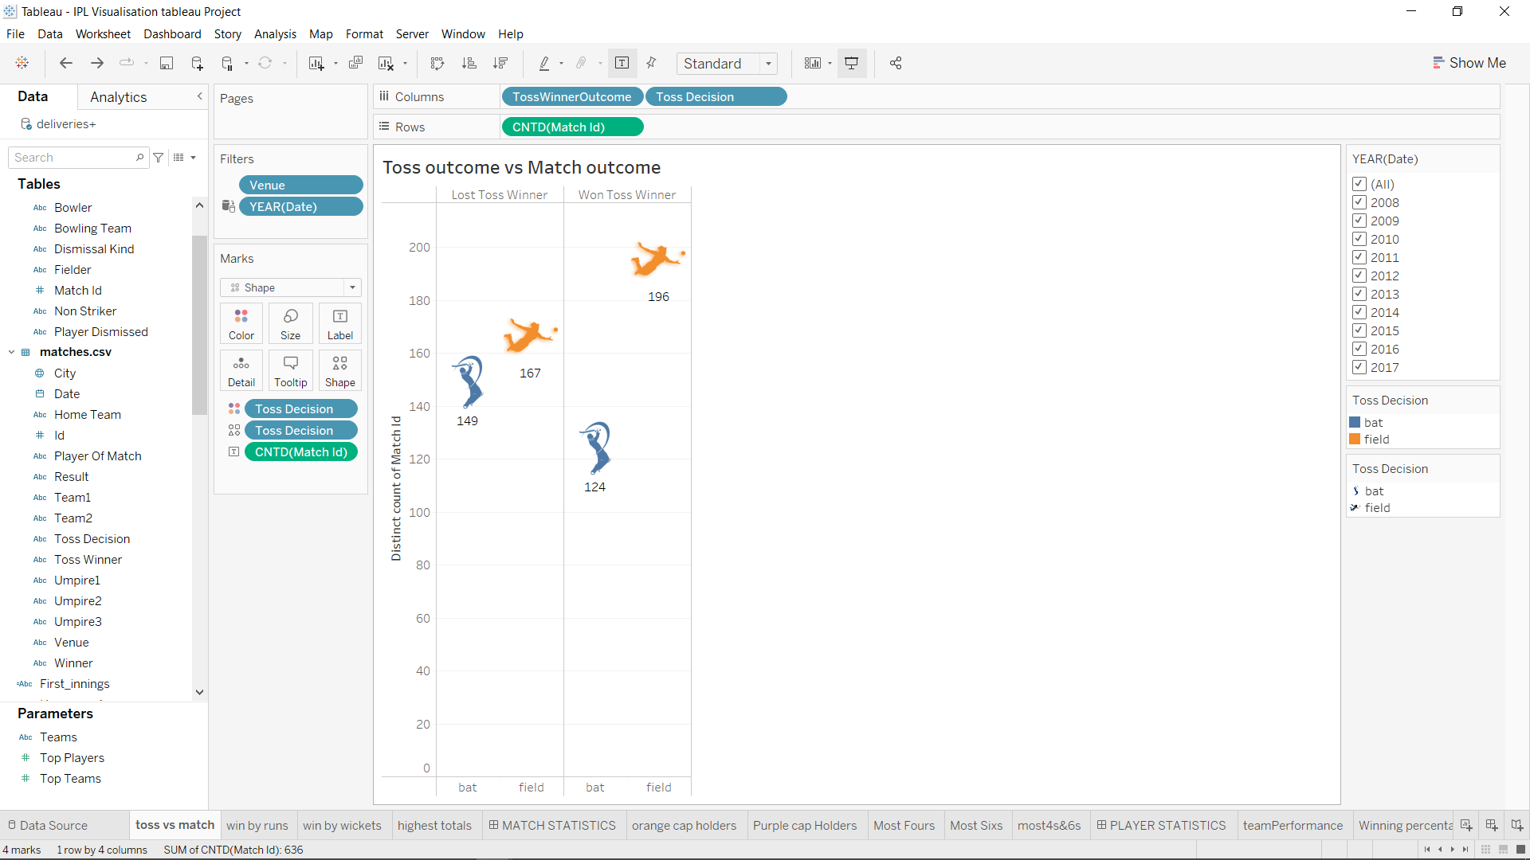
Match Statistics
Toss outcome vs Match outcome (for each Ground/Venue)
INSIGHTS
Team Winning the TOSS And Choosing Fielding is Having highest Number of Wins Across the Venues
Losing the Toss and Goes To Field has the highest rate of wins for toss loser
Bating first having less winning rate as compared to fielding first for all venues

Slide 5
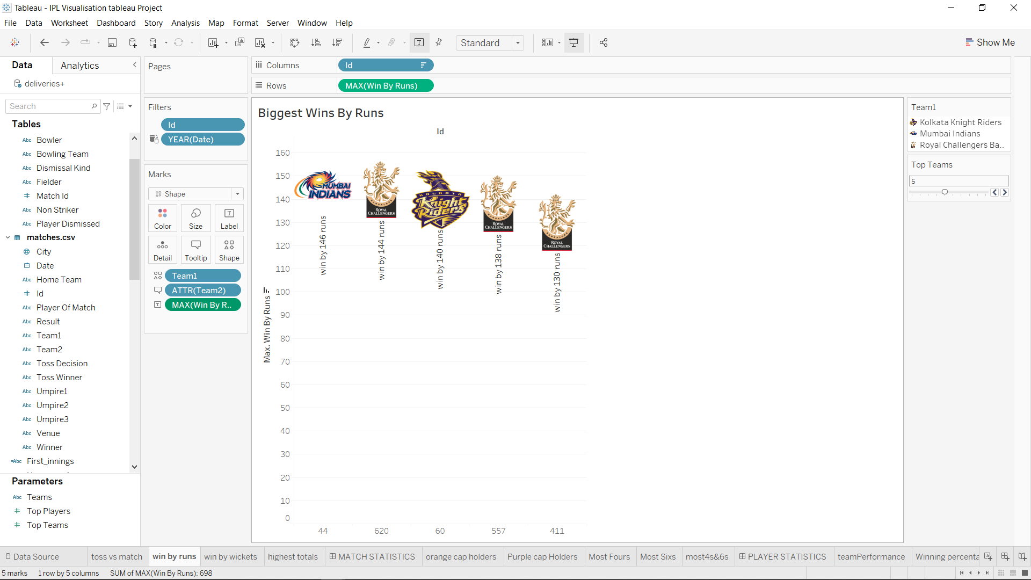
Match Statistics
Biggest Wins By Runs
INSIGHTS
Mumbai Indians top the charts
With the Win against Delhi Daredevils by All time Huge margin of 146 Runs
Followed By Royal Challenger Bangalore registered three biggest wins at the top 5 chart
Kolkata Knight riders registered 1 biggest win by runs

Slide 6
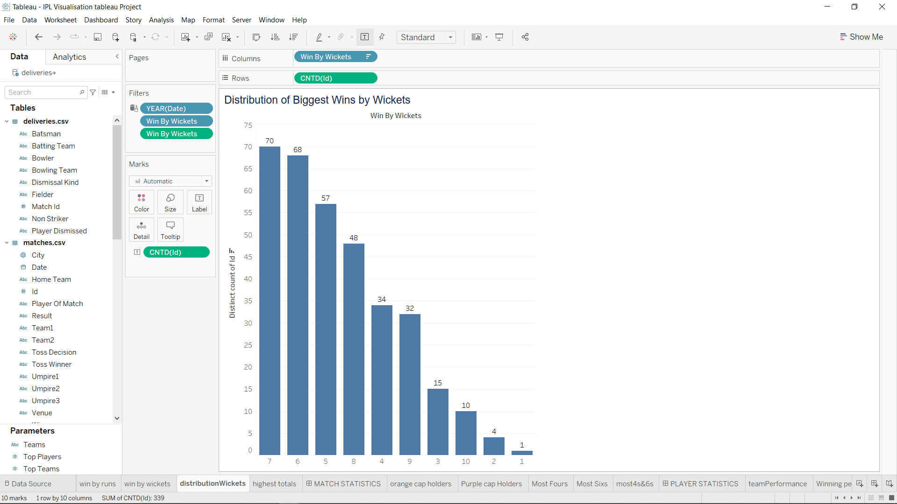
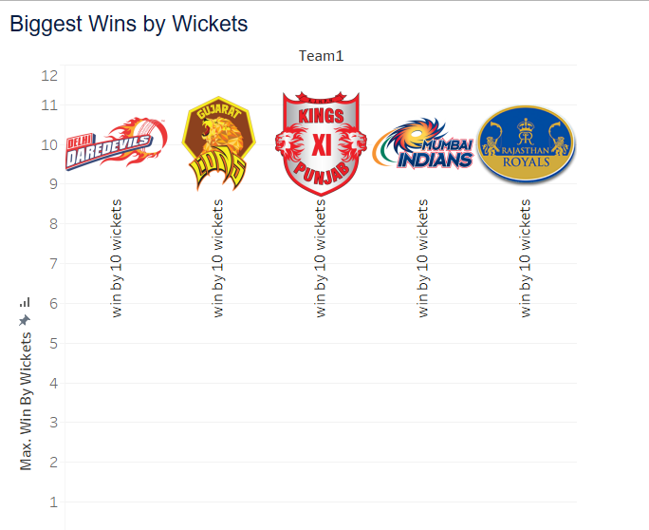
Biggest Wins by Wickets
INSIGHTS
As per data first biggest win by 10 wickets was registered by Delhi Daredevils
7 wickets wins registered Most of the times in IPL History

Slide 7
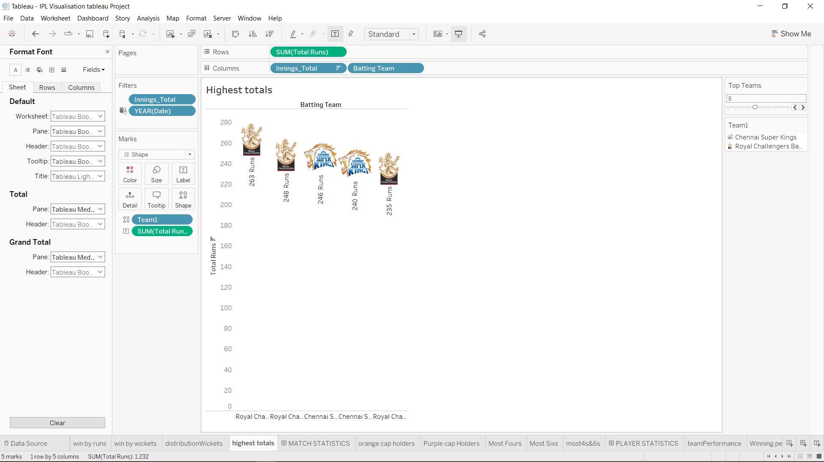
Highest Totals
INSIGHTS
Royal Challengers Bangalore Leads the chart with 263 Runs
Royal Challengers Registered 3 highest Totals in IPL history and in top 5 chart got 3 highest totals
Followed by Chennai Super kings with highest 246Runs and got 2 spots among top 5 chart

Slide 8
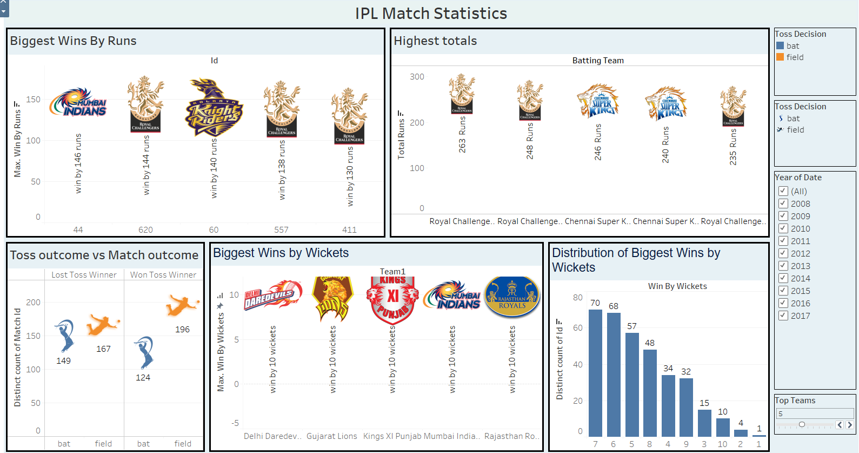
IPL Match Statistics
The Above Dashboard is showing Top Five in All Formats Performance among from 2008 to 2018
We can Manipulated the Dashboard for particular season by Year and Selecting Top Teams Parameter

Slide 9
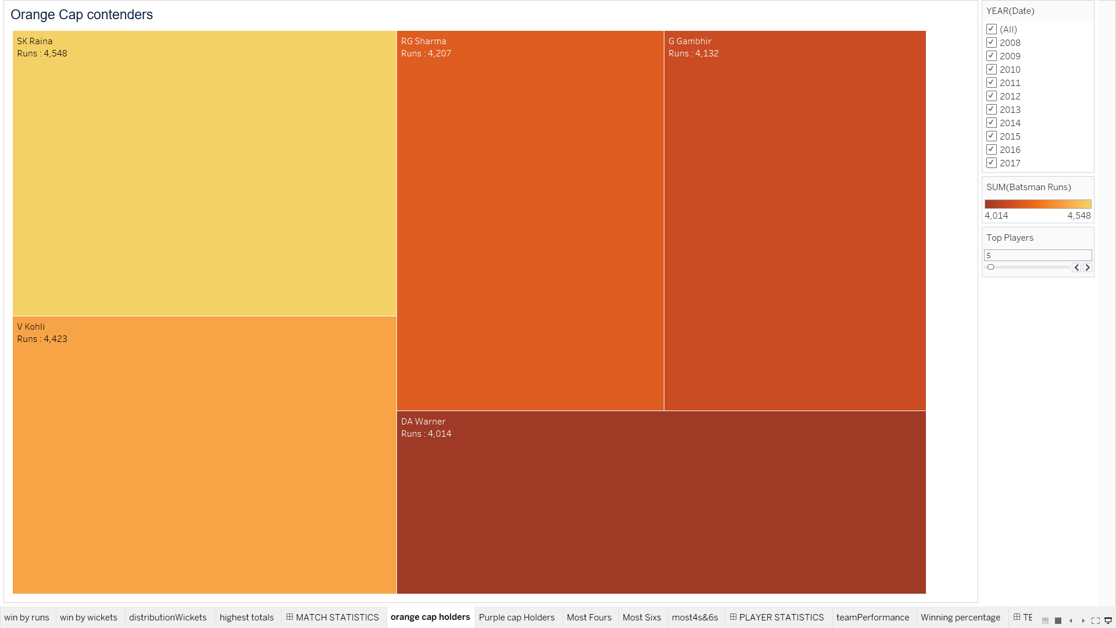
Orange Cap contenders
INSIGHTS
Suresh Raina is highest runner getter in the IPL followed by Virat kohli
For the batsman who have scored the maximum number of runs in a particular season we can filter it out with help of year filter and we can select top N players from parameter TOP PLAYERS

Slide 10
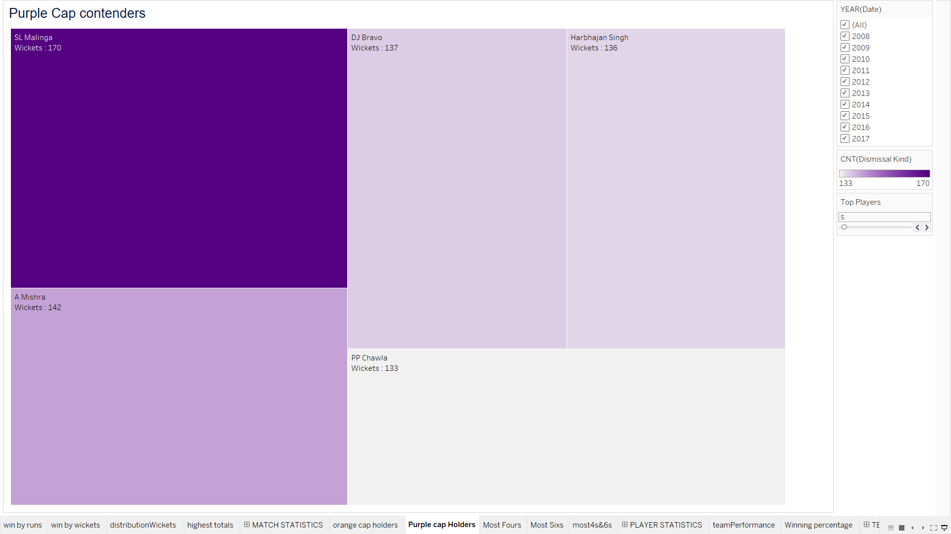
Purple Cap Contenders
INSIGHTS
Lasith Maling is the Highest Wickets getter in the IPL and followed by A Mishra
For the batsman who have scored the maximum number of runs in a particular season we can filter it out with help of year filter and we can select top N players from parameter TOP PLAYERS

Slide 11
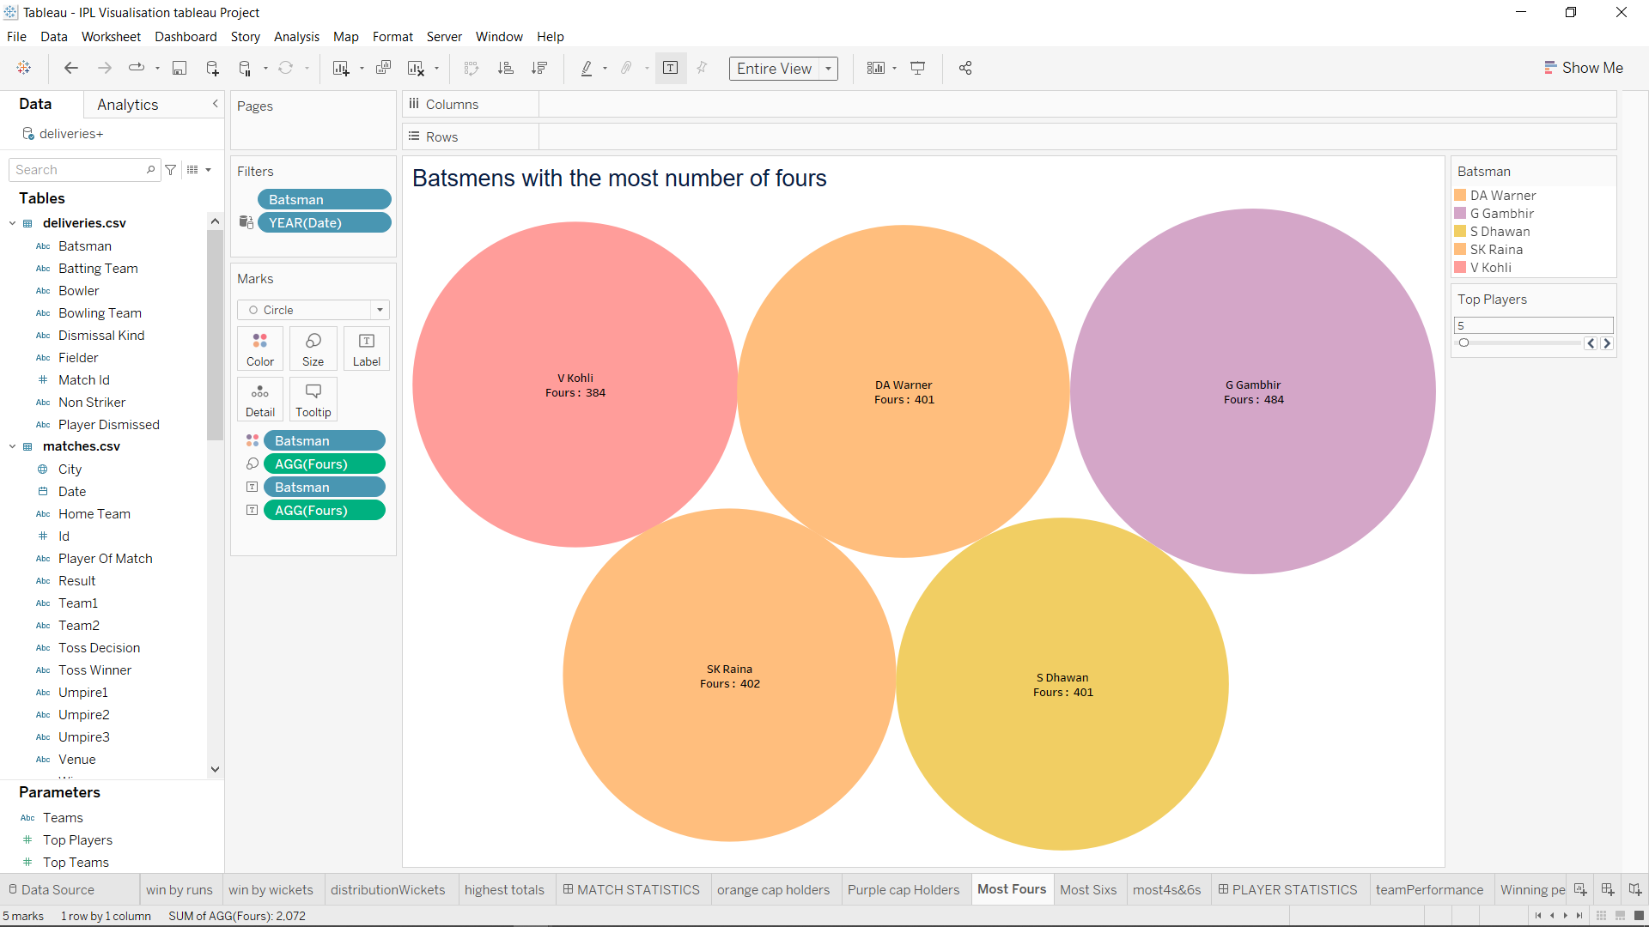
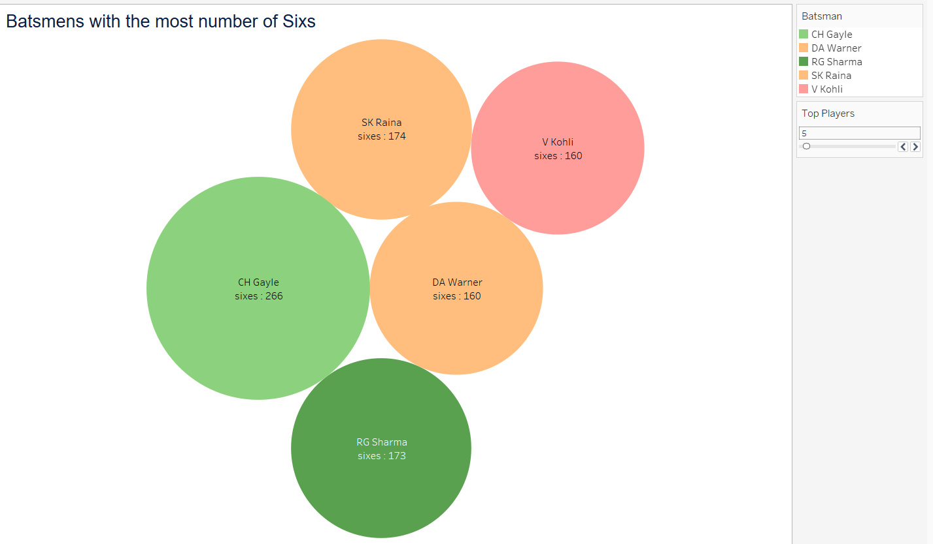
Batmen's with Most fours INSIGHTS: Goutam Gambhir is Hitted Highest Number Of Fours Suresh Raina got second place for hitting Fours
Batmen’s With Most Sixes
INSIGHTS: Chris Gayle is Hitted Highest Number of Sixes and
Suresh Raina Suresh Raina got second place for hitting Sixes

Slide 12
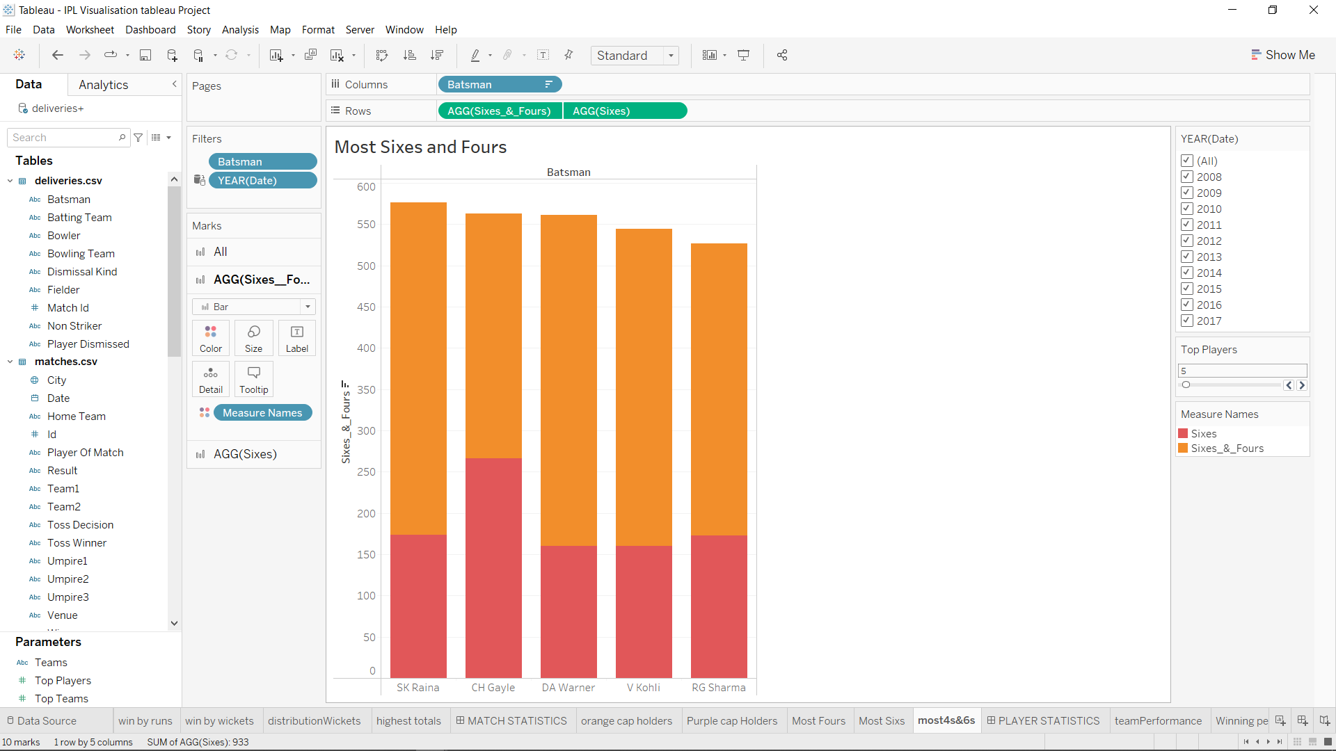
Batsmen who have hit the most number of fours and sixes (per season and overall)
INSIGHTS
Suresh Raina is player with the most number of fours and sixes in the IPL and followed by Chris Gayle
For the batsman who have the most number of fours and sixes in a particular season we can filter it out with help of year filter and we can select top N players from parameter TOP PLAYERS

Slide 13
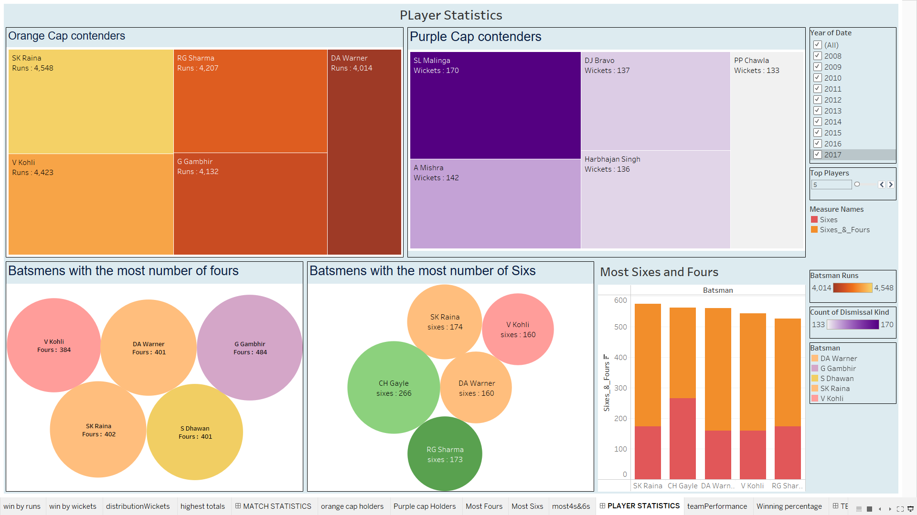
PLAYER STATISTICS DASHBOARD
For the Players who have Performed Excellent in a particular Formats in particular season we can filter it out Using the “Year of Date” filter and we can select top N players from parameter TOP PLAYERS

Slide 14
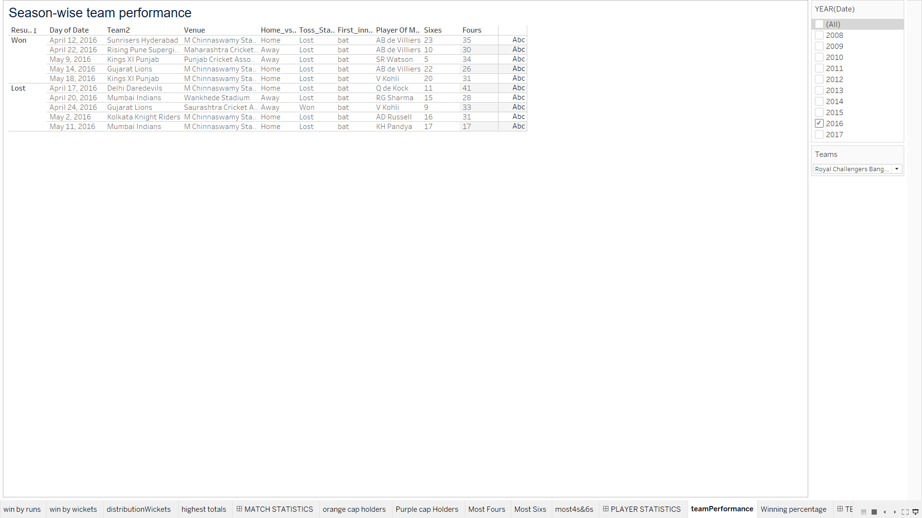
Season-wise team performance (wins vs losses)
The above table is having particular Team performance for particular season
We can manipulates the above table by Year filter and selecting particular team for the results
The above table is breakdown by Result status showing two Category Won and lost followed by Further information of the matches

Slide 15
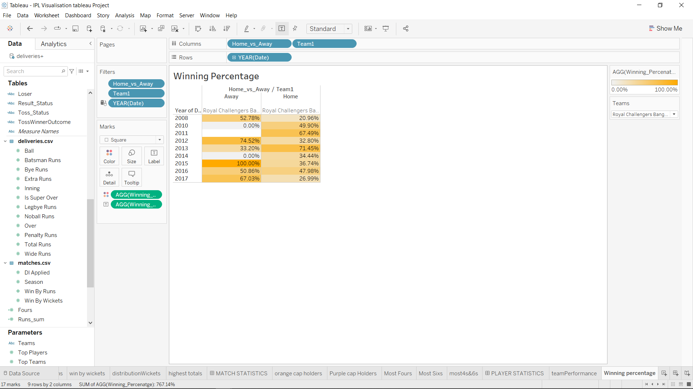
Win %age ( home vs away)
The above table is showing the winning percentage of the team if team played in home ground or Away
The above table is representing the Royal Challengers Bengaluru Winning percentage
In 2015 team Having 100% Winning Percentage in home Ground
In 2013 team wins 70% of the matches when its played Away from the Home
We can Select Team Accordingly From TEAMS Parameter to see the Home Vs Away winning percentage of team

Slide 16
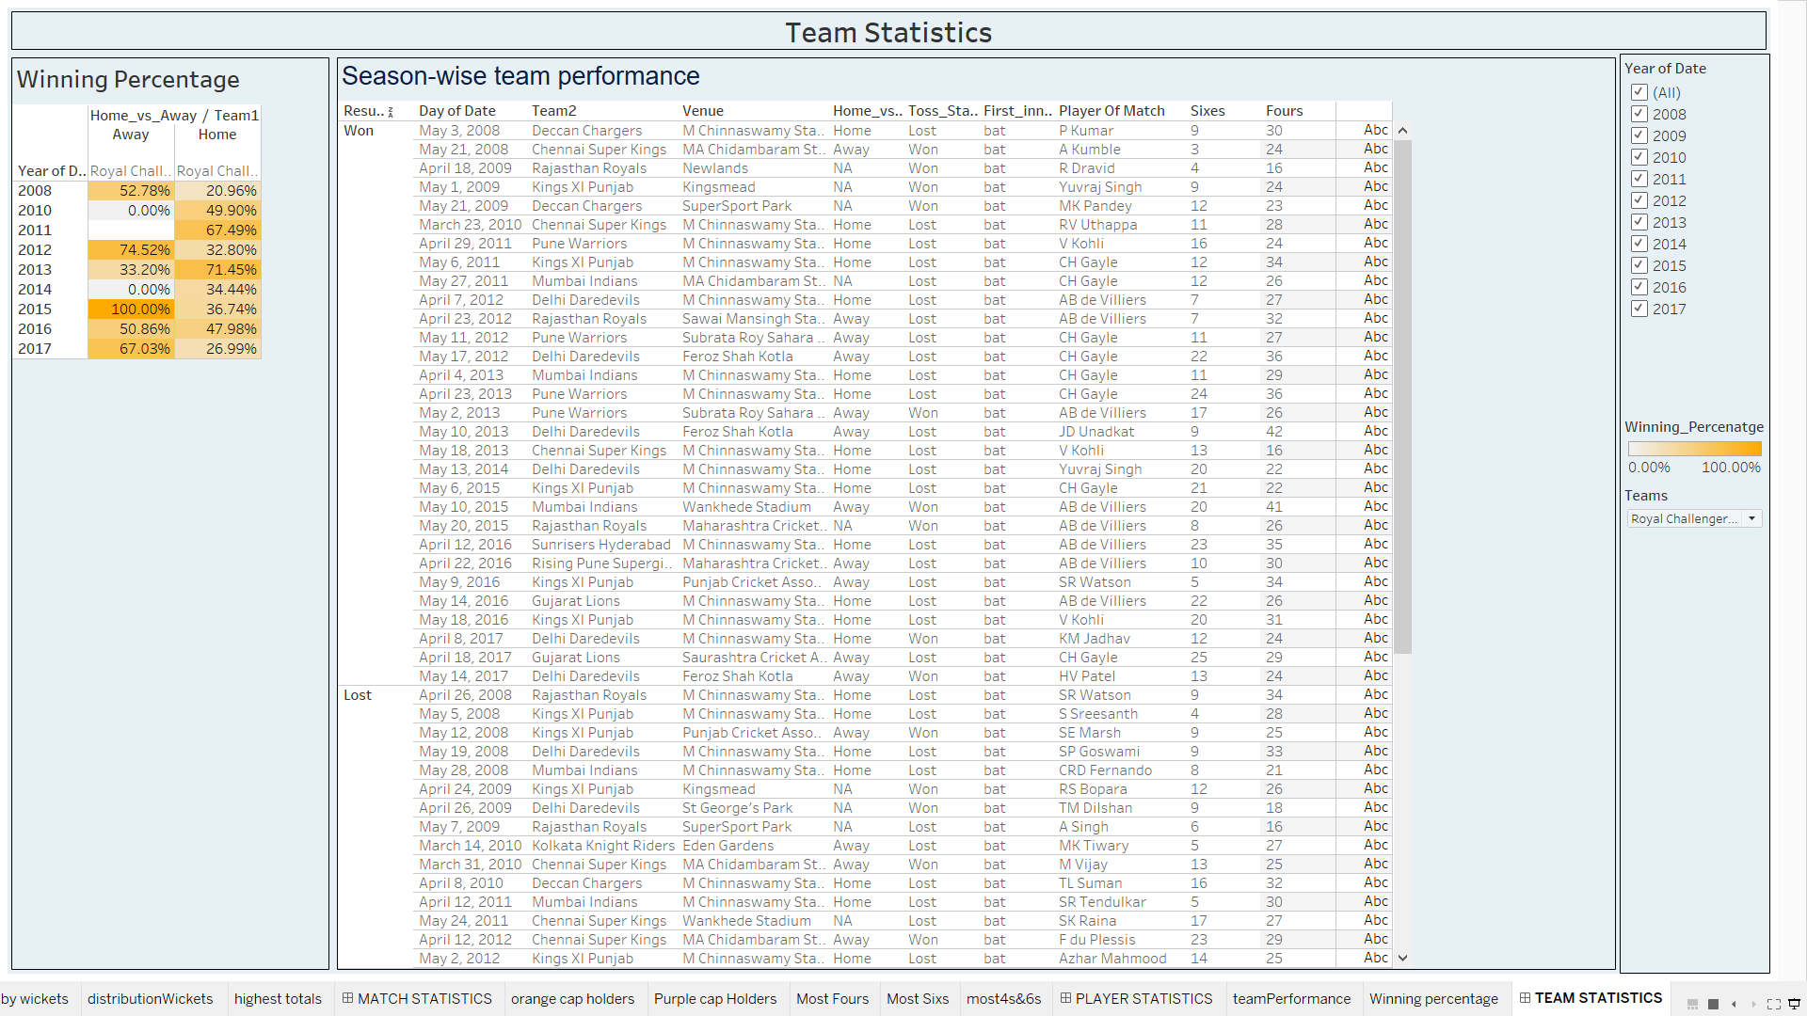
Team Statistics Dashboard
The above Dashboard showing insights for the Royal Challengers Bengaluru for all Seasons
We Can Get Team wise insights by selecting the teams from ‘TEAMS’ parameter for particular season

Slide 17
CONCLUSIONS
Team Winning the TOSS And Choosing Fielding is Having highest Number of Wins Across the Venues
Losing the Toss and Goes To Field has the highest rate of wins for toss loser and Bating first having less winning rate as compared to fielding first for all venues
Mumbai Indians top the charts With the Win against Delhi Daredevils by All time Huge margin of 146 Runs
Followed By Royal Challenger Bangalore registered three biggest wins at the top 5 chart and Kolkata Knight riders registered 1 biggest win by runs
first biggest win by 10 wickets was registered by Delhi Daredevils 7 wickets wins registered Most of the times in IPL History
Royal Challengers Bangalore Leads the chart with 263 Runs and RCB has 3 highest Totals in IPL history and in top 5 chart got 3 highest totals and Followed by Chennai Super kings with highest 246Runs and got 2 spots among top 5 chart
Suresh Raina is highest runner getter in the IPL followed by Virat kohli
For the batsman who have scored the maximum number of runs in a particular season we can filter it out with help of year filter and we can select top N players from parameter TOP PLAYERS
Lasith Maling is the Highest Wickets getter in the IPL and followed by A Mishra
For the batsman who have scored the maximum number of runs in a particular season we can filter it out with help of year filter and we can select top N players from parameter TOP PLAYERS
Chris Gayle having Highest Number of Sixes and Goutam Gambhir is Having Highest Number Of Fours

Slide 18

Visualization Using tableau
Done by
Paramesh E

