Slide 1

  CHATBOT DEPLOYMENT WITH IBM CLOUD WATSON ASSISTANT PHASE-5

Slide 2
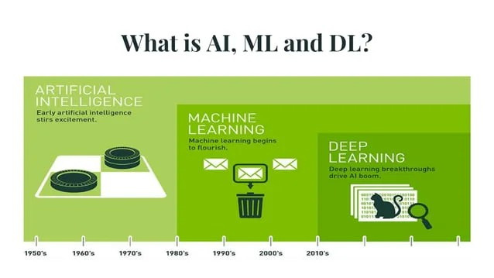

Slide 3


Slide 4
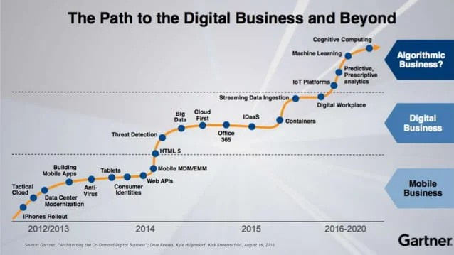

Slide 5
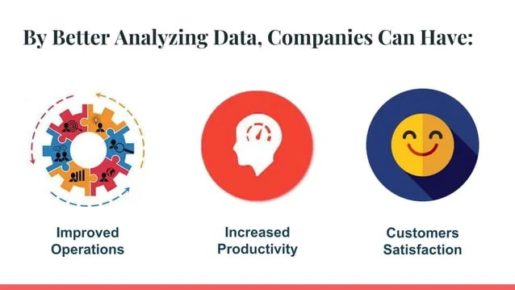

Slide 6
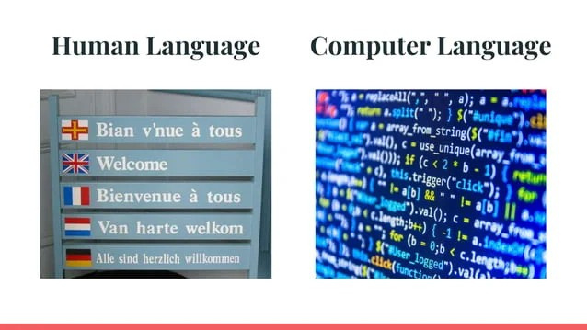

Slide 7
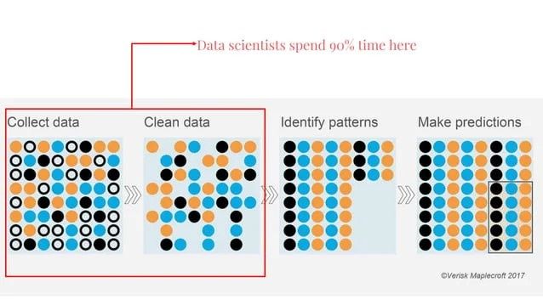

Slide 8
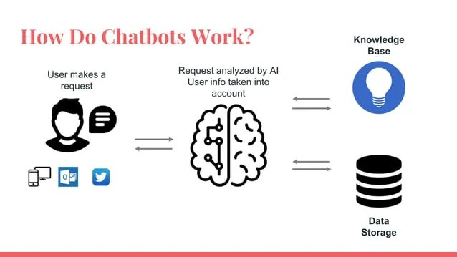

Slide 9
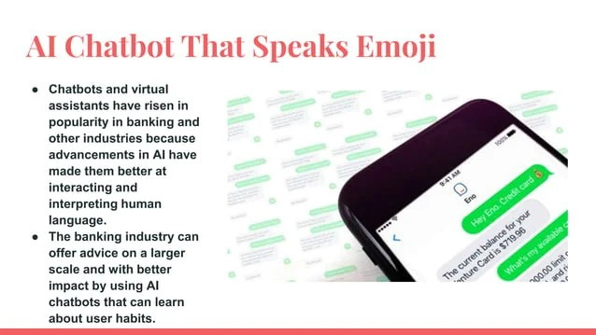

Slide 10
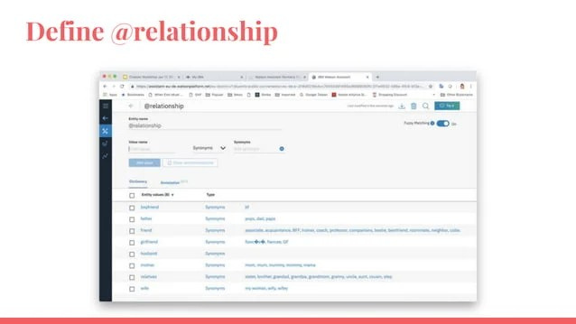

Slide 11
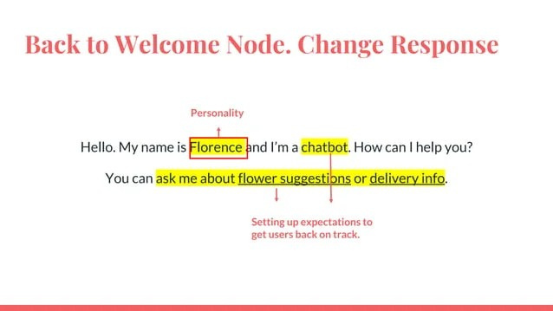

Slide 12
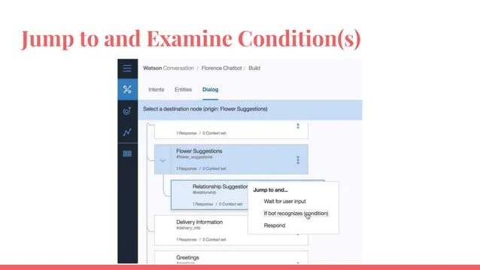

Slide 13
Documentation & Submission
Step 1: Install IBM Watson SDK Begin by installing the "ibm-watson" Python SDK using pip: pip install ibm-watson
Step 2: Import Required Libraries In your Python script, import the necessary libraries: from ibm_watson import AssistantV1 from ibm_cloud_sdk_core.authenticators import IAMAuthenticator
Step 3: Create Watson Assistant Instance Sign in to your IBM Cloud account and create a new Watson Assistant service instance. Obtain the API key and service URL for your Watson Assistant instance.

Slide 14
Step 4: Authenticate and Create Watson Assistant Client # Replace "YOUR_API_KEY" and "YOUR_SERVICE_URL" with your actual API key and service URL. authenticator = IAMAuthenticator(apikey='YOUR_API_KEY') assistant = AssistantV1(version='2021-06-14', authenticator=authenticator) assistant.set_service_url('YOUR_SERVICE_URL')
Step 5: Create and Deploy a Watson Assistant Chatbot Design your chatbot's dialogue flow by defining a set of intents and responses. # Define the chatbot's di
Inbox
Search for all messages with label Inbox
Remove label Inbox from this conversation

