Slide 1
Machine Learning-Classification

Slide 2
Classification
Data already categorized/grouped
Need to predict the category
Types of Classification problems
Binary
Multi-Class
Multi-Label
Imbalance

Slide 3
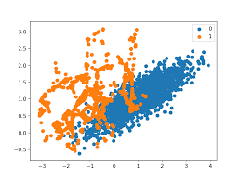
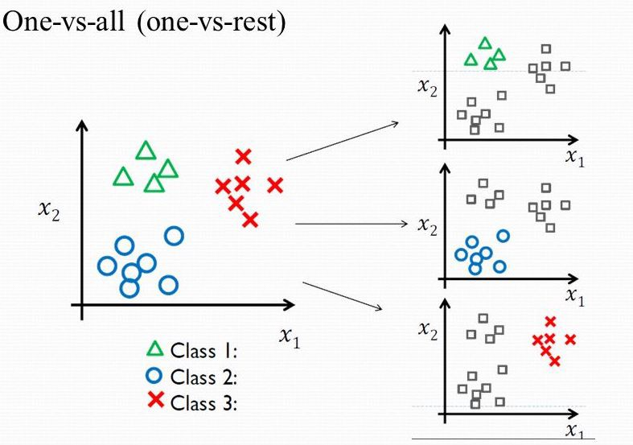
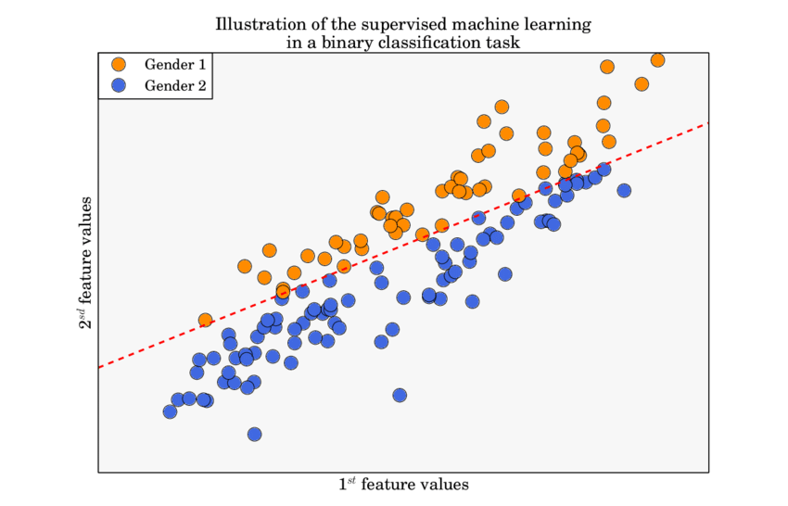
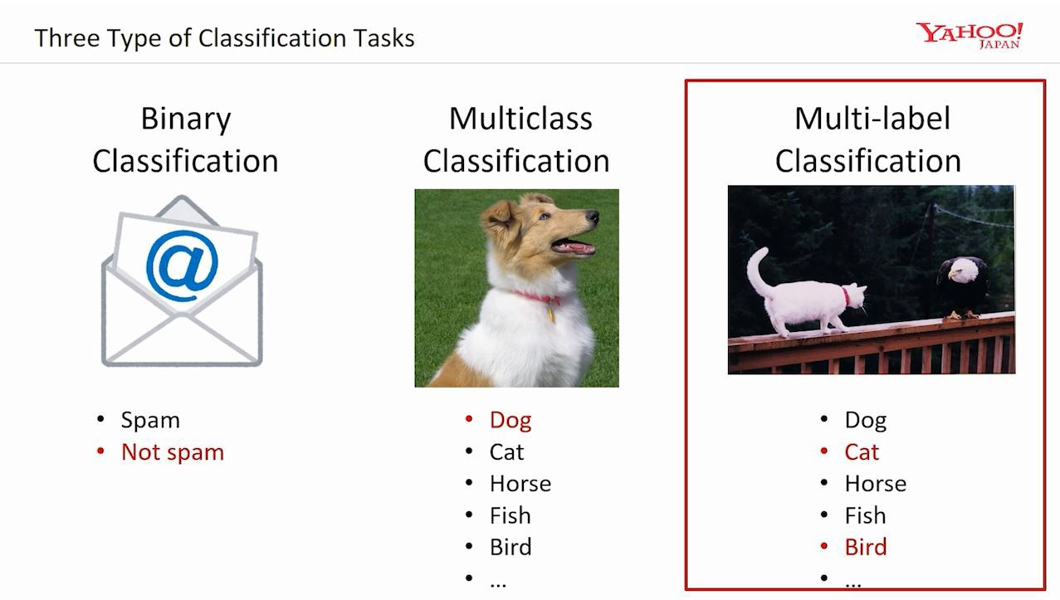

Slide 4
Feature Extraction/Engineering
Information value
Row/Column percentages
Chi-Square test
Select K-Best (Chi-Square test)
Decision Tree --feature selection with information criteria
Random forest-- feature selection
Analysis of variance(ANOVA)
T-Test
Etc.

Slide 5
Classification Models
Logistic Regression
K-Nearest Neighbors
Decision Trees
Support vector machines
Naive Bayes
Random Forest
Gradient Boosting

Slide 6
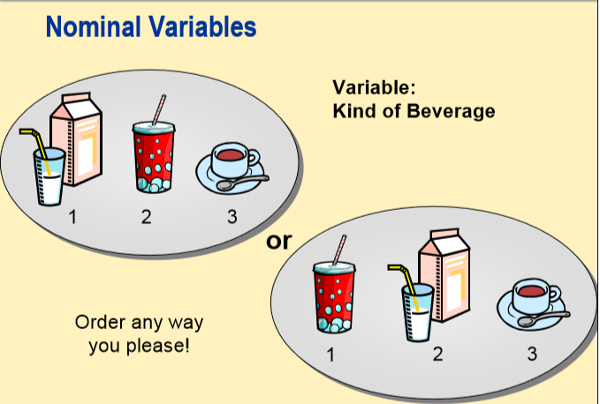
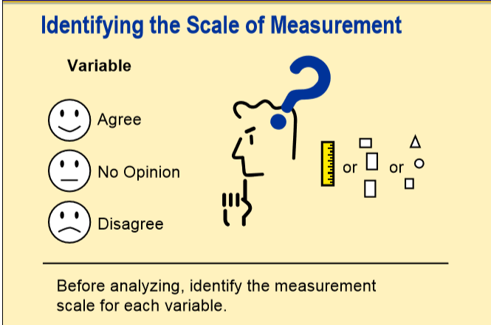
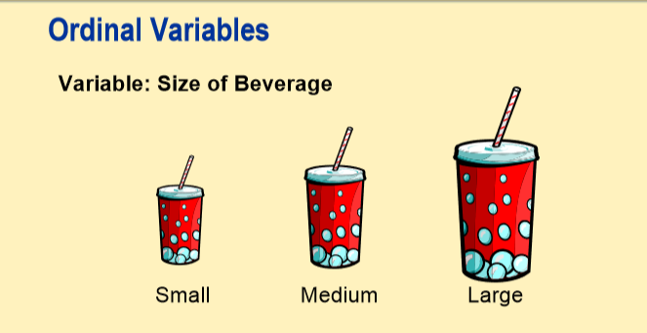
Types in categorical variables
Nominal
Ordinal
Categorical/Grouped

Slide 7
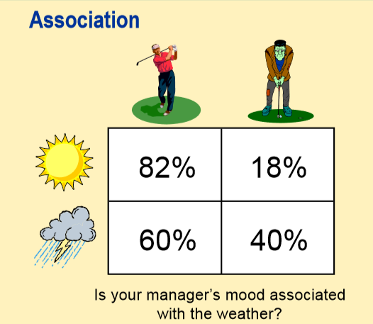
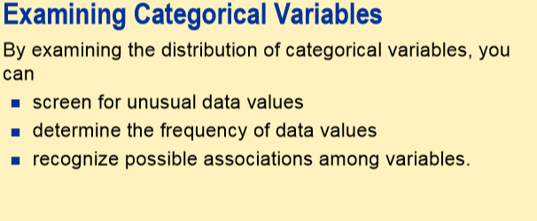
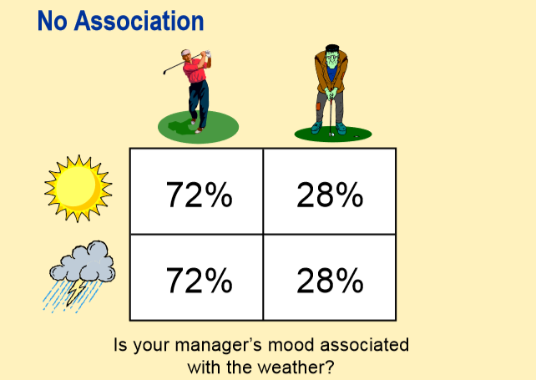
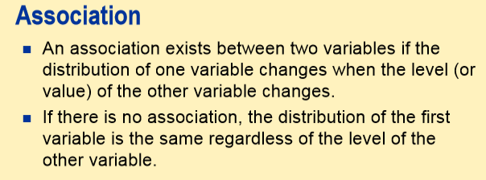

Slide 8
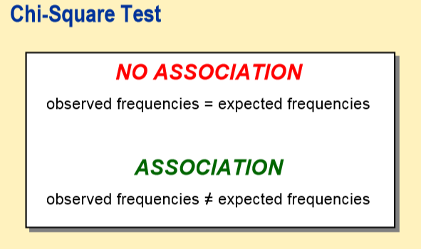
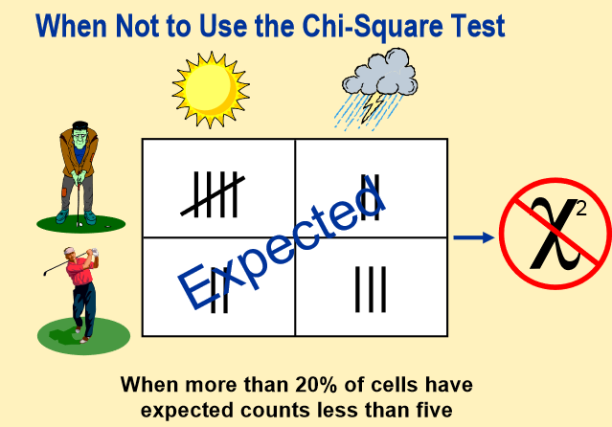
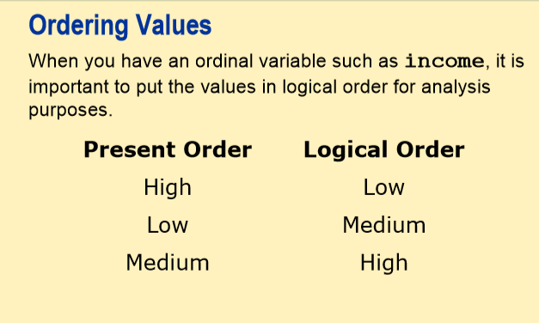
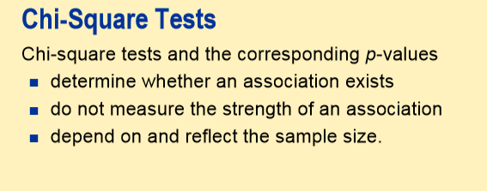

Slide 9
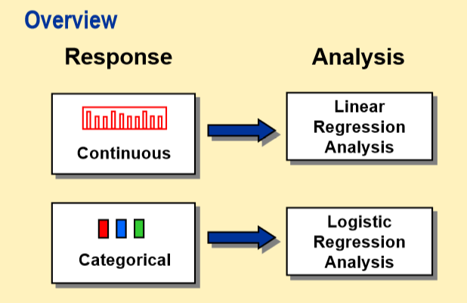
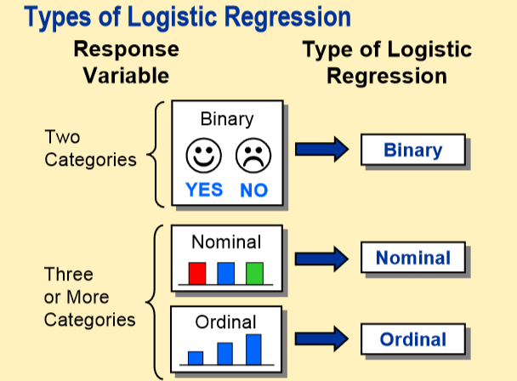
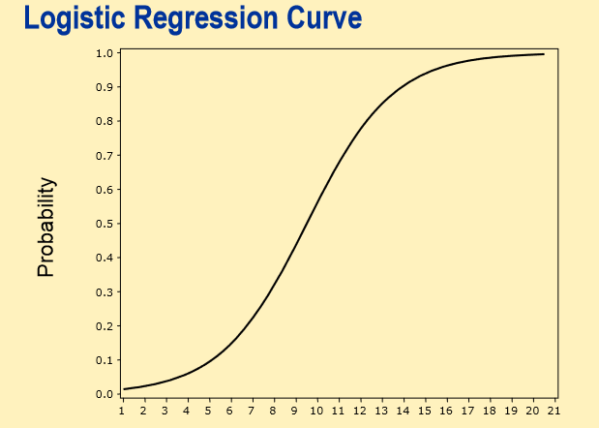
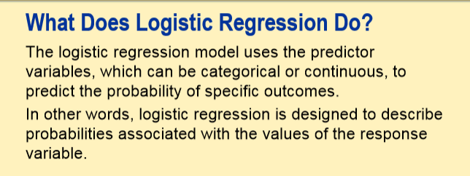

Slide 10
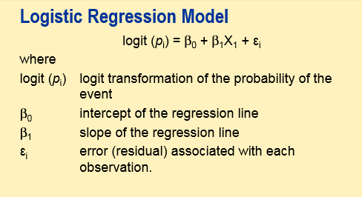
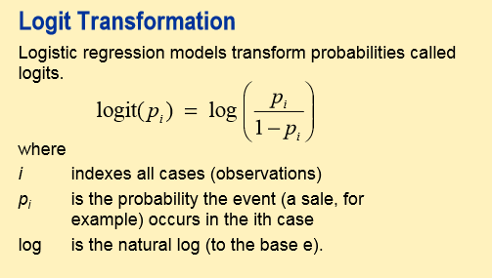
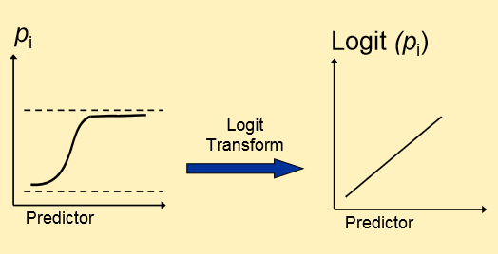

Slide 11
Support Vector Machine

Slide 12
SVM
It’s use for Regression and Classification
It’s has kernel methods as well
It’s good to apply higher dimension data, kernel methods exists.
It’s applicable for binary as well as multiclass problem in classification
It generate hyperplane to separate the data points/classes
The best hyperplane has a maximum distance from data point of classes.
If hyperplane has a minimum distance from data point of classes, there could high miss-classification rate in model.
Need to fix the hyperplane Margins.
Need to adjust miss-classification rate.
Its not good for high volume of the data.

Slide 13
Terms in SVM
Miss-Classification: out of A and B classes one of the Class_A data point classified as Class_B.
Hyperplane: The separator(linear/kernel lines) of Classes in data.
Hyperplane Margins: These are thresholds for miss-classification.
Marginal Distance: The distance between hyperplanes margins, it must be high distance.
Kernel methods: RBF &Polynomial
Hyper-Parameters:
Gamma: lower values –to far , higher value– to close
Cost function/Regularization-C parameter: It allows you to decide how much to penalize misclassified point.
Kernel: To apply for non-linear transformation/ if data has high dimensions.

Slide 14
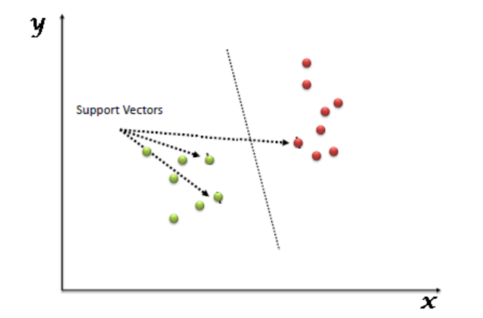
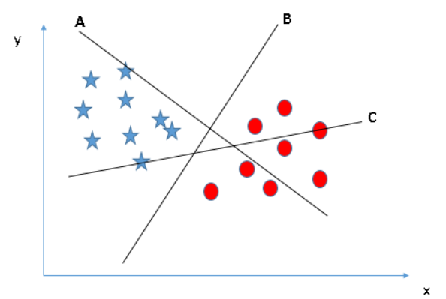
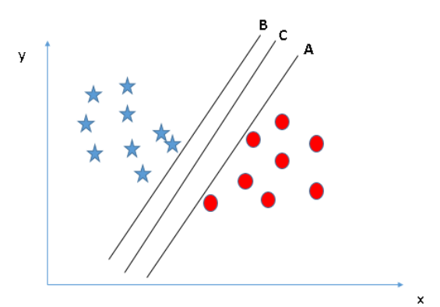
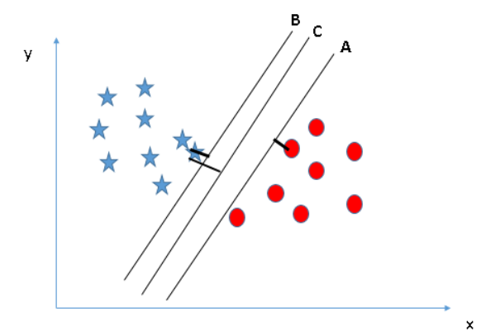

Slide 15
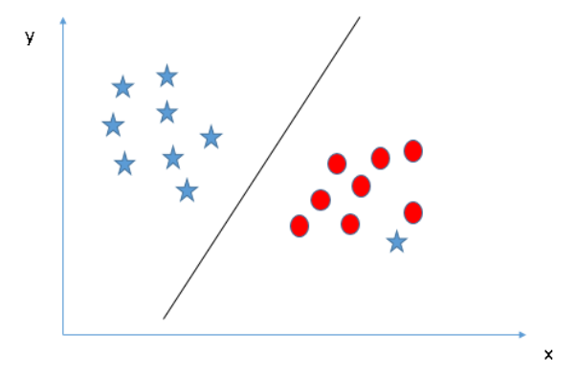
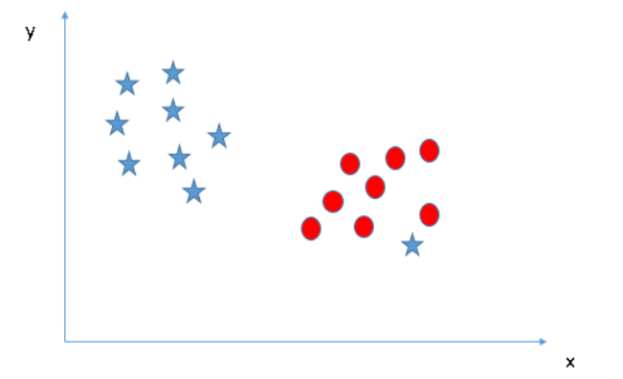
SVM-outliers

Slide 16
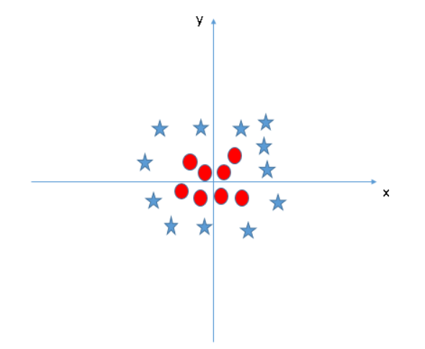
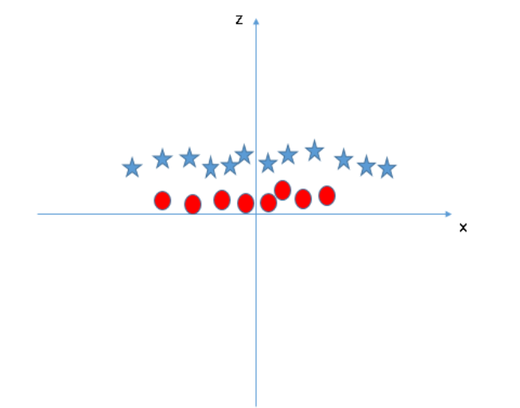
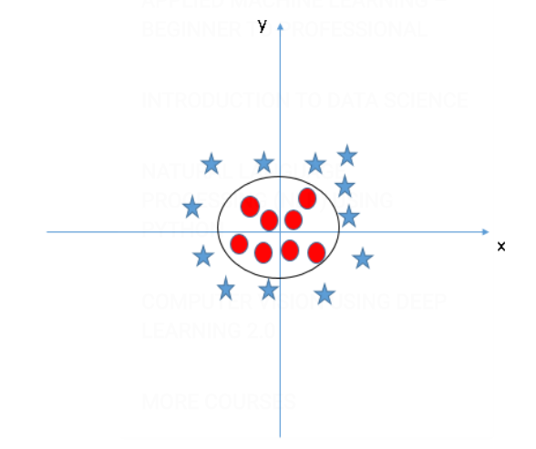
Transformations & kernel methods

Slide 17
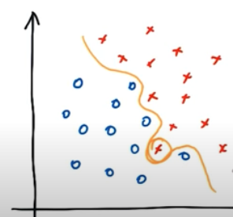
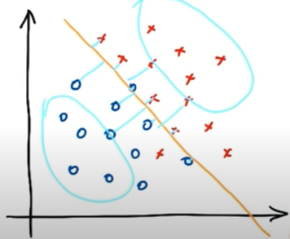
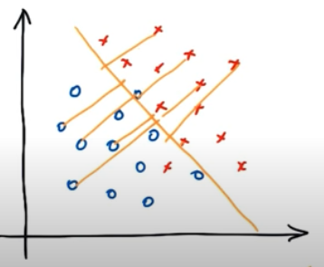
Gamma-Value

Slide 18
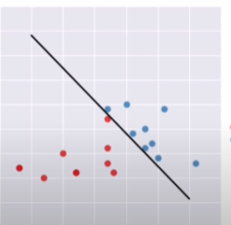
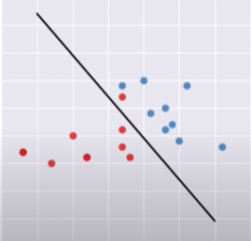
C-parameter Value

Slide 19
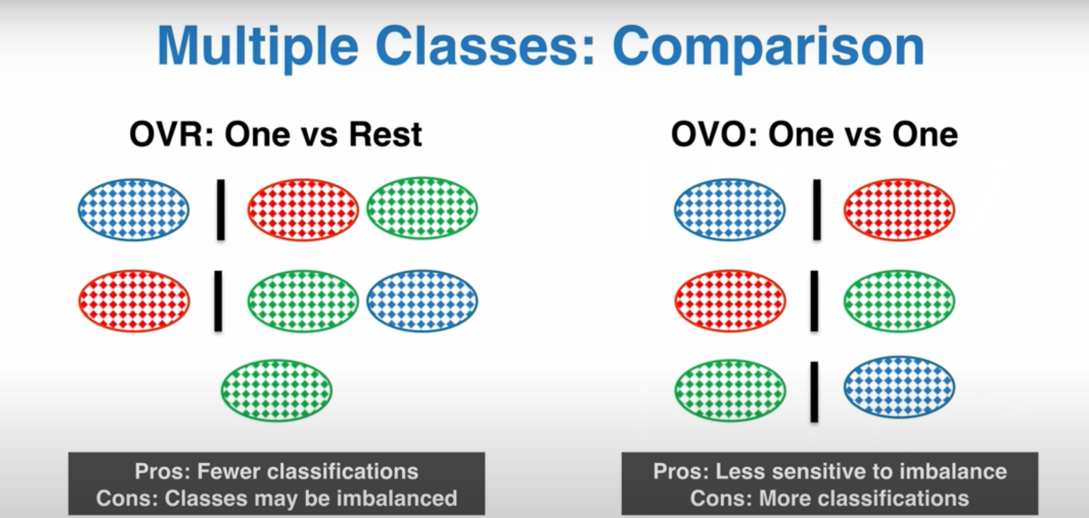

Slide 20
Nearest Neighbors

Slide 21
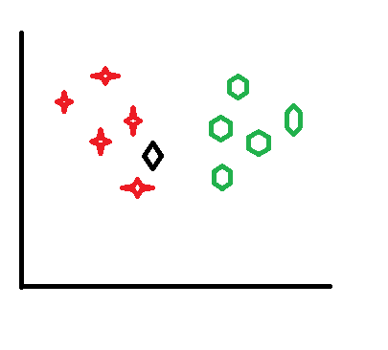
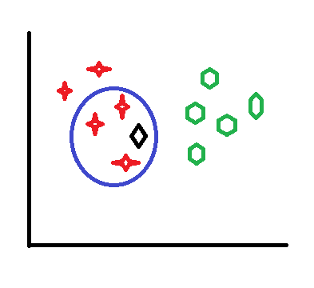
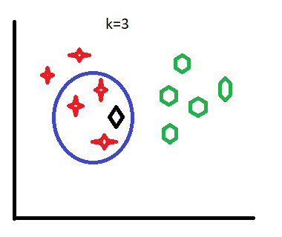
K-NN

Slide 22
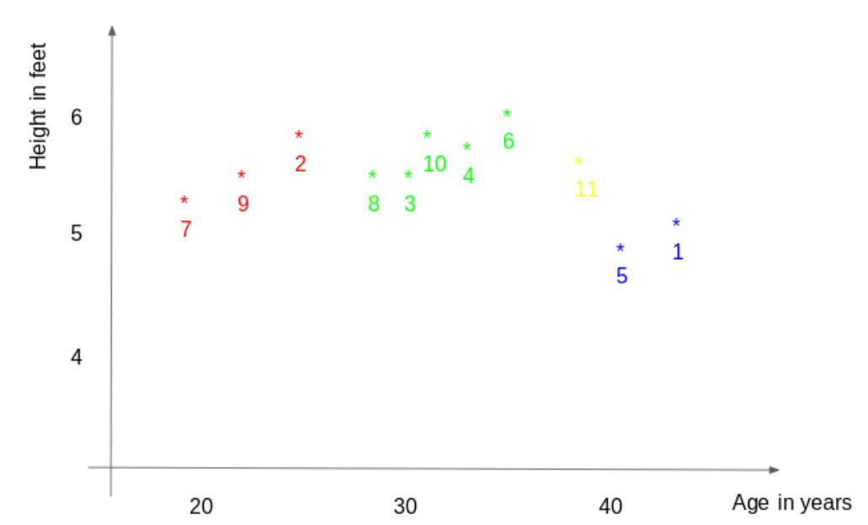
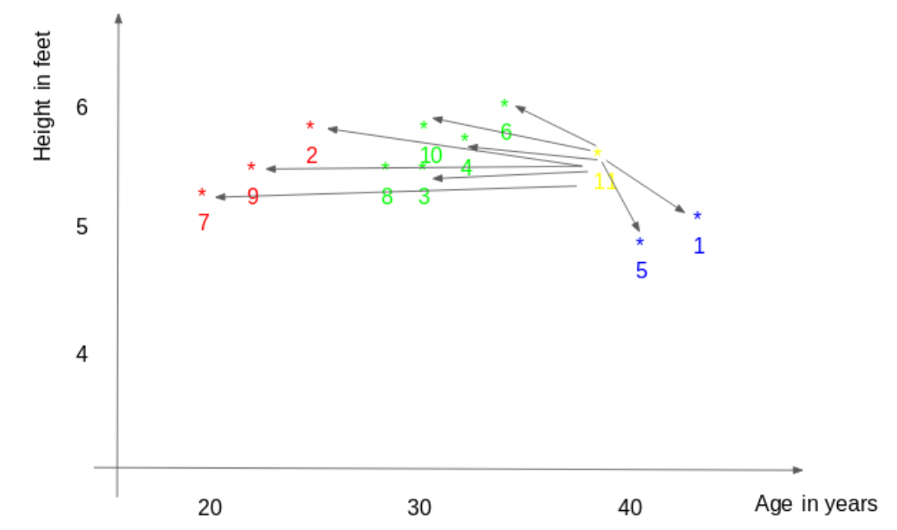
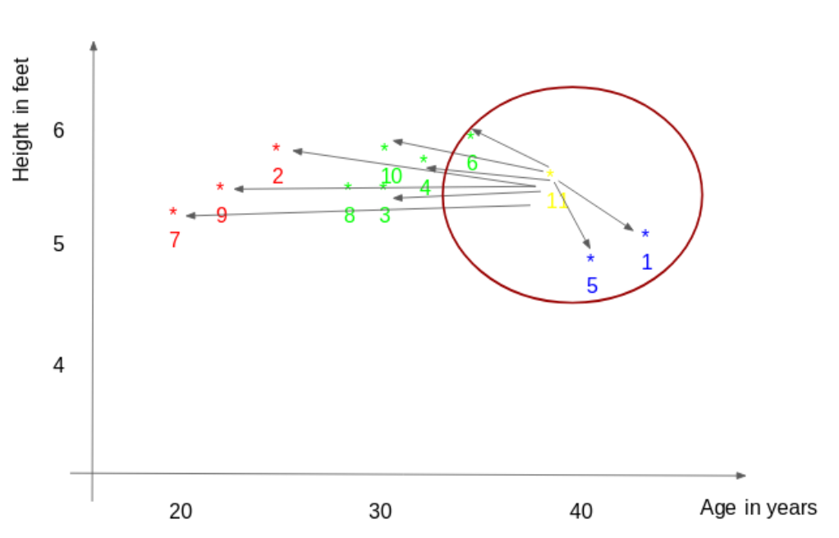
KNN-Classification-Euclidean Distance

Slide 23
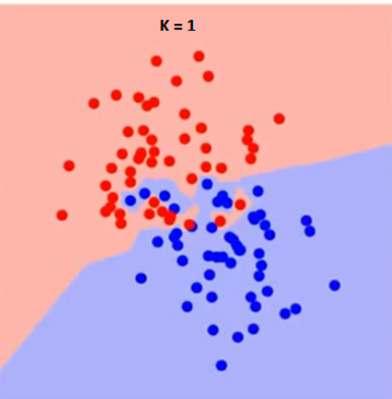
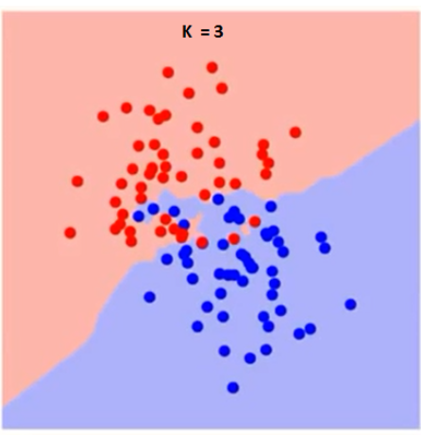
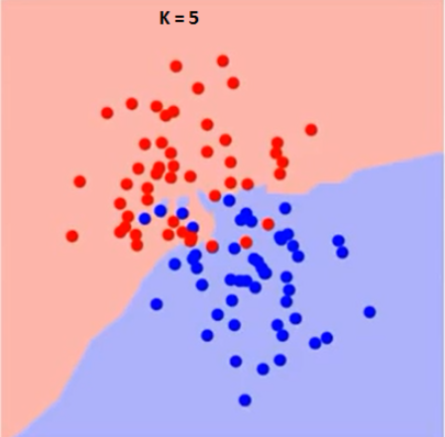
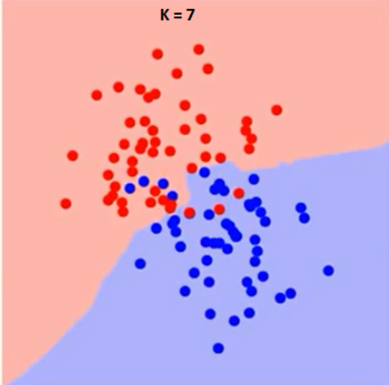
Selecting best K- for separation

Slide 24
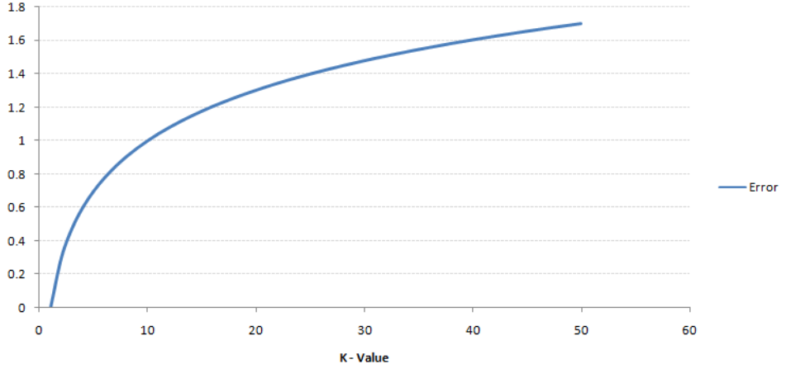
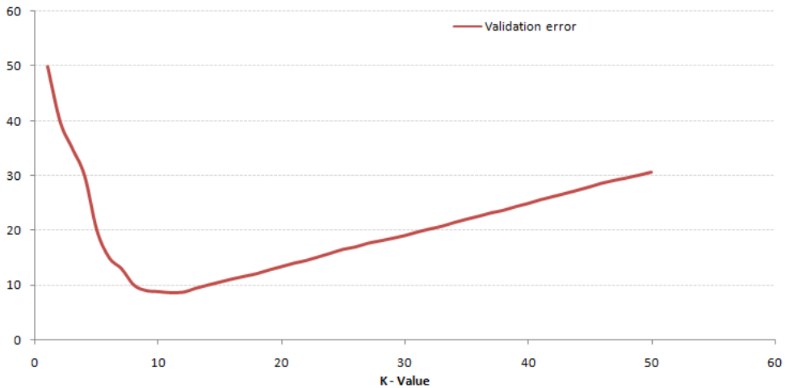
K-Value: Error rate

Slide 25
K-NN
It’s use for Regression(continuous variable) and Classification
It’s use for Supervised and Un-Supervised learning
The principle behind nearest neighbor methods is to find a predefined number of training samples closest in distance to the new point, and predict the label from these.
The number of samples can be a user-defined constant (k-nearest neighbor learning), or vary based on the local density of points (radius-based neighbor learning)
Supervised methods
KnearestNeighborsClassifier: based on the k nearest neighbors of each query point
RadiusNeighborsClassifier: based on the number of neighbors within a fixed radius r of each training point
If data is not uniformly sampled, radius-based neighbors classification is better choice.
Scaling data is better to use KNN methods.
For high-dimensional parameter spaces this method is less effective
Types of methods for unsupervised
Ball Tee
KDTree
Brute-Force

