Slide 1
CI/CD (Continuous Integration & Continuous Deployment)
Automate. Integrate. Deliver Continuously.

Slide 2
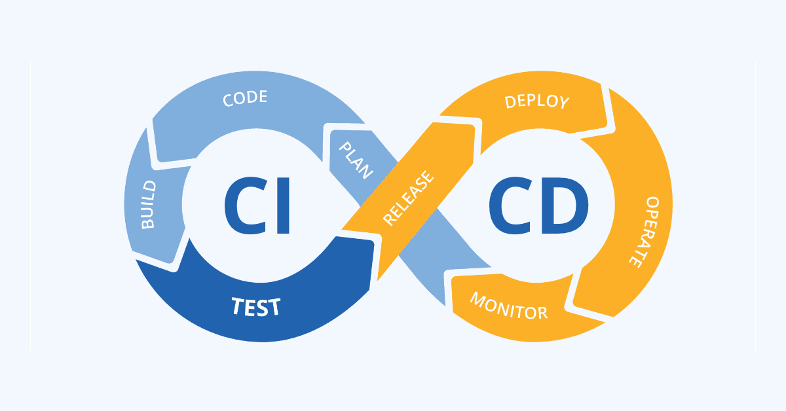

Slide 3
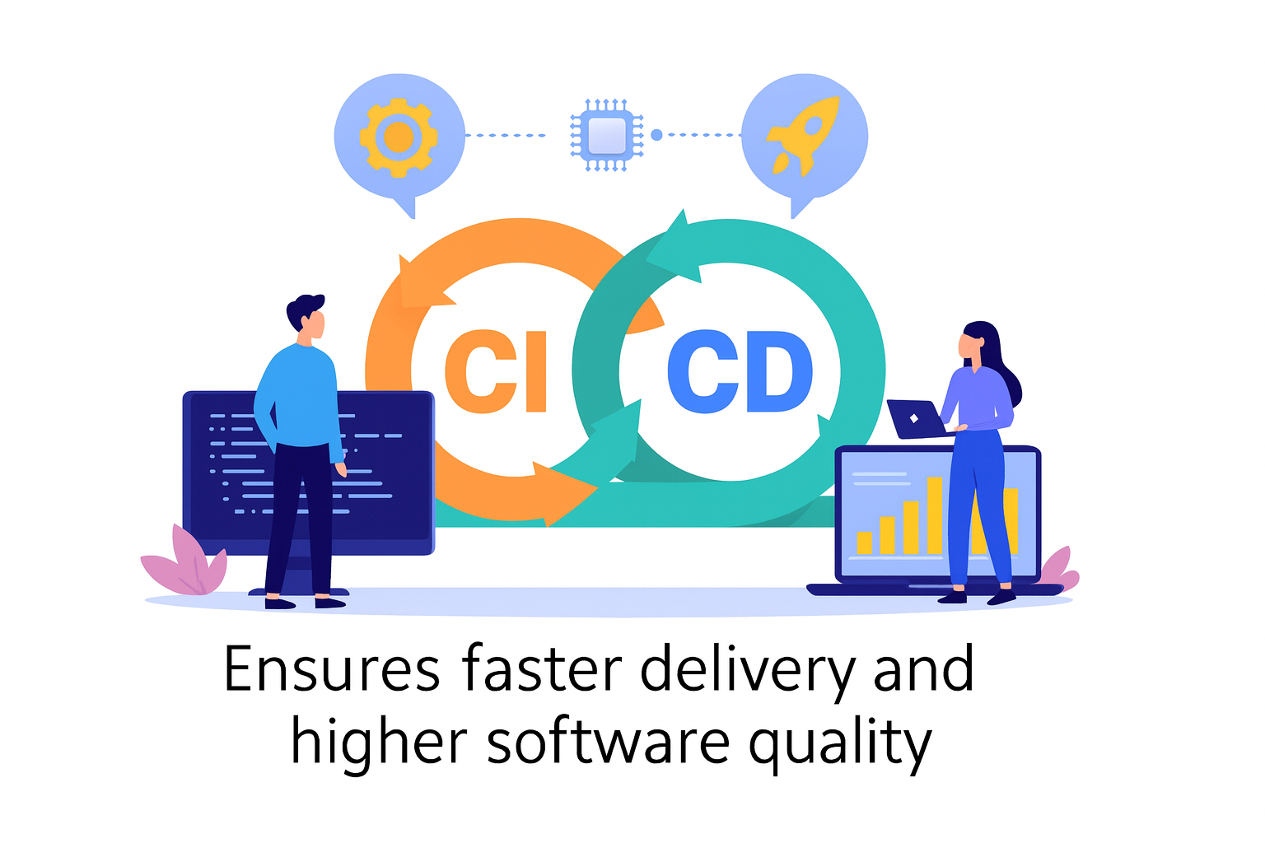
Introduction to CI/CD
CI/CD stands for Continuous Integration and Continuous Deployment/Delivery.
It automates code building, testing, and deployment.
Key Idea: Automate everything from code commit → deployment.

Slide 4
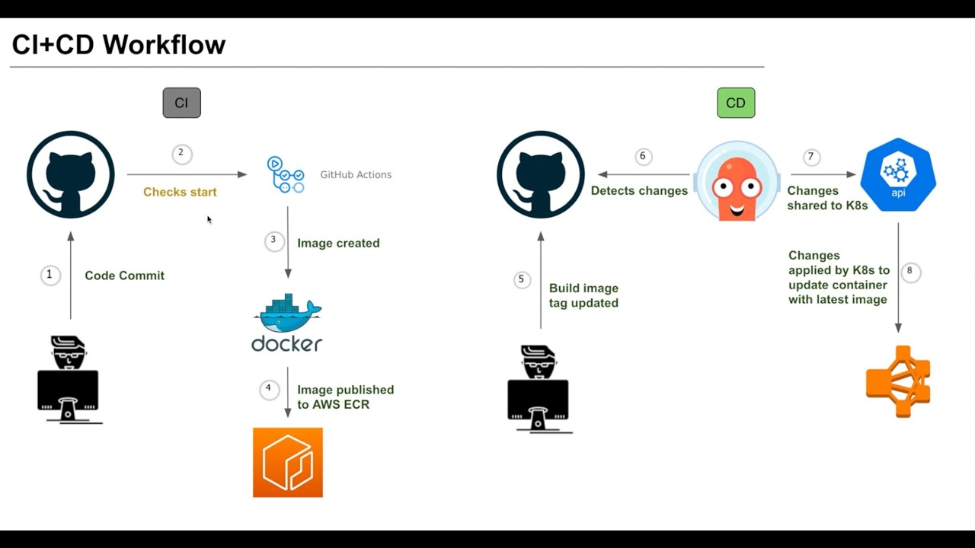

Slide 5
CI/CD Workflow
Typical Stages:
1. Source Control – Developers push code to GitHub/GitLab/Bitbucket.
2. Build Stage – Code compiled and dependencies installed.
3. Test Stage – Automated unit and integration tests run.
4. Deploy Stage – Application deployed to DEV/QA/PROD.
5. Monitor Stage – Application monitored post-deployment.

Slide 6
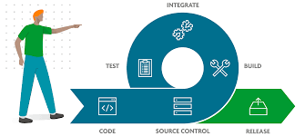

Slide 7
Continuous Integration (CI)
Definition:
Practice of merging developer code into a shared repository several times a day.
Goals:
- Detect integration issues early.
- Ensure build and tests always pass.
Tools: Jenkins, GitHub Actions, GitLab CI, CircleCI.

Slide 8
Continuous Deployment (CD)
Definition:
Automatically deploy validated builds to production.
Benefits:
- Faster release cycles.
- Reduced manual intervention.
- Easier rollback and recovery.
Tools: AWS CodePipeline, Azure DevOps, ArgoCD, Spinnaker.

Slide 9
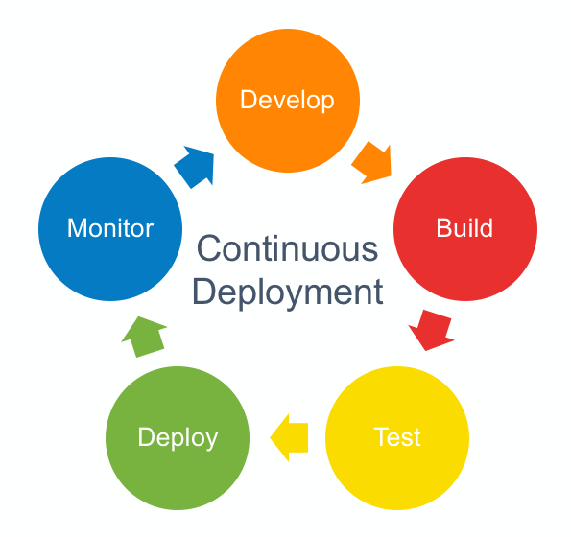

Slide 10
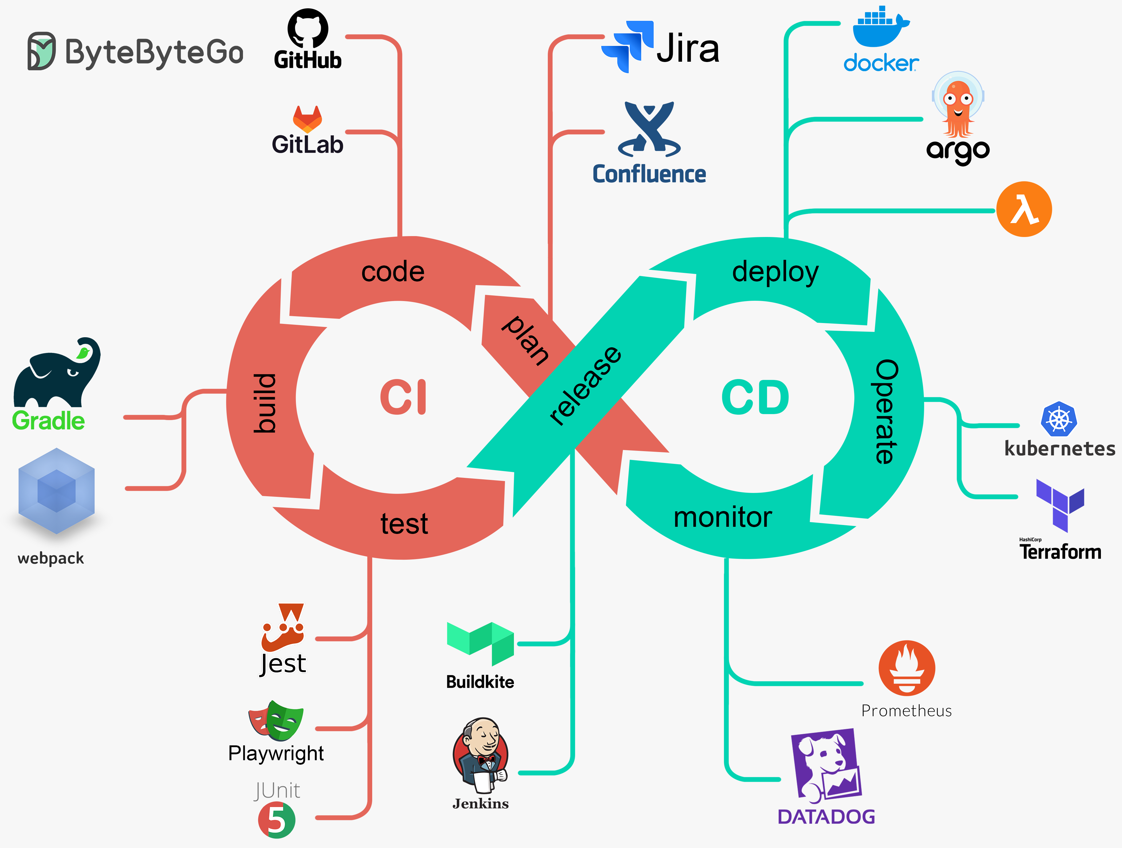
Tools

Slide 11
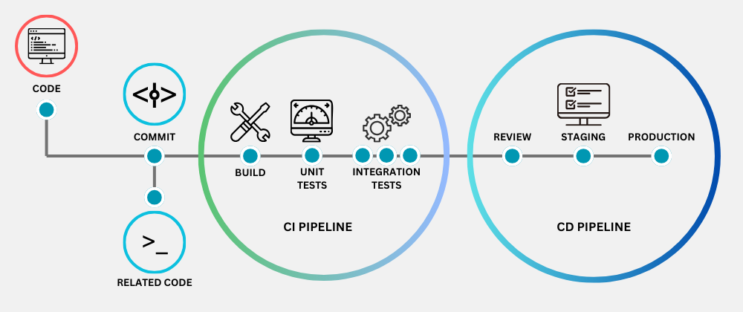
CICD pipeline

Slide 12
Example Pipeline
Scenario: Deploying a Web App using GitHub Actions.
Pipeline Stages:
1. Developer commits code → GitHub repo.
2. GitHub Actions triggers workflow.
3. Runs tests using pytest.
4. Builds Docker image → pushes to AWS ECR.
5. Deploys container to ECS/EC2.
6. Sends Slack/Email notification.

Slide 13
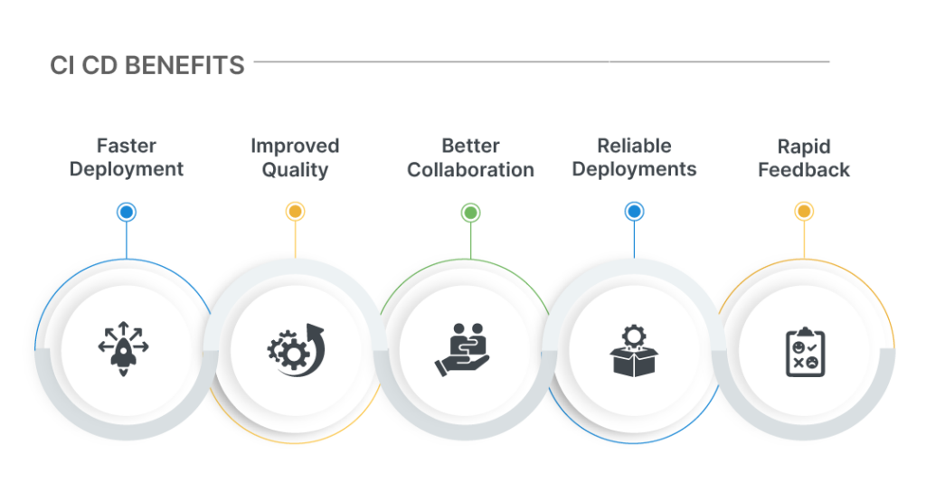

Slide 14
Benefits of CI/CD
- Faster time to market.
- Improved code quality.
- Reduced risk with automated testing.
- Consistent deployments.
- Early bug detection.

Slide 15
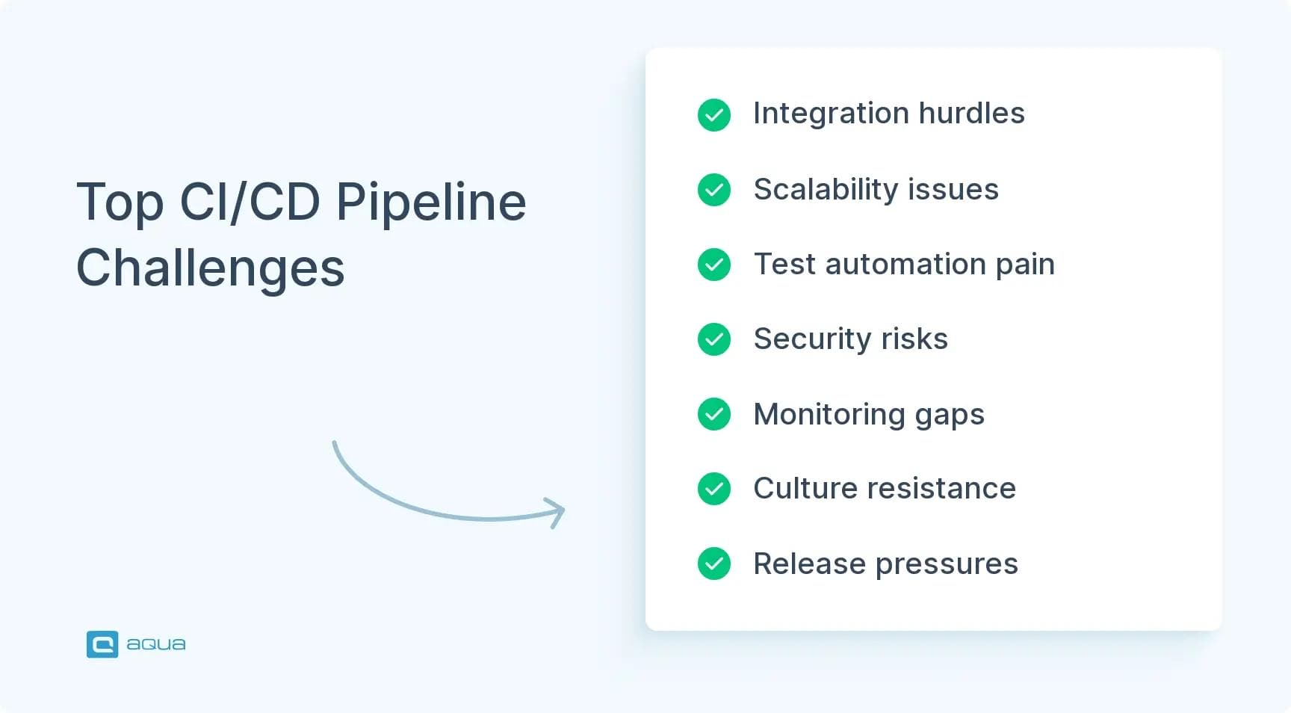

Slide 16
Challenges in CI/CD
- Managing secrets and credentials.
- Handling environment differences (DEV/QA/PROD).
- Complex rollback procedures.
- Toolchain integration issues.

Slide 17
Best Practices
✅ Keep pipelines simple and modular.
✅ Automate tests at every stage.
✅ Use feature branches and pull requests.
✅ Implement version control for pipelines.
✅ Include monitoring and alerts.

Slide 18
Visualization: CI/CD Lifecycle
Code → Build → Test → Deploy → Monitor → Feedback → Code
Represents a continuous improvement cycle.

Slide 19
Summary
CI/CD is a cornerstone of modern DevOps.
Enables faster, reliable, and automated software delivery.
Promotes collaboration between development and operations.
Tagline: Automate. Integrate. Deliver Continuously.

