Slide 1
Development in ITS Software & Product Life Cycle
Paramatma Pulivarthi

Slide 2
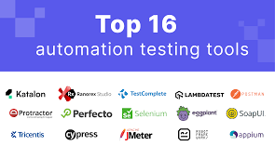

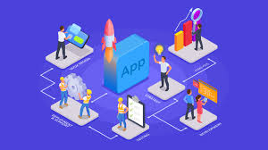

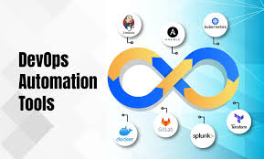
ITS Software Development Overview
Information Technology Systems (ITS) Software Development refers to the process of designing, building, deploying, and maintaining IT-based software solutions to support organizational needs.
Examples: Enterprise applications, healthcare IT systems, cloud platforms, automation tools, etc.

Slide 3
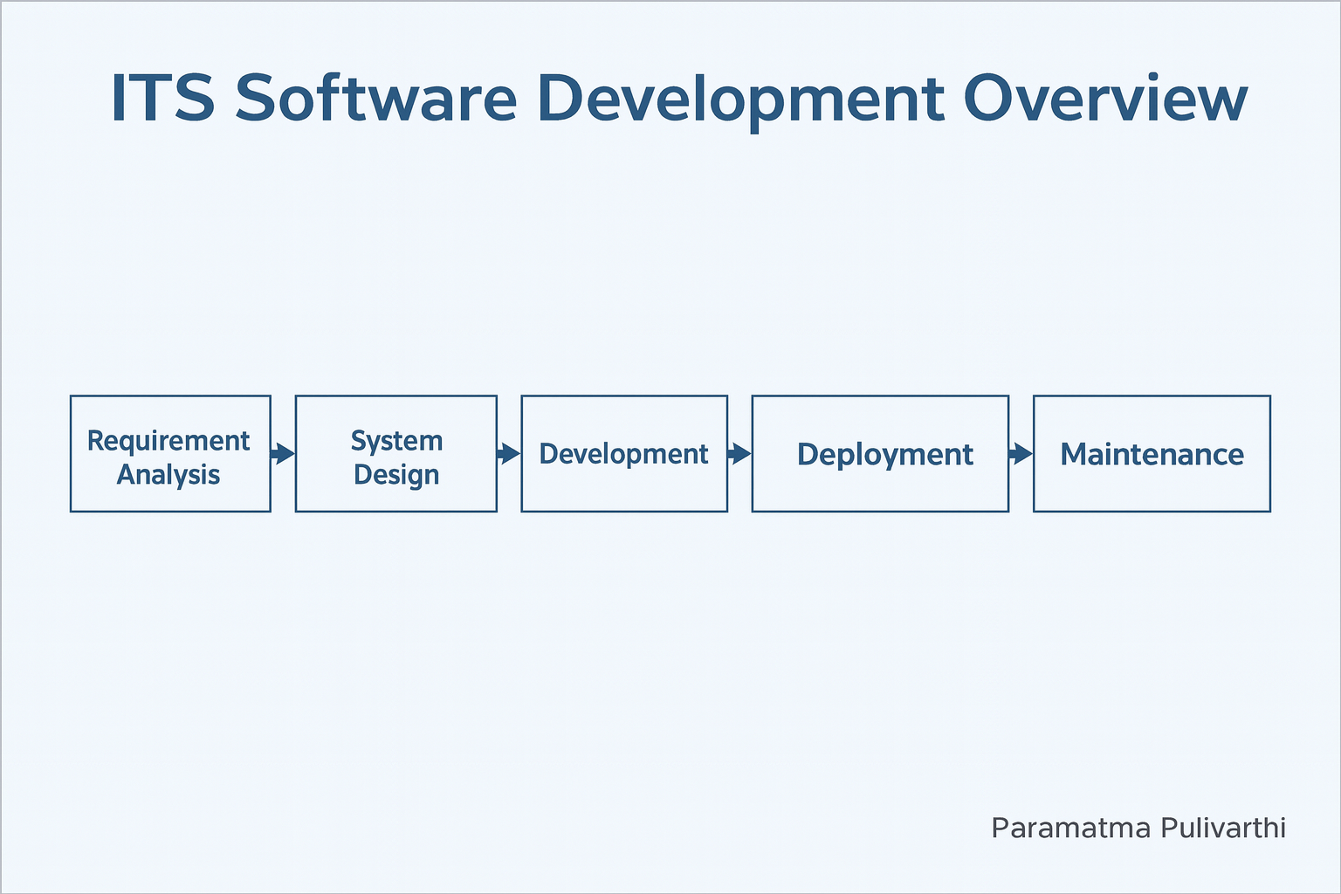

Slide 4
Key Stages in ITS Software Development
1. Requirement Analysis – Understand business needs and user requirements.
2. System Design – Create architecture, data flow diagrams, and UI designs.
3. Development – Write and integrate code for front-end, back-end, and databases.
4. Testing – Verify performance, security, and reliability.
5. Deployment – Release software through CI/CD and cloud environments.
6. Maintenance – Continuous monitoring, updates, and improvements.

Slide 5
Software Product Life Cycle (PLC) Overview
The Software Product Life Cycle describes the stages a software product passes through from its conception to retirement.
Purpose: To align technical development with business and user strategies.

Slide 6
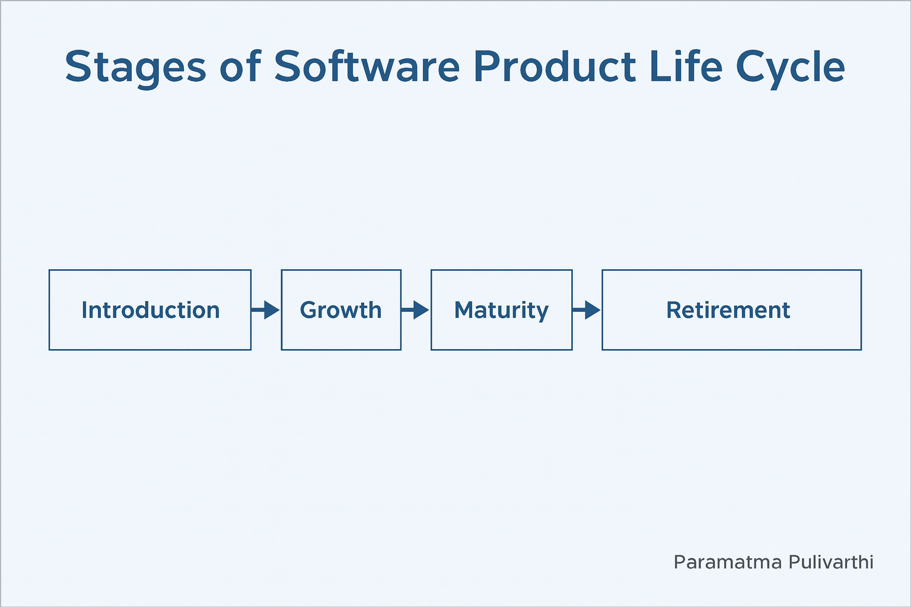

Slide 7
Stages of Software Product Life Cycle
1. Introduction – Product idea, prototyping, and beta launch.
2. Growth – User adoption, scaling, and new features.
3. Maturity – Stable product, optimization, and performance tuning.
4. Decline – Decrease in usage; start planning replacement.
5. Retirement – Decommissioning, data migration, and closure.

Slide 8
Integration of Development & Product Life Cycle
ITS software development acts as a repeating process within the overall Product Life Cycle.
• Each release restarts a mini development cycle.
• Agile and DevOps methods ensure continuous delivery.
• Helps maintain long-term sustainability and adaptability.

Slide 9
Key Takeaways
• ITS software development focuses on business alignment and scalability.
• Product Life Cycle supports strategic decision-making.
• Continuous feedback, automation, and monitoring drive software evolution.

