Slide 1
Python YAML Module
YAML (YAML Ain’t Markup Language) is a human-readable data format.
It is used for configuration files, data serialization, and DevOps tools.
Python uses the PyYAML module to work with YAML data.

Slide 2
1. What is YAML?
• YAML is a data serialization format like JSON but more readable.
• Used in DevOps (Ansible, Kubernetes, Terraform configs, etc.)
• Uses indentation to represent structure.
Example:
name: Paramatma
role: Software Engineer
skills:
- Python
- AWS
- Terraform

Slide 3
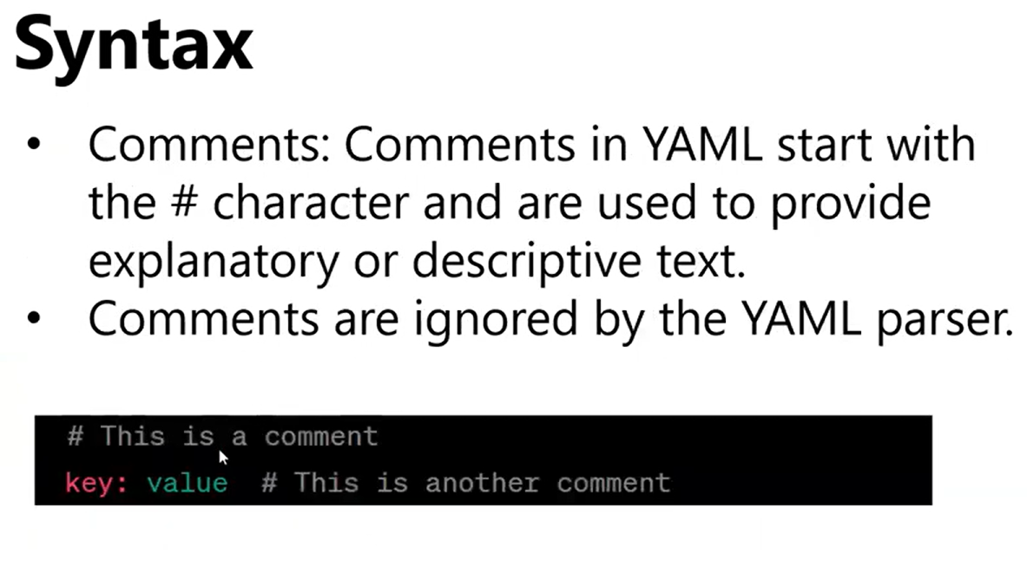

Slide 4
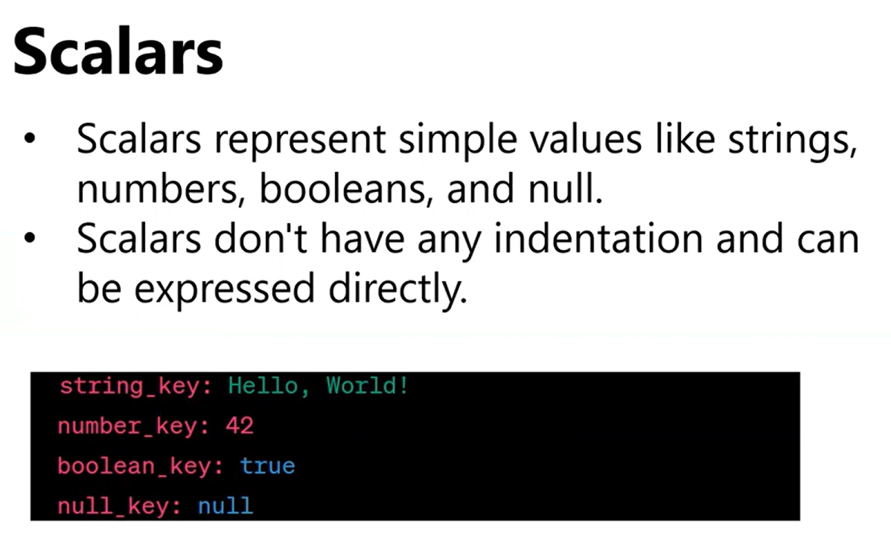

Slide 5
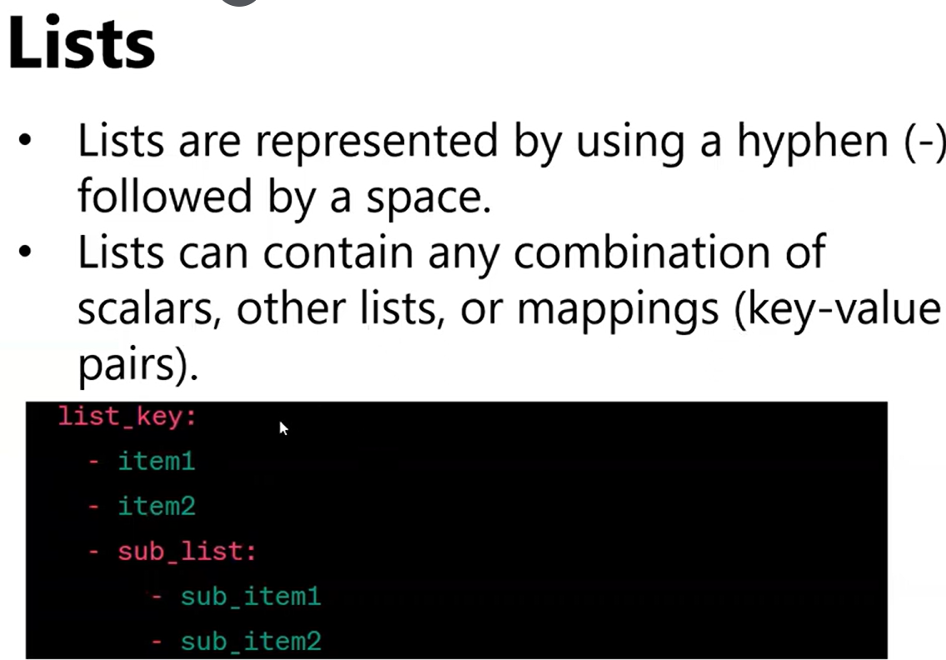

Slide 6
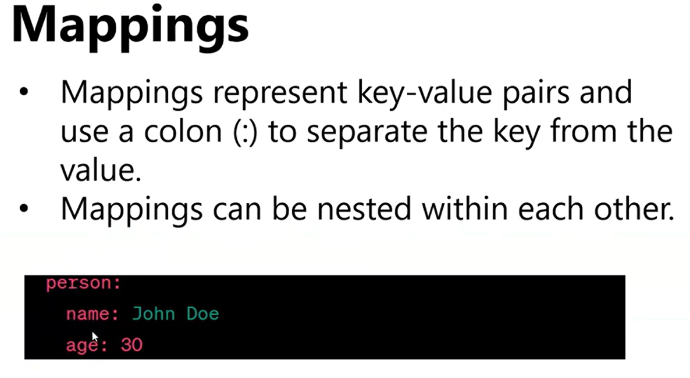

Slide 7


Slide 8
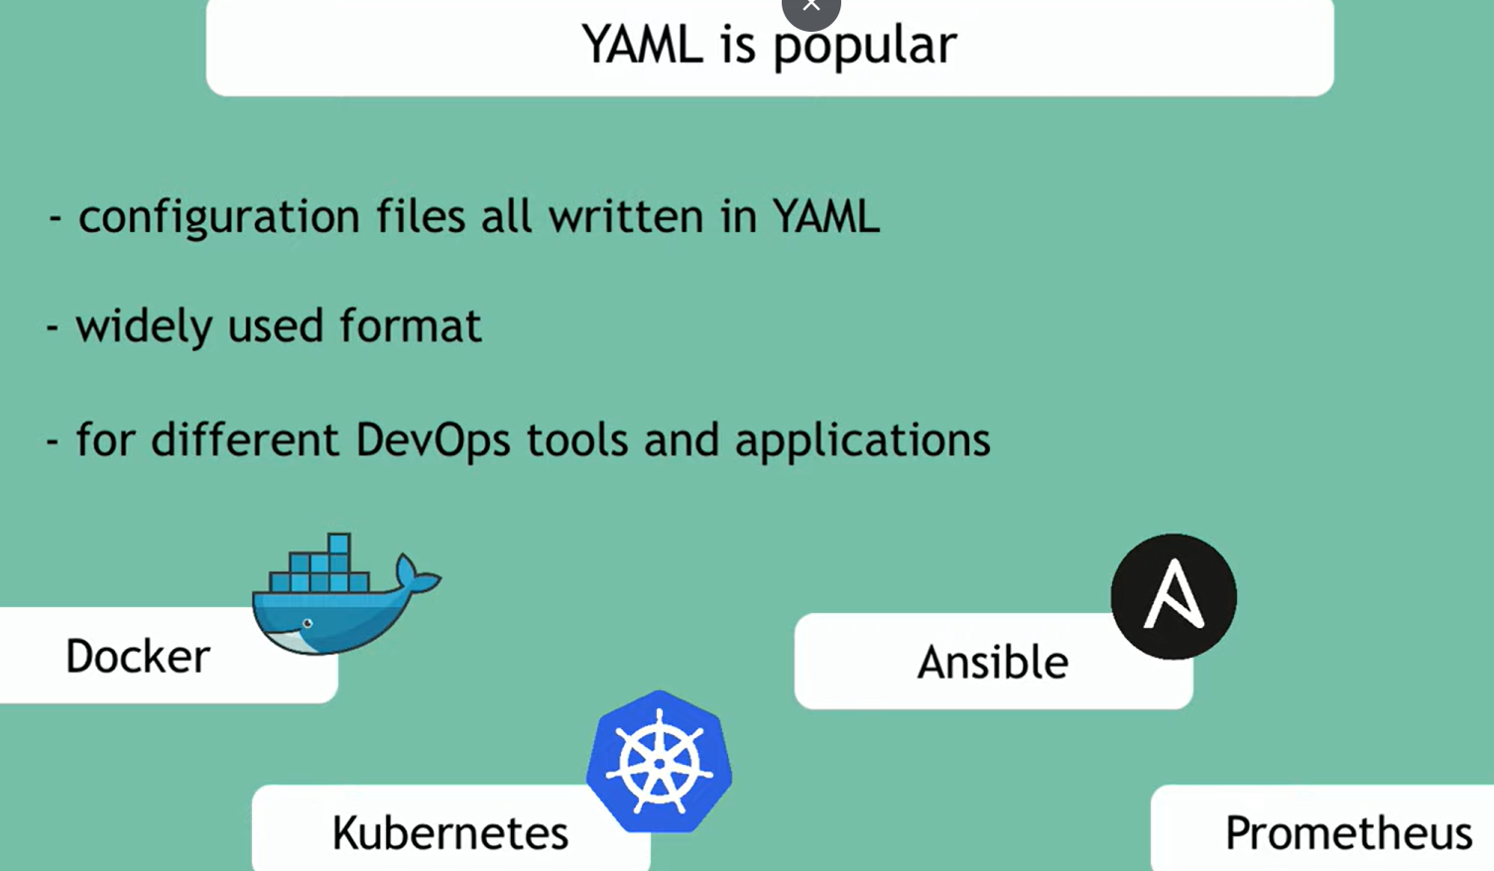

Slide 9
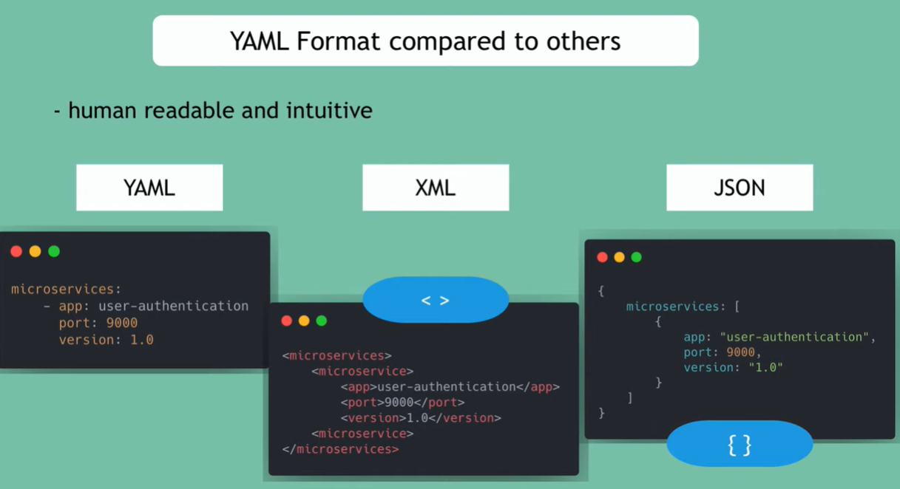

Slide 10
2. Installing PyYAML
To use YAML in Python, install the PyYAML package:
pip install pyyaml

Slide 11
3. Importing and Basic Usage
import yaml
# Load YAML file
with open('config.yaml', 'r') as f:
data = yaml.safe_load(f)
print(data)

Slide 12
4. Writing YAML Files
import yaml
data = {
'project': 'Paramatma',
‘version': 8,
'category': ‘testing'
}
with open('output.yaml', 'w') as f:
yaml.dump(data, f, default_flow_style=False)

Slide 13
5. Reading YAML Files
with open('output.yaml', 'r') as f:
data = yaml.safe_load(f)
print(data['project'])

Slide 14
6. YAML vs JSON
• YAML is more human-readable and supports comments.
• JSON is more widely used for APIs.
• YAML supports complex data types like sets and references.
Example YAML comment:
# This is a comment
version: 1.0

Slide 15
7. Safe Loading and Security
Use safe_load() instead of load() to avoid executing arbitrary code.
yaml.safe_load() → Safe
yaml.load() → Can be unsafe if file contains malicious code.

Slide 16
8. Dump Formatting Options
yaml.dump(data, sort_keys=False, indent=4, default_flow_style=False)
• sort_keys=False → Keep original key order
• indent → Controls indentation spaces
• default_flow_style=False → Block style (multi-line)

Slide 17
9. Nested YAML Structures
Example:
project:
name: Paramatma Productions
type: Web Series
details:
episodes: 8
language: Telugu
status: In Progress

Slide 18
10. Summary
Functions:
• yaml.safe_load() → Read YAML
• yaml.dump() → Write YAML
Usage:
• Common in configuration files (DevOps, CI/CD, ML Pipelines)
• More readable than JSON
• Always prefer safe_load() for security.

