Slide 1
Title of the Project
Mind Game USING PYTHON 3
Let’s see what’s in

Slide 2
Project Name : Let’s guess it
Objective :
My main objective is to guess the number with in seven trails.
Idea :
Finding the number using condition selected by the user using Binary search and OOP concept.
Concepts used :
Classes
Iterative statements
Data structures – Binary search algorithm
Exception Handling :
If user doesn’t give the actual input ,It will re-promot for the same input.
Environment used :
Python 3 IN Jupyter Notebook .

Slide 3
Brief Description :
By using Python 3 , I have created a class called Mind_game which contains
3 sub methods and 1 main method .
Def permission () - it asks for the permission to start the game either yes or no.
Def get_int() – It checks the condition inbetween the start and end value.
Def get_one_of () - It gets the variable either ‘Y’ or ‘N’ from the user.
Def main() – It consist the main Binary search algorithm part. First it will generate the middle number of the start and end number,Then it asks the user is that number is correct or wrong .If correct prints the end statement ,if wrong it will ask the user whether the number is greater or lesser .If greater, Start = mid + 1 else end = mid -1 and this loop repeat until the correct number reaches but within 7 iterations.
if __name__ == "__main__“ is used to access the main method by creating object file for the Mind_game class.

Slide 4
Algorithm :
START
Ready
NO
Yes
Is the number is 50 ?
Yes
No
Using Binary search algorithm prompt another number
Gives lesser number than the generated number using Binary search algorithm.
Is the number is Greater or lesser
Gives Greater number than the generated number using Binary search algorithm.
Lesser
Greater
No
Correct?
Yes
END

Slide 5
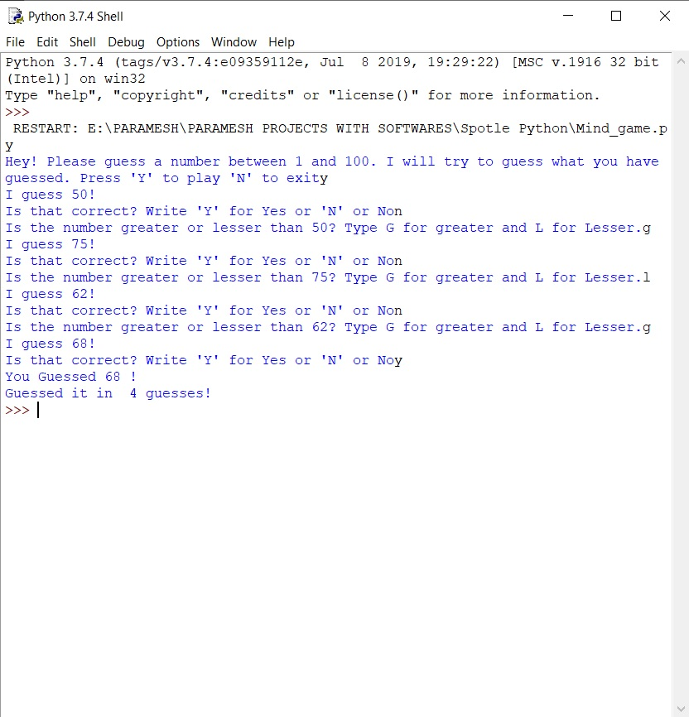
Output:

Slide 6
THANK YOU !
Created By PARAMESH T S

