Slide 1

AMRITA VISHWA VIDYAPEETHAM

Slide 2
18CSC402 - DEEP LEARNING
Sentence-BERT: Sentence Embeddings using Siamese BERT-Networks
CASE STUDY REVIEW - 1
Parameshwari S - CB.SC.I5DAS18026

Slide 3
Outline
Details of the paper
Significance
Problem Statement
BERT vs SBERT
About the dataset
Architecture diagram
Major steps
Tools & Software
References

Slide 4
Details of the Paper
PAPER TITLE : Sentence-BERT: Sentence Embeddings using Siamese BERT-Networks
AUTHOR DETAILS : Nils Reimers, Iryna Gurevych - Darmstadt, Germany
YEAR PUBLISHED : 2019
LANGUAGE : English
EVENT TITLE : The 2019 Conference on Empirical Methods in Natural Language Processing (EMNLP 2019)
EVENT LOCATION : Hong Kong, China
ABSTRACT
In this paper, they introduced new model Sentence-BERT (SBERT) which is a modification to the pretrained model BERT. This model is to achieve semantic similarity in a computationally efficient way.
OFFICIAL URL https://aclanthology.org/D19-1410.pdf

Slide 5
Significance
Around 80%-90% of data produced is text which is an unstructured data. It has to be processed, mined in order to perform text analytics (retrieving high quality information from text).
One such process is semantic similarity i.e, finding similarity between sentences or words. This has a wide range of applications such as :
Sentence-pair regression
Text summarization
Document clustering
Question generations etc.
In google search, we get similar search suggestions in the below list box while we type which is a common daily application of semantic similarity. Similarly, in Quora website which is mainly used for question-answering.

Slide 6
Problem Statement
BERT and RoBERTa requires that both sentences are fed
into the network, which causes a massive computational overhead: Finding the most similar pair in a collection of 10,000 sentences requires about 50 million inference computations (~65 hours) with BERT. The construction of BERT makes it unsuitable for semantic similarity search as well as for unsupervised tasks like clustering.

Slide 7
BERT VS SBERT
Bidirectional Encoder Representations from Transformer
BERT learns information from both the left and the right side of a token’s context.
Not suitable for regression tasks due to many possible combinations.
No independent sentence embeddings are computed which makes it difficult to derive sentence embeddings.
Sentence - BERT
The siamese network architecture enables that fixed-sized vectors for input sentences can be derived.
Using a similarity measure like cosine similarity or Manhattan/ Euclidean distance, semantically similar sentences can be found.
These similarity measures can be performed extremely efficient on modern hardware

Slide 8
10,000
4,99,95,000
65 hrs - 5 secs
Sentences
Inference computations
!!!

Slide 9
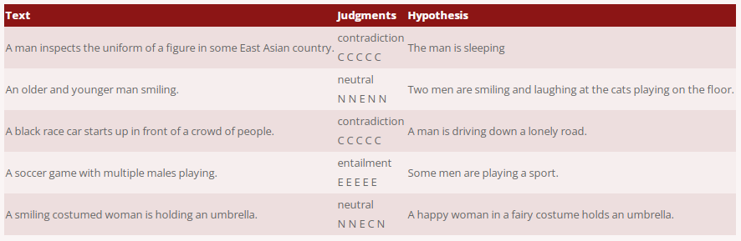
About the Dataset
DATASET - 1 (USED IN PAPER)
SOURCE : https://nlp.stanford.edu/projects/snli/
ABOUT THE DATASET : Natural Language Inference (NLI), also known as Recognizing Textual Entailment (RTE), is the task of determining the inference relation between two (short, ordered) texts: entailment, contradiction, or neutral. The Stanford Natural Language Inference (SNLI) corpus (version 1.0) is a collection of 570k human-written English sentence pairs manually labeled for balanced classification.
SAMPLE DATASET :

Slide 10
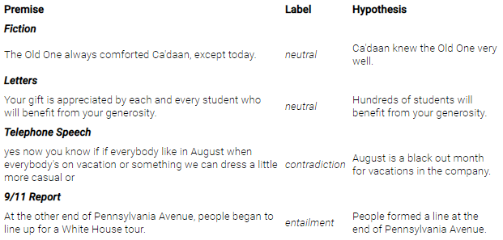
DATASET - 2 (USED IN PAPER)
SOURCE : https://cims.nyu.edu/~sbowman/multinli/
ABOUT THE DATASET : The Multi-Genre Natural Language Inference (MultiNLI) corpus is a crowd-sourced collection of 433k sentence pairs annotated with textual entailment information. The corpus is modeled on the SNLI corpus, but differs in that covers a range of genres.
SAMPLE DATASET :

Slide 11
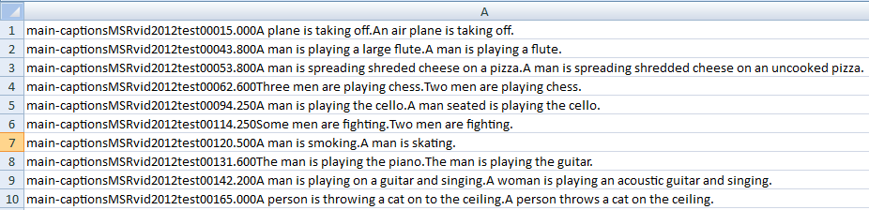
DATASET - 3 (USED IN PAPER)
SOURCE : https://deepai.org/dataset/sts-benchmark
ABOUT THE DATASET : STS Benchmark comprises a selection of the English datasets used in the STS tasks organized in the context of SemEval between 2012 and 2017. The selection of datasets include text from image captions, news headlines and user forums. It is divided into train (5,749), dev (1,500) and test (1,379) for the year 2017.
SAMPLE DATASET :

Slide 12
DATASET - 4 (USED IN PAPER)
ABOUT THE DATASET : The AFS (Argument Facet Similarity) corpus annotated 6,000 sentential argument pairs from social media dialogs on three controversial topics: gun control, gay marriage, and death penalty. The data was annotated on a scale from 0 (“different topic”) to 5 (“completely equivalent”).

Slide 13
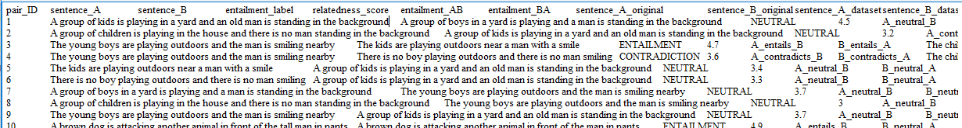
DATASET - 5 (USED IN PAPER)
SOURCE : https://zenodo.org/record/2787612#.YYApnLgzaUk
ABOUT THE DATASET : The SICK data set consists of about 10,000 English sentence pairs, generated starting from two existing sets: the 8K ImageFlickr data set and the SemEval 2012 STS MSR-Video Description data set. The SICK relatedness (SICK-R) task trains a linear model to output a score from 1 to 5 indicating the relatedness of two sentences. For the same dataset (SICK-E) can be treated as a three-class classification problem using the entailment labels (classes are ‘entailment’, ‘contradiction’, and ‘neutral’).
SAMPLE DATASET :

Slide 14
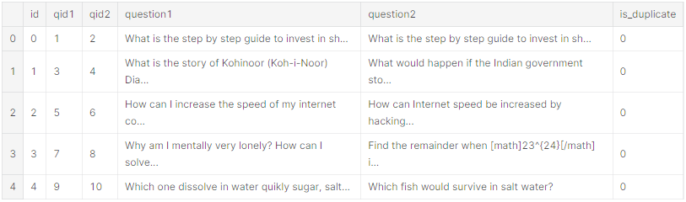
DATASET TO TRY
SOURCE : https://www.kaggle.com/c/quora-question-pairs/data
ABOUT THE DATASET : The dataset was given in a competition where Kagglers are challenged to tackle this natural language processing problem by applying advanced techniques to classify whether question pairs are duplicates or not by considering the contextual meaning resulting in an improved experience for Quora writers, seekers, and readers. There are about 400K rows in train set and about 2.35M rows in test set, each row consisting a pair of questions.
SAMPLE DATASET :

Slide 15
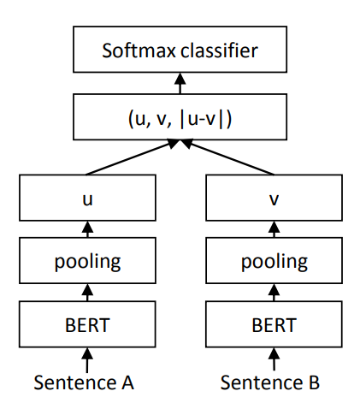
Architecture Diagram
CLASSIFICATION
It has two BERT transformers into which two sentences are passed. The output is passed to a pooling layer which computes mean pooling.
Embedded vectors are u and v for which it computes distance which is then used for classification using softmax classifier.
Examples - NLI, SNLI datasets
Siamese network
structure

Slide 16
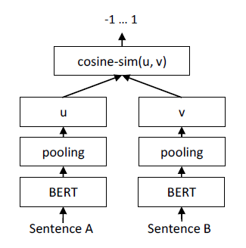
REGRESSION
Similar to classification, instead of computing distance it computes cosine-similarity between embeddings.
The result is then used for regression.
Examples - Used when computing similarity scores between sentences : STSb, AFS

Slide 17
Major Steps
Model and dataset understanding
Training the model (SBERT)
Classifying the results
1
3
5
2
4
6
Data preprocessing
Computing correlation between the embeddings
Results and Inferences from various models

Slide 18
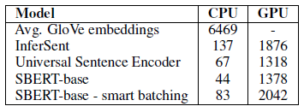
Tools & Softwares
Results
On CPU, InferSent is about 65% faster than SBERT.
Smart batching achieves a speed-up of 89% on CPU and 48% on GPU.
SBERT with smart batching is about 9% faster than InferSent and about 55% faster than Universal Sentence Encoder.
Requirements
Intel i7-5820K CPU @ 3.30GHz, Nvidia Tesla V100 GPU, CUDA 9.2 and cuDNN.
Python 3.6
PyTorch 1.6.0
Sentence-transformers
Google colab

Slide 19
References
https://www.youtube.com/watch?v=4I3gS1cmqe4
https://nadjet.github.io/blog/posts/sentence_similarity/
https://www.sbert.net/examples/training/quora_duplicate_questions/README.html
https://github.com/UKPLab/sentence-transformers
http://tubiblio.ulb.tu-darmstadt.de/117723/
https://jalammar.github.io/illustrated-bert/
https://www.kaggle.com/c/quora-question-pairs/overview
https://nlp.stanford.edu/projects/snli/
https://cims.nyu.edu/~sbowman/multinli/

Slide 20
Thanks!

