Slide 1
iPhone Operating System (iOS)
Thobani Shaba
COSC 101

Slide 2
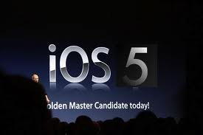
Overview
What is an Operating System
What is iOS?
History
Features
iOS Jailbreaking
Conclusion

Slide 3
What is an Operating System?
A set of programs that manage computer hardware resources and provide common services for application software
Most important system software in computer system
NOTE: User cannot run an application program on computer without OS
Ie. Android, Mac OS X, Microsoft Windows

Slide 4
What is iOS?
Apples mobile operating system considered the foundation of the iPhone
Originally designed for the iPhone but now supports iPod touch, iPad, and Apple TV
It is updated just like Itune for iPods
As of Oct 2011 Apple contains over 500,000 iOS applications

Slide 5
History
iPhone OS was first unveiled in Jan 2007 at the Macworld Conference and Expo
Released June 2007
In June 2010 licensed the trademark iOS (From Cisco IOS)
Now goes all the way up to iOS 5 (released last month)
Originally did not allow third party applications but after Feb 2008 this changed
With either 30% profit to apple, or free with membership fee

Slide 6
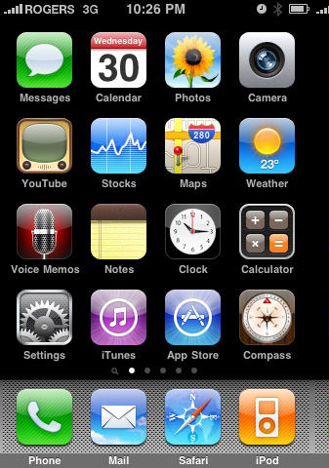
Features
Home screen

Slide 7

Primary Applications
Safari
Music
Mail
Phone, Face time video calling

Slide 8

Secondary Applications
Camera, Camcorder
Photos
Calendar
Messaging
YouTube
Stocks
Map
Clock
etc.

Slide 9
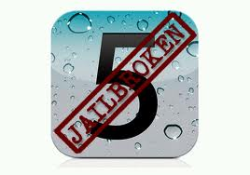
Jailbreaking
Has been prone to numerous hackings by adding functions not supported by Apple
Before this was done in order to install third party applications, but since there is no longer a need, this is done to modify current applications
The more the iOS has been updated, the fewer the jailbreaking incidences

Slide 10
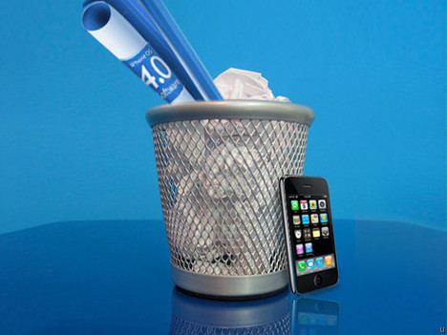
iOS 5 New Features
Over 200 new features including better security
FullTwitter intergration
New Apple iCloud enable users to synch data automatically wirelessly with no USB connection to Itunes

Slide 11
In Conclusion
An operating system is needed in order to use various applications on your computer and wireless devices
Without iOS and its continual upgrades there would be no way to operate today’s trend setting wireless Apple devices

Slide 12
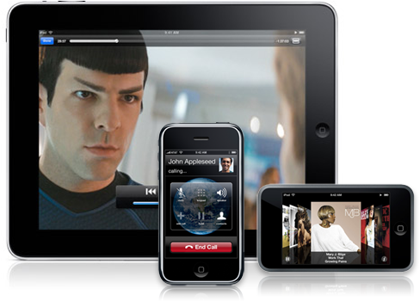
THE END

Slide 13
Works Cited
http://developer.apple.com/technologies/ios
http://www.zdnet.com/blog/apple/trapster-45-for-ios-adds-better-maps-traffic-and-speed-limit-data/11810
http://www.freakgeeks.com/2011/19251/the-ios-hackers-handbook-teaches-you-all-about-ios-hacking-book/
http://mshmparseghian.wordpress.com/2011/06/06/ios-5-2/

