Slide 1
Introduction To JPA and Hibernate
Parameswari C

Slide 2
JPA

Slide 3
What is JPA
Java Persistence API is a collection of classes and methods to persistently store the vast amounts of data into a database which is provided by the Oracle Corporation.
Generally, Java developers use lots of code, or use the proprietary framework to interact with the database, whereas using JPA, the burden of interacting with the database reduces significantly.

Slide 4
Where to use JPA?
To reduce the burden of writing codes for relational object management, a programmer follows the ‘JPA Provider’ framework, which allows easy interaction with database instance. Here the required framework is taken over by JPA.

Slide 5
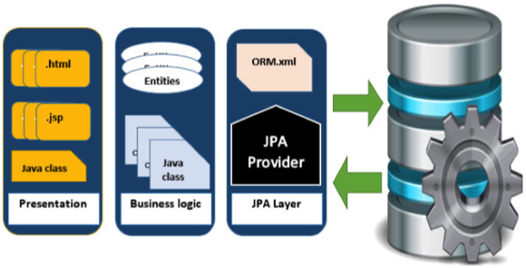
JPA Architecture

Slide 6
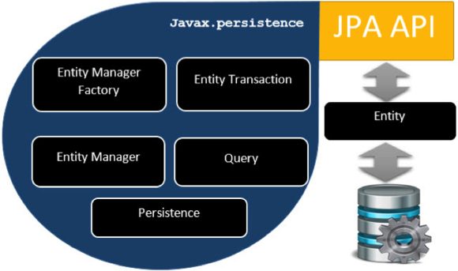
JPA Class Level Architecture

Slide 7
JPA Class Level Architecture - Cont
The following table describes each of the units shown in the above architecture.
Units | Description
EntityManagerFactory | This is a factory class of EntityManager. It creates and manages multiple EntityManager instances.
EntityManager | It is an Interface, it manages the persistence operations on objects. It works like factory for Query instance.
Entity | Entities are the persistence objects, stores as records in the database.
EntityTransaction | It has one-to-one relationship with EntityManager. For each EntityManager, operations are maintained by EntityTransaction class.
Persistence | This class contain static methods to obtain EntityManagerFactory instance.
Query | This interface is implemented by each JPA vendor to obtain relational objects that meet the criteria.

Slide 8
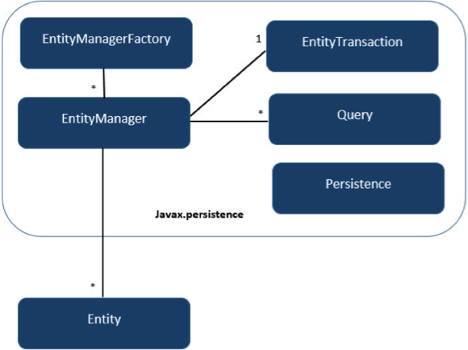
JPA Class Relationship
In the above architecture, the relations between the classes and interfaces belong to the javax.persistence package. The following diagram shows the relationship between them.

Slide 9
JPA Class Relationship – Cont.
The relationship between EntityManagerFactory and EntityManager is one-to-many. It is a factory class to EntityManager instances.
The relationship between EntityManager and EntityTransaction is one-to-one. For each EntityManager operation, there is an EntityTransaction instance.
The relationship between EntityManager and Query is one-to-many. Many number of queries can execute using one EntityManager instance.
The relationship between EntityManager and Entity is one-to-many. One EntityManager instance can manage multiple Entities.

Slide 10
Java Persistence Query language
JPQL is Java Persistence Query Language defined in JPA specification. It is used to create queries against entities to store in a relational database. JPQL is developed based on SQL syntax
Query Structure
  JPQL syntax is very similar to the syntax of SQL. Having SQL like syntax is an advantage because SQL is a simple structured query language and many developers are using it in applications. SQL works directly against relational database tables, records and fields, whereas JPQL works with Java classes and instances.

Slide 11
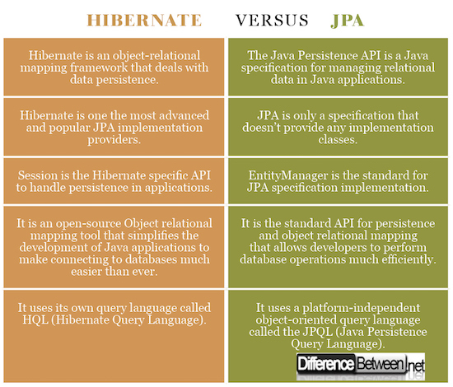
Hibernate Vs JPA

Slide 12
Hibernate

Slide 13
Overview
Why use Object/Relational Mapping(ORM)?
What is and Why Hibernate?
Hibernate architecture
Instance states
Persistence lifecycle operations
HQL
Examples

Slide 14
Comparison to SQL
1) Hibernate is data base independent, your code will work for all ORACLE, MySQL, SQLServer etc. In case of JDBC query must be data base specific.
2) As Hibernate is set of Objects , you don’t need to learn SQL language. You can treat TABLE as a Object . Only Java knowledge is need. In case of JDBC you need to learn SQL.
3) Don’t need Query tuning in case of Hibernate. If you use Criteria Quires in Hibernate then hibernate automatically tuned your query and return best result with performance. In case of JDBC you need to tune your queries.
4) You will get benefit of Cache. Hibernate support two level of cache. First level and 2nd level. So you can store your data into Cache for better performance. In case of JDBC you need to implement your java cache .

Slide 15
Comparison to SQL
5) Hibernate supports Query cache and It will provide the statistics about your query and database status. JDBC Not provides any statistics.
6) Development fast in case of Hibernate because you don’t need to write queries
7) No need to create any connection pool in case of Hibernate. You can use c3p0.In case of JDBC you need to write your own connection pool
8) In the xml file you can see all the relations between tables in case of Hibernate. Easy readability.
9) You can load your objects on start up using lazy=false in case of Hibernate

Slide 16

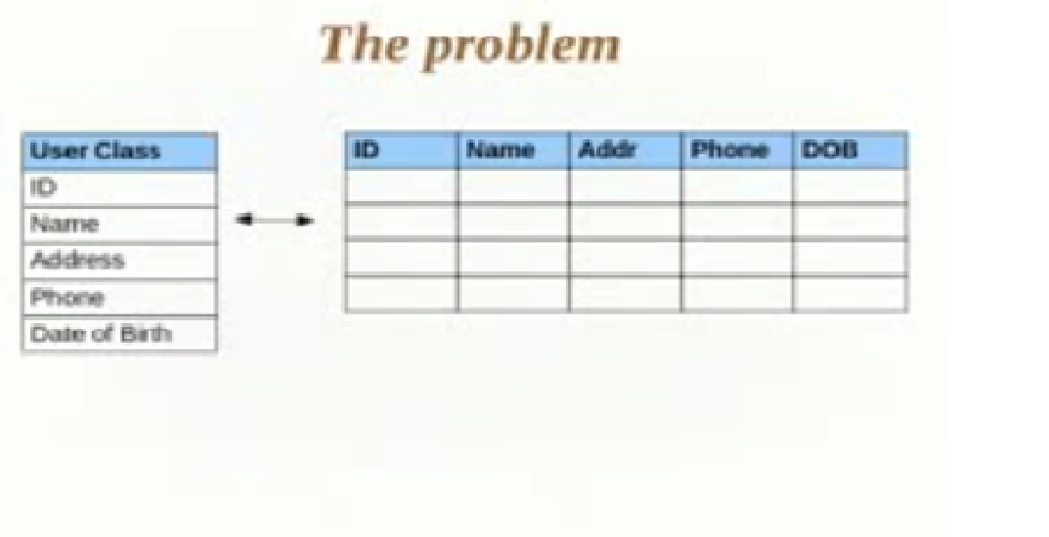
Problem

Slide 17
Problem
Mapping Member variables to column.
Mapping Relationship.
Handling data types.
Changes made to Object states.

Slide 18
Object/Relational Mapping
Presentation
Layer
Business
Layer
Persistence
Layer
Database
Object Model
Relational Model

Slide 19
Why Object/Relational Mapping?
A major part of any enterprise application development project is the persistence layer
ORM handles Object-relational impedance
mismatch

Slide 20
What is Hibernate?
Hibernate is an object-relational mapping (ORM) library for the Java language, providing a framework for mapping an object-oriented domain model to a traditional relational database. Hibernate solves object-relational impedance mismatch problems by replacing direct persistence-related database accesses with high-level object handling functions.

Slide 21
object-relational impedance mismatch
The object-oriented paradigm is based on proven software engineering principles. The relational paradigm, however, is based on proven mathematical principles. Because the underlying paradigms are different the two technologies do not work together seamlessly. The impedance mismatch becomes apparent when you look at the preferred approach to access: With the object paradigm you traverse objects via their relationships whereas with the relational paradigm you join the data rows of tables. This fundamental difference results in a non-ideal combination of object and relational technologies, although when have you ever used two different things together without a few hitches?

Slide 22
Why use Hibernate?
Performance
  High performance object caching
Sophisticated query facilities
  Hibernate Query Language (HQL)
  Native SQL
  Effective Cross-Database Portability
  It is literally one configuration parameter change. You only have to change the database dialect.
  Developers' Productivity

Slide 23
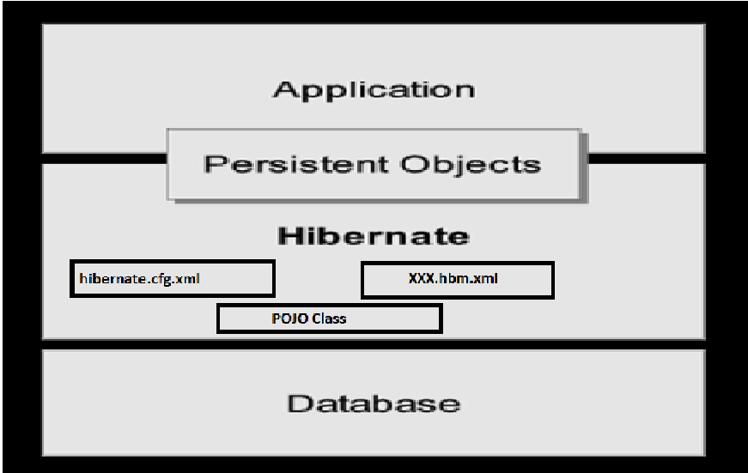
Hibernate Architecture

Slide 24
Types of Architecture & Architecture component
Lite Architecture
Full cream Architecture.
Components.
- Connection Management
- Transaction Management
- Object Relational Mapping

Slide 25
Hibernate Architecture
Hibernate is very good tool as far as object relational mapping is concern, but in terms of connection management and transaction management, it is lacking in performance and capabilities. So usually hibernate is being used with other connection management and transaction management tools. For example apache DBCP is used for connection pooling with the Hibernate.
Hibernate provides a lot of flexibility in use. It is called "Lite" architecture when we only uses the object relational mapping component. While in "Full Cream" architecture all the three component Object Relational mapping, Connection Management and Transaction Management) are used.

Slide 26
Hibernate Framework Objects
SessionFactory
  Typically one for each database
  Maintain mappings for a single database
  A factory for Session
  Optionally maintains a second level cache of data that is reusable between transactions at a process or cluster level.

Slide 27
Hibernate Framework Objects
Session
  A single-threaded, short-lived object representing a conversation between the application and the persistent store
  Handles life-cycle operations of persistent objects
  Wraps a JDBC connection
  Factory for Transaction
  Maintains a first level cache of persistent the application’s persistent objects

Slide 28
Hibernate Framework Objects
Transaction
  A single-threaded, short-lived object used by the
  application to specify atomic units of work.
  Abstracts application from underlying JDBC, JTA transaction.
ConnectionProvider
  A factory for (and pool of) JDBC connections.
  Abstracts application from underlying Datasource or DriverManager

Slide 29
Instance States
An instance of classes may be in one of the four different states
– transient
– persistent
– removed
– detached

Slide 30
Instance States
“transient” state
  is not, and has never been associated with any session (persistence context)
  has no persistent identity (primary key value)
  has no corresponding row in the database
“persistent” state
  The instance is currently associated with a session
  It has a persistent identity (primary key value) and likely to have a corresponding row in the database

Slide 31
Instance States
“removed” state
  A previously persistent object that is deleted from database.
  Java instance still exist, but it is ignored by hibernate.
“detached” state
  The instance is currently associated with a session
  It has a persistent identity (primary key value) and likely to have a corresponding row in the database

Slide 32
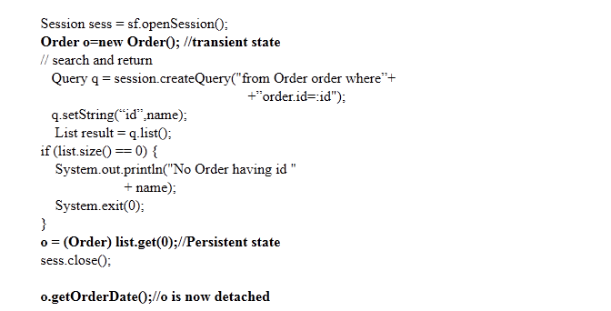
Example for Hibernate State

Slide 33
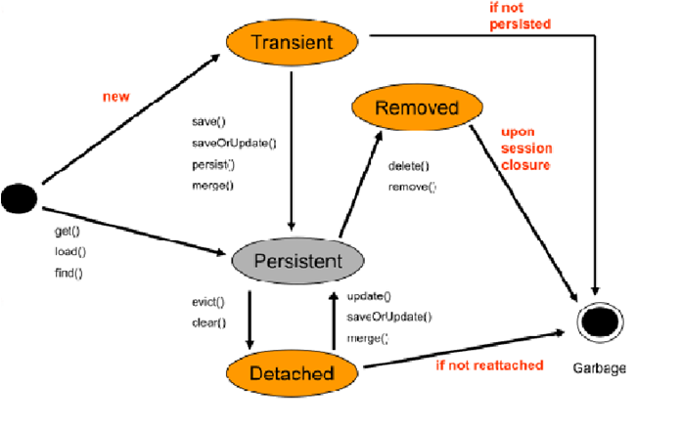
State Transitions (lifecycle of instance)

Slide 34
Saving Objects
Creating an instance of a class you map with Hibernate mapping does not automatically persist the object to the database until you save the object with a valid Hibernate session
The class of the object that is being saved must have a mapping file (myclass.hbm.xml)

Slide 35
Types of Mapping
Following two types used to Mapping a table in Hibernate.
1. Using XML ( XXXX.hbm.xml)
2. Using Annotation.
Different way to create SessionFactoy of above types.
XML :
new Configuration().configure().buildSessionFactory();
Annotation:
An alternative interface to the Hibernate Core for
specifying Mapping
An alternative to using xml mapping files
new AnnotationConfiguration().configure().buildSessionFactory();

Slide 36
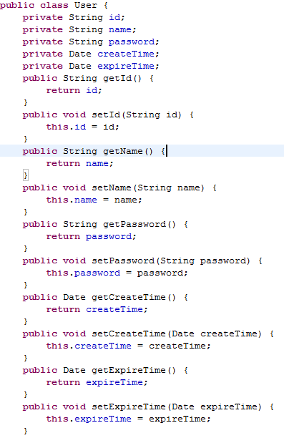
Example: Saving Objects
Note that the User is a ordinary java class with a mapping file (User.hbm.xml)

Slide 37
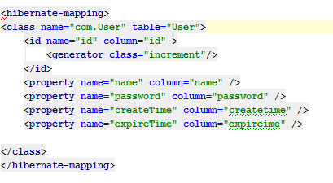
Saving Objects
Create mapping file for class User (User.hbm.xml)

Slide 38
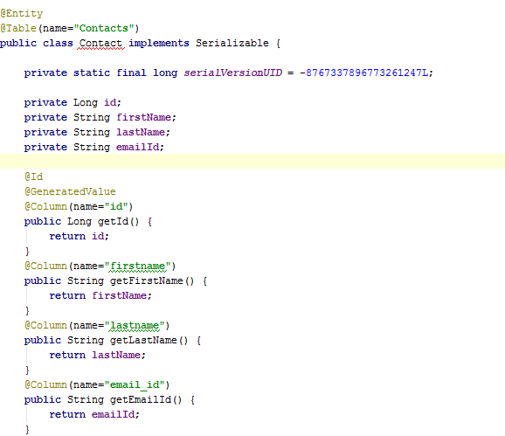
Create Annotation mapping file

Slide 39
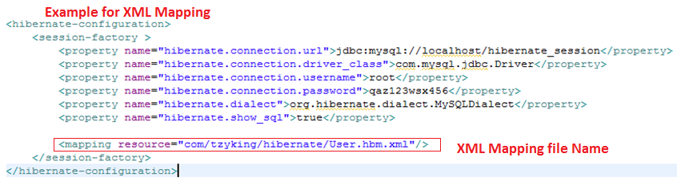
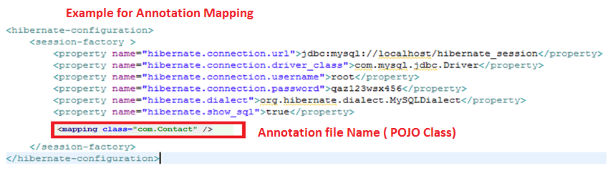
Create configuration file(hibernate.cfg.xml)

Slide 40
Saving Objects
Create Sessionfactory and Session:
Configuration cfg = new Configuration().configure()
SessionFactory factory = cfg.buildSessionFactory()
Session session = factory.openSession()

Slide 41
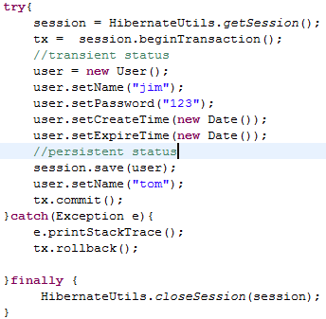
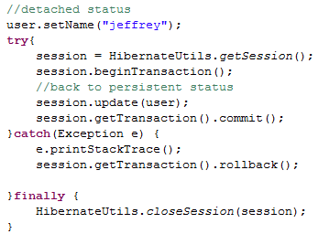
Saving Objects

Slide 42
Association
Many to One
One to One
One to Many
Many to Many

Slide 43
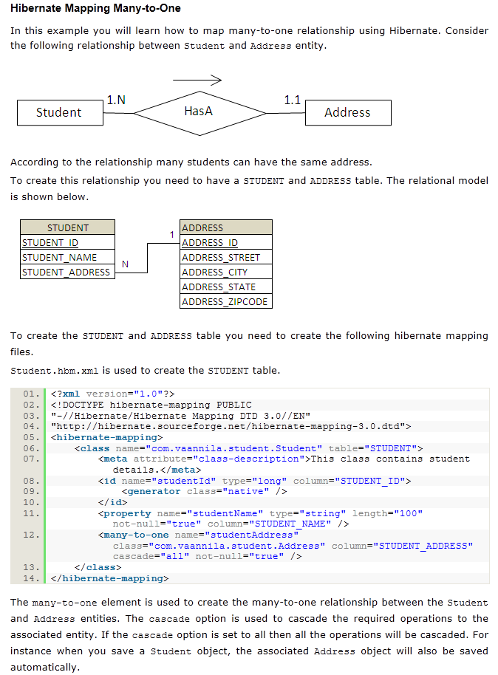
Many to One

Slide 44
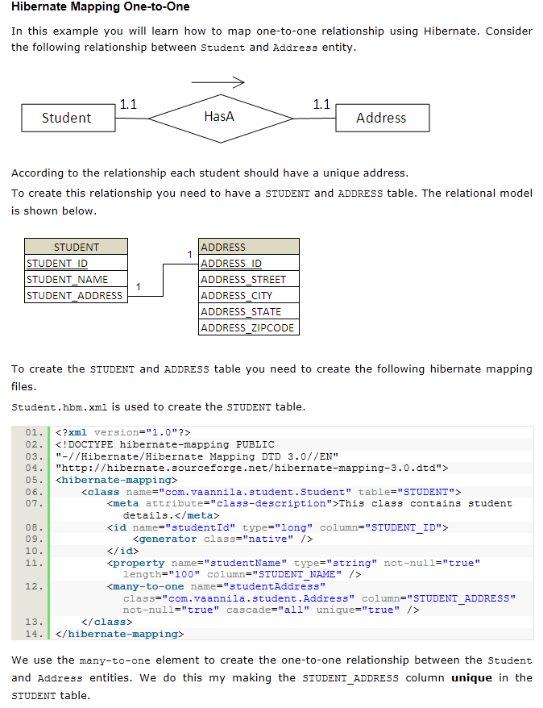
One to One

Slide 45
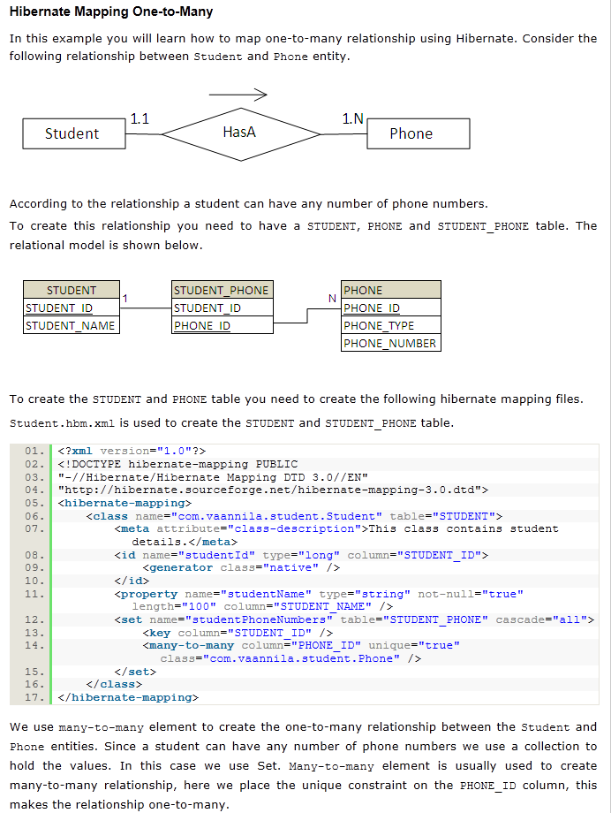
One to Many

Slide 46
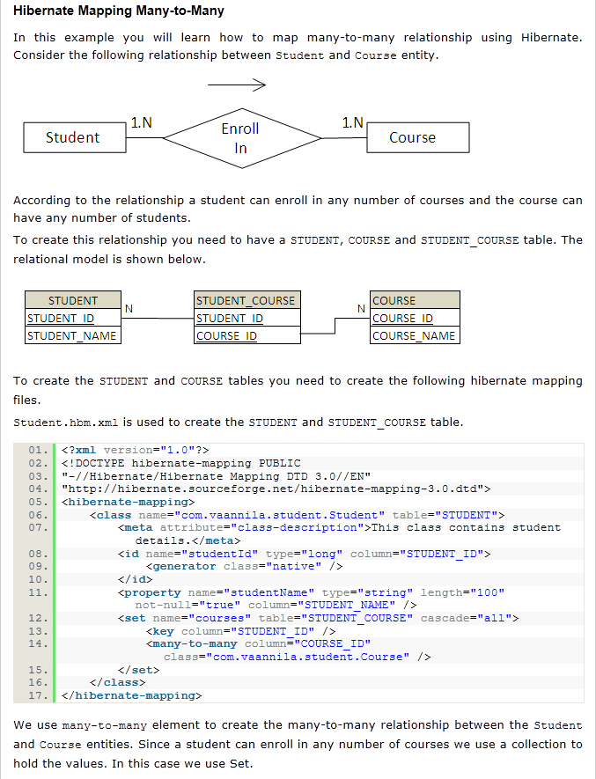
Many to Many

Slide 47
Hibernate Query Language (HQL)
Hibernate created a new language named Hibernate Query Language (HQL), the syntax is quite similar to database SQL language. The main difference between is HQL uses class name instead of table name, and property names instead of column name.
HQL is extremely simple to learn and use, and the code is always self-explanatory.

Slide 48
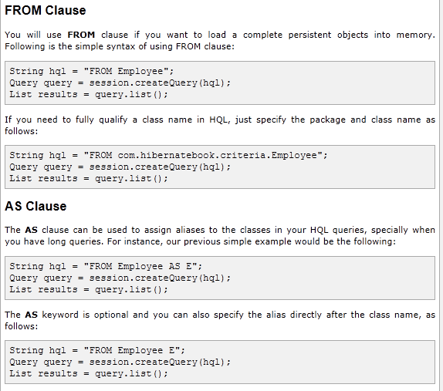
HQL : From, As Clause

Slide 49
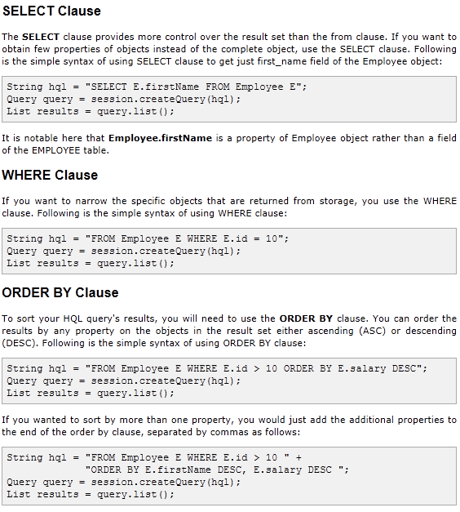
HQL : Select, Where, Order By

Slide 50
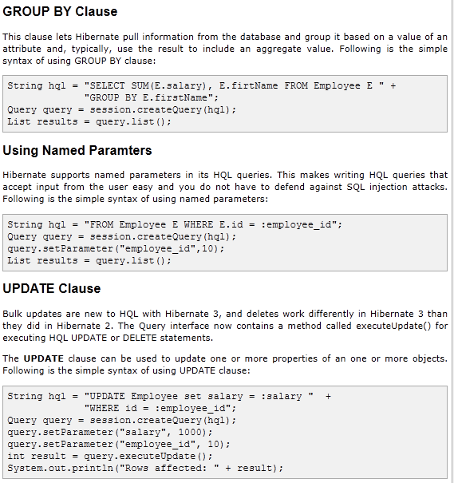
HQL : Group By, Named Parameter, Update

Slide 51
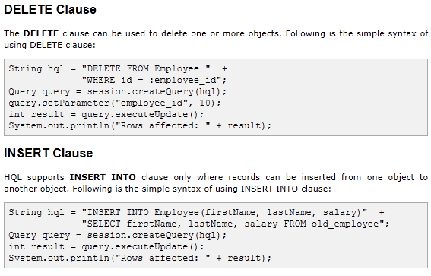
HQL : Delete, Insert

Slide 52
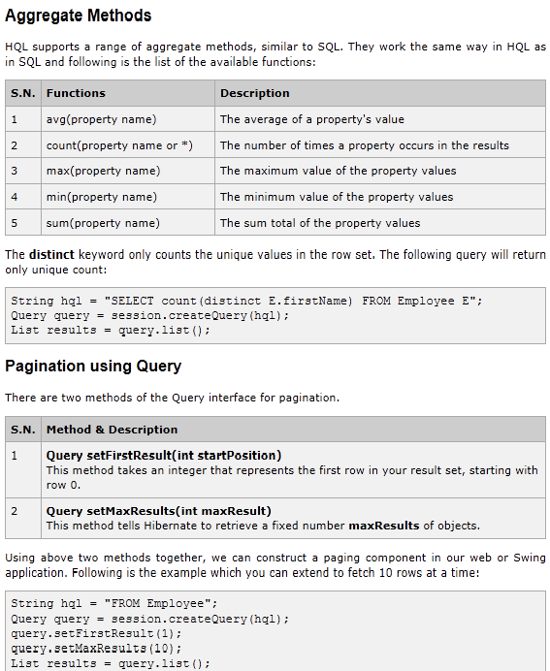
HQL : Aggregate, Pagination

Slide 53
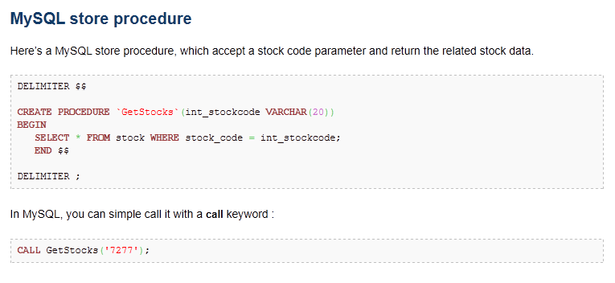
Stored Procedure :

Slide 54
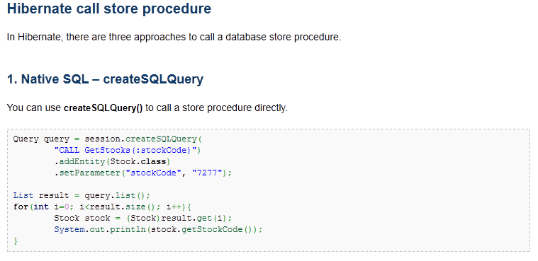
Stored Procedure :

Slide 56
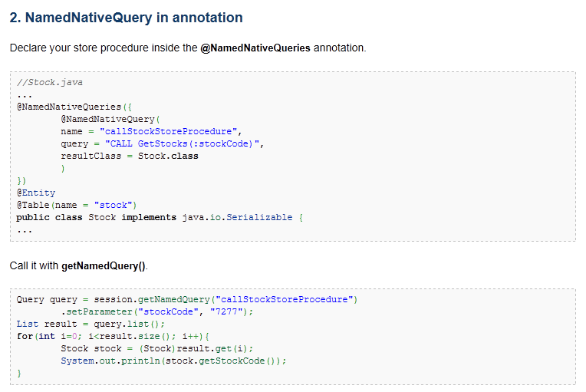
Stored Procedure :

Slide 57
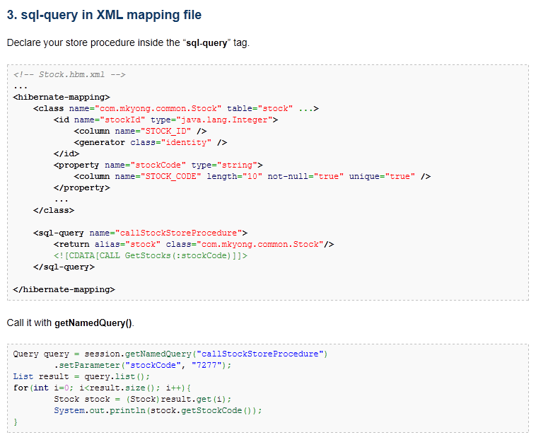
Stored Procedure :

Slide 58
Cache
While working with Hibernate web applications we will face so many problems in its performance due to database traffic. That to when the database traffic is very heavy . Actually hibernate is well used just because of its high performance only. So some techniques are necessary to maintain its performance. Caching is the best technique to solve this problem. In this article we will discuss about, how we can improve the performance of Hibernate web applications using caching.

Slide 59
Types of Cache
1) First-level cache
First-level cache always Associates with the Session object. Hibernate uses this cache by default. Here, it processes one transaction after another one, means wont process one transaction many times. Mainly it reduces the number of SQL queries it needs to generate within a given transaction. That is instead of updating after every modification done in the transaction, it updates the transaction only at the end of the transaction.
2) Second-level cache
Second-level cache always associates with the Session Factory object. While running the transactions, in between it loads the objects at the Session Factory level, so that those objects will available to the entire application, don’t bounds to single user. Since the objects are already loaded in the cache, whenever an object is returned by the query, at that time no need to go for a database transaction. In this way the second level cache works. Here we can use query level cache also.

Slide 60
Cache Implementations
Hibernate supports four open-source cache implementations named
EHCache (Easy Hibernate Cache),
OSCache (Open Symphony Cache),
Swarm Cache, and
JBoss Tree Cache.
Each cache has different performance, memory use, and configuration possibilities.

Slide 61
        Queries

Slide 62
        Thank you

