Slide 1
Angular JS (v1.x)
A brief Introduction

Slide 2
What is AngularJS
Open Source JavaScript Framework by Google for Rich Web Application Development.
AngularJS is not just another JavaScript library but it is a complete framework that helps in writing a proper architecture, maintainable and testable client side code.
Applications written in AngularJs are cross-browser compliant. AngularJS automatically handles JavaScript code suitable for each browser.
It follows MVW ( MVVM / MVC ) framework.
AngularJS is primarily aimed to develop SPA's (Single Page Applications), it means your single HTML document turns into application.
AngularJS extends HTML with ng-directives.

Slide 3
Why AngularJS
Structure, Quality and Organization
Lightweight ( < 36KB compressed and minified)
Open Source
Separation of concern
Modularity
Extensibility & Maintainability
Reusable Components
“ HTML? Build UI Declaratively! CSS? Animations! JavaScript/JQuery? Use it the plain old way!”

Slide 4
AngularJS Version
Angular v1.x (v1.0 – v1.4)
Angular v1.5 and v1.6 (Component Based Approach)
Angular 2
Angular 3 (Never Came Up )
Angular 4
Angular 5
Link :- https://docs.angularjs.org/guide/component

Slide 5
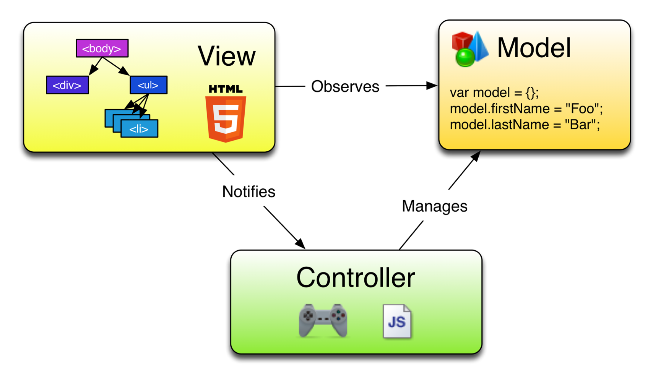
MVW (MVVM/MVC) Architecture

Slide 6
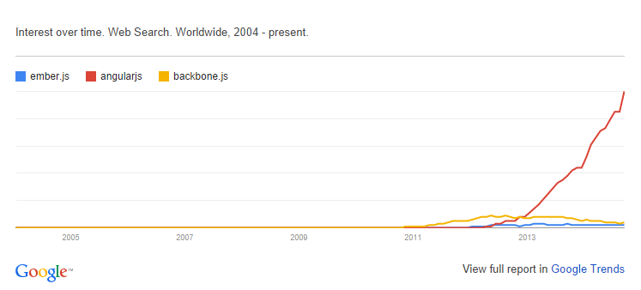
Other Javascript MV* Frameworks
BackboneJS
EmberJS

Slide 7
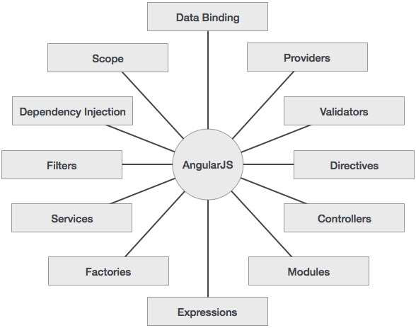
Core Features

Slide 8
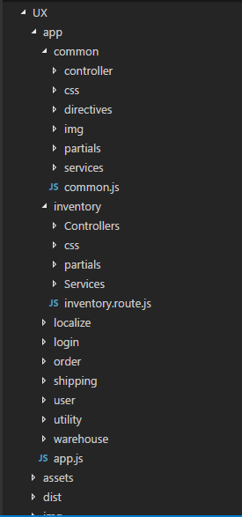
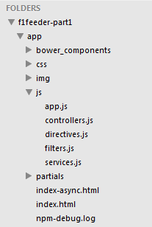
Folder Structure
11/27/17

Slide 9
Set up / Module
AngularJS Library
Editor/IDE
Browser
Web server
11/27/17

Slide 10
Expression/ Data Binding
AngularJS expressions can be written inside double braces: {{ expression }}
AngularJS expressions can also be written inside a directive: ng-bind="expression"
AngularJS expressions are much like JavaScript expressions.
What we can use in Expression:
  Literals
  Operators
  Variables
  Arrays
  JSON Objects
  Strings
11/27/17

Slide 11
Directives
Directives are markers on a DOM element (such as an attribute, element name, comment or CSS class) that tell AngularJS's HTML compiler ($compile) to attach a specified behavior to that DOM element (e.g. via event listeners), or even to transform the DOM element and its children.
AngularJS comes with a set of these directives built-in, like ngBind, ngModel, and ngClass.
Compiler is an AngularJS service which traverses the DOM looking for attributes. The compilation process happens in two phases.
  Compile: traverse the DOM and collect all of the directives. The result is a linking function.
  Link: combine the directives with a scope and produce a live view. Any changes in the scope model are reflected in the view, and any user interactions with the view are reflected in the scope model. This makes the scope model the single source of truth.
Some directives such as ng-repeat clone DOM elements once for each item in a collection. Having a compile and link phase improves performance since the cloned template only needs to be compiled once, and then linked once for each clone instance.

Slide 12
Directives Cont…
HTML compilation happens in three phases:
  $compile traverses the DOM and matches directives. If the compiler finds that an element matches a directive, then the directive is added to the list of directives that match the DOM element. A single element may match multiple directives.
  Once all directives matching a DOM element have been identified, the compiler sorts the directives by their priority. Each directive's compile functions are executed. Each compile function has a chance to modify the DOM. Each compile function returns a link function. These functions are composed into a "combined" link function, which invokes each directive's returned link function.
  $compile links the template with the scope by calling the combined linking function from the previous step. This in turn will call the linking function of the individual directives, registering listeners on the elements and setting up $watch with the scope as each directive is configured to do.
The result of this is a live binding between the scope and the DOM. So at this point, a change in a model on the compiled scope will be reflected in the DOM.
11/27/17

Slide 13
Build In Directives
ngModel
  Binding the view into the model
  Providing validation behavior (i.e. required, number, email, url).
  Keeping the state of the control (valid/invalid, dirty/pristine, touched/untouched, validation errors).
  Setting related css classes on the element
    ng-valid: the model is valid
    ng-invalid: the model is invalid
    ng-valid-[key]: for each valid key added by $setValidity
    ng-invalid-[key]: for each invalid key added by $setValidity
    ng-pristine: the control hasn't been interacted with yet
    ng-dirty: the control has been interacted with
    ng-touched: the control has been blurred
    ng-untouched: the control hasn't been blurred
    ng-pending: any $asyncValidators are unfulfilled
    ng-empty: the view does not contain a value or the value is deemed "empty", as defined by the ngModel.NgModelController method
    ng-not-empty: the view contains a non-empty value

Slide 14
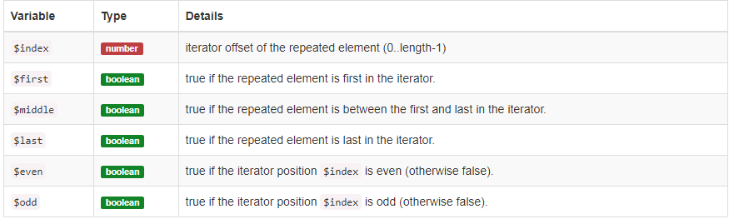
Build In Directives
ngRepeat
  The ngRepeat directive instantiates a template/ HTML element once per item from a collection.
  Each template instance gets its own scope, where the given loop variable is set to the current collection item, and $index is set to the item index or key.

Slide 15
Build In Directives
ngShow
  The ngShow directive shows or hides the given HTML element based on the expression provided to the ngShow attribute.
  The element is shown or hidden by removing or adding the .ng-hide CSS class onto the element. The .ng-hide CSS class is predefined in AngularJS and sets the display style to none (using an !important flag).
ngOptions
  The ngOptions attribute can be used to dynamically generate a list of <option> elements for the <select> element using the array or object obtained by evaluating the ngOptions comprehension expression.
  more flexibility in how the <select>'s model is assigned via the select as part of the comprehension expression
  reduced memory consumption by not creating a new scope for each repeated instance
  increased render speed by creating the options in a documentFragment instead of individually
ngInclude
  Fetches, compiles and includes an external HTML fragment.
Link:- https://docs.angularjs.org/api/ng/directive/a

Slide 16
Scope / RootScope
The scope is the binding part between the HTML (view) and the JavaScript (controller).
Scopes provide APIs ($watch) to observe model mutations.
Scopes provide APIs ($apply) to propagate any model changes through the system into the view from outside of the "Angular realm" (controllers, services, Angular event handlers).
Scopes can be nested to limit access to the properties of application components while providing access to shared model properties. Nested scopes are either "child scopes" or "isolate scopes".
$rootScope is the scope created on the HTML element that contains the ng-app directive.
The rootScope is available in the entire application.

Slide 17
Scope Cont…
Creation : The root scope is created during the application bootstrap by the $injector. During template linking, some directives create new child scopes.
Watcher registration : During template linking, directives register watches on the scope. These watches will be used to propagate model values to the DOM.
Model mutation : For mutations to be properly observed, you should make them only within the scope.$apply(). Angular APIs do this implicitly, so no extra $apply call is needed when doing synchronous work in controllers, or asynchronous work with $http, $timeout or $interval services.
Mutation observation : At the end of $apply, Angular performs a $digest cycle on the root scope, which then propagates throughout all child scopes. During the $digest cycle, all $watched expressions or functions are checked for model mutation and if a mutation is detected, the $watchlistener is called.
Scope destruction : When child scopes are no longer needed, it is the responsibility of the child scope creator to destroy them via scope.$destroy() API. This will stop propagation of $digest calls into the child scope and allow for memory used by the child scope models to be reclaimed by the garbage collector.
11/27/17

Slide 18
Controller
In Angular, a Controller is defined by a JavaScript constructor function that is used to augment the Angular Scope.
When a Controller is attached to the DOM via the ng-controller directive, Angular will instantiate a new Controller object, using the specified Controller's constructor function. A new child scope will be created and made available as an injectable parameter to the Controller's constructor function as $scope.
Use controllers to:
  Set up the initial state of the $scope object.
  Add behavior to the $scope object.
Do not use controllers to:
  Manipulate DOM
  Format input — Use angular form controls instead.
  Filter output — Use angular filters instead.
  Share code or state across controllers — Use angular services instead.
  Manage the life-cycle of other components (for example, to create service instances).

Slide 19
Dependency Injection
Dependency Injection (DI) is a software design pattern that deals with how components get hold of their dependencies.
There are only three ways a component (object or function) can get a hold of its dependencies:
  The component can create the dependency, typically using the new operator.
  The component can look up the dependency, by referring to a global variable.
  The component can have the dependency passed to it where it is needed.

Slide 20
Angular API
https://code.angularjs.org/1.6.7/docs/api

Slide 21
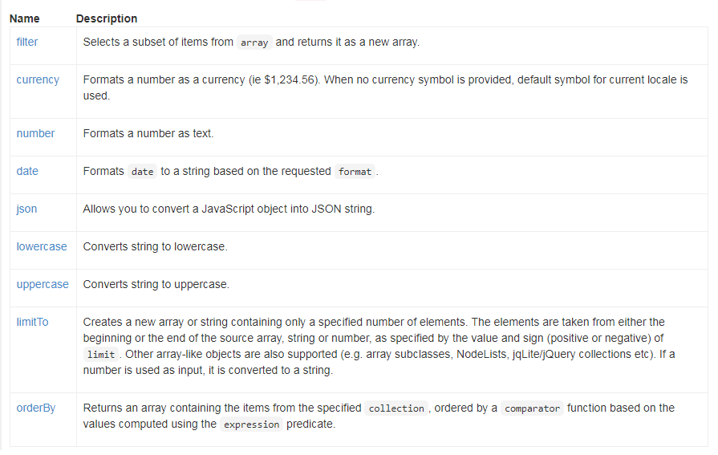
Filter

Slide 22
Custom Directives
The normalization process is as follows:
  Strip x- and data- from the front of the element/attributes.
  Convert the :, -, or _-delimited name to camelCase.
https://code.angularjs.org/1.6.7/docs/api

Slide 23
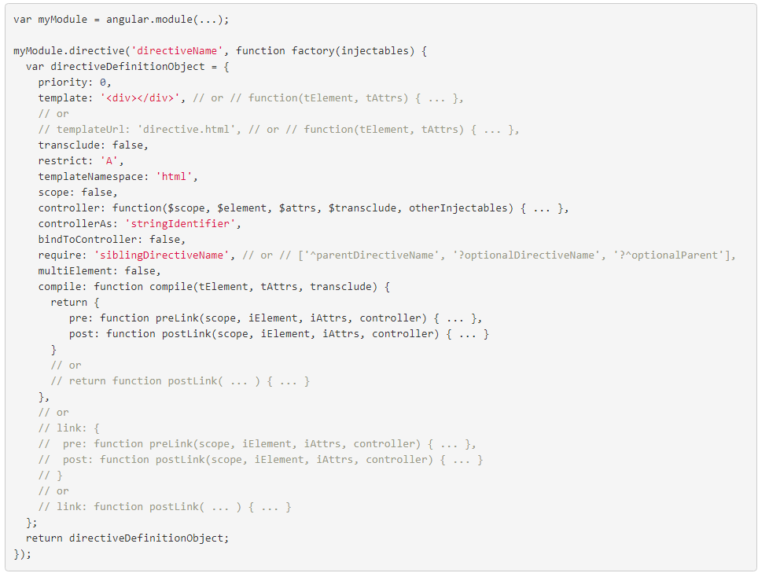
11/27/17

Slide 24
Scope in Directives
Scope : False ( Directive uses its parent scope )
  The controller & directive are using the same scope object. This means any changes to the controller or directive will be in sync.
Scope : True ( Directive gets a new scope )
  This newly created scope object is prototypically inherited from its parent scope
  Any changes made to this new scope will not reflect back to the parent scope. However, since the new scope is inherited from the parent scope, any changes made in the controller ( the parent scope ) will be reflected in the directive scope.
Scope : { } ( Directive gets a new isolated scope )
  This time, there will be a new scope created for the directive, but it will not be inherited from the parent scope. This new scope also known as Isolated scope because it is completely detached from its parent scope.
  Though it’s called as an Isolated scope, AngularJS allows to communicate with the parent scope using some special symbols knows as prefixes.
11/27/17

Slide 25
Scope in Directives Cont…
Prefixes to Isolated Scope:
  "@" ( Text binding / one-way binding )
    The “@” prefix is a one-way binding between the directive scope and parent scope. It always expects the mapped attribute to be an expression.
    Since “@” is creating a one-way binding between the parent and directive scope, any changes made in the parent scope will reflect inside the directive scope, but not the other way.
    “@” prefix is really useful when our directive needs to be initialised with some data from parent scope.
  "=" ( Direct model binding / two-way binding )
    It creates a two-way binding between the parent and directive scope.
  "&" ( Behaviour binding / Method binding )
    This is used to bind any methods from the parent scope to the directive scope.
    This will be particularly useful when our directive needs to execute any callbacks in the parent scope.
11/27/17
11/27/17

Slide 26
Tags & Link in Directives
The link function has the duty of linking the model to the templates. Link function is the place where AngularJs does the data binding to the compiled templates.
  link: function LinkFn(scope, elem, attr, ctrl){}
  scope: The scope of the directive
  elem: Dom element where the directive is applied
  attr: Collection of attributes of the Dom Element
  ctrl: Array of controllers required by the directive
Post-link
  Link function is by default post link
  Executed after the child elements are linked.
Pre-link
  Executed before the child elements are linked.
11/27/17
11/27/17
11/27/17

Slide 27
Tags & Link in Directives …
Order of Execution
  Controller gets executed first
  Pre-link gets executed next
  Post-link gets executed last
Post : This is the most commonly used for data binding
  Safe to attach event handlers to the DOM element
  All children directives are linked, so it’s safe to access them
  Never set any data required by the child directive here. Because child directive’s will be linked already.
Pre : Used rarely.
  Set data required for its child directives
  Safe to attach event handlers to the DOM element
  Not safe to access DOM elements belong to child directives. They’re not linked yet.
Controller: Using controller, directives can communicate and share data each other.
  Set the data required to other directives.
  Never access DOM element inside the controller.
11/27/17
11/27/17

Slide 28
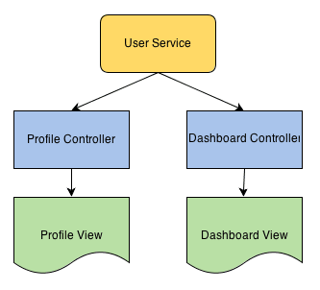
Services
The services are singleton objects or functions that carry out specific tasks. It holds some business logic.
Separation of concern is at the heart while designing an AngularJS application. Your controller must be responsible for binding model data to views using $scope. It does not contain logic to fetch the data or manipulating it.
service is a stateless object that contains some useful functions. These functions can be called from anywhere; Controllers, Directive, Filters etc. Thus we can divide our application in logical units.
11/27/17
11/27/17
11/27/17

Slide 29
Internal Services
$resource
  Dependencies
    $http
    $log
    $q
    $timeout
  $resource(url, [paramDefaults], [actions], options);
$watch
$location
11/27/17
11/27/17
11/27/17
11/27/17

Slide 30
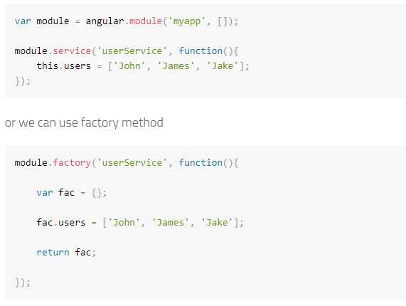
Custom Services / Factory
AngularJS services are singleton objects. These objects are application wide. Thus a service object once created can be used within any other services or controllers etc.
When declaring ’serviceName’ as an injectable argument you will be provided with an instance of the function.
When declaring ’factoryName’ as an injectable argument you will be provided with the value that is returned by invoking the function reference passed to module.factory.
11/27/17
11/27/17
11/27/17
11/27/17

Slide 31
Routing / Promises
Routing helps you in dividing your application in logical views and bind different views to Controllers.
The ngRoute module provides routing and deeplinking services and directives for AngularJS apps.
‘ngView’ is a directive that complements the $route service by including the rendered template of the current route into the main layout (index.html) file. Every time the current route changes, the included view changes with it according to the configuration of the $route service.
‘$routeProvider’ Used for configuring routes
‘$route’ is used for deep-linking URLs to controllers and views (HTML partials). It watches $location.url() and tries to map the path to an existing route definition.
The ’$routeParams’ service allows you to retrieve the current set of route parameters.
https://www.undefinednull.com/2014/02/17/resolve-in-angularjs-routes-explained-as-story/
11/27/17
11/27/17
11/27/17
11/27/17
11/27/17

Slide 32
Angular Style Guide
https://github.com/johnpapa/angular-styleguide/blob/master/a1/README.md
11/27/17
11/27/17
11/27/17
11/27/17
11/27/17
11/27/17

Slide 33
Links
https://docs.angularjs.org/api/ngResource/service/$resource
https://github.com/johnpapa/angular-styleguide/blob/master/a1/README.md
https://www.tutorialspoint.com/angularjs/
http://www.toptal.com/angular-js/a-step-by-step-guide-to-your-first-angularjs-app
11/27/17
11/27/17
11/27/17
11/27/17
11/27/17
11/27/17
11/27/17

