Slide 1
AI in Phishing Detection
Developing a User-Friendly Tool for Enhanced Cybersecurity Awareness

Slide 2
Introduction
This presentation explores the development of an AI-driven web application aimed at enhancing phishing detection and website security analysis, focusing on user-friendliness and accessibility.

Slide 3
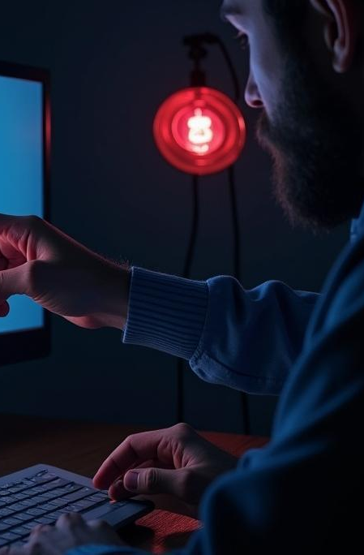
01
Phishing Problem

Slide 4
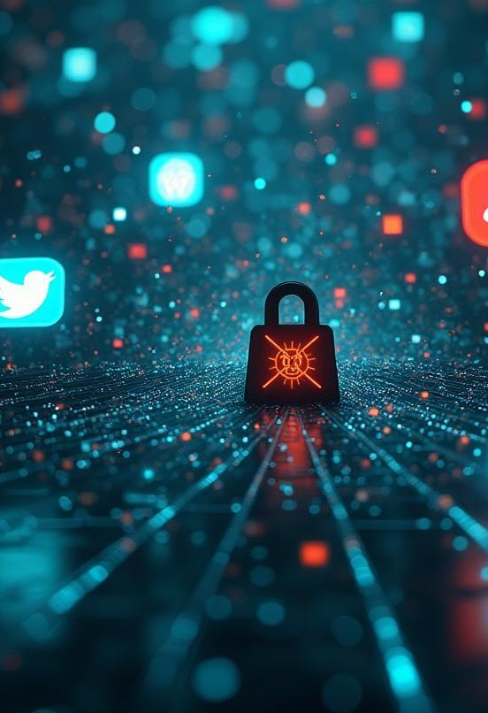
Widespread Nature of Phishing
Phishing scams are a significant threat, targeting users across various platforms. These scams trick individuals into revealing sensitive information such as passwords and financial details, leading to identity theft and financial loss. Recent statistics indicate that phishing attacks have surged dramatically in recent years, emphasizing the urgency of combating this issue.

Slide 5
Complexity of Current Tools
Many existing tools for phishing detection and website security are often overly technical and difficult for the average user to understand. This complexity creates a barrier for non-technical users, preventing them from effectively utilizing these resources to protect themselves online. As a result, there is a pressing need for accessible tools that present information in a clear and comprehensible manner.

Slide 6
Low Awareness Among Users
Many users remain unaware of the risks associated with phishing attacks. This lack of awareness stems from limited education on cybersecurity practices, making individuals vulnerable to online threats. Without proper knowledge, users may not recognize phishing attempts or understand how to protect themselves, which underscores the necessity for tools that not only detect threats but also educate users about cybersecurity.

Slide 7

02
Tool Features

Slide 8

Django Web App Structure
The web application is built using Django, which allows for an efficient and secure framework for development. The structure includes a user-friendly homepage, a URL scanner for checking links, a security checker that analyzes website safety, and a help page providing guidance on using the tool. This modular design enhances the user experience and facilitates easy navigation.

Slide 9
Detection System with VirusTotal
The detection system integrates the VirusTotal API, which scans URLs to determine their safety. By analyzing various factors such as SSL certification and HTTP headers, the tool provides users with a clear risk assessment. This feature is crucial for identifying potential phishing sites in real-time and gives users confidence in the results produced by the application.

Slide 10
User-Friendly Design and Outputs
The application features an intuitive interface designed for ease of use. Color-coded alerts indicate safety levels—green for safe, red for risk detected—making it simple for users to comprehend their findings. The overarching goal is to present technical information in layman's terms, ensuring that even non-technical users can make informed decisions regarding their online safety.

Slide 11
Conclusions
In conclusion, the development of this AI-driven web app addresses the pressing challenges of phishing detection and user awareness. By simplifying complex security concepts and presenting them in an accessible manner, the tool not only enhances user protection but also fosters greater cybersecurity awareness among everyday users. The integration of user-friendly design and effective detection mechanisms will play a significant role in combating phishing threats.

Slide 12
Thank you!
Do you have any questions?
Credits: Paramjeet Dhanjal
Mail: paramjeetkaurdhanjal8@gmail.com
GitHub: paramjeetdhanjal

