Slide 1

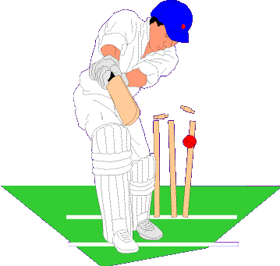
CS – 7641 A (Machine Learning)
Sethuraman Krishnan, Parameswaran Raman, Vijay Ramakrishnan

Slide 2

Scenario 1:
Team 1 scored 200 runs from their 50 overs, and then Team 2 reaches 146 for the loss of two wickets from their first 40 overs before rain stops play.
Scenario 2:
Bad weather reduces match to 40 overs. Team 1 scores 223 from their 40 overs. During, Team 2’s innings, it rains after 30 overs, by which point they are 147/5. They lose 5 overs due to rain and face the final 5 overs.
Notes:
Explain the above two scenarios and also other variations of the problem.

Slide 3

Duckworth/Lewis method
  Each team has two resources to use to make as many runs as possible: overs and wickets
  At any point, score depends on combination of these two resources
  A published table provides the % of these combined resources remaining for any number of overs left and wickets lost
  This table helps calculate the target score
Notes:
Summary of D/L method
-Resources
-how the table is created?
-interpret the graph on next slide

Slide 4

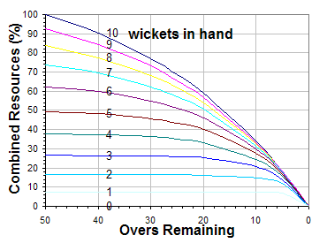
Essence of D/L method
Notes:
-how to interpret this graph?

Slide 5

Other factors that equally affect outcome not considered:
Venue
Power play
Player Rating
Player History
Momentum

Slide 6




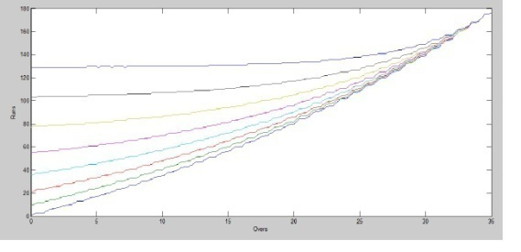
Creating an efficient model to reflect as many diverse scenarios in real-time matches as possible
Rain Affected
Match
Model
(applied to)
Runs
Wickets
Player Rating
(predict)
Power play
Venue
Outcome

Slide 7


Data sets for cricket matches were not available in usable form
Data had to be extracted from websites that maintain cricket statistics (eg: )
Ball-by-ball details of the match were extracted (commentary)
Data was formatted based on desired attributes (over, runs, wickets, batsman, bowler, power play) and written to a file
Notes:
52 innings seems pretty less. Need to quote a much higher figure to say we collected enough data!
Other details about data extraction like HTML parser, etc can be mentioned

Slide 8
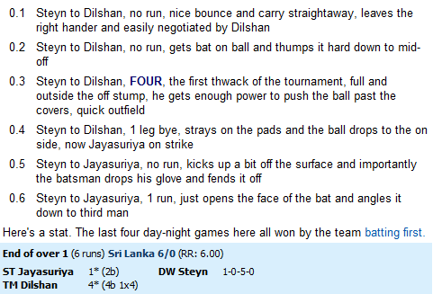
Commentary
Notes:
Problems here:
-- powerplay data is provided differently every time, some places its missing
-- not all matches have commentary, bla bla bla!!
Mention what all is extracted from each commentary into the data set file

Slide 9

D/L method uses only two features – runs and overs
New features were added – venues, teams taking part in the game, data about the batsman/bowler, nature of the over with field restriction (ie, power play or not)
Ran feature extraction algorithms & finally selected Correlation Based Subset Feature Selection (with fast correlation based filter search strategy)
Notes:
What are the other feature extraction algos we used?
And, why did we land up with CBF finally?

Slide 10

Principle:
A good feature subset is one that contains features highly correlated with (predictive of) the class, yet uncorrelated with (not predictive of) each other.
Results:
Showed that most important attributes were runs scored, wickets, venue & power play
Also validated by PCA

Slide 11

FEATURE | MERIT OF THE FEATURE
Run | 0.418
Wicket | 0.418
Venue | 0.095
Power play | 0.076
Batsman | 0.007
Notes:
Justification for the above values? And any interpretation!

Slide 12

Almost all target prediction algorithms make use of function approximation
Standard basic classifiers were used to benchmark the effort of the data sets
Classification rate is currently lower than the D/L method mainly because of the lesser number of data sets available for training. This can be increased with more data samples
kNN and Linear Regression provided high classification rates
Notes:
In case of benchmarking, classification rate is said to be lower than D/L coz of lesser training data. Do we go ahead with this stmt?
Does it suggest that we did not collect sufficient number of data samples??

Slide 13

ALGORITHM | ERROR RATE
Neural Network | 51 %
Linear Regression | 19 %
kNN | 16 %
REPTree | 23 %
Notes:
Interpretation/Conclusion from the above results?
Why each algo performed as seen above?

Slide 14

Thought:
  kNN and Linear Regression can be used together?
Why Quadratic Regression?
  Many curve fitting functions used to predict sports scores are cubic
  Can be an improvement over Linear Regression, which already performed well
  Predictor variables are run, run² ,wicket, wicket²
  Can be transformed into equivalent Linear Regression and solved
  Can be coupled with Smoothing by Neighbour Polling so that the prediction curve is smoothened
Notes:
I will get more details about the following two points:
-- Predictor variables are run, run² ,wicket, wicket²
-Can be transformed into equivalent Linear Regression and solved
-How coefficients for the regression are calculated?
Might have to explain the above ones.

Slide 15

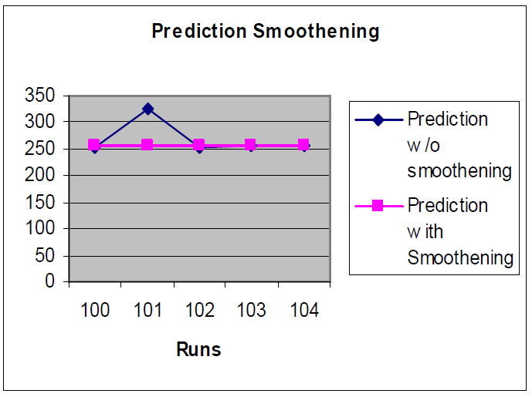
Reduces spikes in the prediction curve
Notes:
Explain with an example like below:
“When scores 101, 102,104 predict a score around 250, if the 103 predicts a score of 325, it is highly likely that 103 is a singular value and it might be lowered with more data”.

Slide 16

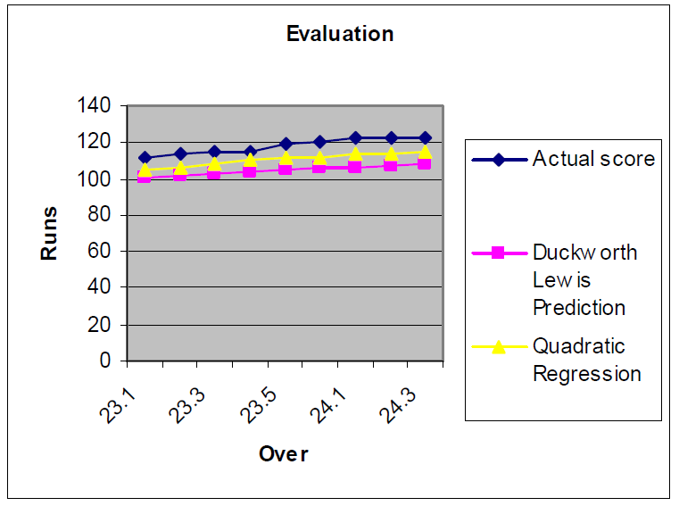
Variance Analysis:
  Obtain actual match curve
  Calculate our prediction
  Fit them over each other and obtain the variance
  This is per-match metric and hence captures accuracy locally over a continuous period
  Converges with Absolute Mean Error & Least Square Error methods (for equal samples in each match)
Notes:
How is variance metric used?
Any other metric we looked at?

Slide 17



Match Interrupted
100 /3
25 overs
  Will both the teams score at the same rate?
After 15 overs: | Score:
Team 1 | 90/0
Team 2 | 40/3
  Given the above history, will the answer to above question change?
  Yes - The trends in the scoring pattern suggests that Team -2 scores more!
Notes:
Explain how momentum (or history of how the team played so far) change the idea of probable score?
(using above two teams example)

Slide 18
Explained by the momentum attribute
Momentum is mimicked by adding an attribute μ to the data set
Adding this attribute gives an improvement of 2% on an average
Runs in last 5 overs
Wickets in the period + 1
X
Runs scored in the inning
Wickets in the innings + 1
PER MATCH TABLE
Positive influence | 14
No significant effect | 30
Negative influence | 5

Slide 19

Data sets
No prior research on Cricket
D/L method is closed source
Notes:
To Fill in (I could not think of others)

Slide 20

Duckworth/Lewis method of score prediction was analyzed and its pitfalls were addressed
Correlation Based Subset evaluation method was used for Feature Evaluation
Modified data set was used to benchmark the predictions of naïve classifiers
Hybrid approach using Quadratic Regression and kNN was used, which performed on par with D/L method
Introduced concept of prediction using Momentum

Slide 21


