Slide 1
Data Management issues
In
Location Dependent Services

Slide 2
Next few slides…
Location Based Services
Challenges
Why Caching ?
Terminologies
Existing Caching Techniques
Drawbacks
Proposed system

Slide 3
Location- Dependent Information Services (LDIS)
Provide services based on the geographical location of users.

Slide 4
Application Opportunities
Mapping, navigation, and directions applications
Workforce-tracking and management applications
Entertainment and gaming applications
“Finder” applications - find services in the local environment
Weather applications
Reminder applications to prompt users when they reach particular locations
Information services
  stock quotes
  nearest cash ATM

Slide 5
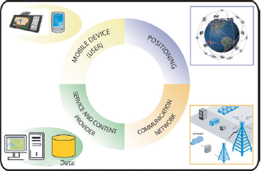
Enabling Technologies
Wireless Networks
Mobile Devices
Positioning Technologies
Database Systems

Slide 6
Next few slides
Location Based Services
Challenges
Why Caching?
Existing Caching Techniques
Drawbacks
Proposed system

Slide 7
What makes LDIS Challenging?
User Movement
Mobile Environment Constraints
Spatial Property of Queries

Slide 8
User Mobility
Continuous querying leads to high work load
Results may be invalid due to high movement

Slide 9
Mobile Environment Constraints
Characteristic of Wireless Communication
Frequent Disconnections
Expensive
Relatively unreliable
High bandwidth Variability
Scarcity of Bandwidth
Characteristic of Mobile Devices
Limited memory
Limited computational power
Small screen
Limited battery Life
Variability in resources
Frequent location updates

Slide 10
Location Dependent Data (LD)
The class of data whose value is functionally dependent on location.
location determines the current value of the data.
Examples: City code
Location Independent Data (LID)
The class of data whose value is functionally independent of location.
Value of the location does not determine the value of the data.
Example: name, account number

Slide 11
Location Dependent Queries
Data objects are associated with location
Query predicates based on location
Query result depends on location and time
E.g., Find the cheapest hotel here ….(Planar) Point query
􀁺E.g., Find all hotels within 5 miles….. Window query
􀁺E.g., Find the nearest hotel to me …(K-)nearest-neighbor search
􀁺

Slide 12
Query Types
Mobile clients ,querying static objects
Stationary clients, querying moving objects
Mobile clients, querying mobile objects

Slide 13
Differ from Temporal Queries
􀁺
Highly Dynamic
􀁺Multiple answer sets depending on location/time
􀁺The mobility of clients
􀁺Location of client may be part of the query itself
􀁺May depend on direction of movement
􀁺The mobility of data objects
􀁺Locations of data objects change (e.g., cars)

Slide 14
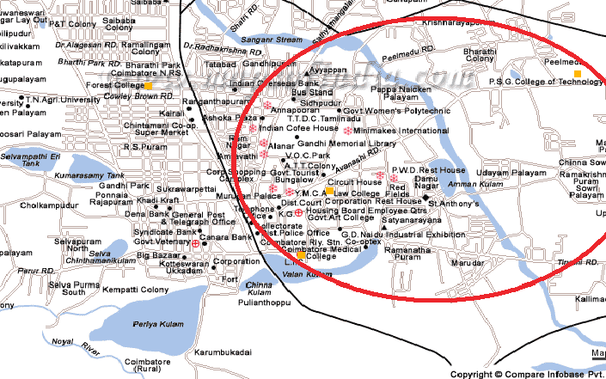

Slide 15
Next few slides
Location Based Services
Challenges
Why Caching ?
Terminologies
Existing Caching Techniques
Drawbacks
Proposed system

Slide 16
Why Caching ?
Improves data accessibility
Minimizes access costs.

Slide 17
Cache Management
Cache Prefetching
Cache Invalidation
Cache Replacement

Slide 18
Cache Prefetching
The Data required is predicted based on the user demands and client’s movements
Cache repository will consist of data required for high update intensive transactions.

Slide 19
Cache invalidation
Cache inconsistency can occur due to temporal and location - dependent updates.
  Temporal-dependent invalidation
  Location-dependent invalidation

Slide 20
Cache Replacement…
Process
  - Flush out cache chunks
  - Write back to the server or drop
  - Increase in communication overhead
Objective
  Provide a high hit rate
  Perform as few replacements as possible.

Slide 21
Existing Cache Replacement Strategies
Euclidean
Manhattan
Farthest Away Replacement (FAR)
Probability Area Inverse Distance (PAID)

Slide 22
Drawbacks
Rely on the temporal locality of client’s access pattern.
Evict only the most unlikely data item from the cache.

Slide 23
Farthest Away Replacement (FAR)
d1
d2
M
M
d3
M
M--very large

Slide 24
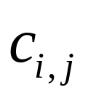
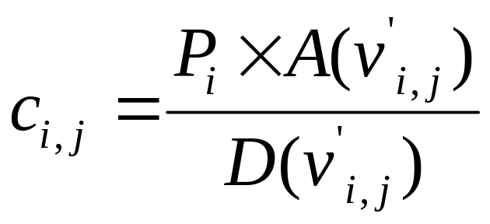

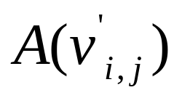
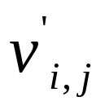
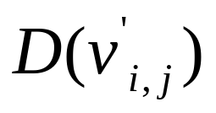
Probability Area Inverse Distance (PAID)
The Cost function for data value j of item i is defined as:
Where
Access probability of item i
Area of the attached valid scope
Distance between the current position and valid scope

Slide 25
DrawBacks of PAID
Does not consider the randomness of user movement
Does not consider data updates
Does not give the user an option to choose his object of interest

Slide 26
Next few slides
Location Based Services
Challenges
Why Caching ?
Terminologies
Existing Caching Techniques
Drawbacks
Proposed system

Slide 27
Weighted Angular Distance Based Cache Replacement Strategy
Temporal locality,
Location of data,
Location of the client
Direction of the client’s movement
User Preference
Remove a set of data items and replace them with a corresponding number of data items which are more likely to be used.

Slide 28
Terminologies and Assumptions
Geometric Model
2D or 3-D coordinates,
e.g., the latitude/ longitude pair
Compatibility across heterogonous systems
Symbolic Model
Logical, real-world entities
Bus stop number, train station name
Coarser location granularity
Suitable for LBS applications due to semantics
Service Area : the geographical area covered by the mobile system

Slide 29
Terminologies
Data instance
location-dependent queries return different results, each result is called a data instance
Valid scope
the area within which a data instance remains valid
Can be seen as an implicit property associated with a query result.
Spatial Scope
the area where the query result remains valid.
Temporal Scope
the period of time when the query result remains valid.
Contextual Attributes Scope for context-aware applications
e.g., temperature range

Slide 30
Valid Scope
The valid scope is defined as the region within which the item value is valid.
For Data Item i
Item Value | Valid Scope
OV₁ | VS₁
OV₂ | VS₂
OV₃ | VS₃
OV₄ | VS₄
OV₅ | VS₅
OV₆ | VS₆
VS₁
VS₂
OV₁
OV₂
OV₆
VS₆
OV₃
OV₅
OV₄
VS₅
VS₄
VS₃

Slide 31
… Valid Scope
Refers to the geometric area of the valid scope of a data value.
Indicator of the access probabilities for different data values.
Larger the valid scope area of the data, higher the probability of access

Slide 32
Scope Distribution
It is the set of valid scopes for all items values of a data item.
For Data Item i, scope distribution SD_{i} :
VS₁
VS₂
OV₁
OV₂
SD_{i} ={VS₁, VS₂, VS₃, VS₄, VS₅, VS₆}
OV₆
VS₆
OV₃
OV₅
OV₄
VS₅
VS₄
VS₃

Slide 33
Voronoi Diagrams …
The Voronoi diagram of a point set is the collection of regions that are closer to one point than to any other point.

Slide 34
…Voronoi Diagrams
Area of valid Scope is generated based on the
Voronoi diagram.
A Voronoi diagram divides a space into disjoint polygons
The nearest neighbor of any point inside a polygon
is the generator of the polygon.

Slide 35
Voronoi Polygons
A set of limited number of points, called generator points, in the Euclidean plane
Associate all locations in the plane to their closest generator(s).
The set of locations assigned to each generator forms a region called Voronoi polygon or Voronoi cell, of that generator.
The set of Voronoi polygons associated with all the generators is called the Voronoi diagram with respect to the generators set.
The Voronoi polygons of a Voronoi diagram are collectively exhaustive because every location in the plane is associated with at least one generator.
The polygons are also mutually exclusive except for their boundaries.
The boundaries of the polygons, called Voronoi edges, are the set of locations that can be assigned to more than one generator. The Voronoi polygons that share the same edges are called adjacent polygons and their generators are called adjacent generators.

Slide 36




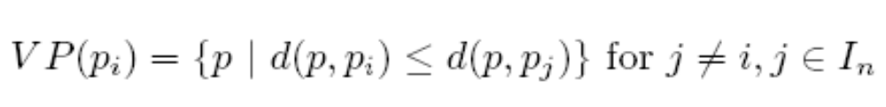
Voronoi
The Voronoi polygon and Voronoi diagram can be formally defined as:
where
And
for
The region given by
where d(p; pi) specifies the minimum distance between p and pi is called the Voronoi Polygon associated with pi, and the set given by:

Slide 37
Properties
Property 1:
The Voronoi diagram of a point set P, V D(P), is unique.
Property 2:
The nearest generator point of pi (e.g., pj) is among the generator points whose Voronoi polygons share similar Voronoi edges with V P(pi).

Slide 38
Weighted Angular Distance Based Cache Replacement Strategy
Temporal locality,
Location of data,
Location of the client
Direction of the client’s movement
User Preference
Remove a set of data items and replace them with a corresponding number of data items which are more likely to be used.

Slide 39
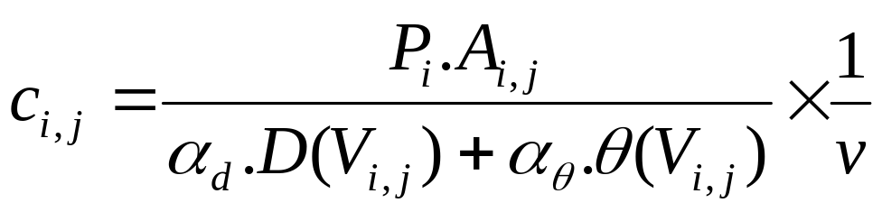
Cost Function
P - access probability,
A - valid scope area,
D - beeline distance
θ - angle of bearing,
αd and αθ - beeline and bearing coefficients
v denotes the supplement variable.

Slide 40
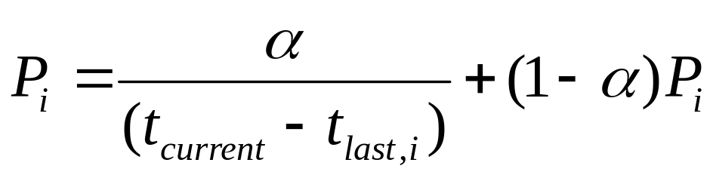
Access Probability
Probability of a particular data item being queried again within the same valid scope.
Exponential aging method. (Two parameters are maintained for each data item i)
(Pi) Running probability
(tlast, i) Time of the last access to the item
tcurrent The current system time
α a constant factor to weight the importance of the most recent access in the probability estimate

Slide 41
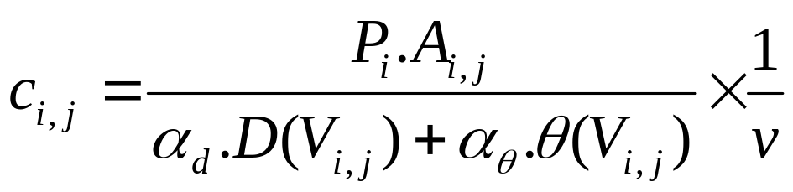
Angle of Bearing
The angular distance (in degrees), θ between the client’s current direction and direction vector of a particular valid scope.

Slide 42
Y
v₃
v₂
d₃
v₁
v₄
d₂
v₅
d₄
d₁
d₅
v₆
d₆
X
Clients’ current direction
Direction Vector
v_{i}
Valid scope area

Slide 43
Beeline Distance
The linear distance of a valid scope from the client’s current location. In a location-dependent data service,

Slide 44
Beeline and Bearing coefficients
In location-dependent data services, the beeline distance may gain precedence over the angle of bearing or vice-versa depending on the need and type of service.

Slide 45
Supplement Variable
Relevance of LDD changes dynamically
V is a measure of data relevance
Can signify any scenario being just a numerical value.

Slide 46
Flow of the proposed cache replacement policy
Service
Provider
DB
{P, A , V , D , θ}_{data item}
CACHE REPLACEMENT POLICY
Rank
Generation
Algorithm
Access Probability
Valid Scope Area
Data Relevance
{Cost} _{data item}
α_{θ} and α_{d} values
Mobile Client
App
Rank List
Selected Data Items
C
A
C
H
E
Manager
Cache
…
Evicted Data Items

Slide 47
Algorithm
Input : Rank list, list of current items in the cache
Output : List of items in the cache
Procedure :
1: loop i = 0 to all items in the cache
  Determine lowest ranked item in the cache, Clowest
  Compare Clowest with the highest ranked item in the rank list, Rhighest.
  If Rank(Clowest) < Rank(Rhighest) then
    Replace Clowest with Rhighest
    Remove Rhighest
  If Rank(Clowest) >= Rank(Rhighest) then
    Exit
End loop

Slide 48
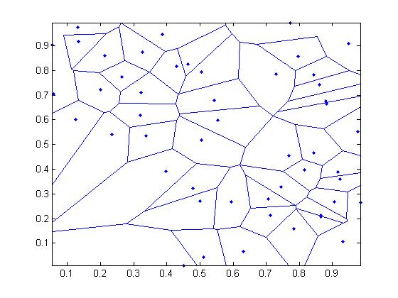
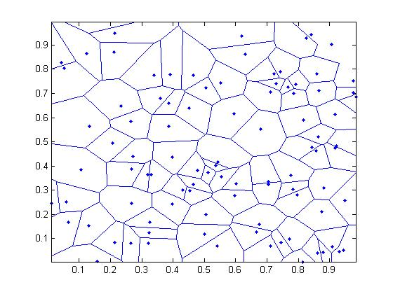
Scope Distributions
Scope distribution S1
Scope distribution S2

Slide 49
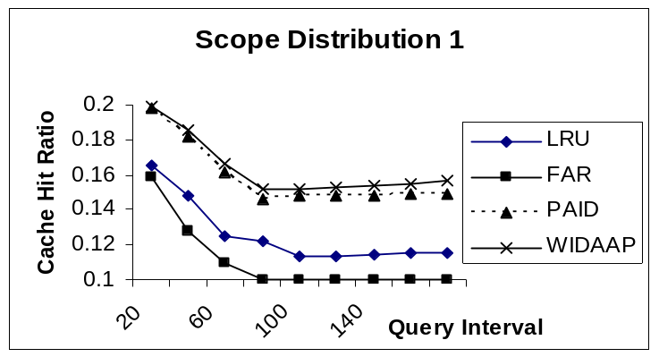
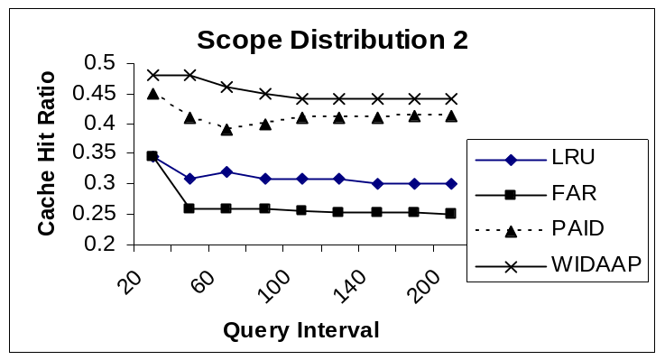
Effect of changing Query Interval

Slide 50
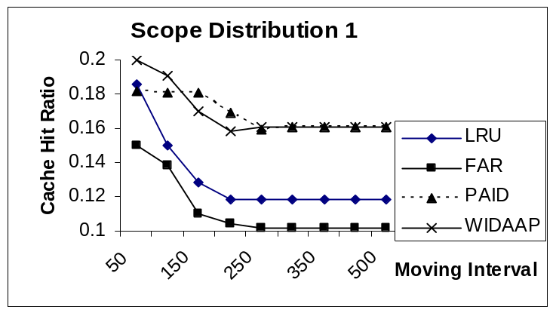
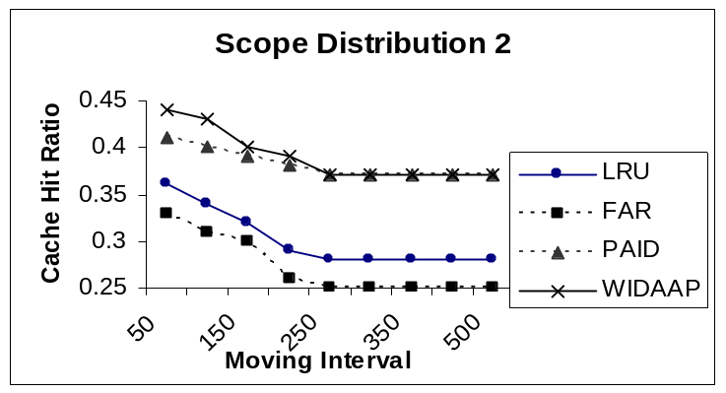
Effect of changing Moving Interval

Slide 51
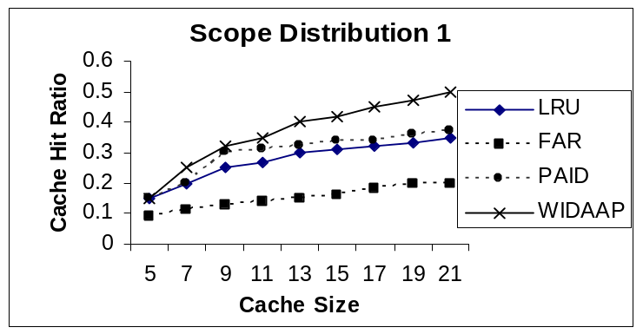
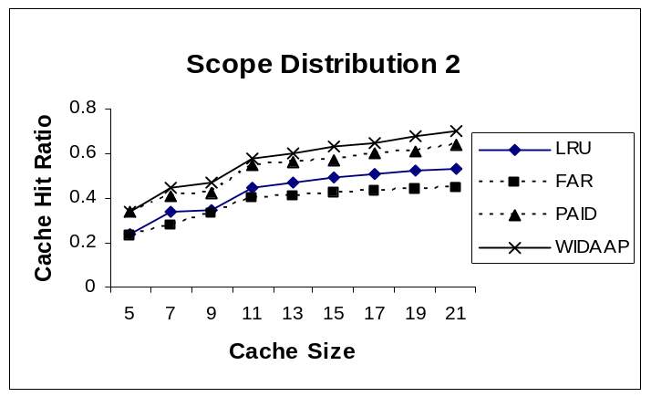
Effect of Cache Size

Slide 52
Thank You

Slide 53
Cache Replacement
        Cache Replacement Decisions
1. Distance between a client’s current location and the location of each cached data object
2. Movement direction of mobile clients and the object’s updates.
The most common replacement policies are:
Extensions of traditional replacement techniques
Key-based techniques use priority factors
Function-based techniques use time factor

