Slide 1
Karnataka Schemes AI — Proof of Concept
Executive overview · 2026-04-10

Slide 2
What we built
An end-to-end assistant over government scheme content—not just a chat box
Grounded answers using your indexed documents plus optional rule context
Working demo: questions, scheme shortlist, downloadable application-kit PDF

Slide 3
Business value
Faster discovery of relevant schemes for citizens and field staff
Consistent packaging of scheme text into a printable kit (PoC)
Same engine usable from a web UI or API for future products

Slide 4
How it works (one minute)
Official PDFs are ingested into a private searchable knowledge base
User questions pull the most relevant passages first, then an AI model words the answer
Optional steps improve search quality before the final answer

Slide 5
Why this architecture matters
Retrieval-first design ties answers to source material
Orchestration allows refinement and transparency (what was read)
Export to PDF supports real-world “takeaway” workflows

Slide 6
Technology (at a glance)
Python application; local vector database (Chroma)
Google Gemini for language generation
Streamlit demo + Flask API option

Slide 7
Flexibility for your environment
Vector DB, embeddings, and LLM can be swapped for cloud or on-prem options
Orchestration can later use standard frameworks if your IT prefers
We document trade-offs: cost, latency, compliance—not one-size-fits-all

Slide 8
Roadmap: trust and safety (planned)
Stronger grounding: relevance thresholds and “we don’t know” when data is thin
Clear citations and optional verification of claims against sources
Disclaimers: official portals remain authoritative

Slide 9
Roadmap: privacy and governance (planned)
Data minimization and policies for what may be sent to AI providers
Audit trail of model and knowledge-base version—not just free-text logs
Access control and separation of dev vs production keys and quotas

Slide 10
Alignment with enterprise AI practice
Layered story: data → knowledge → orchestration → experience → governance
Can map to NIST AI RMF or ISO/IEC 42001 conversations when you need it

Slide 11
What is proven vs what comes next
Proven: working pipeline, demo UX, API hook, PDF export
Next: production hardening, guardrails, privacy controls, SLAs—scoped to your sector

Slide 12
Suggested next conversation
Pilot scope: corpus, users, compliance constraints
Hosting: your cloud, VPC, or air-gapped options
Success metrics: accuracy checks, user satisfaction, time saved

Slide 13
Who this serves
Citizens and field staff exploring eligibility and steps
Program teams needing consistent scheme text in one place
Partners integrating via API into existing portals or contact centres

Slide 14
Ways to engage
Pilot: limited corpus, defined users, success criteria
Co-development: guardrails and hosting aligned to your IT policy
Support: iteration on accuracy, UX, and governance milestones

Slide 15
Thank you
Questions and deep-dive sessions welcome
Deck date: 2026-04-10

Slide 16
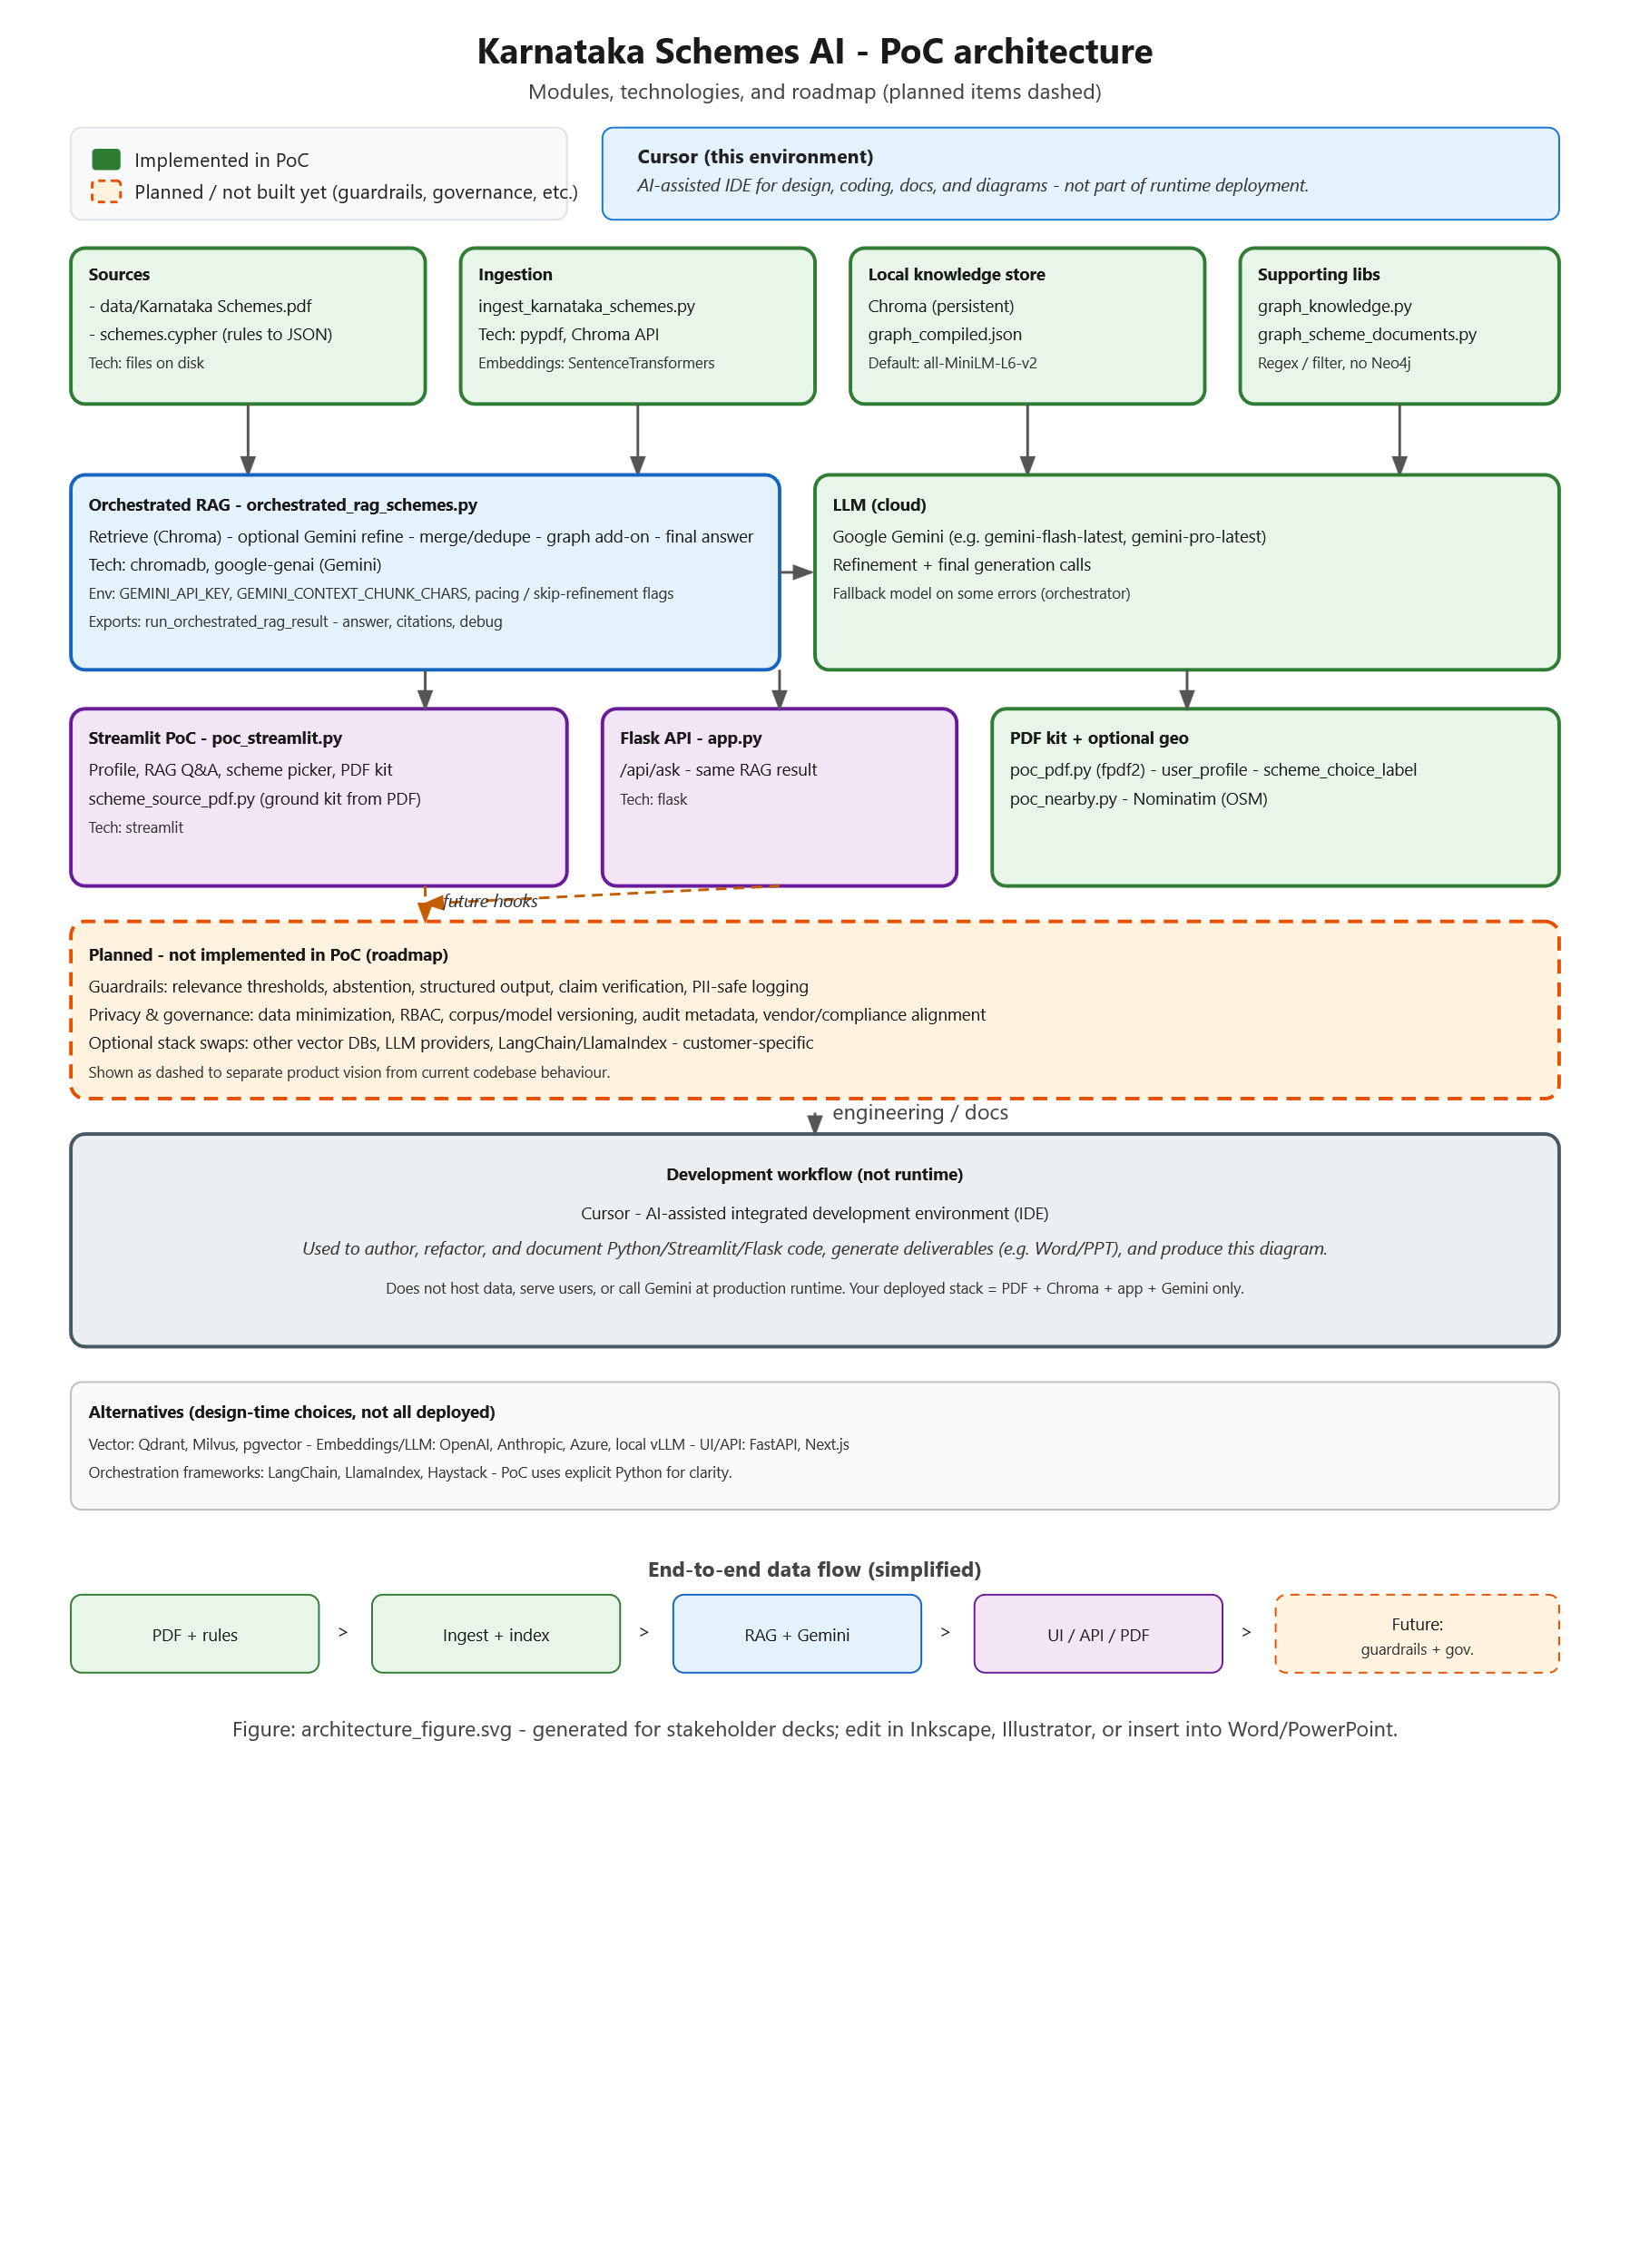

Slide 17
