Slide 1

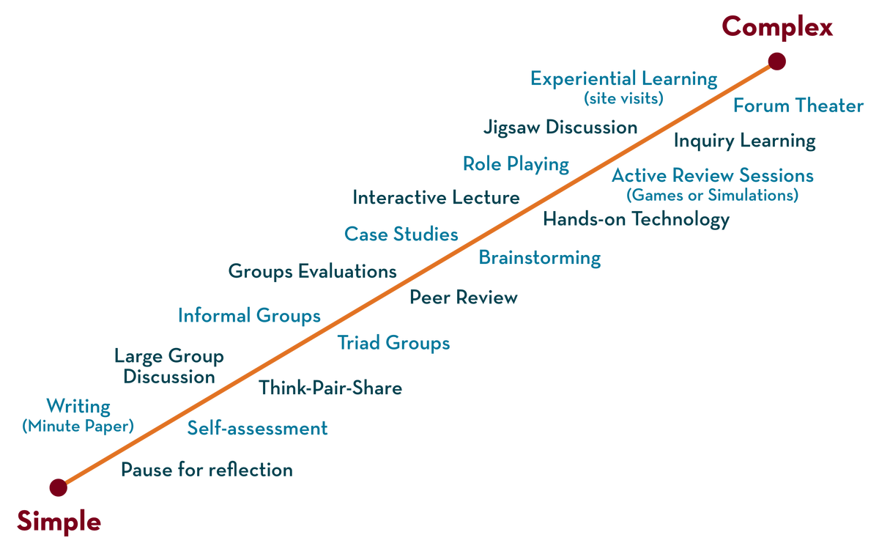
Department of CSAIML
OOSD with C++ / BCS-054

Slide 2
UNIT-1 OBJECTIVES
Understand the principles of object-oriented programming.
Explore core concepts like information hiding and polymorphism.
Discuss the often overlooked but essential topic of software generosity.
Learn why modelling is crucial in system design and development.

Slide 3
WHY OBJECT-ORIENTED PRINCIPLES
Drives modern software design.
Helps build reusable, scalable, and secure systems.
Provides abstraction that simplifies real-world complexity

Slide 4
UNIT-1 OVERVIEW
UNIT 1
The meaning of Object
Orientation,
object identity, Encapsulation
information hiding, polymorphism,
generosity, importance of
modelling,
Introduction to UML,
conceptual model of the UML,
Architecture
principles of modelling,
object oriented modelling,
UNIT 1

Slide 5
Why Object-Oriented?
The term object-oriented (OO) means that we organize software as a collection of discrete objects that incorporate both data structure and behavior.
This contrasts with previous programming approaches in which data structure and behavior are only loosely connected.
They generally include four aspects: identity, classification, inheritance, and polymorphism.

Slide 6
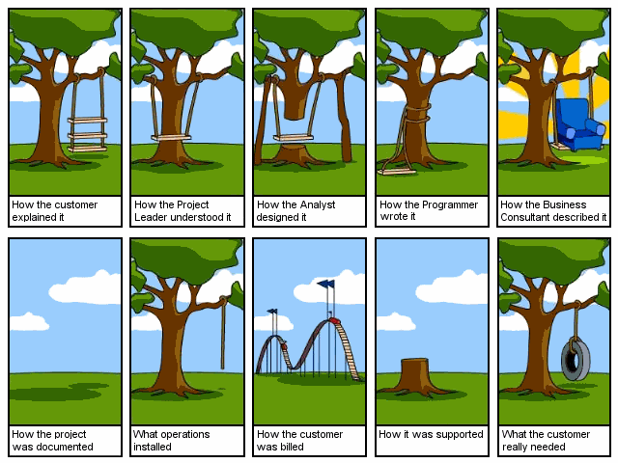
Why Object-Oriented?

Slide 7


Why Object-Oriented?
“The "software crises" came about when people realized the major problems in software development were … caused by communication difficulties and the management of complexity” [Budd]
The Whorfian Hypothesis:
Human beings … are very much at the mercy of the particular language which has become the medium of expression for their society … the 'real world' is … built upon the language habits … We cut nature up, organize it into concepts, and ascribe significances as we do, largely because we are parties to an agreement to organize it in this way … and is codified in the patterns of our language.


What kind of language can alleviate difficulties with
communication & complexity hopefully well?

Slide 8
Why Object-Oriented?
– Consider Human Growth & Concept Formation
Communication & complexity about the problem and the solution, all expressed in terms of concepts in a language!
But then, What is CONCEPT? [Martin & Odell]
Consider Human Growth & Concept Formation
stage | concepts
infant | the world is a buzzing confusion
very young age | "blue" "sky“ (individual concepts) "blue sky“ (more complex concept) hypothesis: humans possess an innate capacity for perception
getting older | -> increased meaning, precision, subtlety, ... the sky is blue only on cloudless days the sky is not really blue it only looks blue from our planet Earth because of atmospheric effects elaborate conceptual constructs
Concept formation: from chaos to order!

Slide 9
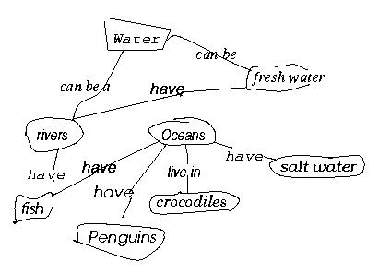
Why Object-Oriented?
- concepts and objects
So, concepts are needed to bring order … into
But, What is CONCEPT? [Martin & Odell] [Novak, 1984, Cambridge University Press]
Study of a first grade class
When given a list of concepts (water, salt water, Oceans, Penguins,...),
Harry constructed a concept diagram through which he understands his world and communicates meaning
Does Harry understand the concepts? Do you understand what Harry understands? Agree or Diagree?

Slide 10
Why Object-Oriented?
… for Conceptual … Modeling Reasons
What kind of language can be used to create this concept diagram, or Harry’s mental image?
Water
Fresh water
have
Rivers
Oceans
have
have
live in
Salt water
have
Crocodiles
Fish
have
Penguins

Slide 11
Why Object-Oriented ->
What is a model and why?
A model is a simplification of reality.
E.g., a miniature bridge for a real bridge to be built
  Well...sort of….but not quite
  A model is our simplification of our perception of reality
  (that is, if it exists, otherwise it could be a mere illusion).
  communication is not about reality but about your/my/his/her perception of reality => validation and verification hard but needed
A model is an abstraction of something for the purpose of understanding, be it the problem or a solution.
To understand why a software system is needed, what it should do, and how it should do it.
To communicate our understanding of why, what and how.
To detect commonalities and differences in your perception, my perception, his perception and her perception of reality.
To detect misunderstandings and miscommunications.

Slide 12


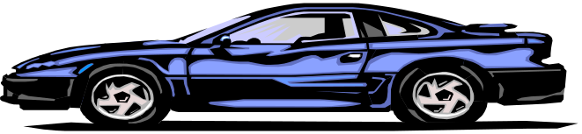
What is Object-Orientation?
- What is Object?
An "object" is anything to which a concept applies, in our awareness
Things drawn from the problem domain or solution space.
  E.g., a living person in the problem domain, a software component in the solution space.
A structure that has identity and properties and behavior
It is an instance of a collective concept, i.e., a class.

Slide 13

What is Object-Orientation
- Abstraction and Encapsulation
Abstraction
  Focus on the essential
  Omits tremendous amount of details
  …Focus on what an object “is and does”
Encapsulation
  a.k.a. information hiding
Objects encapsulate:
  property
  behavior as a collection of methods invoked by messages
  …state as a collection of instance variables

Slide 14
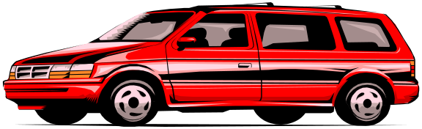
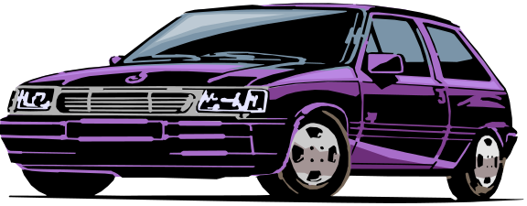
What is Object-Orientation
- Another Example of Abstraction and Encapsulation
Class Car
Attributes
  Model
  Location
  #Wheels = 4
Operations
  Start
  Accelerate
<<instanceOf>>
<<instanceOf>>
<<instanceOf>>
What is generalization?
What is over-generalization??
Forall x [Car(x) -> …]

Slide 15
What is Object-Orientation?
- Class
<<instanceOf>>
Class Car
Attributes
  Model
  Location
  #Wheels = 4
Operations
  Start
  Accelerate
<<instanceOf>>
<<instanceOf>>
What is CLASS?
  a collection of objects that share common properties, attributes, behavior and semantics, in general. What are all these???
  A collection of objects with the same data structure (attributes, state variables) and behavior (function/code/operations) in the solution space.
Classification
  Grouping of common objects into a class
Instantiation.
  The act of creating an instance.

Slide 16
What is Object-Orientation
- Subclass vs. Superclass
Specialization: The act of defining one class as a refinement of another.
Subclass: A class defined in terms of a specialization of a superclass using inheritance.
Superclass: A class serving as a base for inheritance in a class hierarchy
Inheritance: Automatic duplication of superclass attribute and behavior definitions in subclass.
Person
name
SSN
Student
Employee
std-id
emp-id
multiple inheritance?
level
age

Slide 17
What is Object-Orientation
- Subclass vs. Superclass
A
A
A
B
B
B
C
C
A
A
A
A
<<instanceOf>>
<<instanceOf>>
B
B
B
B
<<instanceOf>>
<<instanceOf>>
c: C
c: C

Slide 18
What is Object-Orientation
- Subclass vs. Superclass and …
3
A
A
A
A
A
2
<<instanceOf>>
<<instanceOf>>
<<instanceOf>>
<<instanceOf>>
B
B
B
B
B
<<instanceOf>>
<<instanceOf>>
c: C
C
C
C
C
<<instanceOf>>
1
d: D
D

Slide 19
What is Object-Orientation
- Polymorphism
  Objects of different classes respond to the same message differently.
Person
name
SSN
Student
Employee
payTuition
std-id
level
emp-id
payTuition
In-State
Student
Out-of-State
Student
state
payTuition
payTuition

Slide 20
What is Object-Orientation
- Interfaces
Information hiding - all data should be hidden within a class, at least in principle.
make all data attributes private
provide public methods to get and set the data values (cf. Java design patterns)
e.g. Grade information is usually confidential, hence it should be kept
private to the student. Access to the grade information should be
done through interfaces, such as setGrade and getGrade
Student
setGrade
std-id
level
grade
payTuition
setGrade()
getGrade()
getGrade

Slide 21
What is Object-Orientation
- Abstract Class vs. Concrete Class
Abstract Class.
  An incomplete superclass that defines common parts.
  Not instantiated.
Concrete class.
  Is a complete class.
  Describes a concept completely.
  Is intended to be instantiated.
Work out an example!

Slide 22
What is Object-Orientation?
-State
What is STATE?
"State" is a collection of association an object has with other objects and object types.
What is STATE CHANGE?
A "state change" is the transition of an object from one state to another.
What is EVENT?
An "event" is a noteworthy change in state [Rumbaugh]
Work out an example!

Slide 23
What is Object-Orientation?
-State transition impossible?
tom: Actor
tom: Actor
name = “Tom Cruise”
name = “Tom Holmes”
married/changeLastName
katie: Actor
katie: Actor
name = “Katie Holmes”
name = “Katie Holmes”
tom: Actor
name = “Tom Holmes”
newArrival/getName
katie: Actor
name = “Katie Holmes”
suri: BabyActor
name = “Suri Holmes”

Slide 24
What is Object-Oriented Application?
Collection of discrete objects, interacting w. each other
Objects have property and behavior (causing state transition)
Interactions through message passing
(A sender object sends a request (message) to another object (receiver)
to invoke a method of the receiver object’s)
O1
O2
Data
m1
Data
Fn
Fn
m3
m2
O3
{m in Fn}
Data
Fn

Slide 25
What is OOAD?
Analysis — understanding, finding and describing concepts in the problem domain.
Design — understanding and defining software solution/objects that represent the analysis concepts and will eventually be implemented in code.
OOAD — Analysis is object-oriented and design is object-oriented. A software development approach that emphasizes a logical solution based on objects.
Traceability!
Involves both a notation and a process

Slide 26
Harry again …
What do we see here?
Water
Fresh water
have
Rivers
Oceans
have
have
live in
Salt water
have
Crocodiles
Fish
have
Penguins
Things, Relationships, Diagram

Slide 27
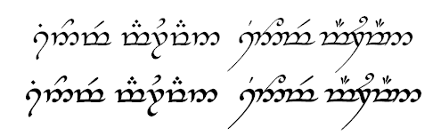
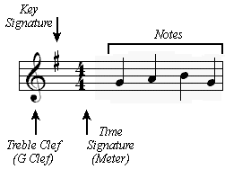
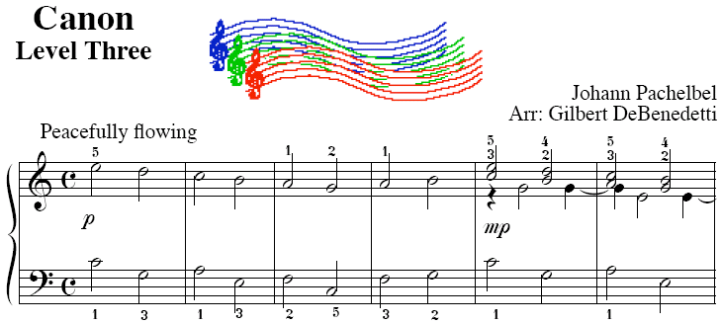

How to do OOAD
- notation vs. process
UML is a notation.
So are English, Elvish, Ku, …
But as yet I can’t

Slide 28
How to Do OOAD
– Where to Use OO?
Software Lifecycle
Systems Engineering
Requirements Analysis
Quality Assurance
Project Planning
Maintenance
Architectural Design
Detailed Design
Implementation
Something missing?
Release
What’s yours like?

Slide 29
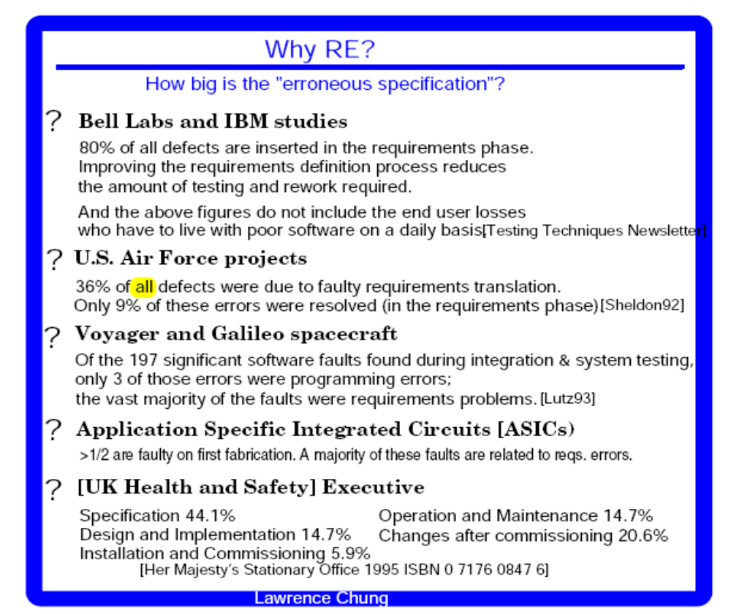
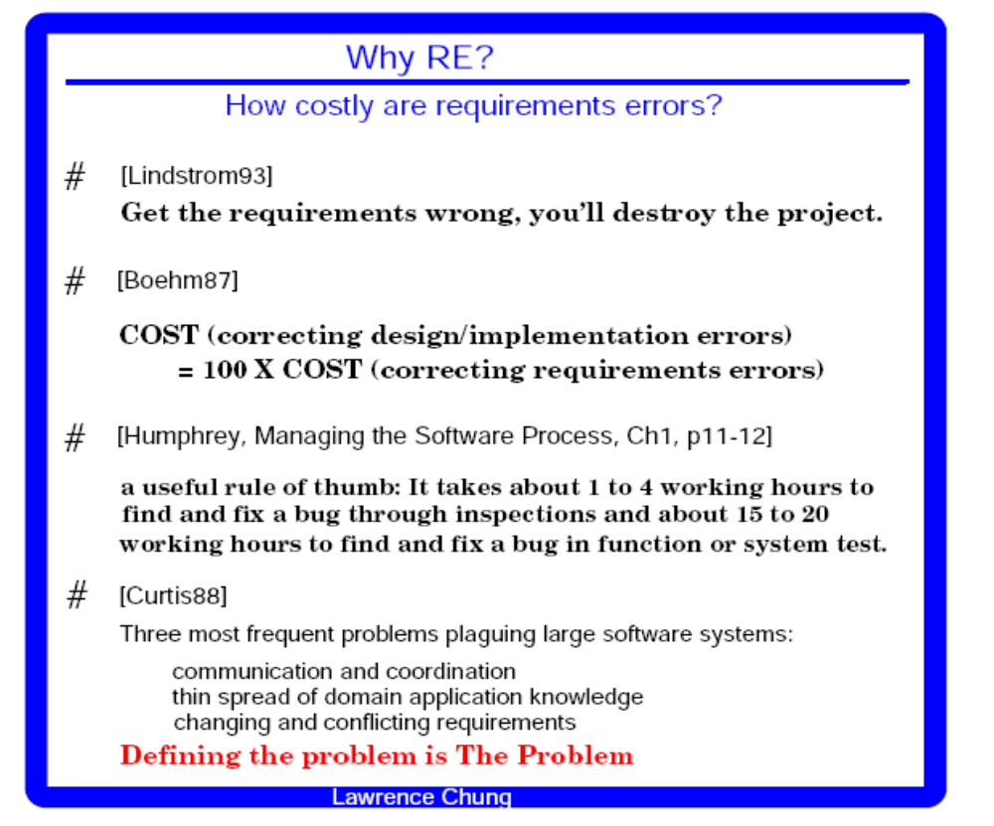
Specifications are important too

Slide 30
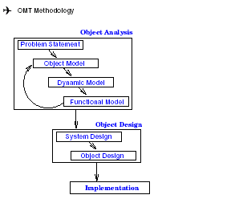
How to Do OOAD
– OMT as Object-Oriented Methodology
Object Model: describes the static structure of the objects in the system and their relationships -> Object Diagrams.
Dynamic Model: describes the interactions among objects in the system -> State Diagrams.
Functional Model: describes the data transformation of the system
-> DataFlow Diagrams.

Slide 31
How to Do OOAD
– OMT as Object-Oriented Methodology
OMT (Object Modeling Technique) by James Rumbaugh
Analysis:
i) Model the real world showing its important properties;
ii) Concise model of what the system will do
System Design:
Organize into subsystems based on analysis structure and propose architecture
Object Design: Based on analysis model but with implementation details; Focus on data structures and algorithms to implement each class; Computer and domain objects
Implementation: Translate the object classes and relationships into a programming language

Slide 32
Introduction to OOAD - Summary
Why
Once Software Crisis due to Communication and Complexity
Languages, Concepts, Models
OO for Conceptual Modeling
What
Fundamental OO Concepts
A little taste of UML
How
OO development processes & (Design) Patterns

Slide 33
How to Do OOAD
- Historical Perspective
OO Technology
Process Perspective
OO Prog. Languages
(Smalltalk, C++)
just program!
OO Design
(Booch)
design then program
OO Analysis
(Rumbaugh, Jacobson)
Analyze (use case) first,
then design,
T then program
Where are we heading?

Slide 34
How to Do OOAD
- OO Development Processes
Some Popular OOAD Processes (for reference only)
Fusion
  Hewlett Packard
Recommended Process and Models
  ObjectSpace best practices
  Larman’s experiences
  …
The Rational Unified Process (RUP)
  Rational; Booch, Jacobson, and Rumbaugh

Slide 35
How to Do OOAD
– One Good Way: Use (OO) Design Patterns
Reusable solutions to typical problems.
“Each design pattern systematically names, explains, and evaluates an important and recurring design in object-oriented systems.” [Gamma]
Name — identifies a particular pattern, creating a vocabulary.
Problem — identifies context when pattern should be applied.
Solution — an abstract description of a design problem along with a template object design that solves the problem.
Consequences — results and trade-offs of applying the pattern.

Slide 36
Why Object-Oriented
- Who’s Behind Object-Orientation w. Diff. Concerns
Knowledge Representation (in A.I.)
Psychological Validity
Philosophical Validity
Computational Validity
Databases
Emphasis in Persistent Data (and now ACID properties)
RelationalDB
Network DB
Hierarchical DB
OODB
ERD
CM
SDM
ADT
Programming Languages
Emphasis in Efficiency
Simula, SmallTalk, C++, Protel, Java
ERD: Entity Relationship Diagram
SDM: Semantic Data Model
ADT: Abstract Data Type
CM: Conceptual Model
System/Software
Engineering
Where does Unified Modeling Language come into this?

Slide 37
Why Object-Oriented
– A New Paradigm with Evolving Object Orientation
OOP: Object-Oriented Programming
  Simula (1967), Smalltalk (70’s), C++ (mid 80’s), Eiffel, Ada95, Turing, …
OOD: Object-Oriented Design
  Taxis (1976), Adaplex, …, Grady Booch (1980)
OOA: Object-Oriented Requirements
  RML (1981), James Rumbaugh (late 80’s)
OO-Databases (OODBs): 1980-90’s
OLE/DCOM, VisualBasic, CORBA, Java: mid 90’s
.Net, C#, (eb/voice…/-)XML, J2EE: into 2000+
UML: mid 90’s and still evolving

Slide 38
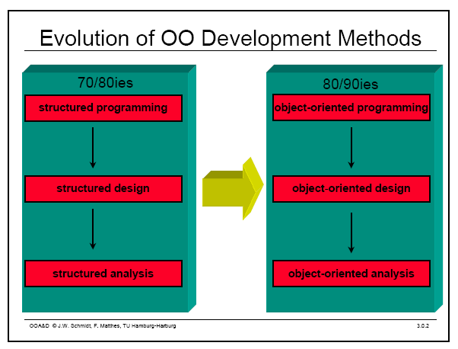
Object Oriented Modeling
Notes:
Evolution of analysis and design techniques
Transition from structured programming to object oriented programming

Slide 39
What is UML?
UML stands for “Unified Modeling Language”
It is a industry-standard graphical language .
UML is a pictorial language used to make software blue prints
It is used for specifying, visualizing, constructing, and documenting the artifacts of software systems
UML is different from the other common programming languages
It uses mostly graphical notations.
Simplifies the complex process of software design
Notes:
. What does UML stand for?
. Industry standard
. Graphical notation
. Modeling tool … simplifies software design process

Slide 40
Why UML for Modeling
Use graphical notation to communicate more clearly than natural language (imprecise) and code(too detailed).
Help acquire an overall view of a system.
Tools can be used to generate code in various languages using UML diagrams
UML is not dependent on any one language or technology.
A picture is worth than thousand words
UML can be defined as a simple modeling mechanism to model all possible practical systems in today’s complex environment.
Notes:
. More precise than natural language … less detailed than source code
. Not dependent on any language
. Standardized by various groups

Slide 41
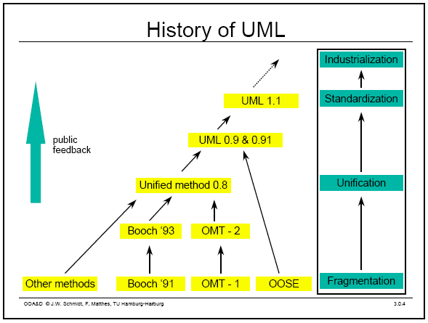
History of UML
Notes:
History:
- Rumbaugh – OMT – object modeling technique
Jacobson – OOSE
UML … unified approach since 1995
UML 1.5 current … UML 2.0 by the end of 2004

Slide 42
Conceptual model of UML
It is a model which is made of concepts and their relationships.
It is the first step before drawing a UML diagram.
It helps to understand the entities in the real world and how they interact with each other
It can be mastered by learning the following three major elements: UML building blocks
Rules to connect the building blocks
Common mechanisms of UML

Slide 43
Object oriented concepts
object contains both data and methods that control the data.
The data represent the state of the object
Data can also describe the relationships between this object and other objects
objects are the real world entities

Slide 44
Object oriented concepts
Every object belongs to (is an instance of) a class
An object may have fields, or variables
The class describes those fields
An object may have methods
The class describes those methods
A class is like a template, or cookie cutter
You use the class’s constructor to make objects

Slide 45

Example: A “Rabbit” object
You could (in a game, for example) create an object representing a rabbit
It would have data:
  How hungry it is
  How frightened it is
  Where it is
And methods:
  eat, hide, run, dig

Slide 46
Concept: Classes form a hierarchy
Classes are arranged in a tree like structure called a hierarchy
The class at the root is named Object
Every class, except Object, has a super class
A class may have several ancestors, up to Object
When you define a class, you specify its super class
Every class may have one or more subclasses

Slide 47
Fundamental concepts of object oriented world
Objects: Objects represent an entity and are the basic building block.
Class: Class is the blue print of an object.
Abstraction: Abstraction represents the behavior of an real world entity.
Encapsulation: Encapsulation is the mechanism of binding the data together and hiding them from outside world.
Inheritance: Inheritance is the mechanism of making new classes from existing one.
Polymorphism: It defines the mechanism to exists in different forms.

Slide 48
Kinds of access
Java provides four levels of access:
  public: available everywhere
  protected: available within the package (in the same subdirectory) and to all subclasses
  [default]: available within the package
  private: only available within the class itself
The default is called package visibility

Slide 49
OO Analysis and Design
it is the investigation of objects. Design means collaboration of identified objects.
identifying the objects their relationships are identified and finally the design is produced
Identifying the objects of a system.
Identify their relationships.
OO Analysis --> OO Design --> OO implementation using OO languages

Slide 50
Building blocks of UML
The building blocks of UML can be defined as:
Things
Relationships
Diagrams

Slide 51
Things
Things are the most important building blocks of UML. Things can be:
Structural
Behavioral
Grouping
Annotational

Slide 52
Structural things
The Structural things define the static part of the model.
They represent physical and conceptual elements.
Class:
Class represents set of objects having similar responsibilities.
Interface:
Interface defines a set of operations which specify the responsibility of a class
Collaboration:
Collaboration defines interaction between elements.

Slide 53
Structural things
Use case:
Use case represents a set of actions performed by a system for a specific goal.
Component:
Component describes physical part of a system.
Node:
A node can be defined as a physical element that exists at run time.

Slide 54
Behavioral things
It consists of the dynamic parts of UML models.
Interaction:
It is defined as a behavior that consists of a group of messages exchanged among elements to accomplish a specific task.
State machine:
It is useful when the state of an object in its life cycle is important. It defines the sequence of states an object goes through in response to events.

Slide 55
Grouping things
Grouping things can be defined as a mechanism to group elements of a UML model together. There is only one grouping thing available:
Package:
Package is the only one grouping thing available for gathering structural and behavioral things.

Slide 56
Annotational things
Annotational things can be defined as a mechanism to capture remarks, descriptions, and comments of UML model elements.
Note
It is the only one Annotational thing available.
A note is used to render comments, constraints etc of an UML element.

Slide 57
Relationships
It shows how elements are associated with each other and this association describes the functionality of an application.
There are four kinds of relationships available.
Dependency:
Dependency is a relationship between two things in which change in one element also affects the other one.
Association:
Association is basically a set of links that connects elements of an UML model. It also describes how many objects are taking part in that relationship.

Slide 58
Relationships
Generalization:
Generalization can be defined as a relationship which connects a specialized element with a generalized element. It basically describes inheritance relationship in the world of objects.
Realization:
Realization can be defined as a relationship in which two elements are connected. One element describes some responsibility which is not implemented and the other one implements them. This relationship exists in case of interfaces.

Slide 59
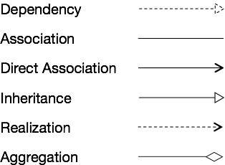

Slide 60
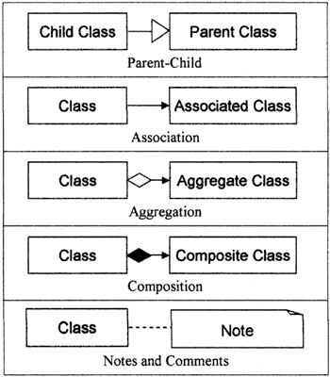

Slide 61
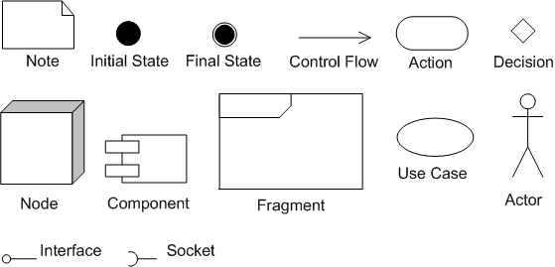
Notations

Slide 62
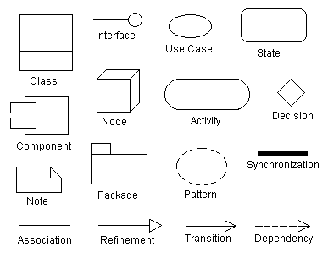
Notations

Slide 63
Types of UML Diagrams
UML includes the following nine diagrams
Class diagram
Object diagram
Use case diagram
Sequence diagram
Collaboration diagram
Activity diagram
Statechart diagram
Deployment diagram
Component diagram

Slide 64
Structural Diagrams
They represent the static aspect of the system. These static aspects represent those parts of a diagram which forms the main structure and therefore stable
The four structural diagrams are:
Class diagram
Object diagram
Component diagram
Deployment diagram

Slide 65
Behavioral diagrams
Any system can have two aspects, static and dynamic.
A model is considered as complete when both the aspects are covered fully.
It basically capture the dynamic aspect of a system.
Dynamic aspect can be further described as the changing/moving parts of a system.
UML has the following five types of behavioral diagrams:
Use case diagram
Sequence diagram
Collaboration diagram
Statechart diagram
Activity diagram

Slide 66
Classes
Each class is represented by a rectangle subdivided into three compartments
  Name
  Attributes
  Operations
Modifiers are used to indicate visibility of attributes and operations.
  ‘+’ is used to denote Public visibility (everyone)
  ‘#’ is used to denote Protected visibility (friends and derived)
  ‘-’ is used to denote Private visibility (no one)
By default, attributes are hidden and operations are visible.

Slide 67
An example of Class
Name
Account_Name
- Customer_Name
- Balance
Attributes
+addFunds( )
+withDraw( )
+transfer( )
Operations

Slide 68
OO Relationships
There are two kinds of Relationships
  Generalization (parent-child relationship)
  Association (student enrolls in course)
Associations can be further classified as
  Aggregation
  Composition

Slide 69
OO Relationships: Generalization
Supertype
Example:
Customer
Regular
Customer
Loyalty
Customer
Subtype1
Subtype2
or:
Customer
- Generalization expresses a parent/child relationship among related classes.
- Used for abstracting details in several layers
Regular
Customer
Loyalty
Customer

Slide 70
OO Relationships: Association
Represent relationship between instances of classes
  Student enrolls in a course
  Courses have students
  Courses have exams
  Etc.
Association has two ends
  Role names (e.g. enrolls)
  Multiplicity (e.g. One course can have many students)
  Navigability (unidirectional, bidirectional)

Slide 71
Association: Multiplicity and Roles
student
1
*
University
Person
0..1
*
employer
teacher
Role
Multiplicity
Symbol Meaning
1 One and only one
0..1 Zero or one
M..N From M to N (natural language)
* From zero to any positive integer
0..* From zero to any positive integer
1..* From one to any positive integer
Role
“A given university groups many people; some act as students, others as teachers. A given student belongs to a single university; a given teacher may or may not be working for the university at a particular time.”

Slide 72
Association: Model to Implementation
*
4
Student
Course
has
enrolls
Class Student {
Course enrolls[4];
}
Class Course {
Student have[];
}

Slide 73
OO Relationships: Composition
Composition: expresses a relationship among instances
of related classes. It is a specific kind of Whole-Part
relationship.
It expresses a relationship where an instance of the
Whole-class has the responsibility to create and initialize
instances of each Part-class.
It may also be used to express a relationship where instances
of the Part-classes have privileged access or visibility to
certain attributes and/or behaviors defined by the
Whole-class.
Composition should also be used to express relationship where
instances of the Whole-class have exclusive access to and
control of instances of the Part-classes.
Composition should be used to express a relationship where
the behavior of Part instances is undefined without being
related to an instance of the Whole. And, conversely, the
behavior of the Whole is ill-defined or incomplete if one or
more of the Part instances are undefined.
Whole Class
Class W
Class P₁
Class P₂
Part Classes
Example
Automobile
Engine
Transmission
[From Dr.David A. Workman]

Slide 74
OO Relationships: Aggregation
Container Class
Class C
Aggregation: expresses a relationship among instances
of related classes. It is a specific kind of Container-Containee
relationship.
It expresses a relationship where an instance of the
Container-class has the responsibility to hold and maintain
instances of each Containee-class that have been created
outside the auspices of the Container-class.
Aggregation should be used to express a more informal
relationship than composition expresses. That is, it is an
appropriate relationship where the Container and its
Containees can be manipulated independently.
Aggregation is appropriate when Container and Containees have no special access privileges to each other.
AGGREGATION
Class E₁
Class E₂
Containee Classes
Example
Bag
Apples
Milk
[From Dr.David A. Workman]

Slide 75
Aggregation vs. Composition
  Composition is really a strong form of aggregation
    components have only one owner
    components cannot exist independent of their owner
    components live or die with their owner
    e.g. Each car has an engine that can not be shared with other cars.
  Aggregations may form "part of" the aggregate, but may not be essential to it. They may also exist independent of the aggregate.
  e.g. Apples may exist independent of the bag.

Slide 76
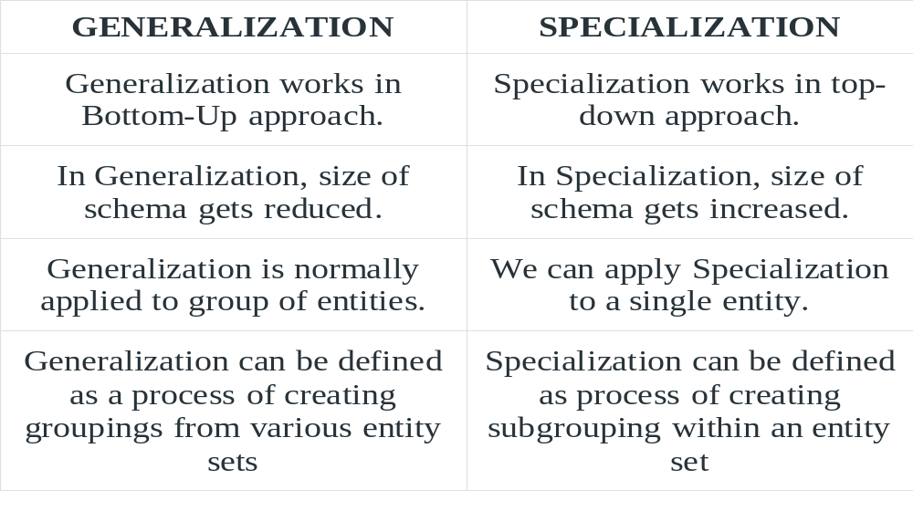
Diffenrence between Generalization and Specialization

Slide 77
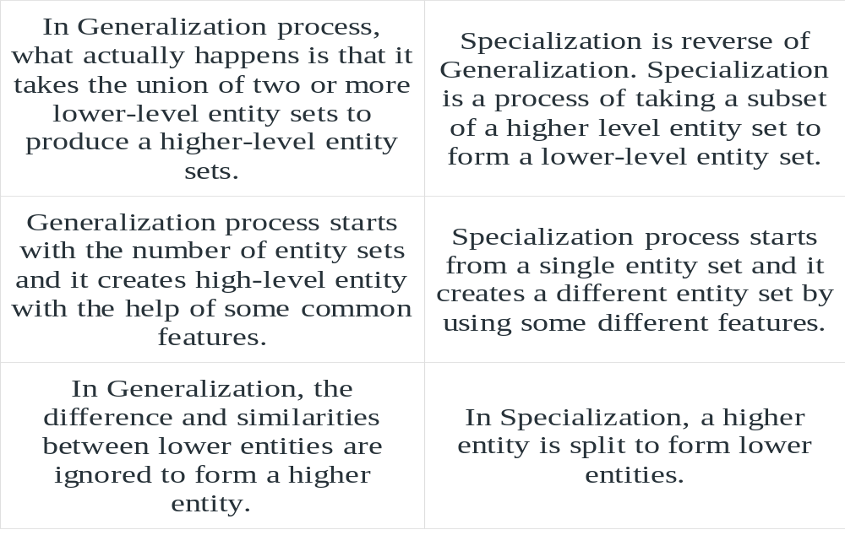
Diffenrence between Generalization and Specialization

Slide 78
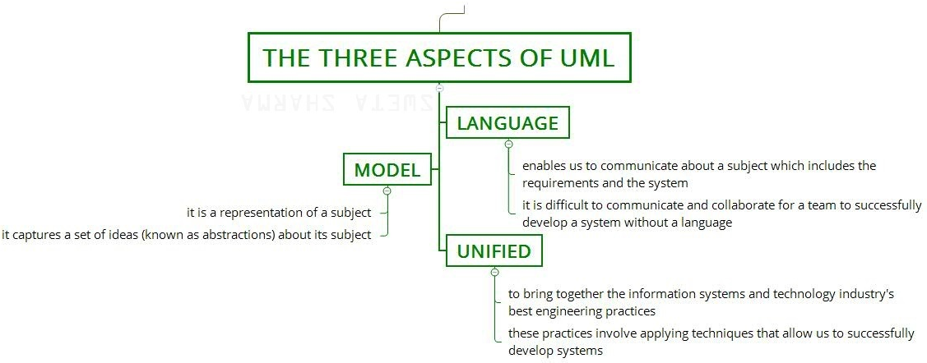
Three Aspects of UML

Slide 79
Three Aspects of UML
1. Language:
It enables us to communicate about a subject which includes the requirements and the system.
It is difficult to communicate and collaborate for a team to successfully develop a system without a language.
2. Model:
It is a representation of a subject.
It captures a set of ideas (known as abstractions) about its subject.

Slide 80
Three Aspects of UML
3. Unified:
It is to bring together the information systems and technology industry’s best engineering practices.
These practices involve applying techniques that allow us to successfully develop systems.

Slide 81
A Conceptual Model of UML
A conceptual model of the language underlines the three major elements:
• The Building Blocks
• The Rules
• Some Common Mechanisms

Slide 82
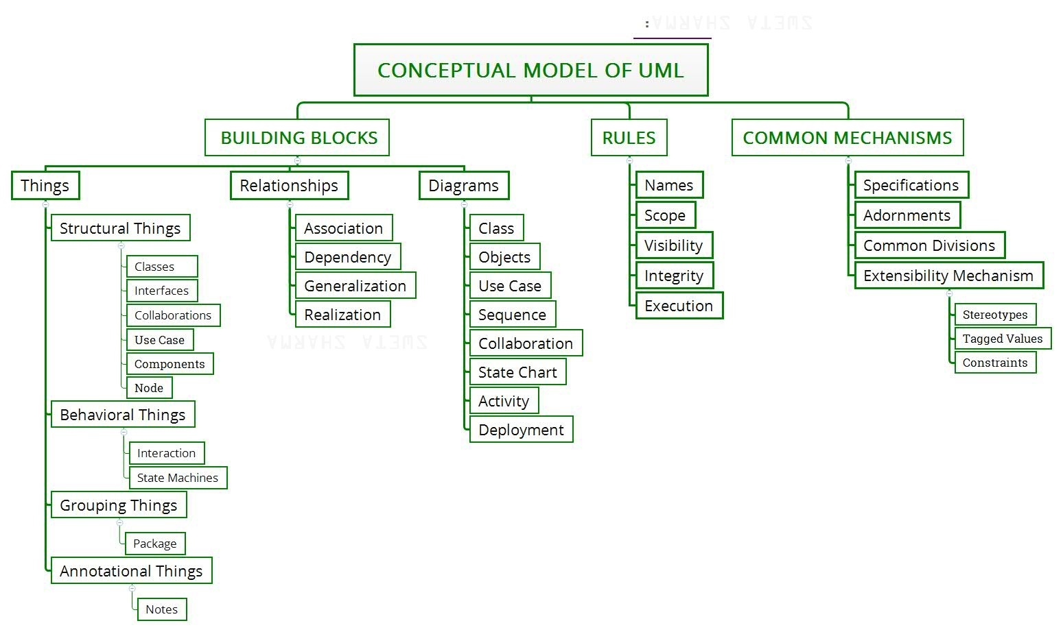
.

Slide 83
Conceptual Model of the UML
The vocabulary of the UML encompasses three kinds of building blocks:
Things: Things are the abstractions that are first-class citizens in a model; relationships tie these things together; diagrams group interesting collections of things. There are 4 kinds of things in the UML:
1. Structural things
2. Behavioral things
3. Grouping things

Slide 84
Building Blocks
Relationships: There are 4 kinds of relationships in the UML:
1. Dependency
2. Association
3. Generalization
4. Realization

Slide 85
Building Blocks
Diagrams: It is the graphical presentation of a set of elements. It is rendered as a connected graph of vertices (things) and arcs (relationships).
1. Class diagram
2. Object diagram
3. Use case diagram
4. Sequence diagram
5. Collaboration diagram
6. Statechart diagram
7. Activity diagram
8. Component diagram
9. Deployment diagram

Slide 86
UML Architecture
Software architecture provides a basic design of a complete software system.
It defines the elements included in the system, the functions each element has, and how each element relates to one another.
In short, it is a big picture or overall structure of the whole system, how everything works together.
To form an architecture, the software architect will take several factors into consideration:
  What will the system be used for?
  Who will be using the system?
  What quality matters to them?
  Where will the system run?

Slide 87
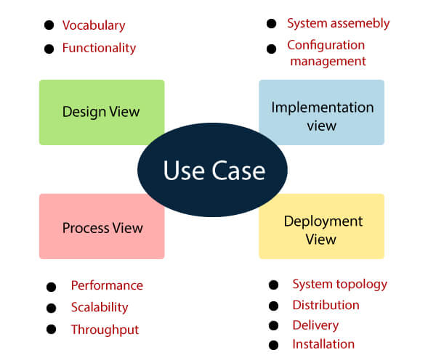
UML Architecture
It is understood as a collection of five views:
  1.Use case view
  2.Design view
  3.Implementation view
  4.Process view
  5.Development view

Slide 88
Use case view
It is a view that shows the functionality of the system as perceived by external actors.
It reveals the requirements of the system.
With UML, it is easy to capture the static aspects of this view in the use case diagrams, whereas it?s dynamic aspects are captured in interaction diagrams, state chart diagrams, and activity diagrams.

Slide 89
Design View
It is a view that shows how the functionality is designed inside the system in terms of static structure and dynamic behavior.
It captures the vocabulary of the problem space and solution space.
With UML, it represents the static aspects of this view in class and object diagrams, whereas its dynamic aspects are captured in interaction diagrams, state chart diagrams, and activity diagrams.

Slide 90
Implementation View
It is the view that represents the organization of the core components and files.
It primarily addresses the configuration management of the system?s releases.
With UML, its static aspects are expressed in component diagrams, and the dynamic aspects are captured in interaction diagrams, state chart diagrams, and activity diagrams.

Slide 91
Process View
It is the view that demonstrates the concurrency of the system.
It incorporates the threads and processes that make concurrent system and synchronized mechanisms.
It primarily addresses the system's scalability, throughput, and performance.
Its static and dynamic aspects are expressed the same way as the design view but focus more on the active classes that represent these threads and processes.

Slide 92
Deployment View
It is the view that shows the deployment of the system in terms of physical architecture.
It includes the nodes, which form the system hardware topology where the system will be executed.
It primarily addresses the distribution, delivery, and installation of the parts that build the physical system.

Slide 93
Summary and Final Thoughts
Object-Oriented Programming (OOP) simplifies real-world problem modeling through classes and objects.
Core concepts like encapsulation, polymorphism, and inheritance promote code reusability and security.
Modeling is essential for clear software design and effective communication among stakeholders.
UML provides standardized diagrams to visualize system structure and behavior.
A solid foundation in OOP and UML supports scalable, maintainable, and efficient software development.

Slide 94
REFERENCES FOR FURTHER LEARNING OF THE SESSION
Books:
  Grady Booch – Object-Oriented Analysis and Design
  Herbert Schildt – Java: The Complete Reference
  Robert C. Martin – Clean Code
Web Links:
  https://www.geeksforgeeks.org/
  https://stackoverflow.com/
  https://docs.oracle.com/javase/

Slide 95
Course Outcomes
Course Learning Outcomes
Understand core object-oriented programming (OOP) concepts such as class, object, inheritance, polymorphism, encapsulation, and abstraction.
Analyze object-oriented design techniques for solving real-world problems using modeling concepts.
Design software systems using UML diagrams like class, sequence, and use-case diagrams.
Apply object-oriented modeling principles to represent the structure and behavior of software systems.
Identify appropriate design patterns and principles for effective software architecture.
Develop well-structured software solutions using object-oriented analysis and design (OOAD) practices in C++.

Slide 96
.
THANK YOU
Team – Object-Oriented Principles
THANK YOU

