Slide 1

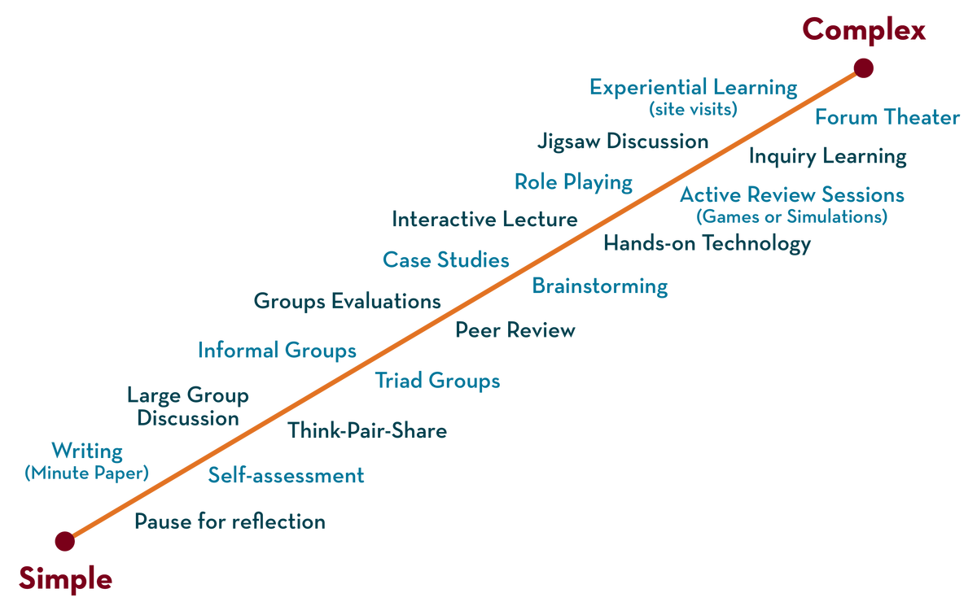
Session - 3

Slide 2
Object-Oriented System Design
Unit III: From Analysis to Implementation
A Comprehensive Guide to Designing and Building OO Systems

Slide 3
MAIN TOPICS
Part 1: The Object Design Process
  Core Activities in Object Design
  Combining Analysis Models
  Designing Algorithms & Optimizing
  Implementing Control and Adjusting Inheritance
  Physical Packaging
Part 2: Bridging Paradigms
  Structured Methodologies (SA/SD, JSD)
  Mapping OO Concepts to Non-OO Languages
Part 3: The Object-Oriented Programming Style
  Key Characteristics of OOP Style
  Procedural vs. Object-Oriented Programming
  Deep Dive: Abstraction & Encapsulation

Slide 4
Object-Oriented Design (OOD)
Analysis is about understanding the problem — figuring out what the system should do.
Design is about figuring out the solution — deciding how the system will do it.
So, Object-Oriented Design takes the results of analysis (objects, classes, relationships) and turns them into a blueprint for implementation.
We refine the analysis model into a design model.
This means adding details about data structures, algorithms, control flow, and packaging.
The goal: make the design precise enough that programmers can directly code it.

Slide 5
Key elements in OOD
Classes & Objects – refined with attributes, methods, and visibility.
Inheritance & Associations – adjusted for efficiency and clarity.
Algorithms – specified for object behaviors.
Control – deciding which object is responsible for decisions.
Packaging – grouping related classes into modules or subsystems.

Slide 6
add the missing details
in Object-Oriented Design, we use the same objects we identified during analysis, but we add the missing details:
How data is represented (e.g., arrays, linked lists, maps).
How operations are carried out (algorithms).
Which classes should inherit from which (sometimes we simplify or optimize).
How to group classes into subsystems or packages.

Slide 7
What is Object Design?
Object-Oriented Design is broad — it covers the whole system’s blueprint.
Object Design is more focused: it takes each class/object and adds implementation details so it can be coded.
OOD = whole system design
Object Design = per-class fine-tuning

Slide 8
Activities in Object Design
1. Define attributes clearly
Choose data types, visibility (public/private/protected), and constraints.
Example: balance: double instead of just balance.
2. Define operations precisely
Add parameters, return types, and pre/post conditions.
Example:
deposit(amount: double): void
withdraw(amount: double): boolean
3. Refine relationships
Decide whether associations should be direct references, arrays, lists, or maps.
4. Add algorithms
Replace abstract actions like “sort books” with a concrete method, e.g., “merge sort on list of books.”
5. Optimize inheritance/encapsulation
Merge unnecessary classes, adjust hierarchy for reuse and clarity.

Slide 9
Example (Library Management System):
In analysis, we might say:
Class: Book
Attributes: title, author, ISBN
Operation: borrow()
In object design, we refine:
class Book {
private String title;
private String author;
private String ISBN;
private boolean isAvailable;
public boolean borrow() {
if (isAvailable) {
isAvailable = false;
return true;
}
return false;
}
}

Slide 10
Combining the Three Models
Rumbaugh’s methodology (OMT — Object Modeling Technique) is built on three models that represent different views of a system:
1. Object Model → structure of the system
  Classes, attributes, operations, associations, inheritance.
  (Like your Book and Member diagrams/code).
2. Dynamic Model → behavior over time
  State diagrams, events, transitions.
  Describes how objects change states (e.g., a Book goes from Available → Borrowed → Returned).
3. Functional Model → data transformations
  Data flow diagrams (DFDs).
  Focuses on what functions transform inputs to outputs.

Slide 11
Combining the Three Models
Why combine them?
Each model answers a different question:
  Object Model = what the system is made of
  Dynamic Model = how it behaves over time
  Functional Model = what transformations happen
To design a complete system, we merge them:
  Start with the object model (the backbone).
  Add the dynamic model to show how objects react to events.
  Add the functional model to describe computations.

Slide 12
Designing Algorithms
When we move from object design to implementation, we need to decide how each operation will actually work. That’s where algorithms come in.
1. From Abstract to Concrete
In analysis, we say: Member borrows a book.
In object design, we say: Method borrowBook() exists.
In algorithm design, we answer: What exact steps should borrowBook() perform?
2. Principles of Algorithm Design
Clarity → The algorithm must be unambiguous.
Correctness → It must achieve the intended effect (e.g., ensure a member cannot borrow more than 5 books).
Efficiency → Choose the right data structures (linked list, hash table, etc.) to make it fast.
Reusability → The algorithm should be general enough to be reused in other contexts if possible.
Modularity → Break large algorithms into smaller helper functions for readability.

Slide 13
Designing Algorithms
3. Steps in Designing Algorithms
Specify behavior in plain language
  Example: “Check if book is available. If yes, mark it as borrowed and update member record. Otherwise, deny request.”
Identify required data
  What attributes/objects do we need to touch? (Book.isAvailable, Member.booksBorrowed).
Choose control structures
  Conditionals (if), loops (for/while), error handling.
Refine into pseudocode
  Before coding, write step-by-step instructions.
Optimize
  Replace naive choices with better ones (e.g., searching a book by ISBN in a hash map instead of a linear list).
4. OOD Twist
Unlike traditional algorithm design (where you think in terms of global functions), in OOD we design algorithms inside classes. That means:
  Algorithms operate on the object’s state (attributes).
  They often involve collaboration between objects (a Member and a Book).
  Responsibility matters → we ask which class should own the algorithm?
Example in words:
  Instead of a global function issueBook(book, member),
  In OOD, we ask: Should Book handle the logic (borrow())? Or should Member handle it (borrowBook(book))?
  The answer depends on who has the responsibility in our design.

Slide 14
Optimize access paths to data / Design optimization
Basic design model uses analysis model which captures the logical information about the system, while design model must add details to support efficient information access.
Inefficient but semantically correct analysis model can be optimized to make the implementation more efficient.
During design optimization, designer must
  Add redundant associations to minimize access cost and maximize convenience.
  Rearrange the computation for greater efficiency.
  Save derived attributes to avoid re-computation of complicated expression

Slide 15
Implementation of control for external interactions
Designer must refine the strategy for implementing the state – event models present in the dynamic model.
Basic approaches to implement dynamic model are
  Using a location within the program to hold state.
  Direct implementation of a state – machine mechanism.
  Control as concurrent tasks.

Slide 16
Adjust class structure to increase inheritance
The designer should rearrange and adjust classes and operations to increase inheritance
The designer should abstract common behaviour out of group of classes
The designer should use delegation to share behaviour when inheritance is semantically invalid.

Slide 17
Design of associations
Associations are the “glue” of object model, providing access paths between objects.
The designer must formulate a strategy for implementing the associations in the object model.
Either choose a global strategy for implementing all associations uniformly or select a particular technique for each association based on the way it is used in the application.
Associations may be either one-way associations or two –way associations.

Slide 18
Determine object representation
Designer must choose when to use primitive types in representing objects and when to combine groups of related objects.
Classes can be defined in terms of other classes, but eventually everything must be implemented in terms of built-in primitive datatypes, such as integers, strings and enumerated types.
Designer must often choose whether to combine groups of related objects.

Slide 19
Packing classes and associations into modules
Object oriented languages have various degrees of packaging.
In large project, careful partitioning of an implementation into packages is important to permit different persons to cooperatively work on a program.
Packaging involves the following issues:
  Hiding internal information from outside view.
  Coherence of entities.
  Constructing physical modules

Slide 20
Documenting Design Considerations
UML diagrams show WHAT you designed. Documentation explains WHY.
Essential for Maintenance & Teamwork:
  Document Trade-offs: "We chose Algorithm X for speed, accepting higher memory usage."
  Document Strategic Choices (Patterns): "We used the Singleton pattern for the database connection to ensure only one connection is ever made."
  Document Assumptions: "Assumed the third-party API will have a latency of less than 200ms."
  Document Interface Contracts: Clearly specify what public methods do, their parameters (pre-conditions), and what they return (post-conditions).

Slide 21
Alternative Design Methodologies
To fully appreciate the power of the Object-Oriented paradigm, we must understand what came before it.
Reasons to study structured methodologies:
  To Understand Evolution: See how software design has evolved from a function-centric to an object-centric view.
  To Work with Legacy Systems: Many existing, critical systems were built using these techniques.
  To Appreciate OOD: Contrasting OOD with older methods highlights its strengths in managing complexity, promoting reuse, and creating stable systems.

Slide 22
Structured Analysis & Design (SA/SD)
Paradigm: Top-Down, Functional Decomposition.
Core Belief: A system is best understood as a set of processes that transform data.
Key Feature: Strict separation of data from the functions that operate on it. Data is passive; functions are active.

Slide 23
SA/SD - The Tools of Analysis
SA/SD - The Tools of Analysis
Data Flow Diagram (DFD): The star of the show. Graphically depicts how data moves through the system.
2. Data Dictionary: A central repository that defines every data flow, data store, and process. It eliminates ambiguity.
3. ER Diagram: Used to model the relationships between the Data Stores.

Slide 24
SA/SD - The Tools of Design
Structure Chart: The main output of the design phase.
It's a hierarchical diagram showing how processes from the DFD are organized into programming language functions and the calling structure between them.
It looks like an organization chart for functions.

Slide 25
Jackson Structured Development (JSD)
Paradigm: Models a system based on real-world events and the time-ordering of those events.
Core Belief: A system's functionality must be fit into a model of the real world it operates in. The structure of the software should mirror the time-ordered structure of the real-world events.
Key Feature: Does not distinguish sharply between analysis and design. It focuses on modeling the "lifeline" of entities through events.

Slide 26
The Six Steps of JSD
Entity Action Step: List the entities and the actions they perform.
Entity Structure Step: Order the actions for each entity over time.
Initial Model Step: Connect the system to the real world (how it gets inputs).
Function Step: Add functions/operations that produce system outputs.
System Timing Step: Consider performance and time constraints.
Implementation Step: Map the abstract model to physical hardware and processes.

Slide 27
JSD - Strengths and Weaknesses
Strengths:
  Excellent for real-time and concurrent systems where timing and sequencing are critical.
  Models are based on the stable real world, not volatile user requirements.
Weaknesses:
  Considered very complex and abstract ("obscure").
  Less graphical than other methods.
  Poor for database-heavy applications because it focuses on actions, not data attributes.

Slide 28
Head-to-Head: SA/SD vs. OOD
Feature | SA/SD (Function-Oriented) | OOD (Object-Oriented)
Basic Unit | Procedure / Function | Object (Data + Behavior)
Organization | Organized around functions. | Organized around real-world objects.
Extensibility | Difficult to extend system boundaries | Easy to add new objects and relationships.
Reusability | Low. Functions are problem-specific. | High. Classes are designed for reuse
Stability | Fragile. Requirement changes often mean function changes | Robust. Objects are stable; changes are localized

Slide 29
Mapping Design to Code
The Thought Experiment
Challenge: How do we simulate OO features in a non-OO language like C?
Why is this important?
  It forces a deep understanding of what OO languages provide automatically (polymorphism, encapsulation).
  It clarifies the fundamental concepts, separating them from language syntax.
  It demonstrates how the design patterns we create are independent of the implementation language.

Slide 30
Mapping Classes & Methods
C++ Class:
class Circle {
private: double radius;
public: void setRadius(double r);
};
Equivalent in C:
  Class -> struct: struct Circle { double radius; };
  Method -> Global Function: void Circle_setRadius(struct Circle* c, double r);
  The object (c) must be passed explicitly! This is the "this" pointer.

Slide 31
Mapping Classes & Methods
C++ Class:
class Circle {
private:
double radius;
public:
void setRadius(double r);
};
Equivalent in C:
Class -> struct
struct Circle {
double radius;
};
Method -> Global Function
void Circle_setRadius(struct Circle* c, double r);
The object (c) must be passed explicitly! This is the C-equivalent of the this pointer.

Slide 32
Mapping Inheritance
How can a struct Student inherit from a struct Person in C?
Technique: Composition / Containment
  The child struct's first member is an instance of the parent struct.
  struct Person { char name[50]; };
  struct Student {
  struct Person person_data; // Inheritance
  int student_id;
  };
  This gives Student all of Person's fields

Slide 33
Mapping Associations (1-to-1)
1-to-1 Association: Use a pointer.
UML: Department <–1–> Manager
class Manager; // Forward declaration
class Department {
private:
Manager* mgr; // Association
};
1-to-Many Association: Use a container of pointers.
UML: Employee <–*–> Dependent
#include <vector>
class Dependent;
class Employee {
private:
std::vector<Dependent*> dependents;
};

Slide 34
Mapping Encapsulation in C
Technique: Opaque Pointers (The "PIMPL" Idiom)
In the public header file (.h), only forward-declare the struct. Do not expose its members. This makes the pointer "opaque.“
// widget.h
struct Widget; // Opaque type
struct Widget* create_widget();
void widget_do_something(struct Widget* w);
In the private source file (.c), define the struct fully and implement the functions.
// widget.c
#include "widget.h"
struct Widget { int internal_data; }; // Full definition
// ... implementations ...
This hides the implementation details (internal_data) from any client that only includes widget.h.

Slide 35
The OOP Style: Programming in the Large
The Philosophy of OO Programming
OOP is not just a set of language features; it's a style of writing software to manage complexity over the long term.
The goals are to create software that is:
  Reusable: Components can be used again in different systems.
  Extensible: New functionality can be added without modifying existing, working code.
  Robust: The system can cope with errors and abnormal situations gracefully.

Slide 36
Style Pillar 1: Reusability
Definition: Creating components that can be used again in different systems.
Mechanisms:
  Inheritance (White-Box Reuse): A new class inherits and can see/modify the implementation details of its parent. It's a tight coupling.
  Composition (Black-Box Reuse): An object uses another object through its public interface, without knowing its internal details. It's a loose coupling.
Golden Rule: Favor Composition over Inheritance. It leads to more flexible, modular, and stable designs.

Slide 37
Style Pillar 2: Extensibility
Definition: The ability to add new functionality without modifying existing, working code. This is The Open/Closed Principle.
  Open for extension.
  Closed for modification.
Mechanism: Polymorphism
  Example: Create a system that works with an abstract Shape interface with a draw() method.
  The original system can draw any Shape object.
  Later, you can add new shapes (Triangle, Pentagon) that implement the Shape interface. The original system can draw them without a single line of code change. It is open to new shapes but closed to modification.

Slide 38
Style Pillar 3: Robustness
Definition: The ability of a system to cope with errors and abnormal situations.
Mechanisms:
  Encapsulation: Protects an object’s internal state. Well-defined public methods act as gatekeepers, preventing invalid data from being set from the outside.
  Exception Handling: Provides a clean, structured way to separate error-handling code from the main program logic, improving readability and maintainability.

Slide 39
Procedural vs. Object-Oriented
Procedural:
  Data is passive. Functions are active and operate on data.
  Global data is common, leading to high coupling. A change in a data structure can break many functions.
  Focus is on a sequence of actions.
Object-Oriented:
  Data and the operations on that data are bundled into active objects.
  Data is protected (encapsulated). This reduces coupling and makes the system easier to manage.
  Focus is on interacting, self-contained objects.

Slide 40
The Pillars of OOP: Abstraction
Definition: Hiding complexity and exposing only the essential, high-level features. It's about simplifying the view of a complex entity.
The Classic Analogy: A Car's Dashboard
  It provides a simple interface (speedometer, fuel gauge, steering wheel) that abstracts away the immense complexity of the engine, transmission, and electrical systems. You don't need to know how the engine works to drive the car.
In Code: Achieved with abstract classes and interfaces.

Slide 41
The Pillars of OOP: Encapsulation
Definition: The bundling of data (attributes) and methods (behavior) into a single unit (a class), and hiding the data from the outside world (Information Hiding).
The Classic Analogy: A Medical Capsule
  The medicine (the data) is protected by the shell. You can only interact with it via the intended public method (swallowing). You cannot access the raw powder directly.
In Code: Achieved with private and protected access specifiers.

Slide 43
THANK YOU
Team – OOSD

