Slide 1
A Dirichlet Multinomial Mixture Model-based Approach for Short Text Clustering

Slide 2
Methodology
Interpretation
Implementation
Results
Movie Group Process
Dirichlet Multinomial Mixture (DMM)
Gibbs Sampling for DMM
Dataset
Code
init function
fit function
score function
result function
plot function
Complexity
Evaluation metrics
Influence of
# of Iterations (I)
# of clusters (K)
α
β
Comparing models
Conclusion

Slide 3
Interpretation

Slide 4

Movie Group Process
Groups of students to be formed
Each group - similar movie lists
Rules of formation:
Select group with more students
Select group with similar interests

Slide 5
Dirichlet Multinomial Mixture
DMM is a probabilistic generative model for documents, and embodies two assumptions about the generative process:
The documents are generated by a mixture model, and
There is a one-to-one correspondence between mixture components and clusters

Slide 6


Dirichlet Multinomial Mixture
Probability that document d is generated:
Naive Bayes assumption for words
Probability that d is generated by cluster k:

Slide 7
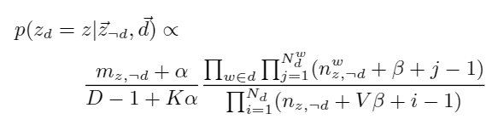
Gibbs Sampling for DMM
Randomly assign the documents to K clusters, and record the following information: z , m_{z}, n_{z}, and n_{z}^{w}.
Traverse the documents for I iterations.
Reassign a cluster for each document d in turn according to p(z_{d} = z|~z ¬d, ~d) . Update z , m_{z}, n_{z} , and n_{z}^{w} accordingly.

Slide 8
Implementation

Slide 9
Dataset
News Dataset
Tweet Dataset
Title Set
Snippet Set
Title-Snippet Set

Slide 10
Initializes all the required variables for the algorithm
Calculates probability based on the formula mentioned in the paper
Plots the iterations vs accuracy graph for a given dataset
init
fit
score
result
plot
Reassign documents to cluster based on score for every iteration
Prints NMI, H, C, ARI, and AMI for the predicted value of a given dataset

Slide 11
Complexity
Space Complexity
Time Complexity
GSDMM stores z , m_{z}, n_{z}, and n_{z}^{w}. Their sizes are D, K, K, and KV, respectively.
With huge datasets, GSDMM spends most space to store the words in each document with complexity O(DL̄), where L̄ is the average length of the documents.
GSDMM re-samples a cluster for the D documents in turn, and for each document d, it computes the conditional probability p for each cluster z. The complexity of p is linear to the average length of documents, L̄ .
GSDMM’s time complexity for each iteration is O(KDL̄ ).

Slide 12
Results

Slide 13
Evaluation Metrics
Normalized Mutual Information (NMI)
Homogeneity (H)
Completeness (C)
Adjusted Rand Index (ARI)
Adjusted Mutual Information (AMI)

Slide 14
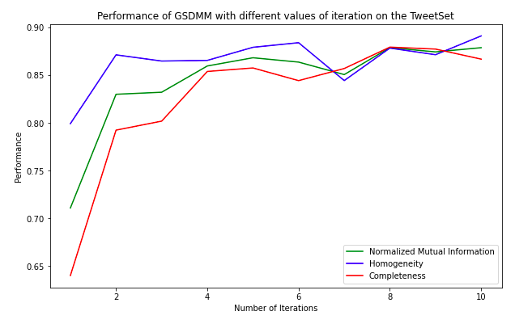
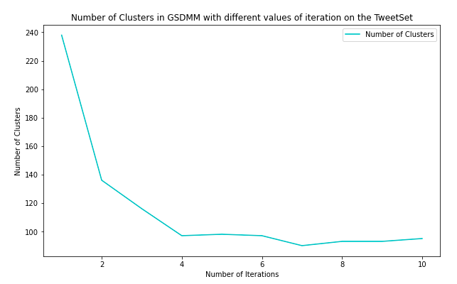
Influence of Number of Iterations

Slide 15
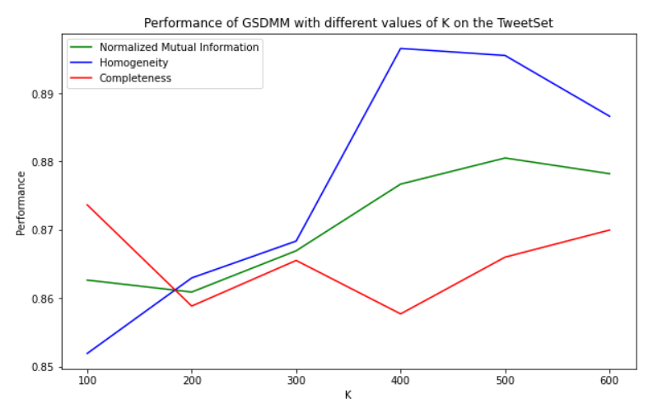
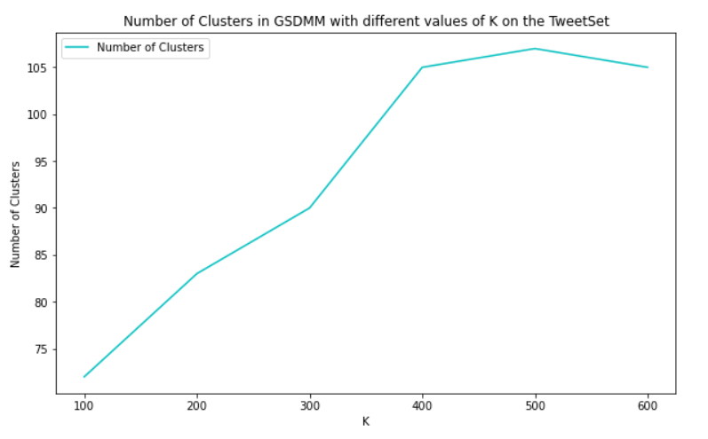
Influence of Number of Initial Clusters (K)

Slide 16
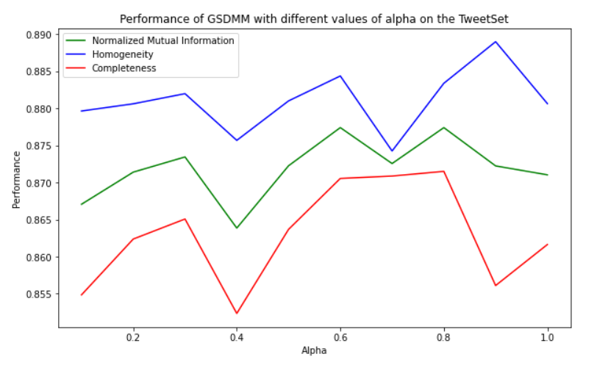
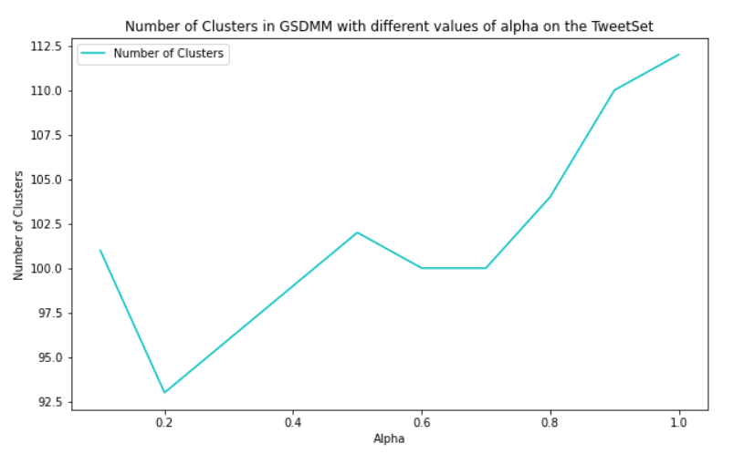
Influence of Alpha (α)

Slide 17
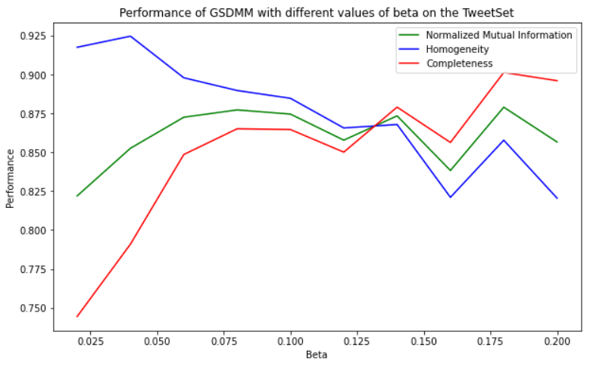
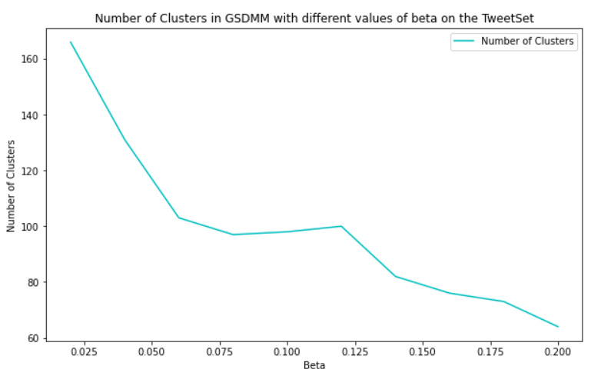
Influence of Beta (β)

Slide 18
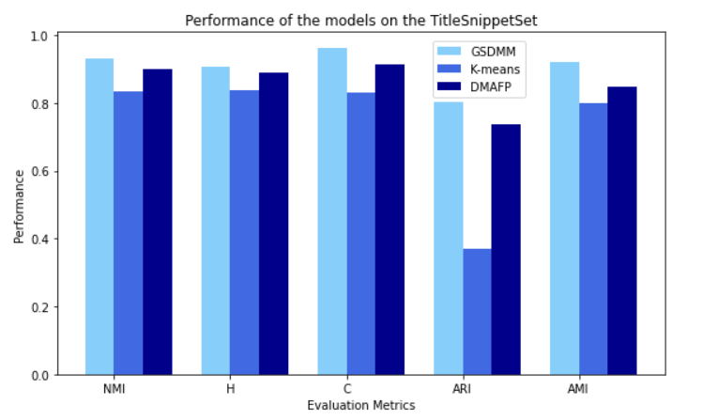
Comparing Models

Slide 19
Conclusion
GSDMM infers the number of clusters automatically with a good balance between the completeness and homogeneity of the clustering results, and is fast to converge
GSDMM copes with the sparse and high-dimensional problem of short texts, and obtain the representative words of each cluster
GSDMM achieves significantly better performance than the baseline methods

Slide 20
Thank You

