Slide 1
Visual Analysis for Players

Slide 2
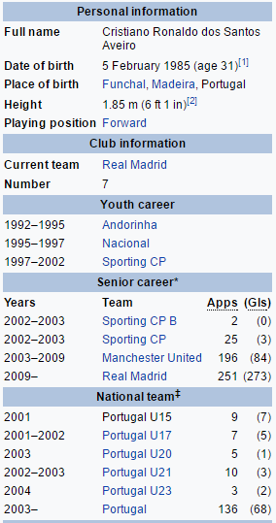
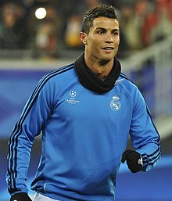
Cristiano Ronaldo
Notes:
Forward

Slide 3
Cristiano Ronaldo

Slide 4
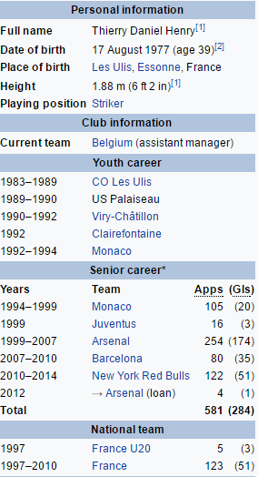
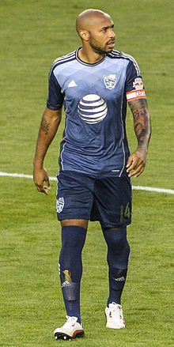
Thiery Henry

Slide 5
Thiery Henry

Slide 6
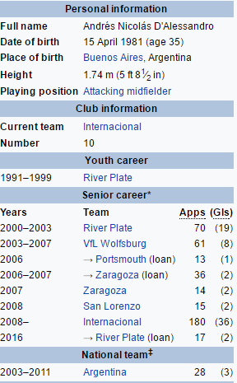
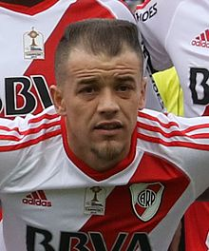
Andrés D'Alessandro
Notes:
Attacking Midfielder: Can be used to represent only time vs performance. No spikes

Slide 7
Notes:
Rating Points are used in place of Caliberated Points to show correlation with the time played.

Slide 8
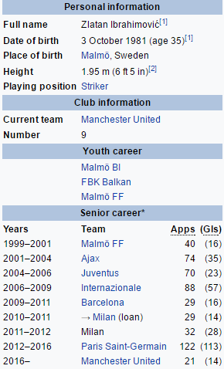

Zlatan Ibrahimovic
Notes:
Forward Player

Slide 10
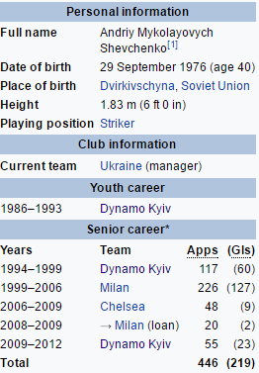
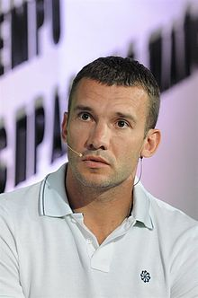
Andriy Shevchenko

Slide 12
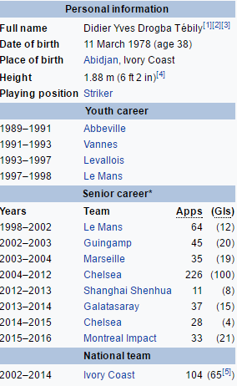
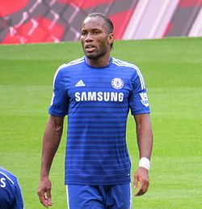
Didier Drogba
Notes:
Striker

Slide 14
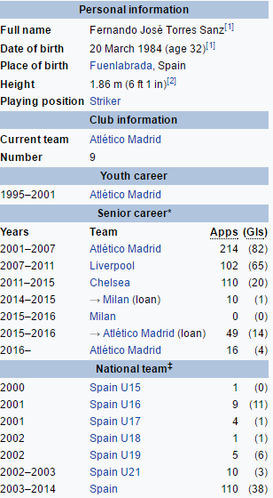
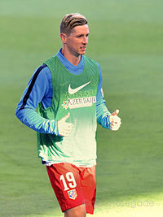
Fernando Torres
Notes:
Striker

Slide 15
Notes:
2 Spikes

Slide 16
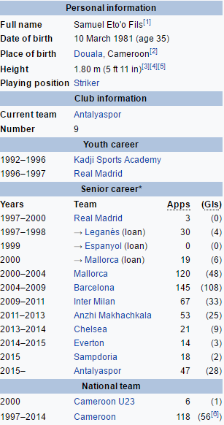
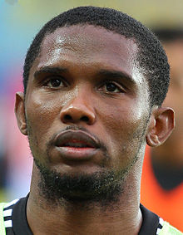
Samuel Eto'o
Notes:
Striker
// Ronaldinho Data Missing

Slide 17
Notes:
3 Spikes

Slide 18
Eto
A
B
C
Notes:
Change the image >> make sure the labels in the table are formatted and the colors are right (excel)

Slide 19
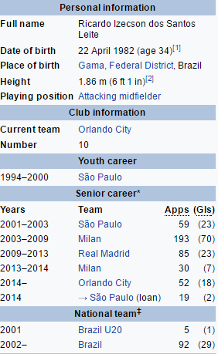
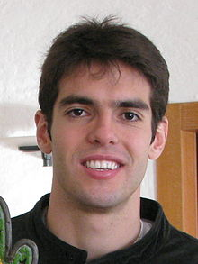
Kaka
Notes:
Attacking Midfielder: No Concept of Spikes Applicable

Slide 20
Notes:
See correlation with time played and rating points

