Slide 1

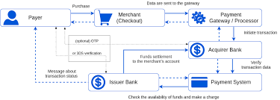

Payment Engine
Dr. Javed Imran
Assistant Professor
(Faculty mentor)
Paras Bakshi
Intern TATA 1MG
Team Payments
101917118
Gaurav Jain
SDE1 TATA 1MG
(Industrial mentor)
1

Slide 2

Table of Content
About TATA 1MG
Problem Statement
About Payment Engine
Objectives
Roles and Contribution
Tools and Technology
Snapshorts of Project
Professional and Technical Learning
Poster
2

Slide 3
About
TATA 1MG
Tata 1MG is a leading healthcare and pharmaceutical company in India.
TATA 1MG offers a wide range of services including online consultation with doctors, ordering medicines, diagnostic tests, and health products.
It was founded in 2015 and currently has over 40 million monthly active users.
3

Slide 4
Problem Statement
Tata 1 Mg's Payment service operates within the Vyked , which is connected to a PostgreSQL databases.
This framework was specifically designed by Tata 1 Mg to manage payment services.
The operations within this framework are based on Synchronous as well as Asynchronous programming.
With time cause a bottleneck in the application's performance and scalability, particularly in situations where multiple requests are made concurrently.
4

Slide 5
Payment Engine
Payment Engine is an Asynchronous version of the existing Payment service at TATA 1MG.
Project Payment Engine is based on Sanic, which is an asynchronous programming framework.
Payment Engine integrates with Tortoise ORM, which is an object-relational mapper that makes it easier to interact with a database in an object-oriented way.
Payment Engine project has a more efficient and scalable architecture, allowing it to handle more requests and respond more quickly to user interactions.
5

Slide 6
Objectives
Convert Payment service from Vyked to Asyncronous Sanic Framework.
Improved Performance and Increased Scalability.
Simplified Development and Maintenance
Improved Workflow for Business Logic
Refactored and Modular Codebase
Better Alerting/Monitoring/CICD/Logging
6

Slide 7
Role & Contribution
Development of Juspay, Paytm, UPI and card routes.
Development of Mock service
Development of Amazonpay and User Config routes.
Performed API testing
Successfully completed the Quality Assurance
Handled Payment-related on-calls
7

Slide 8
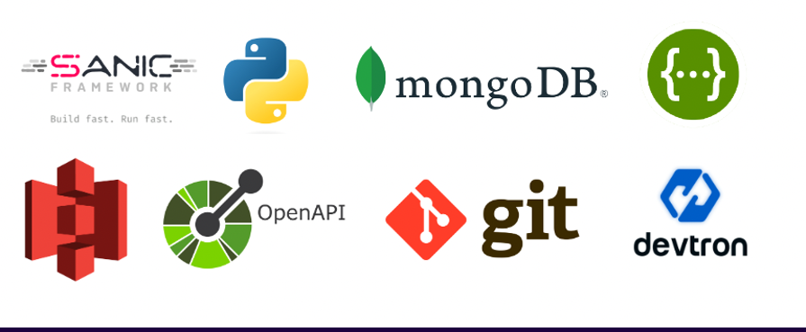
Techniques and Tools used
Git
Linux
Python (Asyncio, Pydantic)
Sanic Framework
PostgreSQL
MongoDB
Pytest for Testing API's
Devtron
Bitbucket Pipelines
8

Slide 9
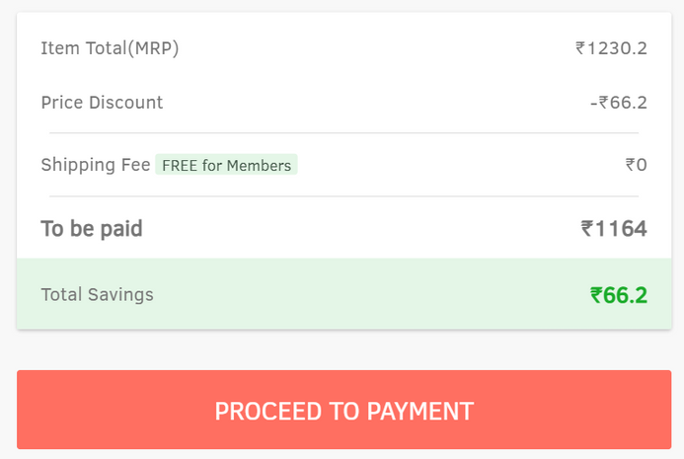
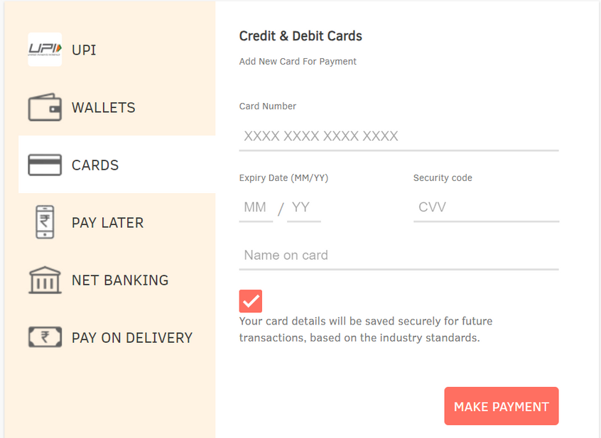
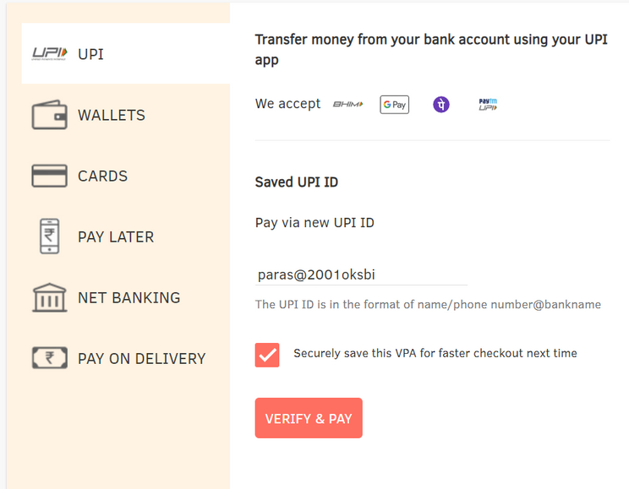
Snapshots of Project
The process of Payment start from Call to Payment Init Route
Backend routes for Save Card and Delete Card.
9
Backend routes for Adding and Validating UPI

Slide 10
Professional and Technical Learning
Acquired hands-on industry experience.
Acquired a broad range of technological knowledge.
Ideal Launchpad for a Software Development Career.
Growth of Soft Skills through Collaborative Interactions.
10

Slide 11
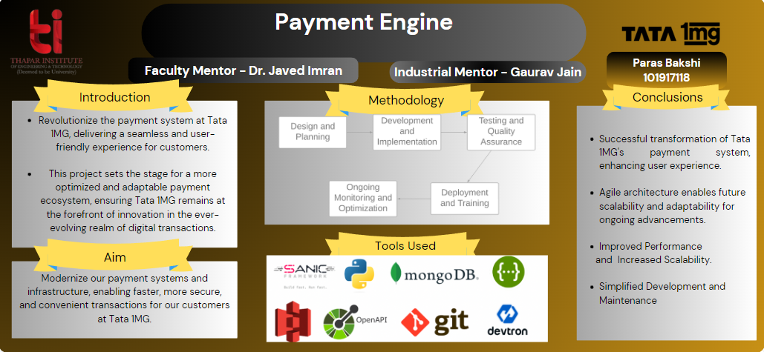
Poster
11

Slide 12
Thank You
12

