Slide 1
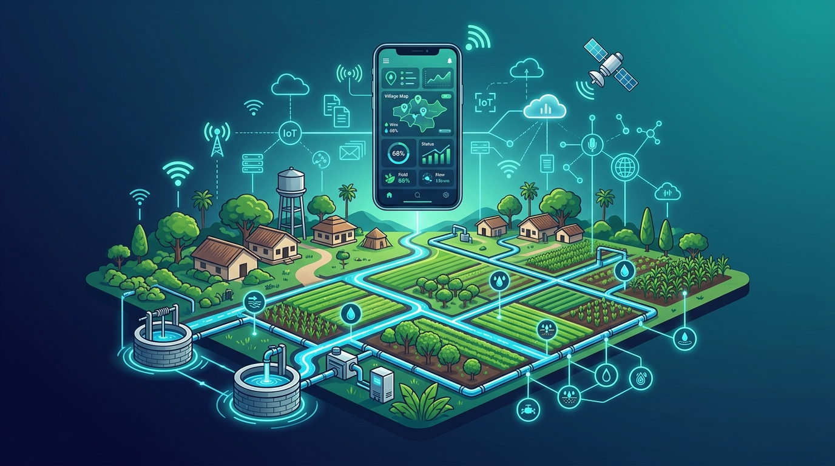
Smart Village Water Management
A Three-Phase IoT + AI Solution for Agricultural Irrigation
Phase 1 — Remote Pump Control
Phase 2 — Smart Valve System
Phase 3 — AI-Driven Irrigation
Confidential — Project Proposal 2026

Slide 2
🎯 PROBLEM STATEMENT
The Irrigation Challenge in Rural Villages
Traditional agricultural water systems are inefficient, uncontrolled, and wasteful — costing farmers time, money, and water.
🚶
💧
⚡
Physical Presence Required
Water Wastage
High Power Consumption
Farmers must travel to wells to manually start/stop pumps — often at odd hours.
Water is over-supplied to fields regardless of crop type or actual requirement.
Motors run longer than necessary, driving up electricity costs.
🤝
🌾
📵
No Individual Control
Crop-Blind Irrigation
Zero Remote Access
All farmers share the same flow — one farmer's need affects all others.
No system accounts for different crop water needs across field types.
No digital monitoring of pump status, runtime, or fault conditions.

Slide 3
🗺️ PROJECT ROADMAP
Three-Phase Implementation Plan
A structured, scalable approach — each phase builds on the previous, delivering increasing value.
1
2
3
Remote Pump Control
Smart Valve Distribution
AI Precision Irrigation
IoT-enabled 4G remote control of two well motors. Real-time status, emergency shutdown, and current sensing.
Electronic solenoid valves on each farmer's branch pipe. Per-farmer individual water control via app.
Crop-aware AI formula computes exact water volume per acre. Automated irrigation — zero waste, max yield.
SYSTEM ARCHITECTURE FLOW
📱 Mobile App
→
☁️ Firebase Cloud
→
📡 4G Network
→
🔧 ESP8266/ESP32
→
⚙️ Motor + Valves
Farmer/Admin
Real-time DB
Jio Dongle
Edge Controller
Field Hardware

Slide 4
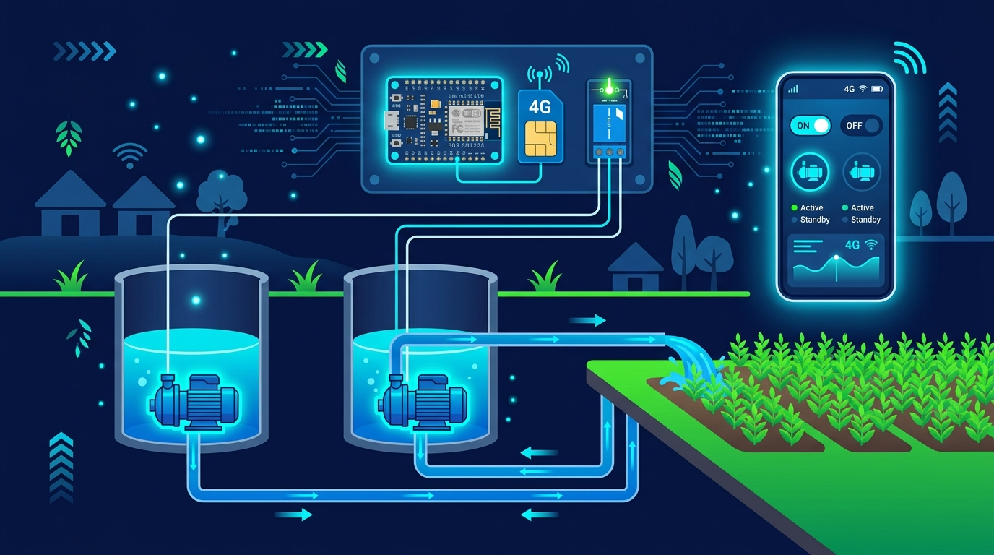
⚡ PHASE 1
Remote Pump
Control System
Two wells in the village, each fitted with an electric motor pump. Farmers start and stop motors remotely via our web app — from anywhere, via 4G.
🪣 2 Village Wells
Each with a dedicated submersible motor distributing water through the main pipe.
📱 Remote ON/OFF Control
Control motors via web/mobile app over 4G — no physical presence at the well.
⏱️ Real-Time Runtime Monitor
Live HH:MM:SS stopwatch tracks exactly how long each motor is running.
2
4G
24/7
🚨 Emergency Shutdown
Wells Covered
Remote Access
Monitoring
One-tap emergency OFF immediately de-energises the motor contactor.
⚡ ACS712 Current Sensing
KEY HARDWARE
Detects dry-run faults and hardware failures automatically.
NodeMCU ESP8266 · 5V Relay Module · AC Contactor
ACS712 Current Sensor · Jio 4G Dongle · Firebase RTDB
💾 Session History & Export
Every pump cycle logged with start/end time, duration, and average current.

Slide 5
🔧 PHASE 1 — TECHNOLOGY STACK
Under the Hood
Industrial-grade components, cloud-native architecture, zero compromise on reliability.
🔬
🔁
⚡
📡
NodeMCU ESP8266
5V Relay + AC Contactor
ACS712 Sensor
Jio 4G Dongle
Wi-Fi edge controller. Controls relay, reads ACS712, syncs Firebase every 10s.
Optocoupled relay drives AC contactor to switch motor safely at mains voltage.
Hall-effect current sensor. Detects dry-run and hardware faults automatically.
Cellular internet hotspot providing reliable connectivity in remote rural areas.
☁️
⚛️
🌐
🔐
Firebase RTDB
React + TypeScript
Vercel Deployment
Firebase Auth
Google Cloud Realtime DB. Command queue & heartbeat with <200ms latency.
Mobile-responsive dashboard with live telemetry, stopwatch & session history.
Global CDN. Accessible from any phone browser — just a URL, no install.
Email/password auth ensures only authorised operators can control pumps.
React App (Vercel)
⇄ Firebase RTDB
⇄ 4G Hotspot
⇄ ESP8266
→ Relay → Motor

Slide 6
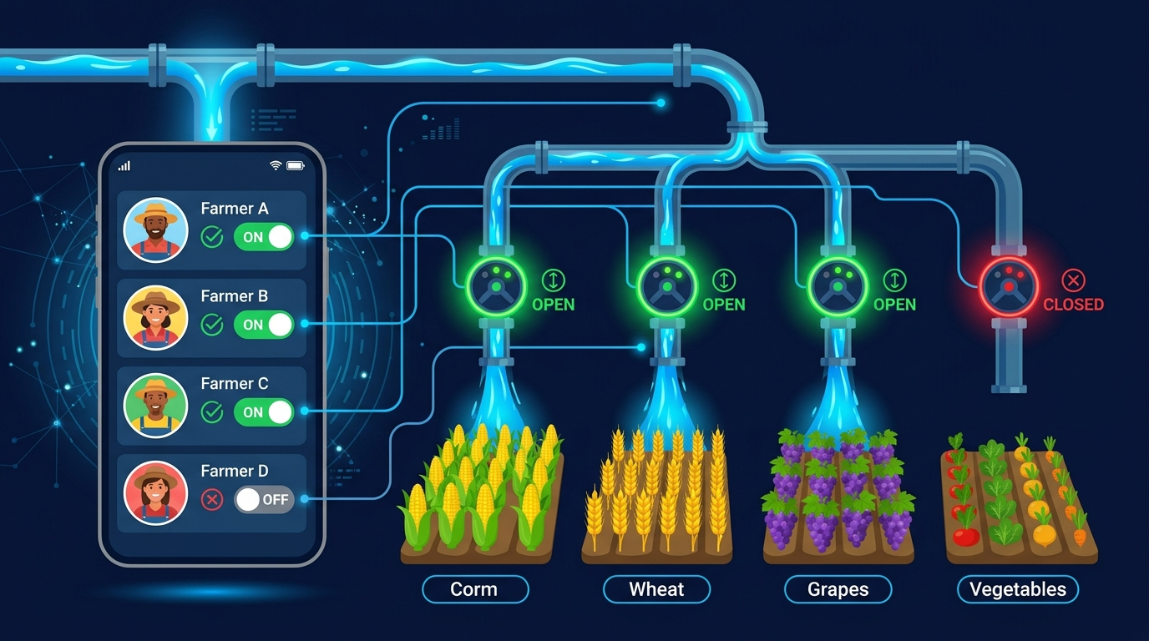
🚰 PHASE 2
Smart Electronic
Valve Distribution
After the motor sends water through the main pipe, it branches into individual pipes for each farmer's field. Each branch has an electronic solenoid valve.
🔀 Branched Pipeline
Main supply splits into N individual farmer pipes, each independently controlled.
🔌 Solenoid Valves
Electronic normally-closed valves. Fail-safe — no power means no flow.
📱 Per-Farmer App Toggle
VALVE CONTROL PER FARMER
If a farmer doesn't need water, they switch OFF — others receive water normally.
👨‍🌾 Farmer A — Field 1
✅ OPEN
🌾 Rice Paddy · 2 Acres
⚖️ Fair Distribution
👨‍🌾 Farmer B — Field 2
Closed valves redirect pressure to active pipes, improving flow for others.
✅ OPEN
🌿 Vegetables · 1.5 Acres
📊 Individual Usage Tracking
👨‍🌾 Farmer C — Field 3
✅ OPEN
Valve history per farmer for accountability and water billing.
🌽 Maize · 3 Acres
👨‍🌾 Farmer D — Field 4
🔴 CLOSED
🌾 Wheat · 2.5 Acres

Slide 7
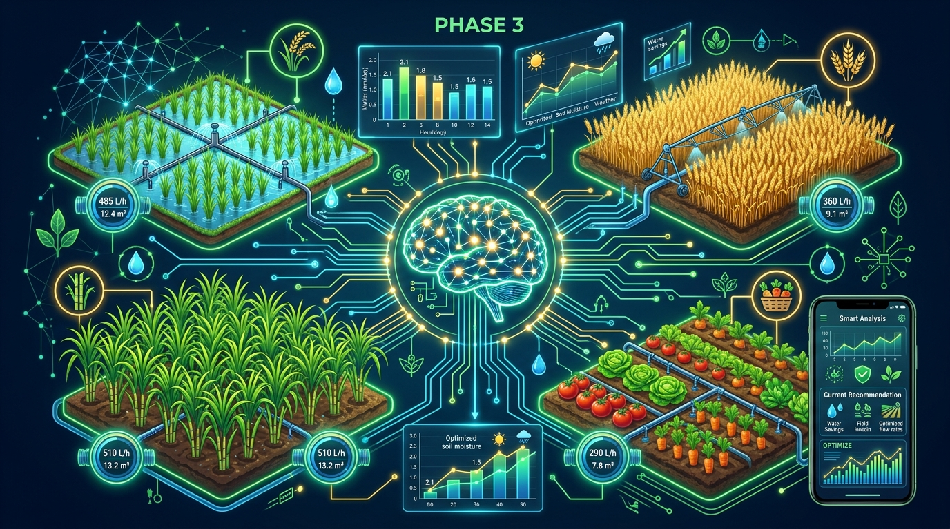
🤖 PHASE 3
AI-Powered Precision
Irrigation
Every crop type has a defined water requirement per acre. Our AI engine calculates the exact volume needed and delivers precisely that amount.
🧠 AI FORMULA LOGIC
1. Farmer inputs crop type and field size (acres) via the app.
2. AI engine references crop-specific water consumption table (L/acre/day).
3. Calculates required valve open-duration based on measured flow rate.
4. Valve auto-closes exactly when the required water volume is delivered.
CROP WATER REQUIREMENT TABLE
Crop
L / Acre / Day
Volume
🌾 Rice Paddy
1,800 – 2,400 L
🎋 Sugarcane
1,500 – 2,000 L
🌾 Wheat
600 – 900 L
🌽 Maize
500 – 800 L
🥦 Vegetables
400 – 700 L

Slide 8
✅ EXPECTED IMPACT
Why This Project Matters
Measurable, real-world benefits for the village community, farmers, and the environment.
40%
100%
30%
💧 Water Savings
📱 Remote Access
⚡ Power Reduction
Precision AI eliminates over-watering, saving up to 40% vs. traditional flood irrigation.
Farmers control pumps and valves from home — no travel to the well required.
Motors run only as needed. AI shutoff reduces electricity bills significantly.
4
24/7
0
🧑‍🌾 Farmers Empowered
🌐 Uptime Monitoring
🚨 Manual Trips
Each farmer has independent real-time control — no more water conflicts or disputes.
10-second heartbeat, fault detection, and session logging round the clock.
Emergency shutdown, dry-run detection, and fault alerts eliminate site visits.

Slide 9
🎯 PROJECT PROPOSAL
Approve AquaFlow —
Transform Village Agriculture
A phased, low-risk, high-impact IoT + AI solution that brings digital transformation
to agricultural water management in rural India.
⚡ Phase 1 — Ready Now
🚰 Phase 2 — 3 Months
🤖 Phase 3 — 6 Months
Hardware, firmware, and web app are already built and tested. Deployable immediately upon approval.
Solenoid valve procurement, installation, and integration with Phase 1. Minimal extra infrastructure.
AI model training with local crop data, flow sensor integration, and automated scheduling rollout.
💧 Approve the Project →
Built on AquaFlow 4G · Firebase · ESP8266/ESP32 · React · AI Irrigation Engine

