Slide 1
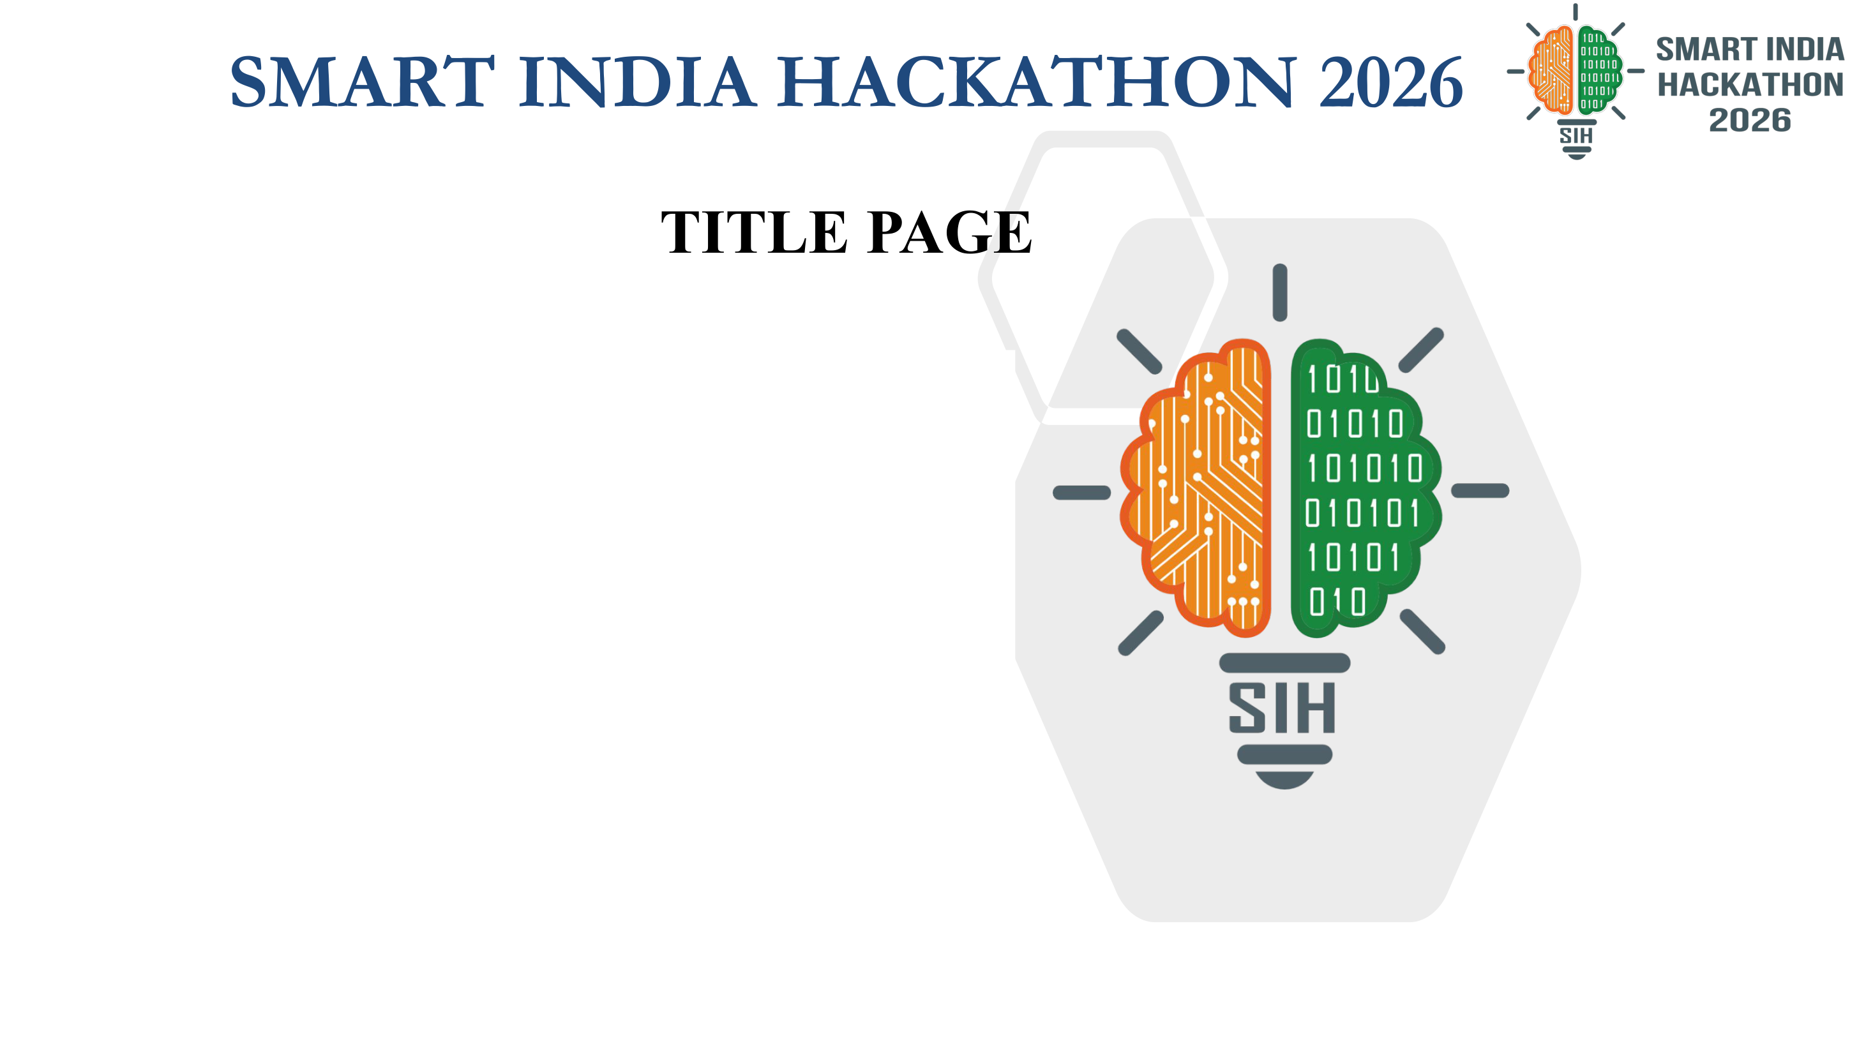
Problem Statement ID – [PS ID]
Problem Statement Title- APAAR-based Student Data Management and Verification System for AICTE-approved Institutions
Theme- [Theme]
PS Category- Software
Team ID- [Team ID]
Team Name (Registered on portal)- [Team Name]
Proposed solution: EDUVERIFY

Slide 2

Team Name
EDUVERIFY
PROPOSED SOLUTION
END-TO-END WORKFLOW
FIGURE NO: 01
Institutions upload APAAR-linked student records after admissions. EDUVERIFY maps each file to a standard schema, checks fields, consistency and category-wise intake limits, flags possible duplicates across institutions with reasons, and routes unclear cases to authorised reviewers. Every decision is audit-logged.
AICTE
1 Configure approved intake (programme, year, seat category)
INSTITUTION
2 Upload CSV / Excel (REST API: planned)
Validation ≠ official verification. Our checks confirm records are complete and consistent. Confirming an APAAR ID with the official registry needs authorised API access; the prototype uses a mock registry and marks records “mock-checked”.
INSTITUTION
3 Map columns to the standard schema; uploader confirms
WHAT MAKES IT DIFFERENT
ENGINE
4 Field, format, consistency, policy and intake checks
● Explainable validation — each flag names the field, rule and evidence
● Institution-specific mapping — a “PRN” column is mapped to the standard student_id field
● Cross-institution duplicate candidates — scored, reviewed, never auto-merged
● Category-wise intake monitoring — regular and supernumerary limits kept separate
● Auditable review — who decided what, when and why
ENGINE
5 Find possible duplicates across institutions
Flag raised?
YES
6 Authorised review: approve / correct / reject
EXAMPLE · INTAKE (illustrative)
B.Tech CSE, 2026-27
Approved regular intake: 120
Admitted on regular seats: 125
→ Potential excess: 5 — sent for review
Supernumerary seats (e.g. TFW, eligible NRI/OCI/FN) are checked against their own limits.
EXAMPLE · CONSISTENCY (illustrative)
Admitted 2026, 4-year programme
Expected graduation: 2030
Recorded graduation year: 2028
→ Potential inconsistency — review
Could be a data error, lateral entry or transfer; a reviewer decides.
AICTE
NO
8 Store with validation + verification status
7 Log decision, evidence, audit trail
AICTE
9 Authorised dashboards, reports; credential check (planned)
prototype scope (in development)
needs authorised integration

Slide 3
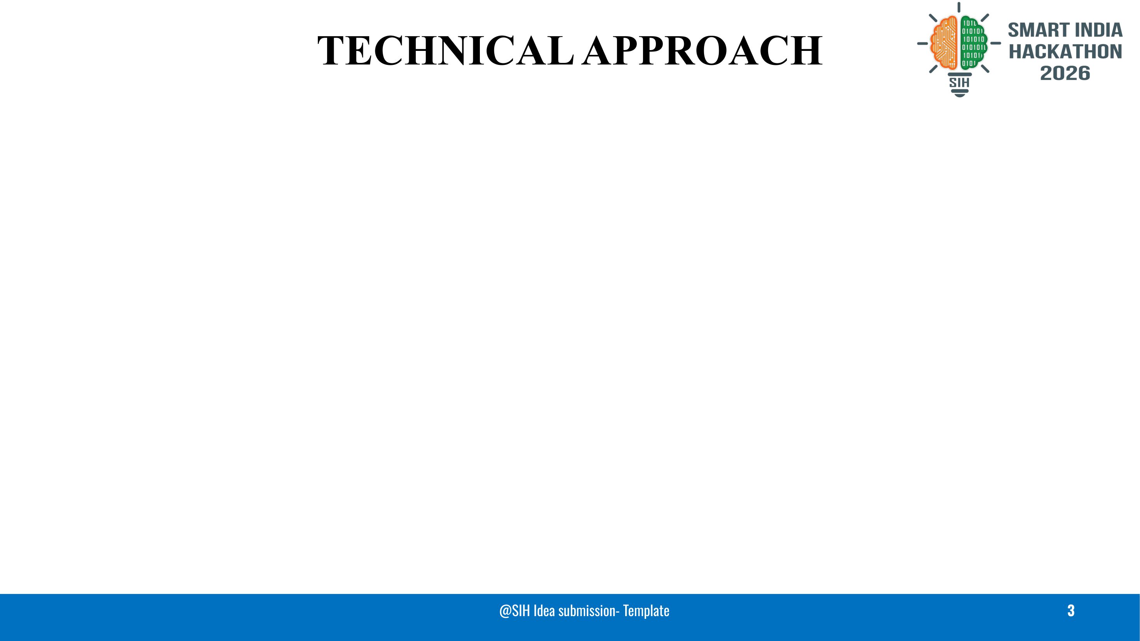









Team Name
SYSTEM ARCHITECTURE
FIGURE NO: 02
TECH STACK
ACCESS
Institution portal
upload, fix flags
Reviewer console
resolve flags
AICTE dashboard
intake, duplicates
Verification page
planned
Frontend
React, TypeScript, Tailwind — portals and dashboards
API · FastAPI
Auth + roles
JWT login, RBAC
Ingestion API
file upload; REST planned
Review API
decisions + evidence
Audit logger
append-only events
Backend
FastAPI, Python — APIs and background jobs
PROCESSING
Schema mapper
PRN column → student_id
Validation engine
pandas + Pandera rules
Intake-rule engine
per programme & category
Duplicate matcher
Splink candidates
Validation
pandas + Pandera — schema and rule checks
DATA
PostgreSQL
records + statuses
Audit trail
who, what, when, why
Mock APAAR registry
prototype only
Official APAAR API
needs authorisation
Matching
Splink on DuckDB — duplicate candidates
RECORD STATUS MODEL
Database
PostgreSQL — records, statuses, audit trail
DUPLICATE-CANDIDATE MATCHING
1 Block — compare only records sharing DOB or a phonetic name key
2 Compare — name, DOB, gender, APAAR ID, institution
3 Score — weighted similarity
4 Route — score ≥ 0.75 → review queue (provisional)
5 Decide — reviewer marks same / different; never auto-merged
Thresholds will be calibrated on labelled test pairs. A high score means “check this pair”, not proof of identity.
Check | Possible status
Validation | passed · failed
Duplicate check | clear · potential duplicate
Review | not needed · pending · resolved
Official APAAR check | not checked · mock-checked · officially verified*
Security
JWT login, RBAC, audit log; Ed25519 signing (planned)
Deployment
Docker Compose — one-command setup
*only through an authorised integration. “Validation passed” is not official verification.

Slide 4
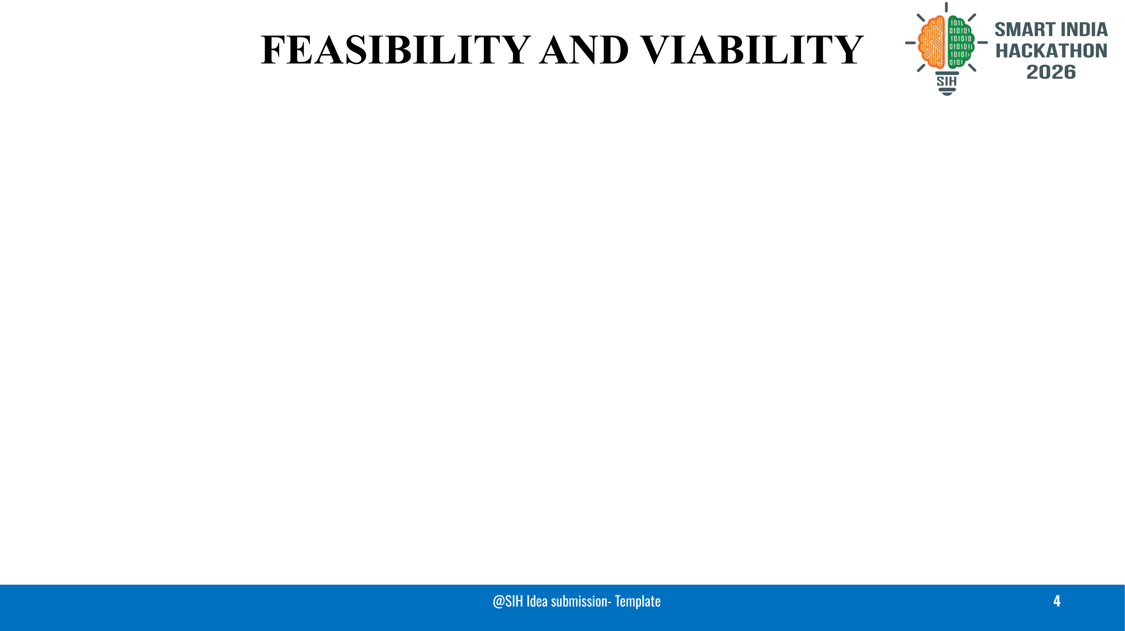
Team Name
FEASIBILITY
RISKS AND HOW WE HANDLE THEM
Technical
❖ Upload, mapping and validation work without any external integration
❖ Mature open-source libraries for rules and matching
Risk | Level | How we handle it
External APAAR / ABC dependency | High | API access, permissions, supported operations and credentials must be confirmed with the authorised service; the prototype uses a mock registry until then
Different column names and formats | High | Schema mapping confirmed by the uploader, plus a downloadable template
False duplicate matches (name variants) | Medium | Candidates only; a person decides; thresholds calibrated on labelled pairs
Wrong intake conclusions | Medium | Separate limits per seat category; excess shown as “potential” until reviewed
Personal data protection (DPDP Act, 2023) | High | Data minimisation, consent records, role-based access, masking, audit log; legal review before any real data
Reviewer workload at admission peaks | Medium | Review queue prioritised by confidence and impact
Operational
❖ Institutions already keep admission lists in spreadsheets
❖ Needs trained reviewers at institution and AICTE level
Financial
❖ Open-source stack; a pilot can run on one server
❖ Hosting and support costs to be estimated with AICTE
ROLLOUT PLAN
Phase 0 — Prototype
synthetic data, mock registry (current)
Phase 1 — Pilot
volunteer institutions, subject to AICTE approval
Phase 2 — Integration
official APAAR / ABC access, if authorised
Phase 3 — Scale-up
wider rollout after pilot review

Slide 5

Team Name
Impact on Each Stakeholder
Benefits
Stakeholder | Impact | Benefit
AICTE | Student-level, APAAR-linked records per programme | Potential excess intake and duplicate candidates seen at submission time
Institutions | One structured upload with explained flags | Fewer clarification rounds with AICTE
Students | One consistent record linked to their APAAR ID | Fewer repeated document checks
Employers & Regulators | Check a credential's issuer signature and status (planned) | Faster than manual email or phone verification
Policy Makers | Programme- and category-level enrolment data | Evidence for seat planning and accreditation
Social
• Fairer seat allocation: one student, one seat
• Consistent, portable academic record
Economic
• Less manual cross-checking
• Open-source stack, no licence fees
Environmental
• Fewer paper and couriered documents
Governance
• Audit trail for every change
• Consent-based data handling
How We Will Evaluate the Prototype
Rule checks
recall on errors injected into synthetic batches
Duplicate candidates
precision and recall on labelled pairs
Review effort
flags per 1,000 records; time per flag
Performance
processing time per 10,000 rows
No results are claimed yet; figures will be reported from the prototype.

Slide 6
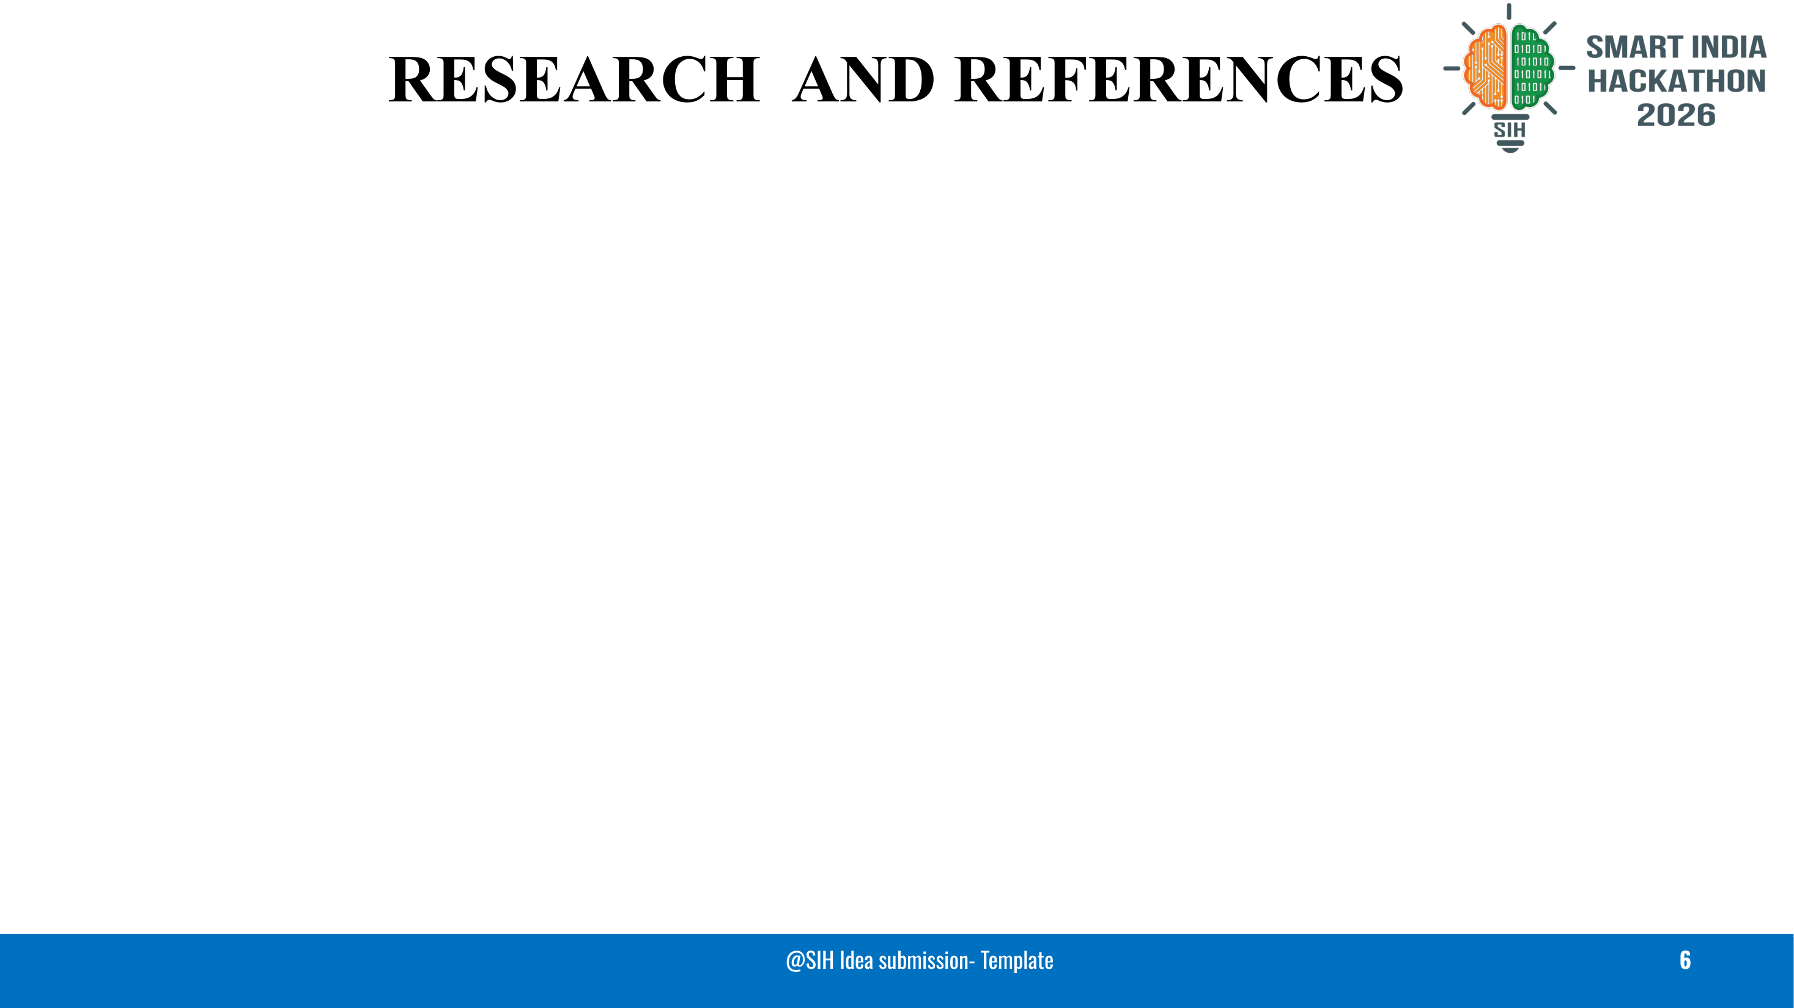
Team Name
RESEARCH WE BUILT ON
DATASETS (SYNTHETIC ONLY)
[1] S. Schelter et al., “Automating Large-Scale Data Quality Verification,” PVLDB 11(12), 2018. — rule checks and metric history → our validation and drift checks
https://www.vldb.org/pvldb/vol11/p1781-schelter.pdf
[2] P. Christen, Data Matching: Concepts and Techniques for Record Linkage, Entity Resolution, and Duplicate Detection, Springer, 2012. — blocking and field comparison → duplicate candidates
https://link.springer.com/book/10.1007/978-3-642-31164-2
[3] dedupe library, API documentation. — human-labelled pairs → review workflow and threshold calibration
https://docs.dedupe.io/en/latest/API-documentation.html
[4] R. P. Wibowo et al., “Problem identification and intervention in the higher education data synchronization system in Indonesia,” Procedia Computer Science 197, 2022. — data problems in national institution reporting → problem framing
https://doi.org/10.1016/j.procs.2021.12.165
[5] T. A. Kustitskaya et al., “Designing an Education Database in a Higher Education Institution for the Data-Driven Management of the Educational Process,” Education Sciences 13(9), 947, 2023. — student-record schema design → our standard schema
https://doi.org/10.3390/educsci13090947
[6] J. A. Berrios Moya, J. Ayoade, M. A. Uddin, “A Zero-Knowledge Proof-Enabled Blockchain-Based Academic Record Verification System,” Sensors 25(11), 3450, 2025. — selective disclosure → future scope
https://doi.org/10.3390/s25113450
student-performance (Hugging Face, CC0-1.0) — value ranges and missing-value tests
https://huggingface.co/datasets/neuralsorcerer/student-performance
UniversityIntake-MLDataset (GitHub, CC BY 4.0) — applicant-stage field tests
https://github.com/drsanjayagal/UniversityIntake-MLDataset
Neither dataset contains APAAR IDs; test IDs are generated. No real student data is used.
STANDARDS REFERENCED
❖ W3C Verifiable Credentials Data Model 2.0 (W3C Recommendation, May 2025) — planned credential format
❖ RFC 8032 (EdDSA / Ed25519) — planned record signing
❖ Digital Personal Data Protection Act, 2023 — privacy design input
❖ AICTE Approval Process Handbook — intake rules (current edition to confirm)

