Slide 1

PAYTM HACKATHON 2026 · TRACK 3: AUTONOMOUS AI TEAMMATES
Resolv
The AI support teammate that resolves failed UPI payments end to end, instead of just talking about them
PROBLEM STATEMENT
Build AI teammates that don't just respond; they get the job done
TEAM NAME
4-Goats
● 100% deterministic refund policy
TEAM MEMBERS
Paras Patil · Swastik Athanikar
Nitish Shinde · Sanchit Tawde
Understands
Acts
Verifies
Escalates
GitHub: github.com/Paras131206/PAYTM_hackathon_2026
Notes:
Introduce the team and Resolv: an AI teammate for Paytm-style payment support that resolves failed UPI payment tickets end to end — it understands the complaint, checks the payment, issues the refund within policy, verifies it, and hands anything risky to a human.

Slide 2




Problem statement
Resolv AI teammate
“Money debited, payment failed”
OFFICIAL PROBLEM STATEMENT
Every ticket needs the same manual checks: payment switch, ledger, refund policy, then a reply. Customers wait and worry.
“How might we build an AI teammate that can independently handle a customer-service or sales workflow end-to-end — resolving issues, taking actions across systems, and escalating to humans only when needed?”
Chatbots answer, they don't act
Today's bots can explain a refund but cannot issue it, verify it or close the ticket, so a human still does the work.
Letting AI move money is risky
An LLM can invent an amount, obey a prompt injection, or claim a refund that never happened.
Our focus: customer service for failed and disputed UPI payments, the most common payments-support ticket.
T+1
Slow resolution has a real cost. RBI requires a failed UPI debit to be reversed by T+1. After that, the customer must be compensated ₹100 for every day of delay.
₹100/day
Source: RBI circular on TAT harmonisation and compensation for failed transactions, 20 Sep 2019
Notes:
The official problem asks for an AI teammate that completes a workflow end to end. We picked failed UPI payments: a high-volume, rule-bound ticket where speed matters (T+1, then ₹100/day compensation) and where a careless AI could do real damage by moving money.

Slide 3


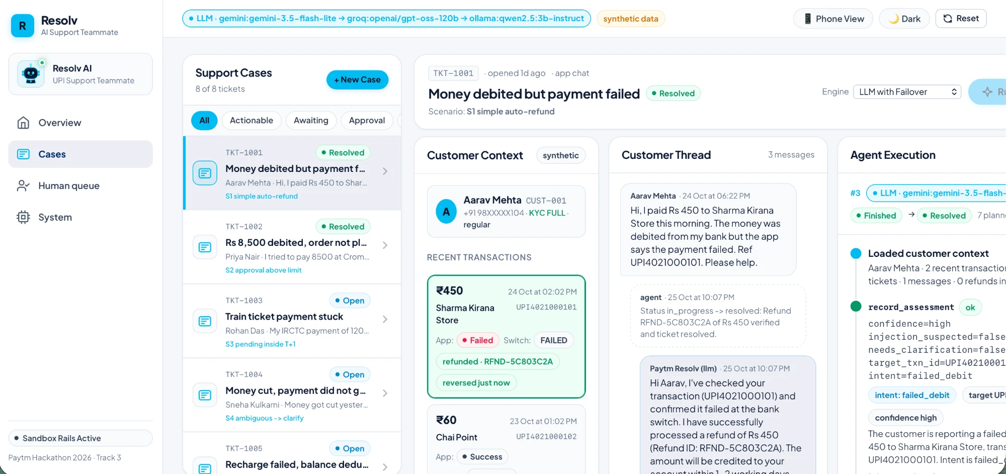




Proposed solution: Resolv
Resolv AI teammate
Core idea: the AI decides what to do, fixed rules decide what is allowed, tools do it, and the ledger proves it.
Understands
Profile, recent payments, past tickets and the chat.
Decides
Intent and which payment; asks once if unsure.
Acts
Checks the switch, refunds, updates the ticket, replies.
Verifies
Confirms the refund in the ledger before saying so.
Escalates
Big refunds, disputes, outages, tricks go to a human.
Working prototype: the case workspace. The ₹450 payment shows “refunded” after a verified ledger check.
WHO IT'S FOR
UPI app support teams
Payment aggregators
Bank service desks
Merchant operations
Notes:
Resolv is a teammate, not a chatbot. The language model plans; a deterministic policy engine decides what is allowed; validated tools do the work; and a ledger check proves it worked. The screenshot is the live prototype after resolving TKT-1001.

Slide 4










End-to-end workflow
Resolv AI teammate
1
2
3
4
Customer message
Load context
Assess
Gather evidence
App chat: “₹450 debited, payment failed”
Profile, last 10 payments, past tickets, policies
Intent + which payment + manipulation check
Ask the payment switch: SUCCESS / FAILED / PENDING
8
7
6
5
Close or hand off
Verify
Act
Policy decision
Resolve + notify, or human queue with evidence
Re-read the ledger; no claim before proof
Refund (amount from ledger), update ticket, reply
Fixed rules: auto-refund, approve, wait or block
OUTCOMES
● Auto-resolved
● Human approval (> ₹2,000 / flagged)
● Wait (pending inside T+1)
● Escalate (dispute · outage · tricks)
Notes:
Walk the loop with TKT-1001: the agent loads context, records its assessment, checks the switch (FAILED), the policy engine allows an automatic refund under ₹2,000, the refund is written and then verified in the ledger, the ticket is resolved and the customer told — all in one run. Other branches go to approval, wait or escalation.

Slide 5








Technology & tech stack
Resolv AI teammate
SYSTEM ARCHITECTURE
React UI
FastAPI
Orchestrator
LLM chain
Policy + tools
Sandbox + SQLite
Cases, timeline, human queue, metrics
Typed API, background agent runs
Turn budget, audit, outcome from state
Gemini → Groq → Ollama failover
Rules engine, 10 validated tools
Switch, refund ledger, audit trail
Tech stack
Why this stack
Python 3.14 · FastAPI · Pydantic backend, tool schemas
FastAPI + Pydantic: every tool call is validated against a typed schema before it runs.
Three LLM providers: if one hits a quota or outage, the run switches mid-ticket. Ollama works offline.
SQLite: zero setup, and every decision, tool call and result is stored for audit.
React + TypeScript: a typed UI that shows real backend state, never mock activity.
React 19 · TypeScript · Vite operations UI
Gemini · Groq · Ollama (local) LLM providers, free tiers
SQLite tickets, ledger, audit events
pytest (95 tests) · GitHub quality and versioning
Notes:
Architecture: the UI talks to a FastAPI backend. The orchestrator runs the loop; the LLM chain only proposes tool calls; the policy engine and tool registry decide and execute; sandbox adapters stand in for the payment switch and refund rail; SQLite stores everything for audit.

Slide 6
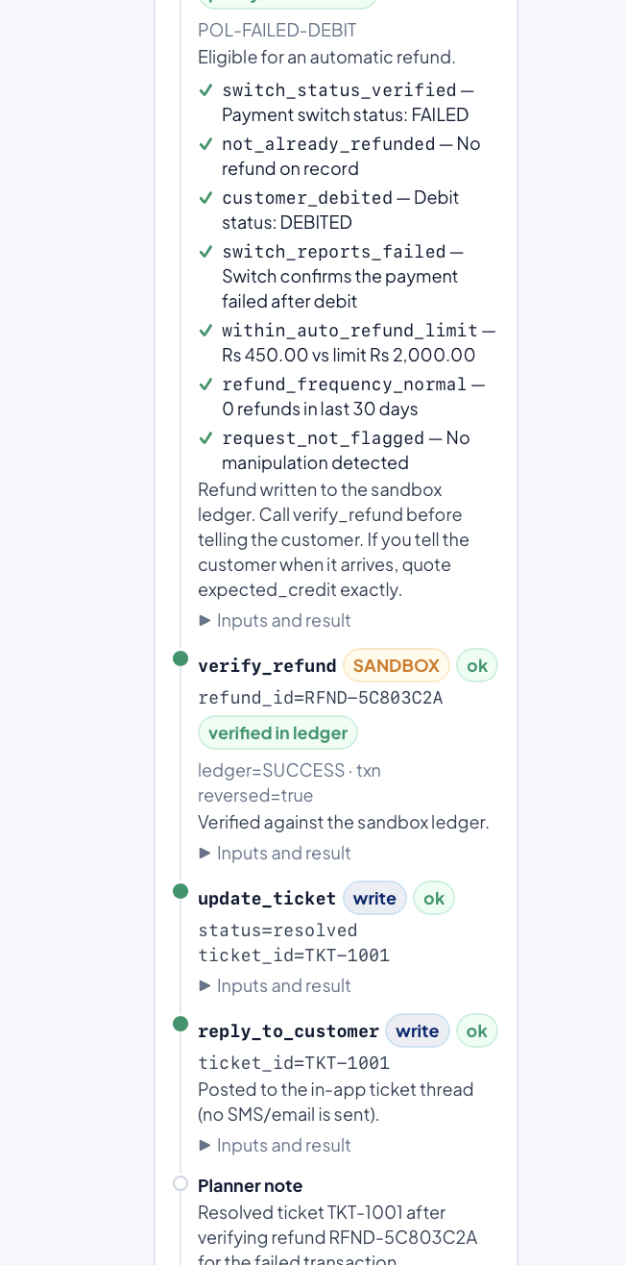


USP: what makes Resolv different
Resolv AI teammate
Acts, not just answers
Policy lives outside the AI
Verify before claiming
Issues the refund, updates the ticket and replies, in one run.
Fixed rules decide refunds; amounts come from the ledger, never the model.
Can't say “refunded” or close a ticket until the ledger confirms it.
Humans where it matters
Never fakes an answer
Audit trail + injection guard
Approval queue shows evidence and policy checks for every handoff.
Gemini → Groq → Ollama failover; if all fail, a human takes over.
Every step is logged; “admin mode” tricks are flagged and blocked.
Real policy checks and ledger proof in the live timeline
Notes:
Most AI agents are trusted to behave. Resolv is built so it doesn't have to be trusted: the model can propose anything, but only policy-approved, validated, verified actions happen — and every one is visible in the timeline.

Slide 7



Impact & benefits
Resolv AI teammate
8 / 8
100%
Customers
Money back faster, inside the T+1 window
Clear, honest status updates in the app chat
demo scenarios handled correctly
of refunds verified in the ledger before the customer was told
Support teams
14–83 s
95
Repetitive lookups and refunds are handled for them
Every handoff arrives with evidence and policy checks
live LLM run, from complaint to resolved ticket
automated tests: policy, tools, failover, API
The business
Avoids ₹100/day delay compensation
Consistent policy, no wrong or duplicate refunds, audit-ready
Prototype measurements on synthetic demo data (sandboxed payment rails), not business results.
Notes:
These are honest prototype numbers on synthetic data: every seeded scenario ends in the expected state, every refund is verified before the customer hears about it, and live LLM runs take seconds to about a minute. The business value is speed inside T+1, freed agent time, and consistent, auditable decisions.

Slide 8



Business model
Resolv AI teammate
B2B SaaS · PROPOSED
Customers
Value
Revenue
Costs
UPI apps & payment service providers
Payment aggregators
Banks' digital service desks
High-volume merchants
Resolves routine payment tickets end to end
Keeps humans for exceptions
Stays inside RBI timelines
Full audit trail
Platform fee per support queue
Outcome fee per verified, auto-resolved ticket
Enterprise tier: on-prem / local LLM, custom policies, SLA
LLM usage: low, with free-tier and local models in the failover chain
Hosting
Integration with switch and refund APIs
GO-TO-MARKET
1
Pilot One support queue: failed UPI debits
2
Expand Wallet, merchant settlement, KYC tickets
3
Scale Offer to other PSPs, banks and merchants
Outcome-based pricing: customers pay most when tickets are actually resolved, matching the brief's “measurable outcomes”.
Notes:
Proposed model: B2B SaaS with a platform fee plus an outcome fee per verified auto-resolved ticket, and an enterprise tier for on-prem or local models. Start with one queue, prove the numbers against a baseline, then expand to more ticket types and more payment companies.

Slide 9







Future scope & references
Resolv AI teammate
Real integrations
Multilingual & voice
Compensation automation
Roles & security
Measured pilot
Bank / PSP sandbox APIs for switch status and refunds
Hindi and regional languages, voice notes
Auto-credit ₹100/day when T+1 is missed
Login, approval roles, per-team policies
Resolution time vs today's baseline, A/B tested
References
Links
RBI: TAT & compensation for failed transactions (2019)
ReAct: reasoning + acting in language models (Yao et al.)
Gemini API: function calling
Groq API documentation
GitHub repository
Paras131206/PAYTM_hackathon_2026
Demo video
[add link]
Notes:
Next: connect real bank or PSP sandbox APIs, add Indian languages and voice, automate T+1 compensation, add roles and login, and run a measured pilot against today's baseline. Code is on GitHub; add the demo video link before submitting.

