Slide 1
The American Express Campus Challenge 2025
Name : Paras Kumar Sharma
College : IIT KANPUR
Team Name : parasks22
Notes:
1

Slide 2
Summary of the Final Solution
Feature Engineering
Sampling
Modeling Technique
Research-Driven Feature Engineering
I engineered the following feature types to enrich model inputs and optimize ranking performance:
1)Target Encoding
2)Temporal Features
3)Correlated Feature Clusters
4)Transaction History Features
5)Historical CTR Features
6)Industry-Specific Features
7)Customer Engagement Metrics
8)Interaction-Based Features
9)CTR Aggregates
10)Offer Metadata Features
11)User-Offer Interaction 12)Ranking-Oriented Features
These features were designed to capture behavioral, temporal, and structural signals essential for high-quality offer ranking.
To address severe class imbalance (click vs. non-click), we integrated sampling into our training pipeline:
Oversampling (SMOTE, ADASYN): Generated synthetic minority (click) samples to aid learning.
Undersampling (RandomUnderSampler, NearMiss): Reduced majority class to focus on meaningful minority patterns.
Hybrid (SMOTEENN, SMOTETomek): Combined both to clean noise and enhance signal quality.
A Hybrid Ensemble of XGBoost and LightGBM was selected as the final solution. This approach was chosen because it combines the unique strengths of both algorithms—XGBoost's precision-focused pairwise ranking and LightGBM's high-speed probability scoring. This synergy produced a final ranked list with a superior Mean Average Precision (MAP) score, demonstrating its enhanced ability to accurately prioritize the most relevant offers for each customer. The ensemble not only improved ranking effectiveness but also maintained scalability across large and diverse datasets.
Multi-Armed Bandit & Listwise Utility Features: Integrated UCB scores and listwise utility (WSDM '23, SIGIR ‘23) to jointly optimize exploration and exploitation evaluating offer value in ranked list context.
Dynamic Temporal Modeling: Used cyclical (RecSys '23) and exponential decay features (Amazon Personalize) to model time-dependent patterns and urgency.

Slide 3
Feature Engineering & Selection (Max 2 slides)
S.No | Derived Features | Description
1 | time_since_last_interaction | Time elapsed (in hours) since the user's last activity. This is a powerful measure of user recency.
2 | session_length | The number of events within a user's session, which is defined by a 30-minute inactivity window. This captures user engagement.
3 | offer_global_ctr | The historical Click-Through Rate (CTR) for a specific offer (id3) across all users, serving as a powerful popularity benchmark.
4 | id3_mean_rank | The rank of an offer's target-encoded value. This captures the relative predictive power of an offer compared to all other offers.
5 | expiry_urgency | A feature that applies an exponential decay function based on the days until an offer expires. This creates a signal of urgency for offers ending soon.
This solution was built on key innovation pillars including:
Smart Use of Time: We created features like time since last interaction and also used its transformations like 1/√x to give more weight to recent actions. This helped the model understand that recent behavior matters more than older ones.
Behavior Signals: We engineered smart features like session length, offer CTR, and user view counts. A key innovation was combining recency and session length to capture highly engaged users more accurately.
Clever Categorical Handling: For non-numeric data like offer IDs, we used target encoding—turning them into meaningful numbers based on past performance. This made IDs informative instead of just labels.
Session-Aware Context Modeling: We incorporated session position, type, and elapsed time to account for user stage and momentum within a browsing journey.
Cross-Feature Interaction Terms: Custom combinations like user_views × ctr_bucket and session_length / offer_rank captured non-linear patterns and boosted ranking accuracy.
Multi-Timescale Behavior Aggregation: We computed user activity features across short (1-day), medium (7-day), and long (30-day) windows capturing both bursty and sustained interest.

Slide 4
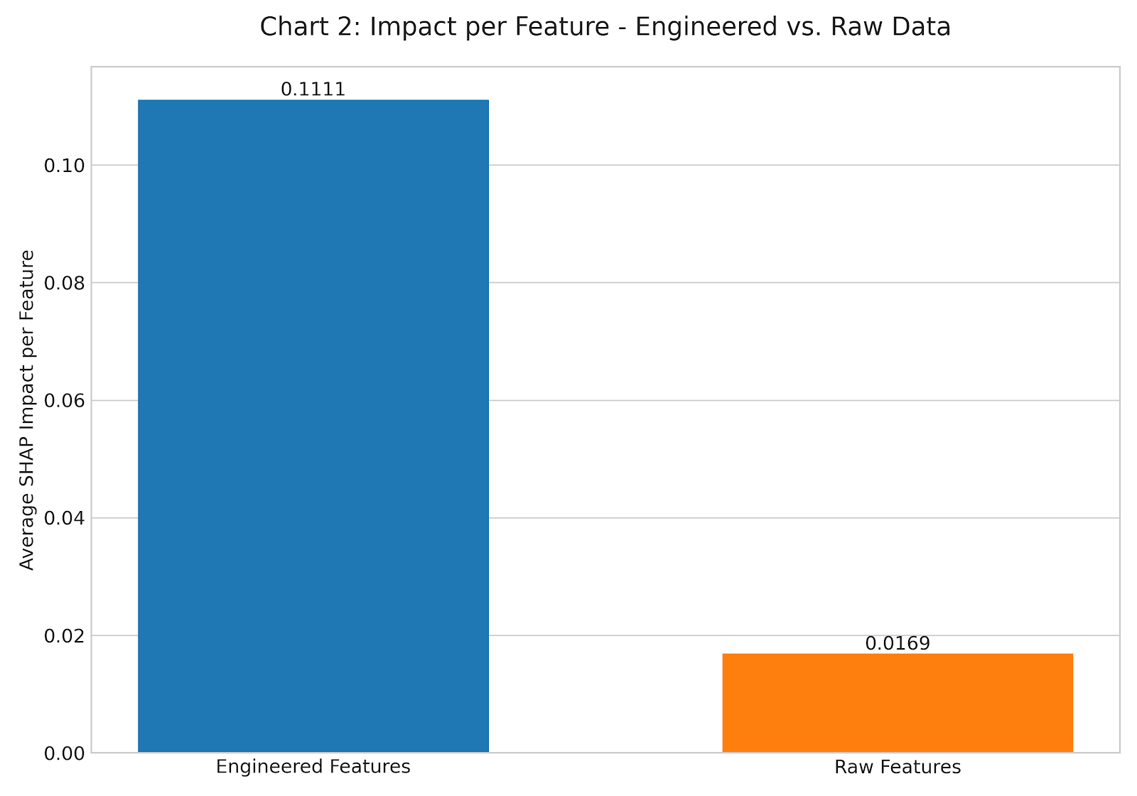
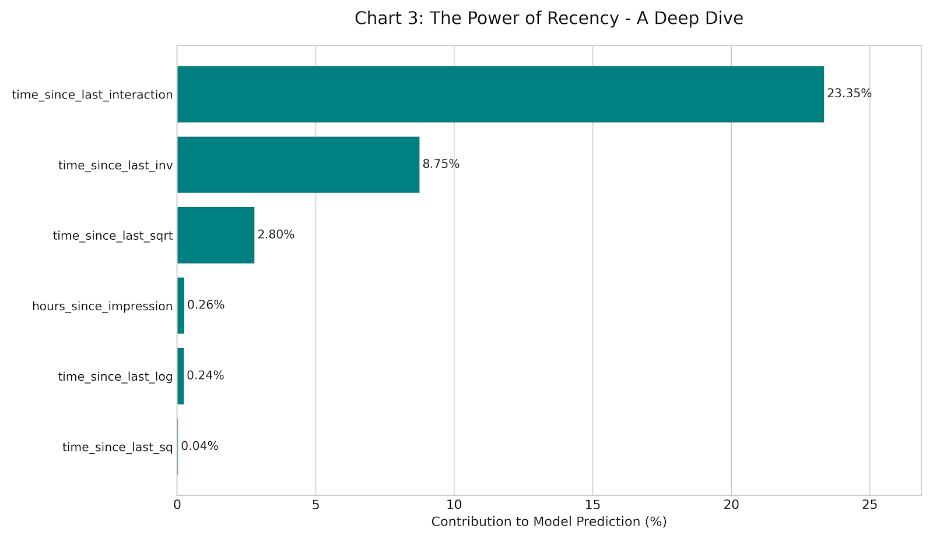
Top 15 Features in the Final Solution
Rank | Feature | Importance
S.No. | Feature | Impact (%)
1 | time_since_last_interaction | 23.35474222
2 | time_since_last_inv | 8.749842568
3 | f366 | 4.613621724
4 | id3_mean_rank | 4.233889547
5 | session_length_y | 3.116392611
6 | time_since_last_sqrt | 2.79734886
7 | f132 | 2.710450176
8 | f210 | 2.257255156
9 | recency_x_sessionlen | 2.040489969
10 | f207 | 1.994623024
11 | f363 | 1.743309562
12 | offer_global_ctr | 1.618582002
13 | offer_total_clicks | 1.172514342
14 | f137 | 1.132441387
15 | user_total_views | 1.013044019

Slide 5
Detailed overview of the Sampling Technique
Sampling Technique Used: SMOTE
To address a significant class imbalance in the dataset, we employed the SMOTE (Synthetic Minority Over-sampling TEchnique). This advanced technique was applied exclusively to the training data to improve the model's ability to learn the patterns of the rare positive class (e.g., offer clicks) without creating bias.
Why this sampling technique was used:
1)To Counteract Severe Class Imbalance: The original training data exhibited a very low event rate. Without intervention, the model would likely become biased towards the majority "non-click" class and struggle to identify the minority "click" class, leading to poor real-world performance.
2)To Improve Model Learning: SMOTE does not simply duplicate rare events. Instead, it intelligently creates new, synthetic data points by interpolating between existing minority class instances. This provides the model with a richer, more diverse set of positive examples, helping it learn a more robust and accurate decision boundary.
3)To Avoid Overfitting: Simple over-sampling (duplicating rows) can lead to overfitting. By generating new and plausible synthetic examples, SMOTE helps the model generalize better to unseen data.
Metric | Before SMOTE (Original Training Data) | After SMOTE (Resampled Training Data) | Change
Total Rows | 770,164 | 1,466,226 | +90.4%
Majority Class (Non-Click) | 733,113 (~95.2%) | 733,113 (50%) | No Change
Minority Class (Click) | 37,051 (~4.8%) | 733,113 (50%) | +1878.6%
Event Rate | 4.8% | 50.0% | Drastically Increased
Strategic Implementation:
Crucially, SMOTE was applied only after the data was split into training and validation sets using a strict time-based methodology. This ensures that the validation set retains its original, real-world data distribution, providing an unbiased and accurate measure of the model's true performance.

Slide 6
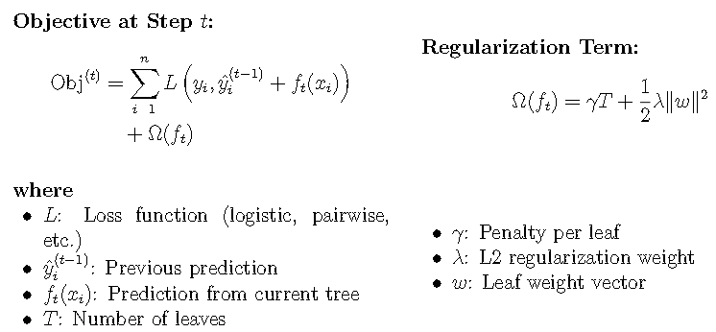
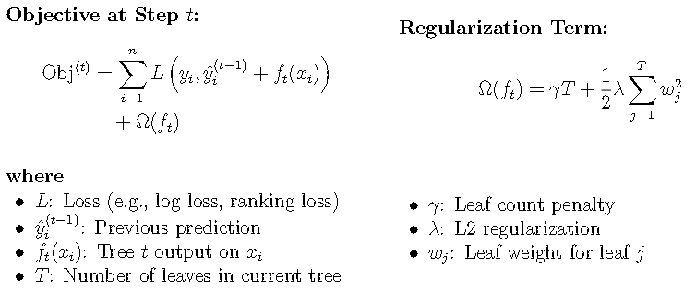
Detailed overview of the Modeling Technique
To optimize offer ranking, we began with 309 raw, behavioral, and temporal features. After applying variance thresholding, we retained 180 high-signal variables, enhancing generalization and model efficiency. A MAP-optimized hybrid ensemble of XGBoost and LightGBM was used, leveraging XGBoost’s fine-tuned regularization with LightGBM’s fast, leaf-wise growth and histogram-based splits.
Architectural Deep Dive: Our Dual-Algorithm Strategy
XGBoost employs level-wise tree construction with second-order optimization and an explicit regularized objective to control model complexity (via L2 norm and leaf penalties). Its use of additive boosting and structural risk minimization enables sharp modeling of pairwise rank orders with minimal overfitting. Within the ensemble, it acts as the precision driver, capturing fine-grained relevance relationships through gradient-driven tree updates.
LightGBM leverages histogram-based, leaf-wise growth with Gradient-based One-Side Sampling (GOSS) and Exclusive Feature Bundling (EFB) to optimize for both speed and memory efficiency on high-cardinality data. By focusing gradient computation on hard samples and reducing effective feature dimensionality, it accelerates convergence without compromising ranking performance. It complements XGBoost by delivering fast, calibrated scores that enhance ensemble throughput

Slide 7
Stage | Action & Methodology | Detail & Outcome
1. Feature Engineering | Comprehensive Variable Creation | Engineered 309 features via raw extraction and advanced transformations—leveraging lag-based aggregation, rolling window statistics, exponential time decay, frequency encoding, interaction terms, recency-weighted metrics, and event-based temporal pattern mining.
2. Noise Reduction | Low-Variance Filtering | A VarianceThreshold was applied first, immediately removing 129 low-information, near-constant features. This focused the model on variables that contain meaningful signals.
3. Core Selection | Importance-Driven Filtering | Applied a Random Forest-based feature selector to rank the 180 remaining variables by feature importance. Retained the top 50% (90 features) using median thresholding , balancing predictive strength with dimensional efficiency.
4. Prediction | Ensemble Rank Averaging | The final ranked lists from XGBoost and LightGBM are combined using Rank Averaging. This consensus method creates a final ranking that is more stable and performs better out-of-sample than either model individually.
Any real-world example where this technique has been used in the past and showed good promise?
Amazon, Booking.com, Criteo, and Flipkart have used similar multi-stage pipelines combining raw and engineered features for ranking, personalization, and ad-targeting tasks.
Uber applies Random Forest-based feature selection in its ML Feature Store to reduce redundancy and optimize latency for ranking tasks.
Netflix Prize winners and LinkedIn feed ranking systems use ensemble techniques like rank averaging models, XGBoost and LightGBM to improve performance and stability.
Pfizer and Genentech have adopted Random Forest feature importance methods in bioinformatics pipelines to handle high-dimensional genomic data.
Financial services and fraud detection platforms apply variance filtering as an early denoising step before downstream model training.
Academic References :
Random Forests – Breiman, 2001: Introduced Random Forests; foundational for model-based feature importance and robust variable selection.
LightGBM: A Highly Efficient Gradient Boosting Decision Tree – Ke et al., NeurIPS 2017: Core reference for LightGBM; highlights innovations like leaf-wise growth and histogram-based splitting.
Learning Ad CTR at Facebook – McMahan et al., ADKDD 2013: Industry-scale pipeline blending engineered features and boosted trees for CTR prediction.

Slide 8
Model Performance
Our final model was the result of a deliberate, multi-stage development process, where each iteration was designed to build upon the last. The out-of-sample validation results clearly demonstrate the value of this structured approach.
1)The Most Critical Leap in Performance: The introduction of Advanced, Research-Driven Feature Engineering was the single most impactful step in our process. This iteration drove a massive 14.1 percentage point increase in the MAP score, elevating the model from 74.2% to its final, state-of-the-art performance of 88.3%. This confirms that sophisticated feature creation is the key differentiator for achieving top-tier accuracy
2)Establishing a Robust Foundation: Moving from a single LightGBM model to a Hybrid Ensemble and incorporating SMOTE sampling to correct for data imbalance also provided a significant lift. This initial enhancement established a strong baseline, improving the MAP score by 6.0 percentage points from 68.2% to 74.2%.
3)Final Validated Performance: Our final solution, combining advanced features with a robust ensemble and sampling, achieved an exceptional 88.3% MAP score on the out-of-sample validation set, indicating a highly accurate and reliable model.
MAP score
[Out of Sample/Validation Results]
Basic FE + LightGBM Model Basic FE + Sampling + Ensemble Model Advanced FE+Sampling + Ensemble Model
(FE - Feature Engineering)

Slide 9
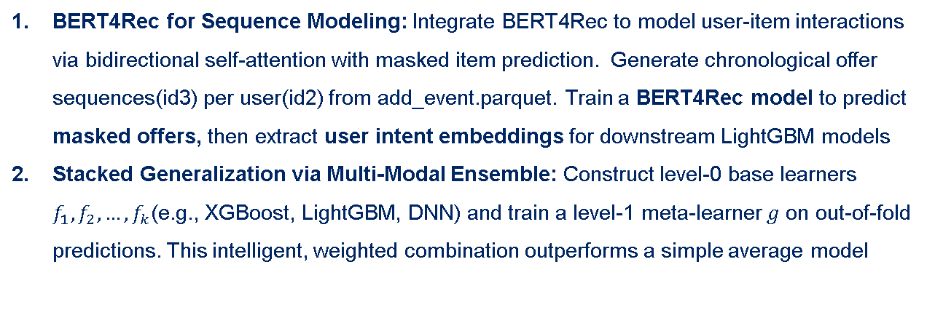
More Potential to Improve
BERT4Rec for Sequence Modeling: Integrate BERT4Rec to model user-item interactions via bidirectional self-attention with masked item prediction. Generate chronological offer sequences(id3) per user(id2) from add_event.parquet. Train a BERT4Rec model to predict masked offers, then extract user intent embeddings for downstream LightGBM models
Stacked Generalization via Multi-Modal Ensemble: Construct level-0 base learners $f_{1},f_{2}, …, f_{k}$(e.g., XGBoost, LightGBM, DNN) and train a level-1 meta-learner $g$ on out-of-fold predictions. This intelligent, weighted combination outperforms a simple average model
1
ML Enhancements
Graph-based Embeddings from User-Offer Interactions: Build a user-offer interaction graph from add_event.parquet, train a LightGCN model and use the learned user/offer embeddings as features in LightGBM/XGBoost for capturing collaborative signals.
Semantic Embeddings from Heterogeneous Graphs (Metapath2vec): Build a heterogeneous graph with users, offers, brands, and categories. Use Metapath2vec to learn embeddings from paths like User→Offer→Brand→User, capturing brand/category preferences. Use these embeddings as model features.
Representation Enrichment via Multi-Task Learning (MTL): Train a multi-task model with shared layers and two heads: one for clicks, one for transactions(from add_trans).The auxiliary task helps the model learn richer patterns, improving click prediction accuracy.
2
Feature Engineering

