Slide 1

How Job Function Affects Heat Score
———
Pu Liu

Slide 2
Contents
1
Introduction
2
Analysis
3
Conclusion
4
Reference

Slide 3
PART ONE
Introduction

Slide 4

GE Aviation
GE(General Electric) company can be traced back to 1892, covering a variety of industries which include commercial, aerospace, medical and other fields. Our sponsor Eric comes from GE Aviation, which is a subsidiary of GE.
https://www.google.com/search

Slide 5
How about my research
1. Demographics file- Use “job function” as the independent variables to run the linear regression model
2.alerts_by_indicators file - Treat “Score” as the dependent variable to find the relationship.
3.alerts_by_pairs file – Take “Score” as the dependent variable and compare the result with the that in
‘alerts_by_pairs’.
Research questions:
Aim to find the top 5 job functions that fire the alert regularly and analyze potential characteristics of the occurrence.

Slide 6
PART TWO
Analysis

Slide 7
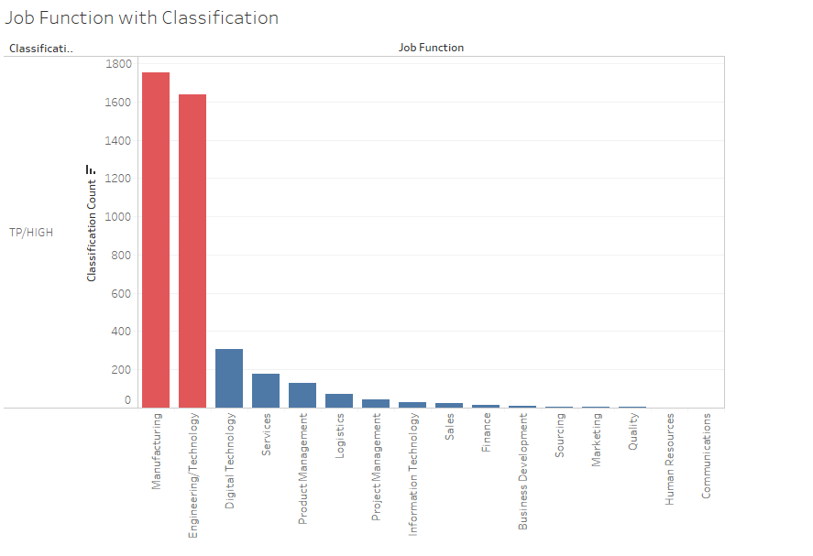
Model 1
Data cleaning & integrating - EDA
Observing the data performance of job functions
The number of high-risk triggers in Manufacturing and Engineering/Technology is significantly higher than in other job functions. It requires further investigation.

Slide 8
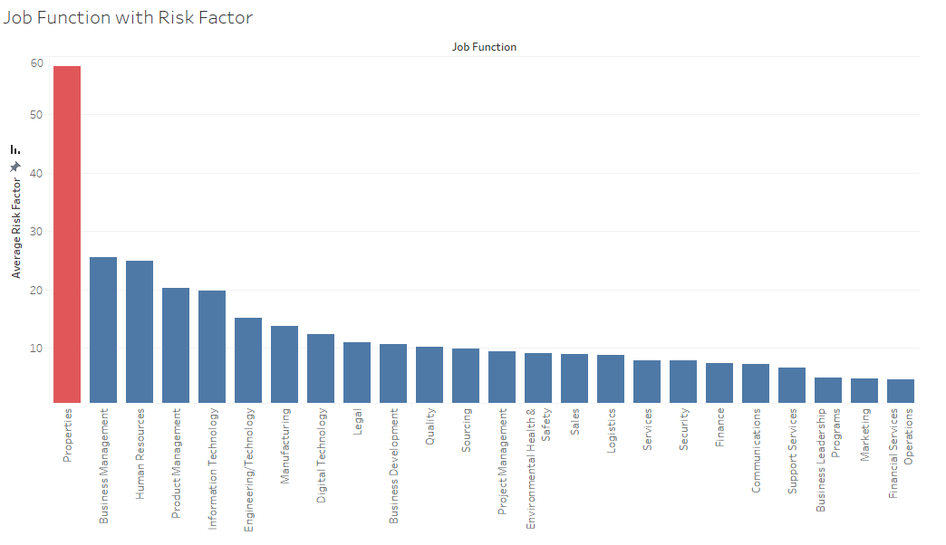
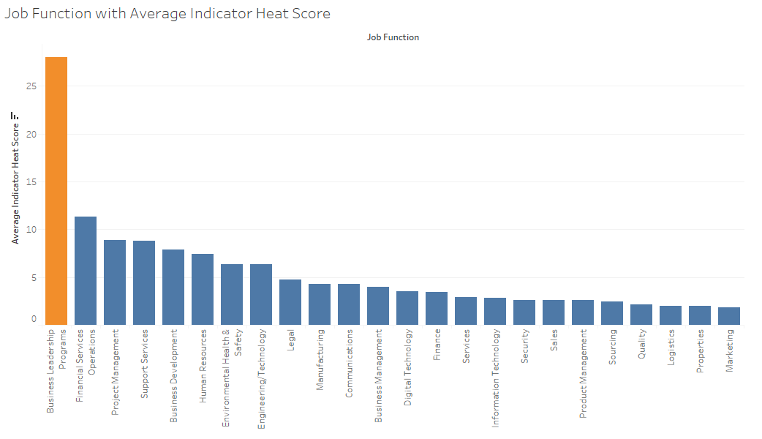
Model 1
Data cleaning & integrating – EDA
Business Leadership Program has the highest heat score among 24 job functions
The Risk factor of Property is the highest among 24 job functions

Slide 9
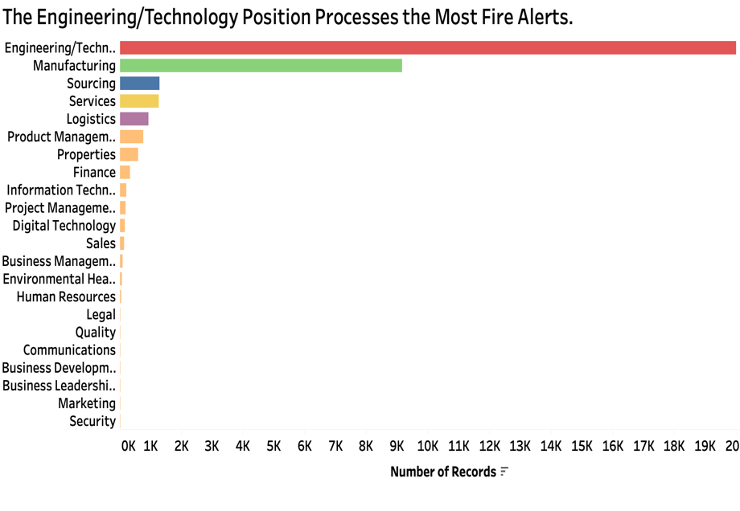
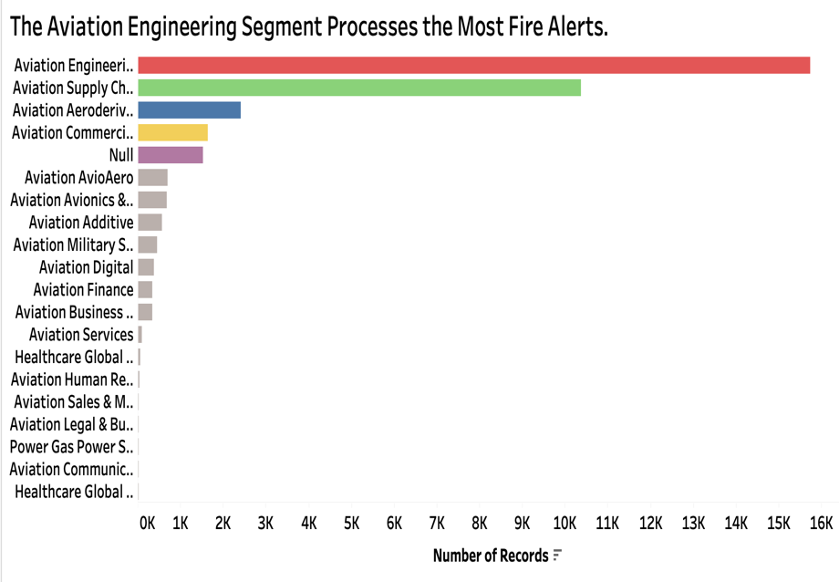
According to the Individual‘s dataset without FP, The top 3 segments of GE that process the most fire alerts are: Aviation Engineering, Aviation Supply Chain, Aviation Aeroderivative.
The top 3 position of GE that process the most fire alerts are: Engineering/Technology, Manufacture, Sourcing.

Slide 10
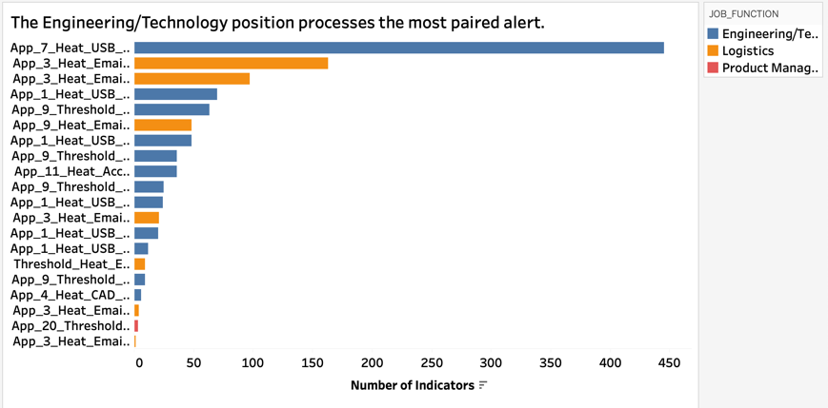
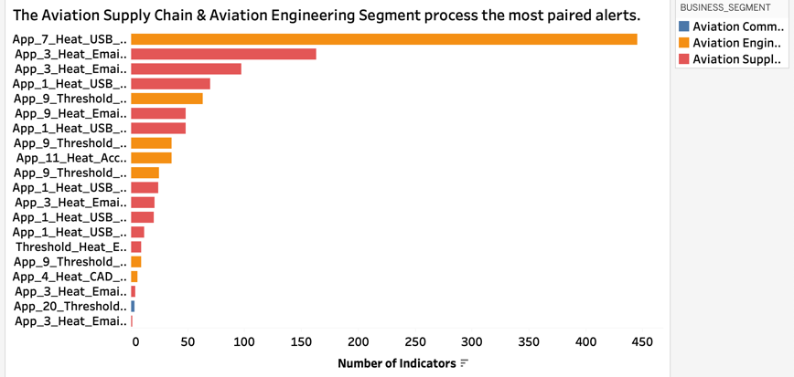
Once time, Engineering/Technology & Logistics are ranked top 1 & 2.
The Aviation Engineering, Aviation Supply Chain are still the worst segments.

Slide 11
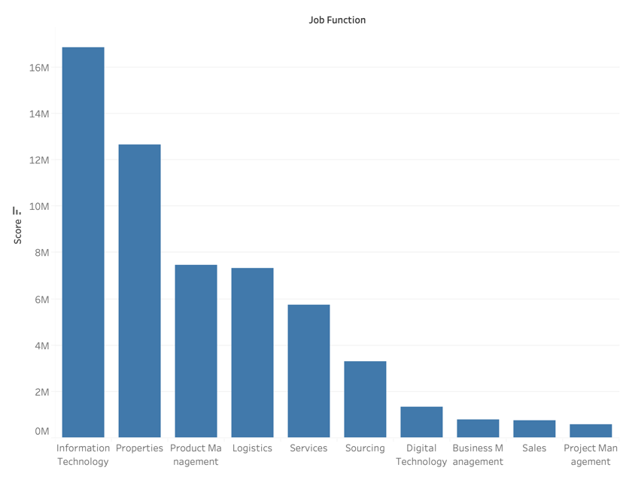
Distribution of Job Function in average score
Top 3: Information Technology, Properties, Product Management
Guess Reason Top 1 is Information Technology:
Frequently need to send email, including notification, update, maintenance and so on
Operation (Network management, software development and database management)
Further
Flaw: Need to calculate the standard deviation to reflect the degree of dispersion

Slide 12
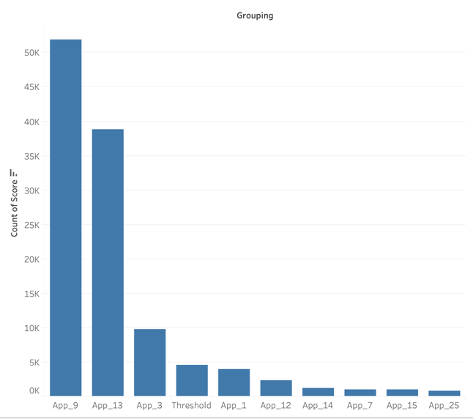
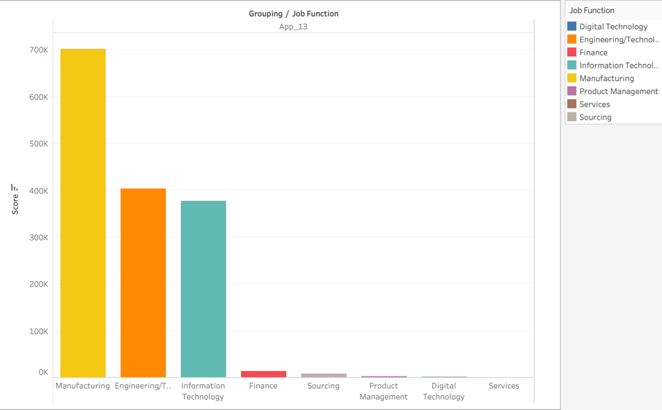
Sum Score: Grouping/Job Function
Count the number by dimension of Grouping
App_13 as an example:
top 3 in sum Score (Job Function) : Manufacturing, Engineering/Technology and Information Technology

Slide 13
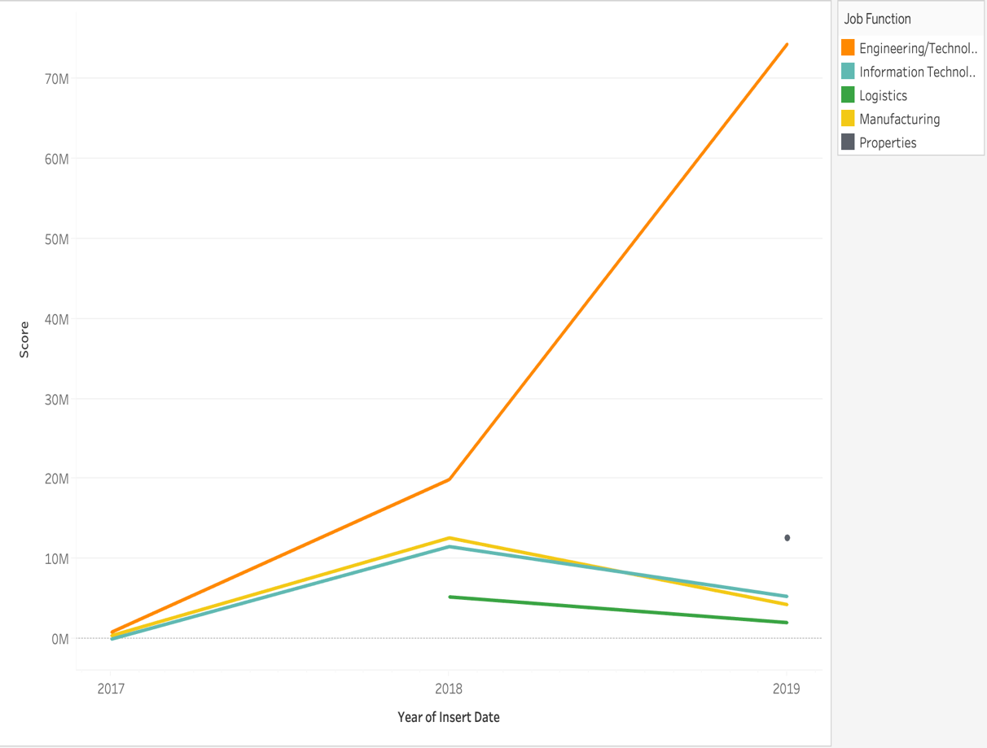
Trend of sum score from 2017 to 2019
Sum Score of Engineering/Technology are increasing from 2017-2019
Sum Score of Information Technology and Manufacturing are increasing from 2017 to 2018, and decreasing from 2018 to 2019
Sum Score of Logistics are decreasing from 2018 to 2017
New job function are added into ‘Digital Guardian’, for example Properties

Slide 14
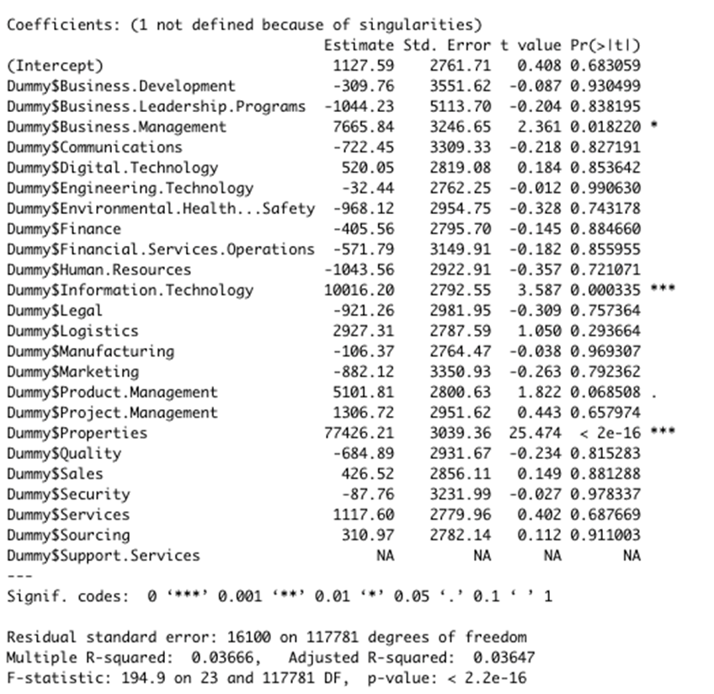
Modeling
Linear Regression Model

Slide 15
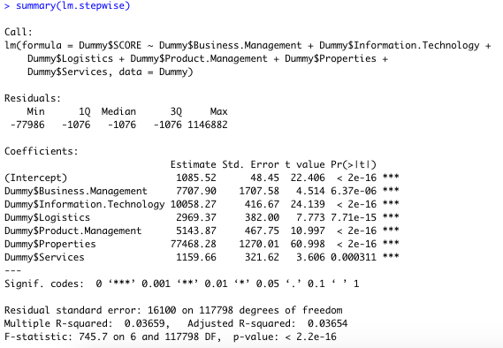
Modeling
Stepwise Model
Reduce the number of variables
Properties is the most significant variable
Optimize the linear regression model

Slide 16
PART THREE
Conclusion

Slide 17
Conclusion
Business management, Information technology, Logistics, Product management, Properties, and Services are top 6 high risky job function
Properties is the most significant variable

Slide 18
PART FOUR
Reference

Slide 19
Reference
Software monitors employees' activities. (Refog Inc. Releases Refog Employee Monitor 5.18). (2009). Product News Network, Product News Network, June 5, 2009. Retrieved from https://go-gale-com.ezproxy.neu.edu/ps/i.do?id=GALE%7CA201127751&v=2.1&u=mlin_b_northest&it=r&p=ITOF&sw=w
Guevara, C., Santos, M., & Lopez, V. (2017). Data leakage detection algorithm based on task sequences and probabilities. Knowledge-Based Systems, 120, 236-246. Retrieved from https://www.sciencedirect.com/science/article/pii/S095070511730010
Ghorbanian, S., Fryklund, G., & Axelsson, S. (2015, January). Do data loss prevention systems really work?. In IFIP International Conference on Digital Forensics (pp. 341-357). Springer, Cham. Retrieved from https://hal.inria.fr/hal-01449068/document
Huth, C. L., Chadwick, D. W., Claycomb, W. R., & You, I. (2013). Guest editorial: A brief overview of data leakage and insider threats. Information Systems Frontiers, 15(1), 1-4. Retrieved from https://hal.inria.fr/hal-01449068/document

Slide 20
THANKS
FOR YOUR WATCHING

