Slide 1
Fine WINE ANALYSIS
Presentation by:
Pu Liu

Slide 2
Agenda
Introduction
EDA and Descriptive statistics
Model Optimization and Model Selection
Key findings, Conclusion and Insights

Slide 3

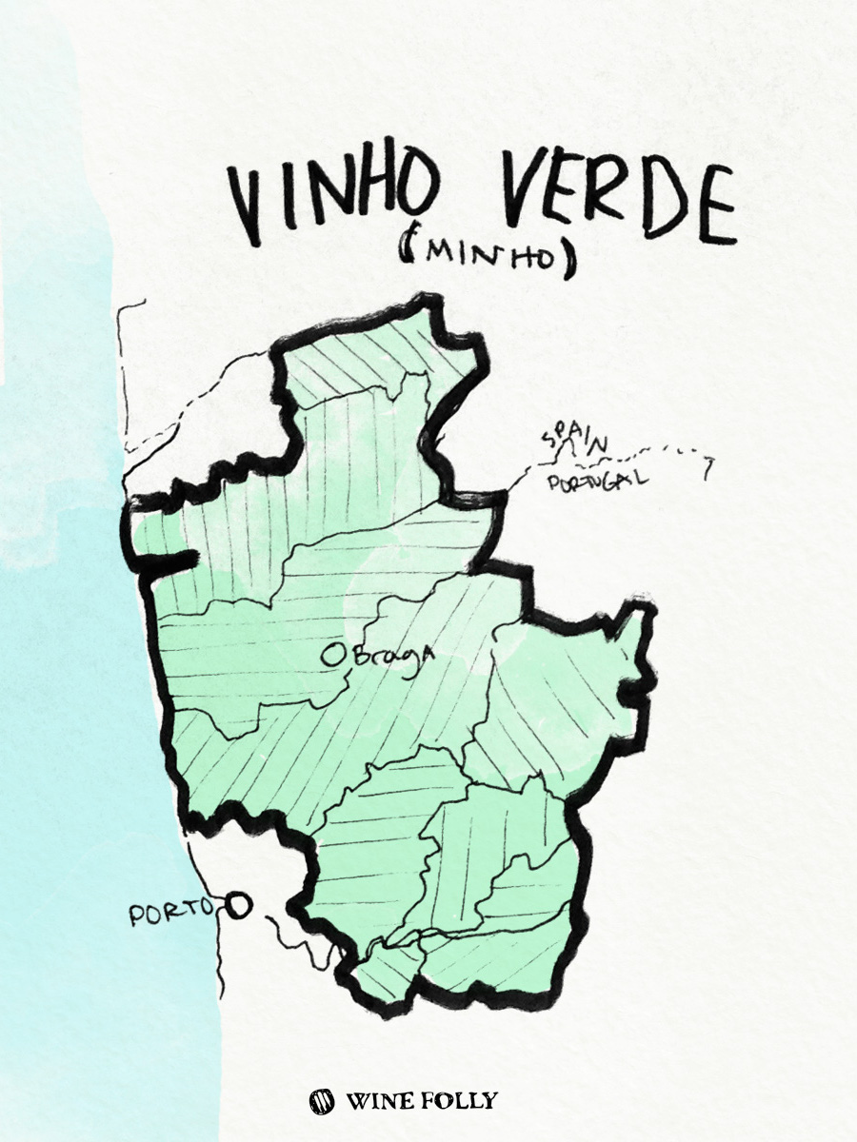
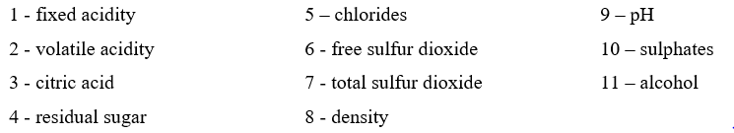

INTRODUCTION TO DATASET
Data source: https://www.kaggle.com/uciml/red-wine-quality-cortez-et-al-2009
Data content: 12 columns x 1599 rows
11 independent variables (based on physicochemical tests)
and 1 dependent variable (based on sensory data): quality (score between 0 and 8)

Slide 4
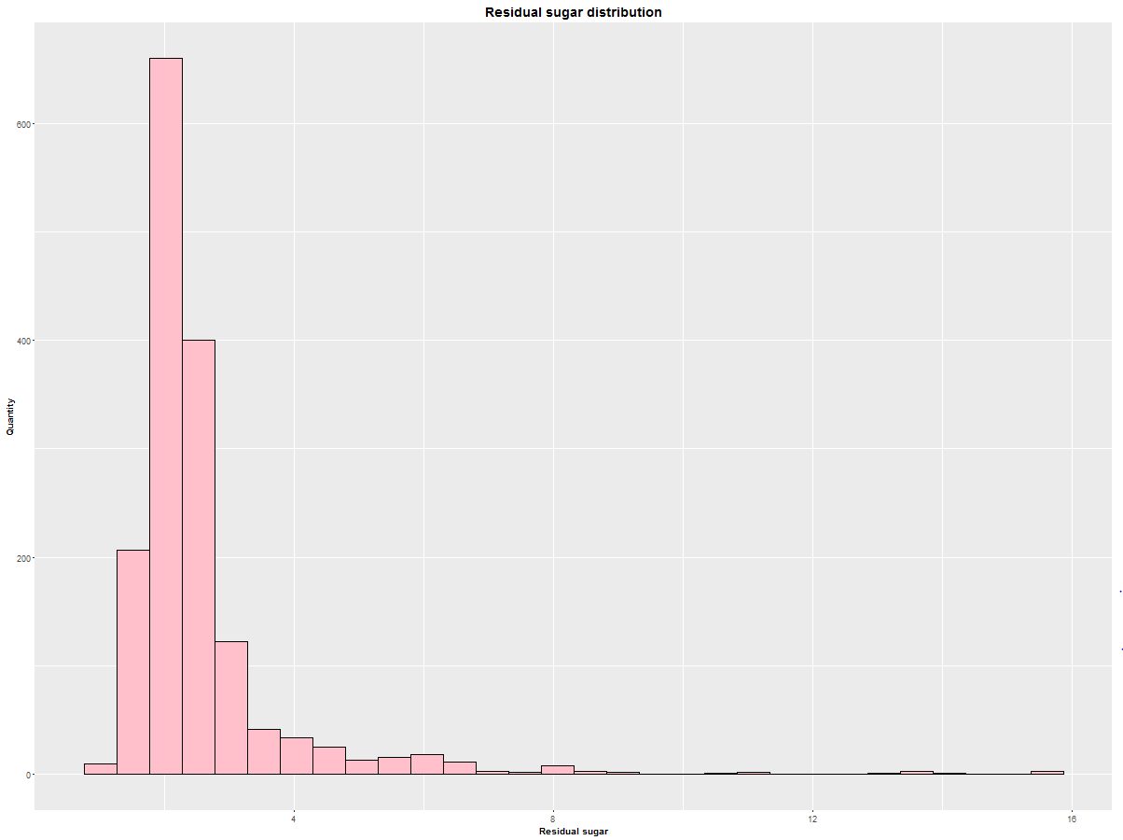
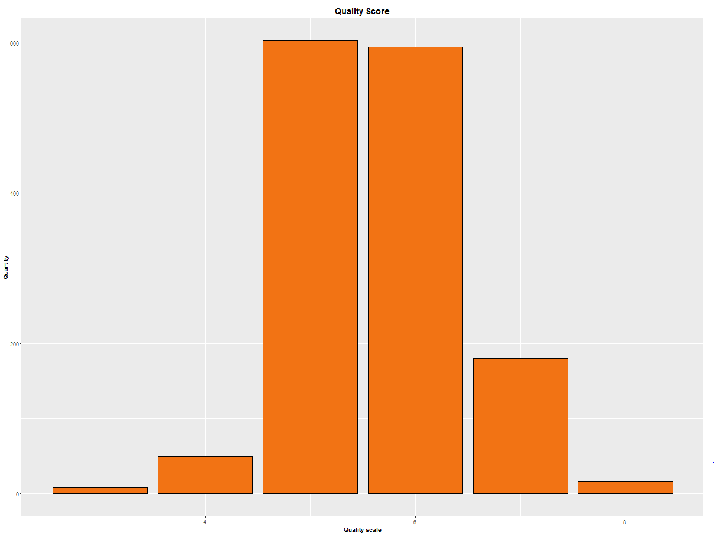
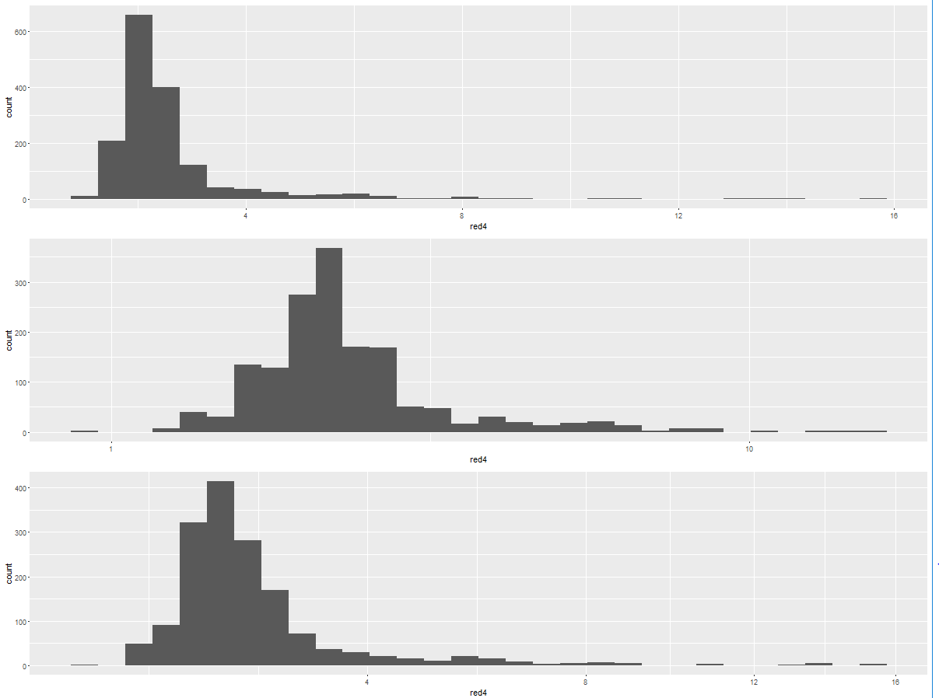
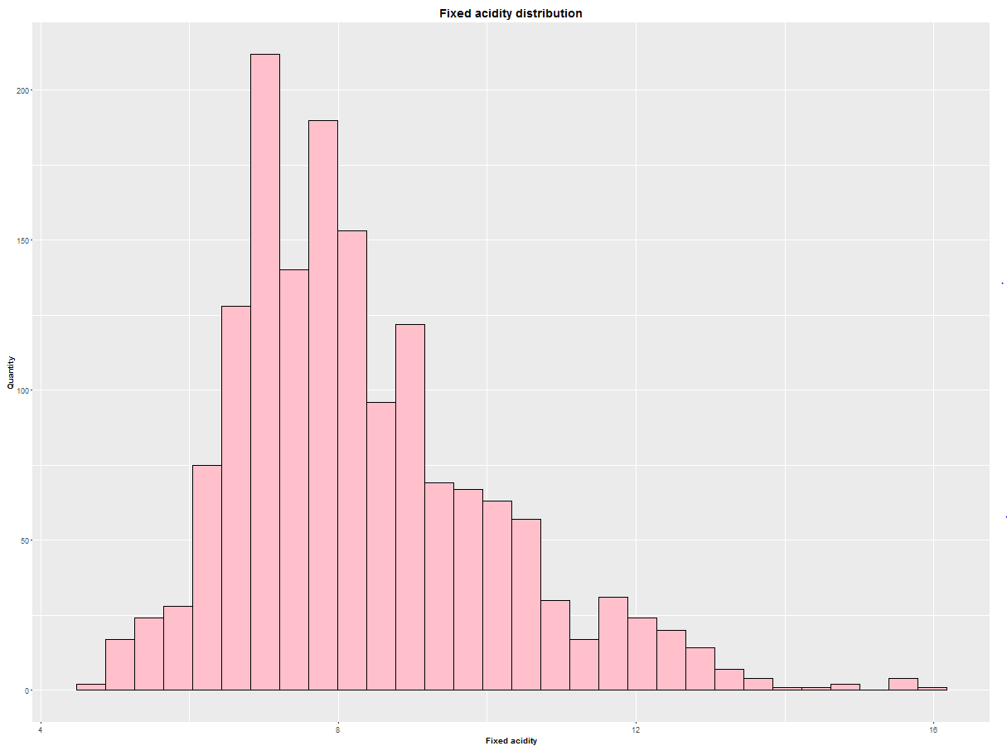
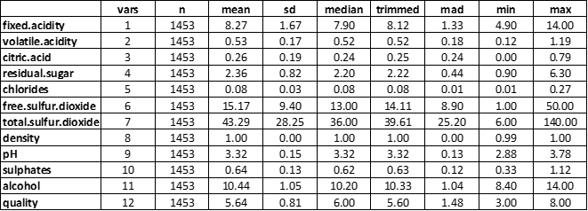
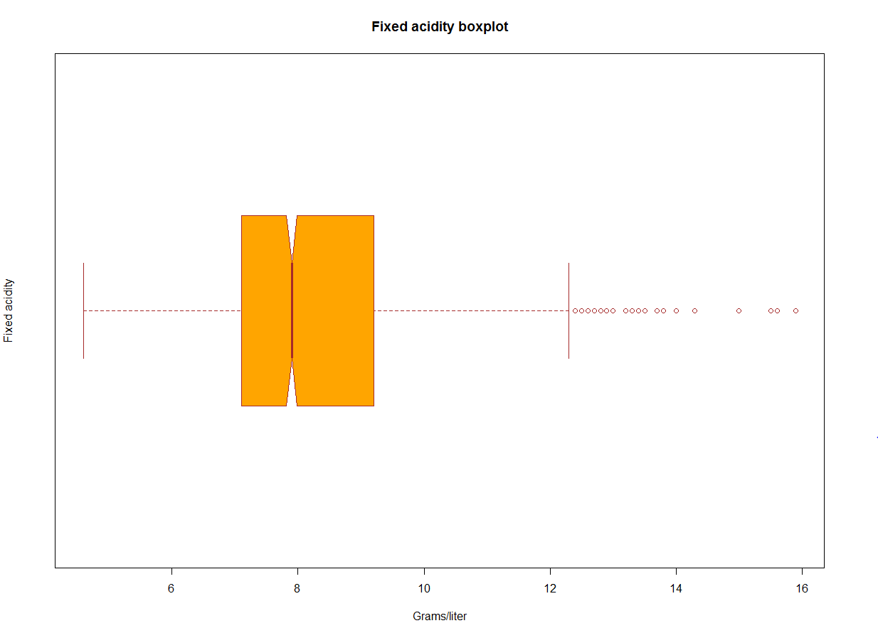
EDA & DESCRIPTIVE STATISTICS
Missing value: 0 values was found
Zero value
Blank (N/A)
Outliers: 146 values were taken out, reduce data set from having 1599 down to 1453 remained obsevations.

Slide 5
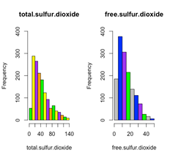
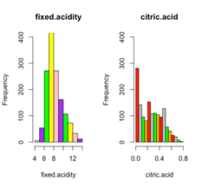
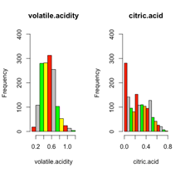
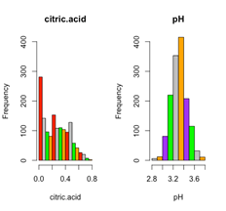
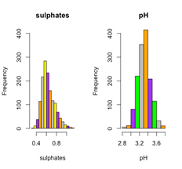
Linear Regression Model
Correlation:
• Total. Sulfur Dioxide versus Free. Sulfur Dioxide (0.66)
• Fixed. acidity versus Citric. acid (0.70)
• Citric. acid versus Volatile. acidity (-0.58)
• Sulphates versus PH (-0.71)
• Citric. acid versus PH (-0.52)

Slide 6
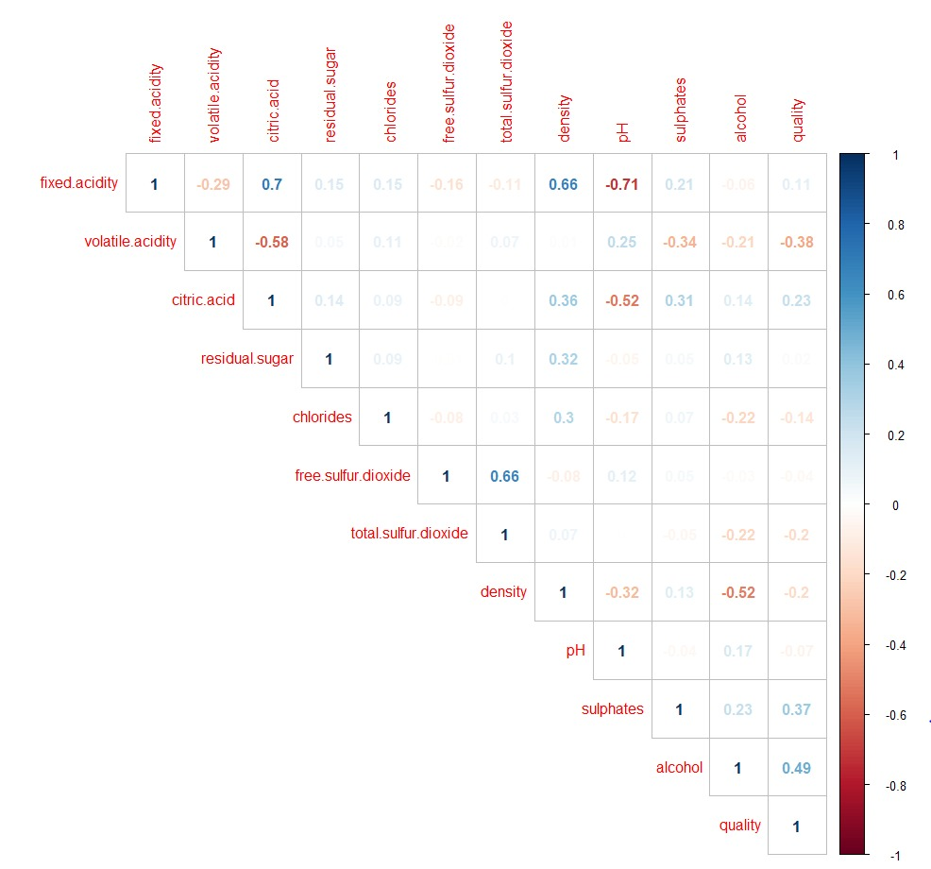
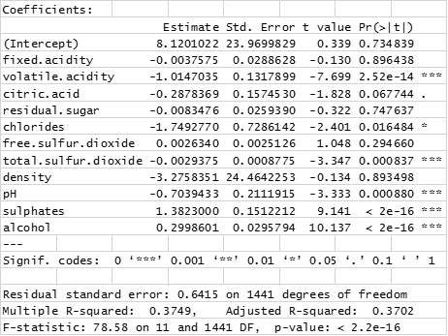
Linear Regression Model
Factors :
•Sulphates (0.37)
•Alcohol (0.49)
•pH (-0.07)
•Volatile acidity (-0.38)
•Total. Sulfur. Dioxide (-0.2)
•Chlorides (-0.14)
Linear regression Model:
*Quality Score = 1.38 sulphates + 0.3 alcohol + 0.0026 free. sulfur. dioxide - 1.01 volatile. acidity -1.75 chlorides - 3.27 density -0.7pH - 0.003 fixed. acidity -0.29 citric. acid -0.008 residual. sugar- 0.0029 total. sulfur. dioxide.

Slide 7
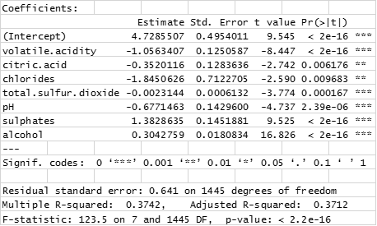
Model Optimization
Model Optimization by Utilizing Stepwise Regression
Backward Selection Method

Slide 8
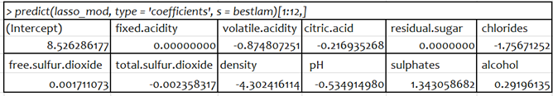
Model Optimization
Model Optimization by Comparing with LASSO Regression
LASSO Model
Quality Score = 8.526 – 0.875 x volatile.acidity – 0.217 x citric.acid – 1.757 x chloride
– 0.002 x free.sulfur.dioxide – 0.02 x total.surful.dioxide – 4.302 x density
– 0.535 x pH + 1.343 x sulphates + 0.292 x alcohol

Slide 9
Model Optimization
Model Optimization by Comparing with LASSO Regression
Comparing MSE Between Linear Regression and LASSO Regression
MSE for Multiple Linear Regression: 0.4048
MSE for LASSO Regression: 0.4118
Difference: 0.0069

Slide 10
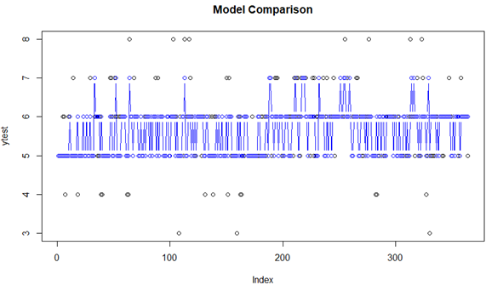
Model Optimization
Model Optimization by Comparing with LASSO Regression
Visualization plot confirmation

Slide 11
Model Optimization
Model selection decision
LASSO Model
1. More accurate on variable selection.
2. Covers the most significant variables appeared in both linear & stepwise regression.
3. Better overall accuracy.

Slide 12
Key findings, Conclusion & Insights
Alcohol, Sulphates, Chloride, and Acidity play a major role in determining the wine quality.
Data-driven approach lessen the dependence on wine taster experts which is prone to be subjective. Enhance the accuracy on decision-making process of wine certification.
Improves the winemaking process and guarantees quality for the wine market.
Global wine manufacturing and trade can be conducted in more efficiently and effectively way. Support further research such as a formula that directly or indirectly improves the quality of wine for health benefits.

