Slide 1




Business Challenges
Preference
Popularity

Slide 2
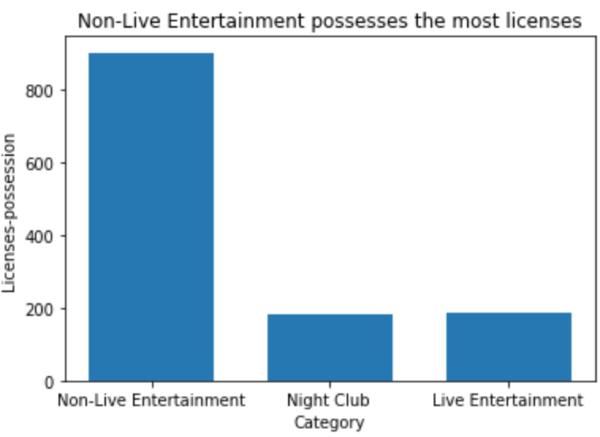
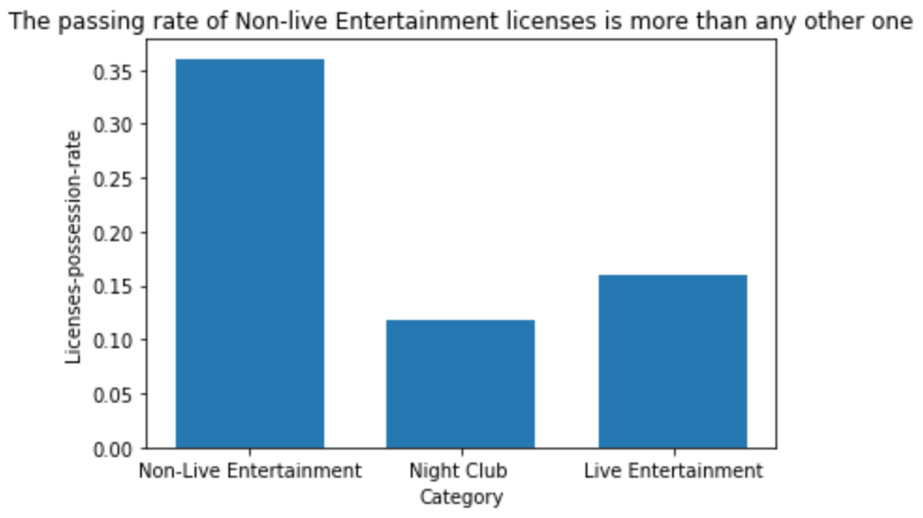
Database
Entertainment licenses: Non-Live, Live Entertainment, Night Club in Boston from 2014.11 to 2015.2.
Conclusion:
The Non-Live Entertainment is the most preferable.

Slide 3

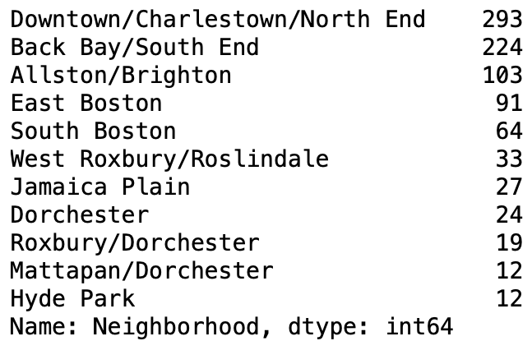
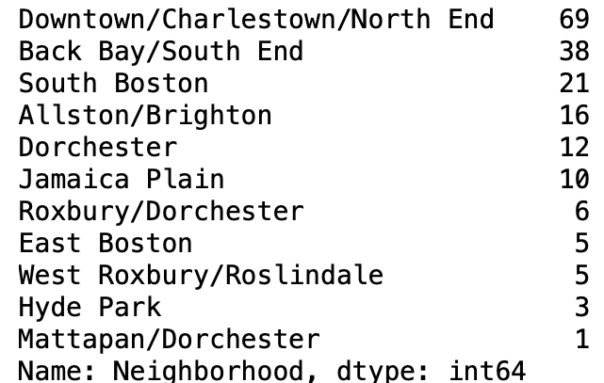
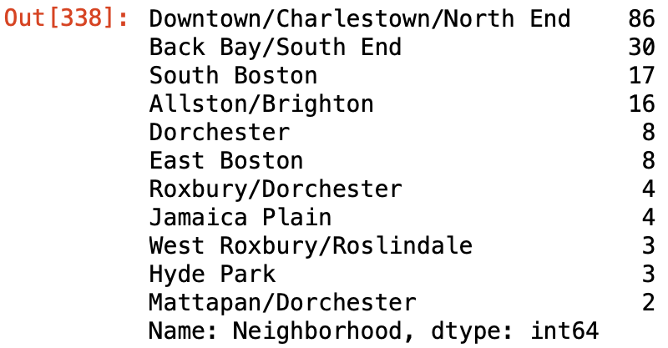
Non-live
Live
Night Club
Conclusion:
The Downtown/Charlestown/North End, Back Bay/South End, South Boston are the most popular areas to conduct activities.

