Slide 1


Myntra
Sales
Analysis

Slide 2


Today's agenda
Project recap
Problem
Process
Insights
Summary

Slide 3

I have taken Myntra Dataset From Kaggle. The Dataset Containing Columns URL, Product_id, BrandName, Category, Individual_category, category_by_Gender, Description, DiscountPrice (in Rs), OriginalPrice (in Rs), DiscountOffer, SizeOption, Ratings, Reviews
Project Recap

Slide 4


Problem
Myntra, a popular e-commerce platform for fashion and lifestyle products, wants to analyze its product data to gain insights into pricing strategies, customer preferences, and product performance. The goal is to identify trends in discounting, evaluate the relationship between ratings and other factors, and understand the distribution of products across categories and brands.

Slide 5
Data Understanding
Process
1
2
Data Cleaning
Exploratory Data Analysis
3
Uncover Insights
4

Slide 6
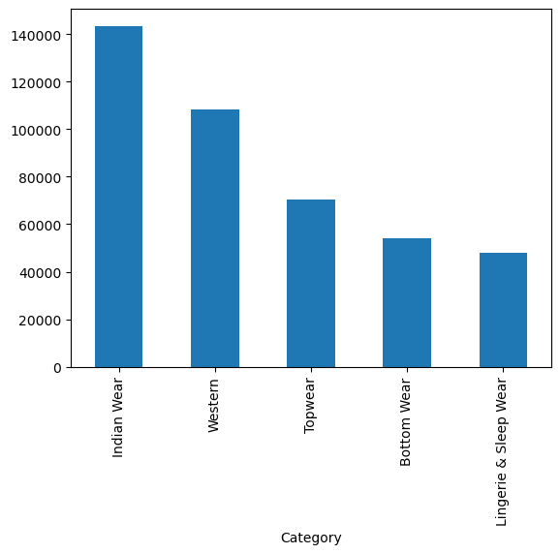
Insights
Top 5 Highest Selling Categories

Slide 7
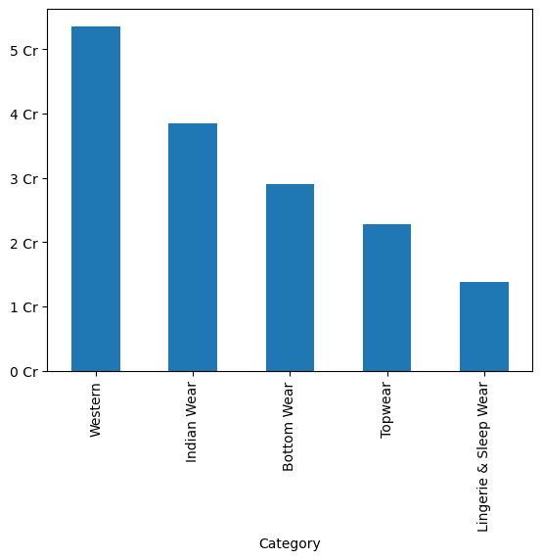
Top 5 Highest Revenue making Categories

Slide 8
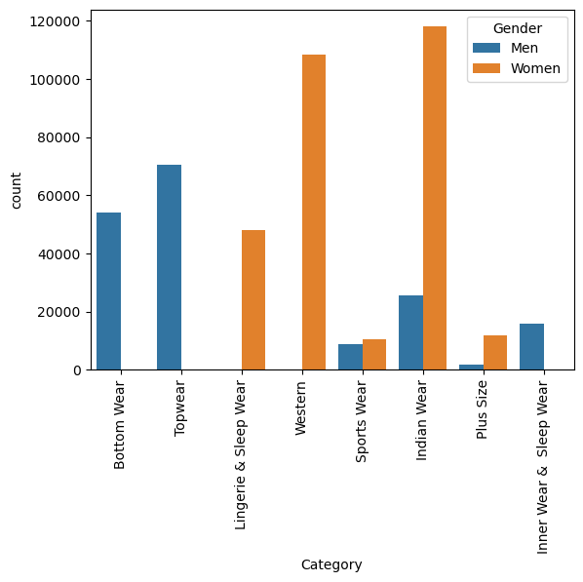
Category Purchasing Behaviour By gender

Slide 9
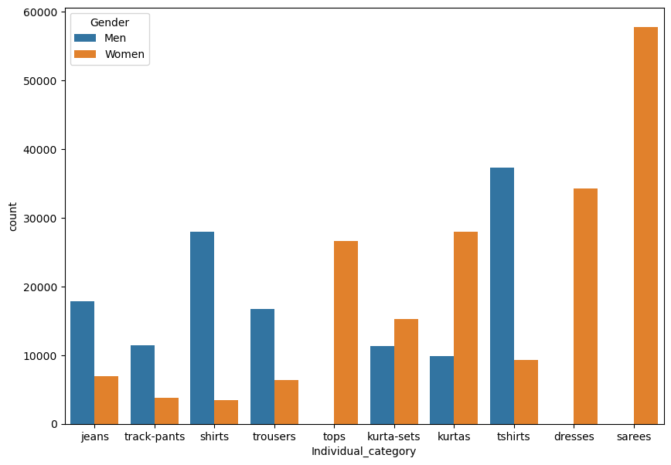
Individual Category Purchasing Behaviour by Gender

Slide 10
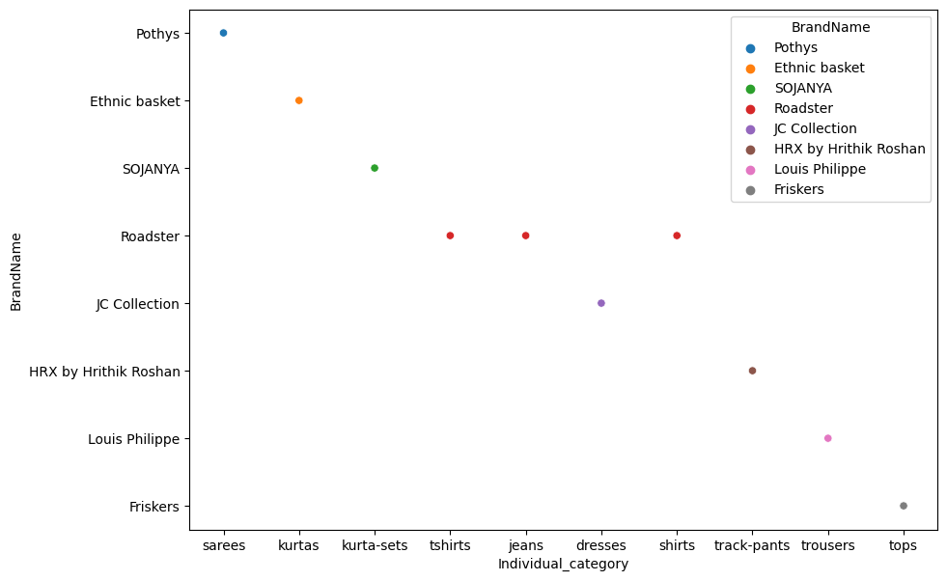
Relationship b/w Brand and Individual Category

Slide 11
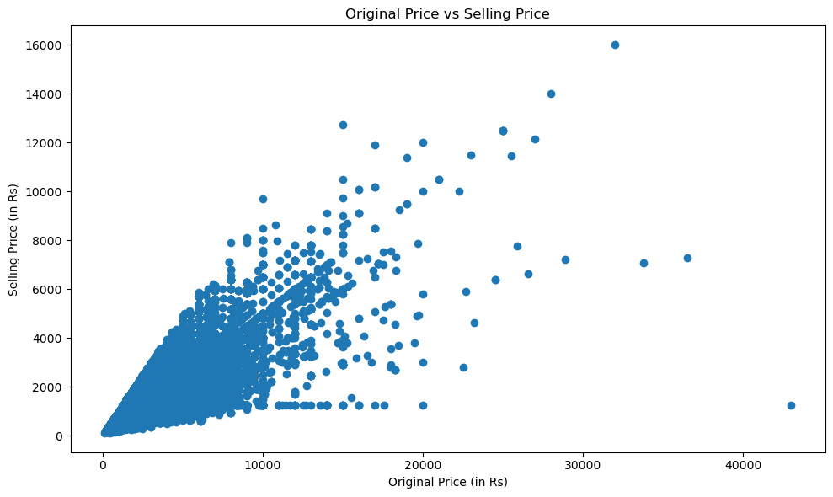
Correlatiob b/w Original Pricce and Selling Price

Slide 12
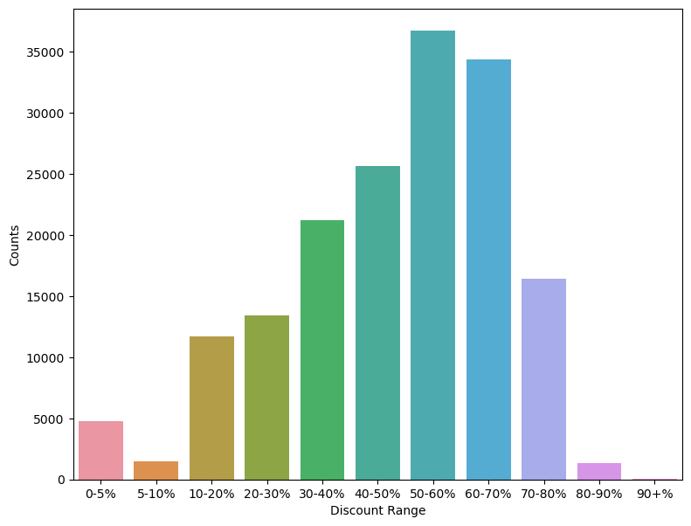
Discount Ranges Counts

Slide 13
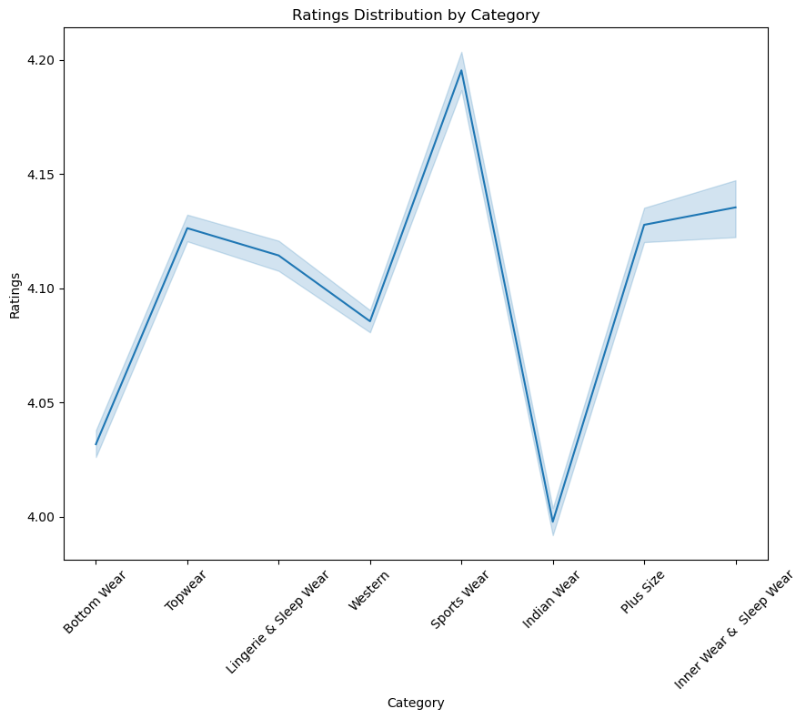

Slide 14
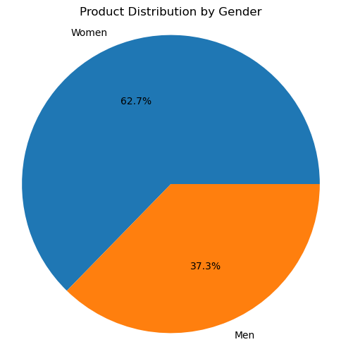
Product Based Distribution

Slide 15

Top 5 Purchasing Categories are Indian Wear, Western, Top Wear, Bottom Wear and Lingerie and Sleep Wear
Top 5 Highest Revenue Generating Categories are Western, Indian Wear, Bottom Wear, Top Wear and Lingerie and Sleep Wear
Bottom Wear, Top Wear and Inner Wear & Sleep Wear are Highest Purchased by Males While Lingerie & Sleep Wear, Western, Indian Wear, Sports Wear and Plus Size are Highely Purchased by Females
Summary
Mens are Most Interested in Jeans, Track Pants, Shirts and Tshirts Whiile Female are in Tops, Kurta Sets, Kurtas, Dresses and Sarees
Most Purchasing Brands Of Categories are:
Sarees : Pothys
Kurtas : Ethnic Basket
Kurta Sets : SOJANYA
T Shirts : Roadster
Jeans : Roadster
Dresses : JC Collection
Shirts : Roadster
Track Pants : HRX by Hritik Roshan
Trousers : Louis Philippe
Tops : Friskers

Slide 16
There is a general trend showing a positive correlation between original prices and discount prices. As the original price increases, the Selling price also tends to increase.
A significant number of data points are clustered in the lower price range (both original and Selling prices). This suggests that most products have relatively lower prices.
The highest sales occur in the 50-60% discount range.
The second-highest sales are in the 60-70% discount range.
There’s a significant drop in sales for discounts less than 50% and greater than 80%.
Summary
Highest Ratings Count in Categories Top Wear, Sports Wear, Plus Size and Inner Wear & Sleep Wear.
Gender Distribution 62 % of Females and 37.3 % of Males.

Slide 17
Suggestions
1
Focus on Top 5 Purchasing and Revenue Generating Categories: Ensure a diverse and updated inventory for categories like Western Wear, Indian Wear, Top Wear, Bottom Wear, and Lingerie & Sleep Wear.
Increase Variety for High Demand Gender-Specific Items: For males, enhance the variety in jeans, track pants, shirts, and t-shirts. For females, increase options in tops, kurta sets, kurtas, dresses, and sarees.
2
Gender-Specific Campaigns: Run tailored marketing campaigns focusing on the top categories for each gender. Highlight products like sarees and kurtas for females and jeans and t-shirts for males.
3
4
Brand Association: Promote the most popular brands for each category. For instance, highlight Pothys for sarees, Roadster for t-shirts and jeans, and HRX by Hritik Roshan for track pants.
5
Maintain Effective Discount Ranges: Concentrate discounts in the 50-60% and 60-70% ranges where sales are highest.

Slide 18
6
Reduce Ineffective Discounts: Minimize or carefully manage discounts less than 50% and greater than 80% to avoid significant drops in sales.
Enhance Top Categories with High Ratings: Continue improving product quality and variety in categories like Top Wear, Sports Wear, Plus Size, and Inner Wear & Sleep Wear where ratings are high.
7
8
Customer Feedback Utilization: Actively collect and use customer feedback to further enhance these high-rating categories.

Slide 19

Thank you!

