Slide 1
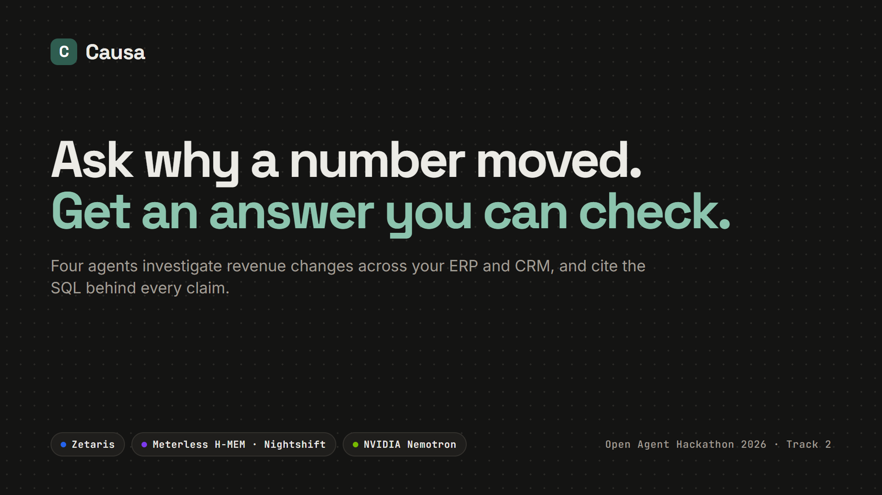
Notes:
Hi, we're Paras and Harshita. This is Causa, for the Open Agent Hackathon, track two: the agent that can explain why. You ask why a number moved, and you get an answer you can check. Four agents investigate revenue changes across an ERP and a CRM, and every claim cites the SQL behind it.

Slide 2
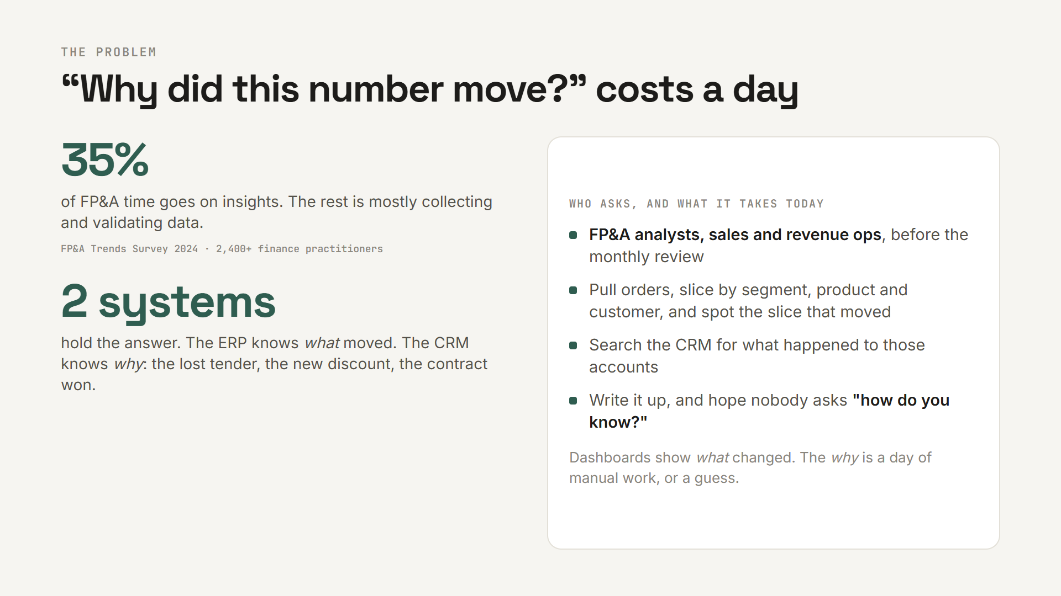
Notes:
Every month someone asks: why did this number move? The FP&A Trends survey of more than 2,400 finance practitioners found only 35 percent of FP&A time goes on insights. The rest is mostly collecting and validating data. And the answer always spans two systems: the ERP knows what moved, the CRM knows why. Dashboards show the what. The why is a day of manual work, or a guess.

Slide 3
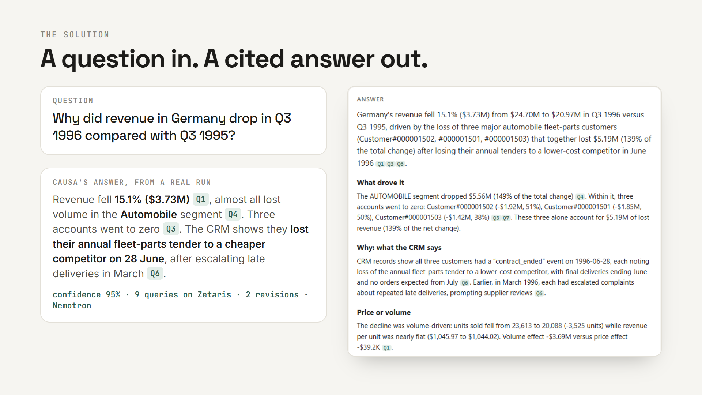
Notes:
Here is a real run. I ask why revenue in Germany dropped in Q3 1996. Minutes later, with every step logged: revenue fell 15.1 percent, almost all lost volume in the Automobile segment. Three accounts went to zero. The CRM shows they lost their annual fleet-parts tender to a cheaper competitor on 28 June. Every number carries a citation, and each one opens the exact SQL and rows.

Slide 4
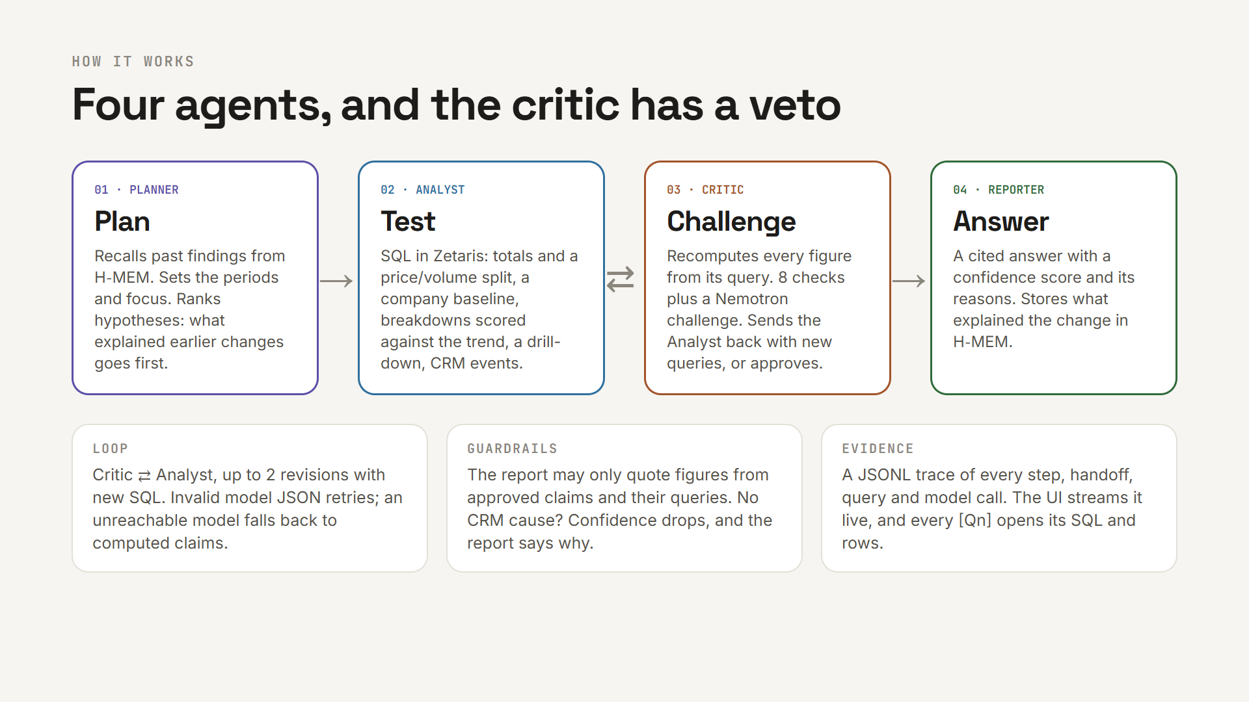
Notes:
Four agents do it. The Planner recalls past findings from H-MEM and ranks hypotheses. The Analyst tests each one with SQL in Zetaris: totals, a price and volume split, a company baseline, breakdowns, a drill-down, and the CRM events. The Critic recomputes every figure and sends the Analyst back with new queries until the draft holds. The Reporter writes the cited answer with a confidence score. It's a loop, not a chain, and every step is traced.

Slide 5
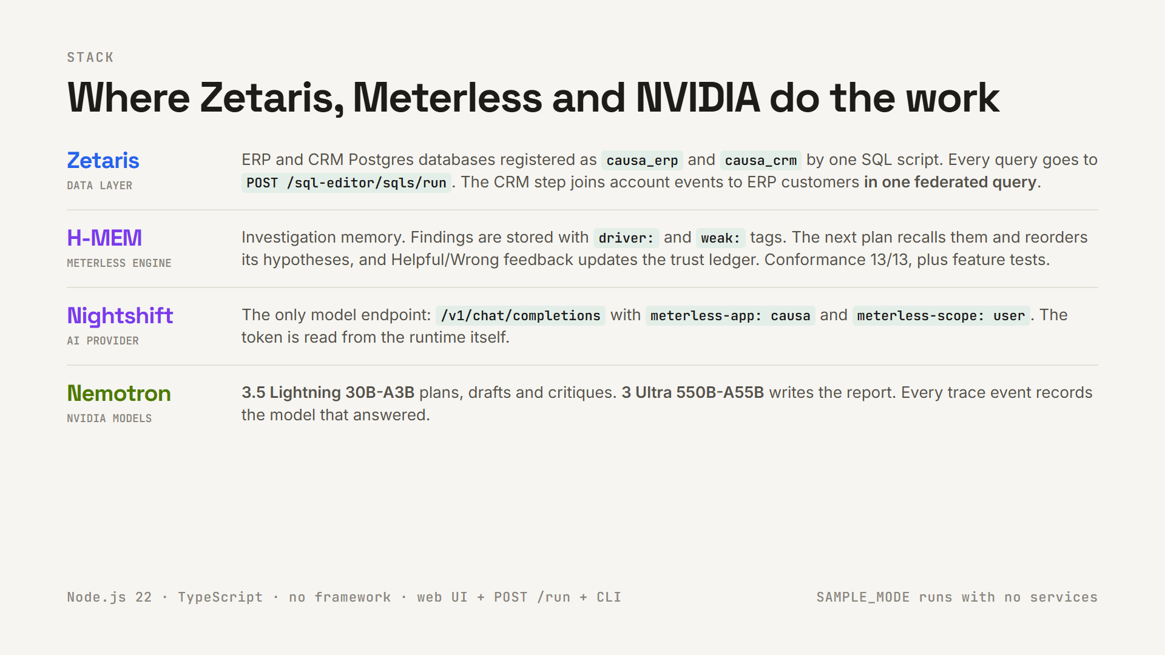
Notes:
The sponsor technology does real work. Zetaris is the data layer: the ERP and CRM are registered as two data sources, and the CRM step is one federated query across both. H-MEM is the engine behind investigation memory: findings are stored and recalled to reorder the next plan, and feedback updates the trust ledger. Nightshift is the only AI provider, and NVIDIA Nemotron does the reasoning: Lightning plans, drafts and critiques, and Ultra writes the report. The trace logs which model answered every call.

Slide 6
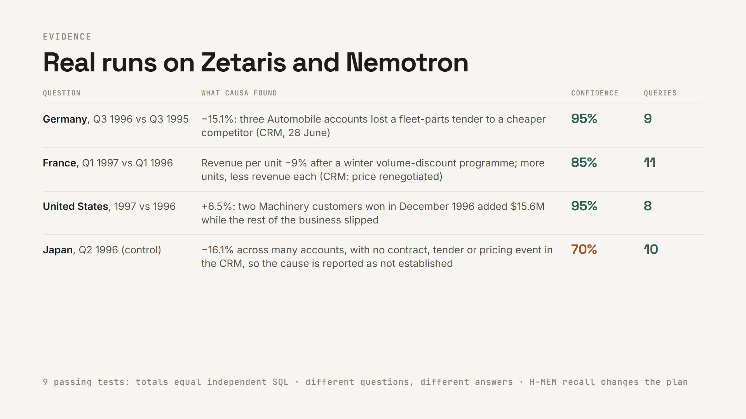
Notes:
These are real runs on Zetaris and Nemotron. Germany: the lost tender. France: a discount programme that cut revenue per unit. The United States: two new machinery customers. And a control question, Japan, where nothing is planted: Causa reports the drop, but says the cause is not established, and its confidence drops. Nine tests check that totals match independent SQL and that memory changes the plan.

Slide 7
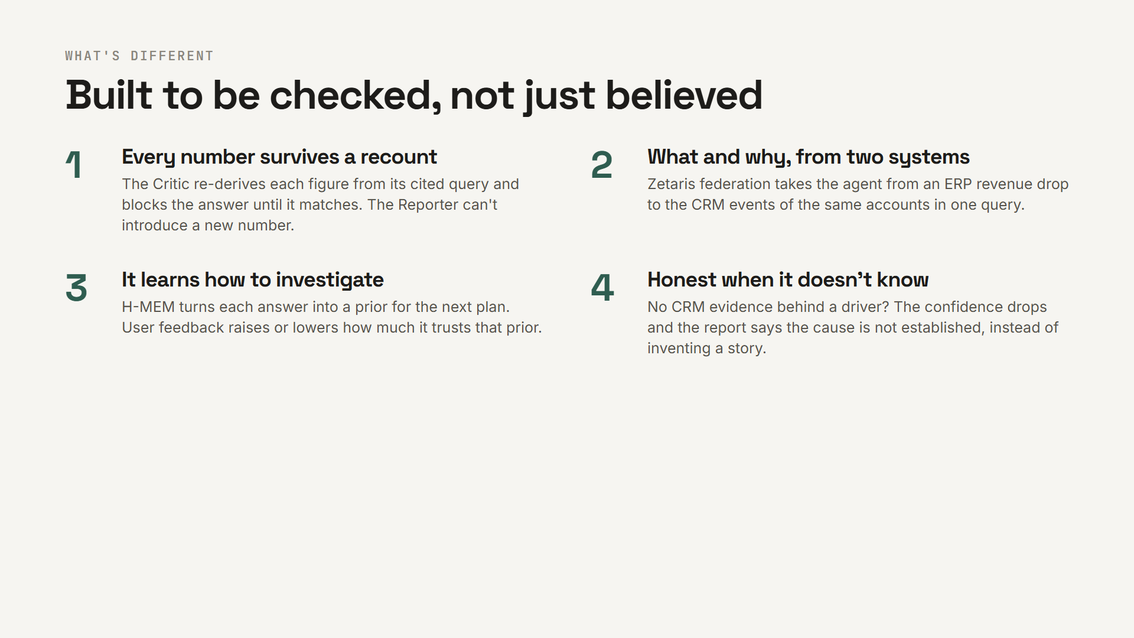
Notes:
What's different: every number survives a recount. The answer joins the what and the why from two systems. It learns which explanations work. And it's honest when it doesn't know.

Slide 8
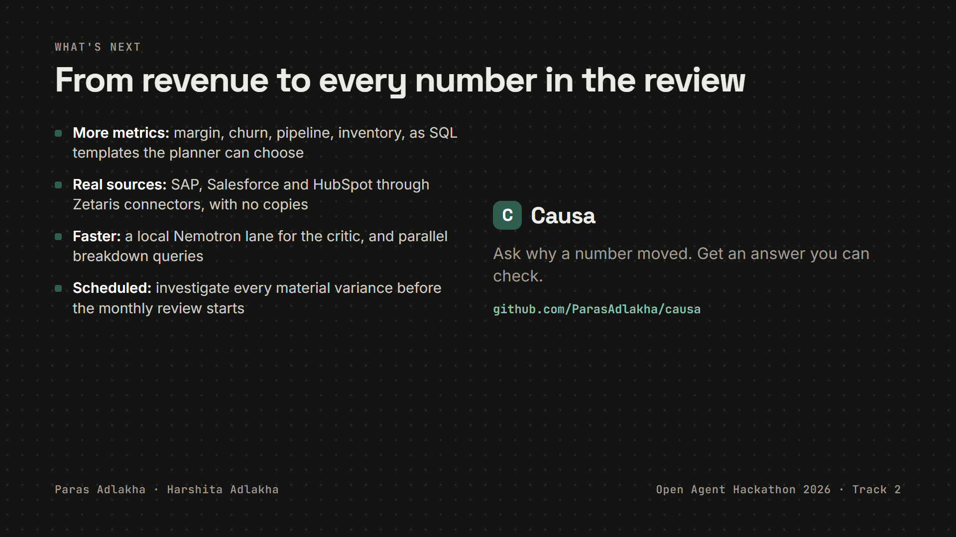
Notes:
Next: more metrics than revenue, real sources like SAP and Salesforce through Zetaris connectors, a faster local critic, and scheduled investigations before every monthly review. Causa: ask why a number moved, and get an answer you can check. Thank you.

