Slide 1
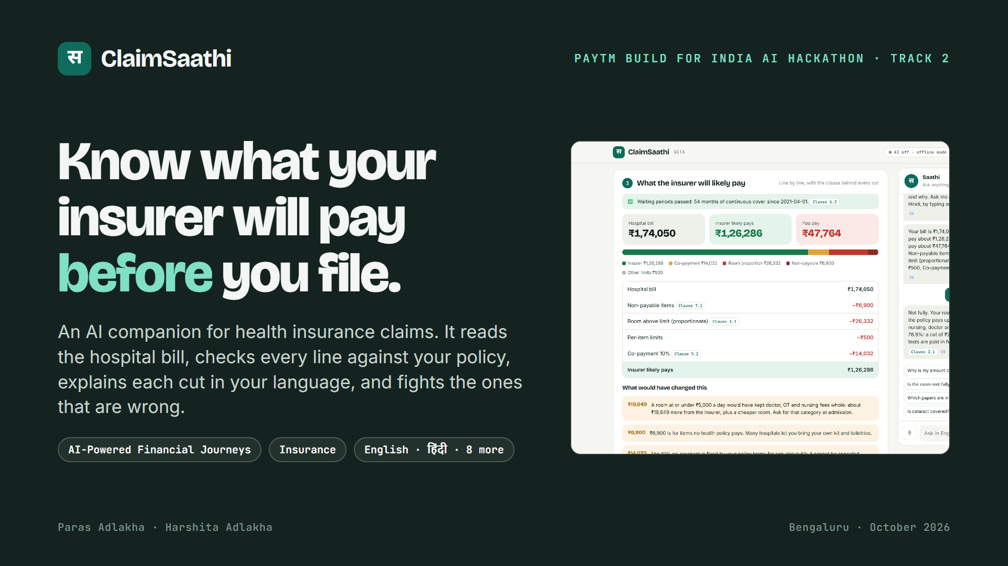
Notes:
Hi, we're Paras and Harshita. ClaimSaathi: know what your health insurer will pay before you file. It reads the hospital bill, checks every line against your policy, explains each cut in Hindi or English, and fights the cuts that are wrong.

Slide 2
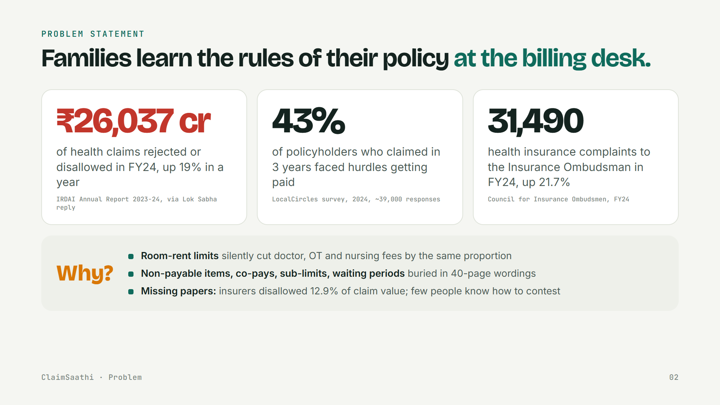
Notes:
The problem: Rs 26,037 crore of health claims were rejected or disallowed in FY24, up 19%. 43% of policyholders who claimed faced hurdles. Health complaints to the Ombudsman rose 21.7% to 31,490. The reasons are rules nobody reads until the billing desk: room-rent limits that cut doctor and OT fees in proportion, non-payable items, co-pays, waiting periods, missing papers.

Slide 3
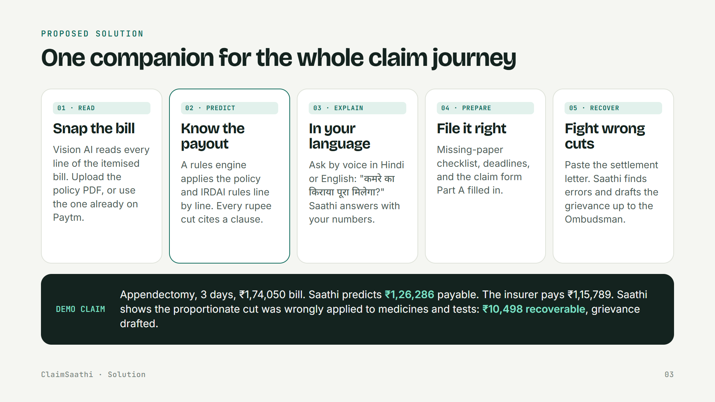
Notes:
ClaimSaathi covers the whole journey: snap the bill, know the payout line by line with a clause behind every cut, ask in your language, file with the right papers and a pre-filled form, and if the insurer pays less, check the letter and draft the grievance. In our demo claim, the insurer underpaid by Rs 10,498 and ClaimSaathi catches it.

Slide 4
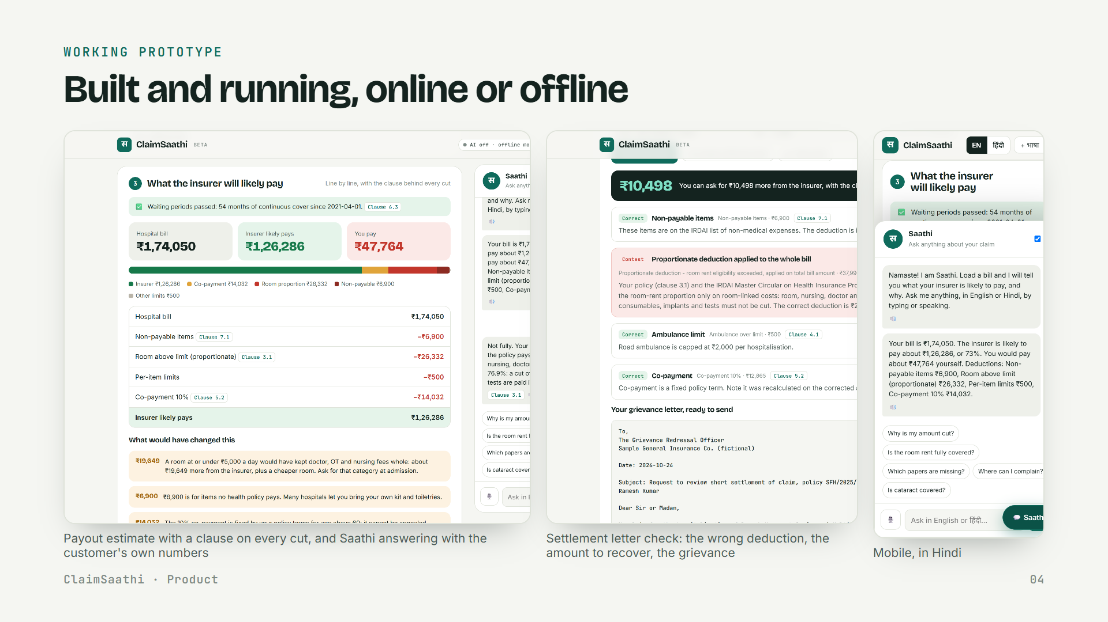
Notes:
It is built and running. Left: the estimate with clauses and Saathi answering with the customer's own numbers. Middle: the settlement letter check. Right: mobile in Hindi. It works fully offline in English and Hindi; with an OpenAI key it reads bill photos and speaks 10 Indian languages.

Slide 5
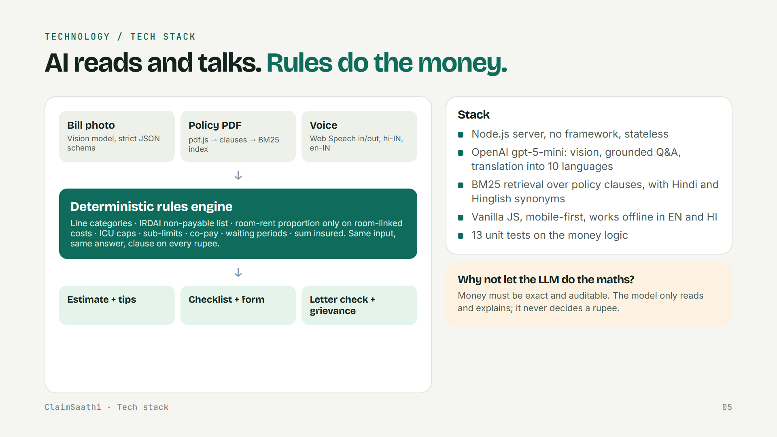
Notes:
Tech: AI reads and talks, rules do the money. A vision model turns the bill photo into lines with a strict schema. The policy PDF becomes clauses in a BM25 index with Hindi synonyms. A deterministic engine encodes the policy and IRDAI rules, so the same bill always gives the same answer, with a clause on every rupee. The model never decides money.

Slide 6
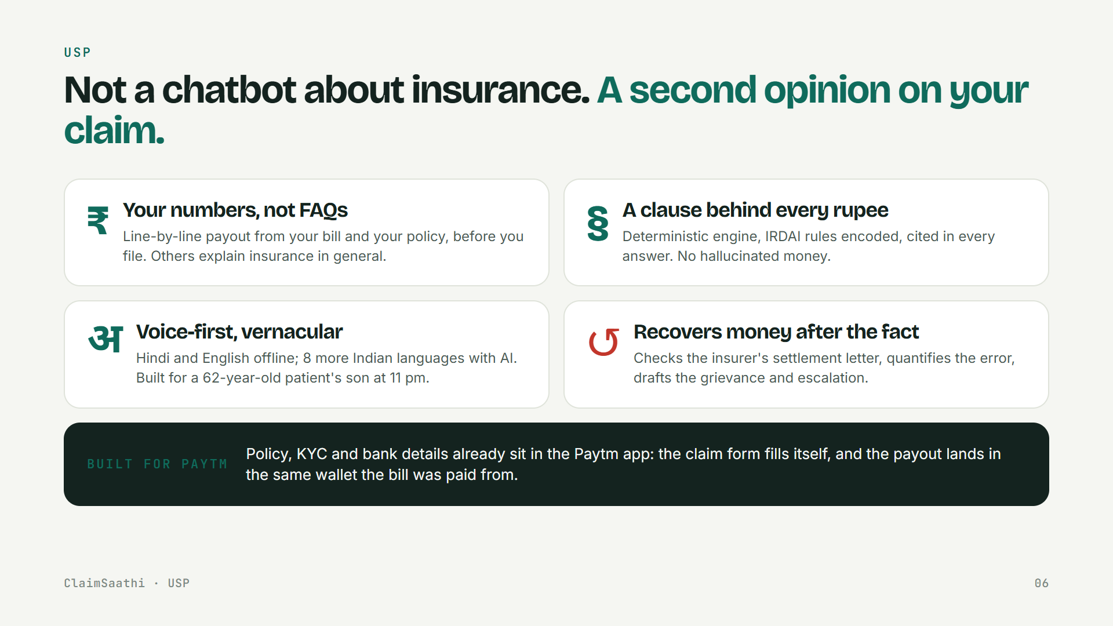
Notes:
USP: not a chatbot about insurance, a second opinion on your claim. Your numbers, not FAQs. A clause behind every rupee. Voice-first and vernacular. And it recovers money after the fact. Inside Paytm, the policy, KYC and bank details are already there, so the form fills itself.

Slide 7
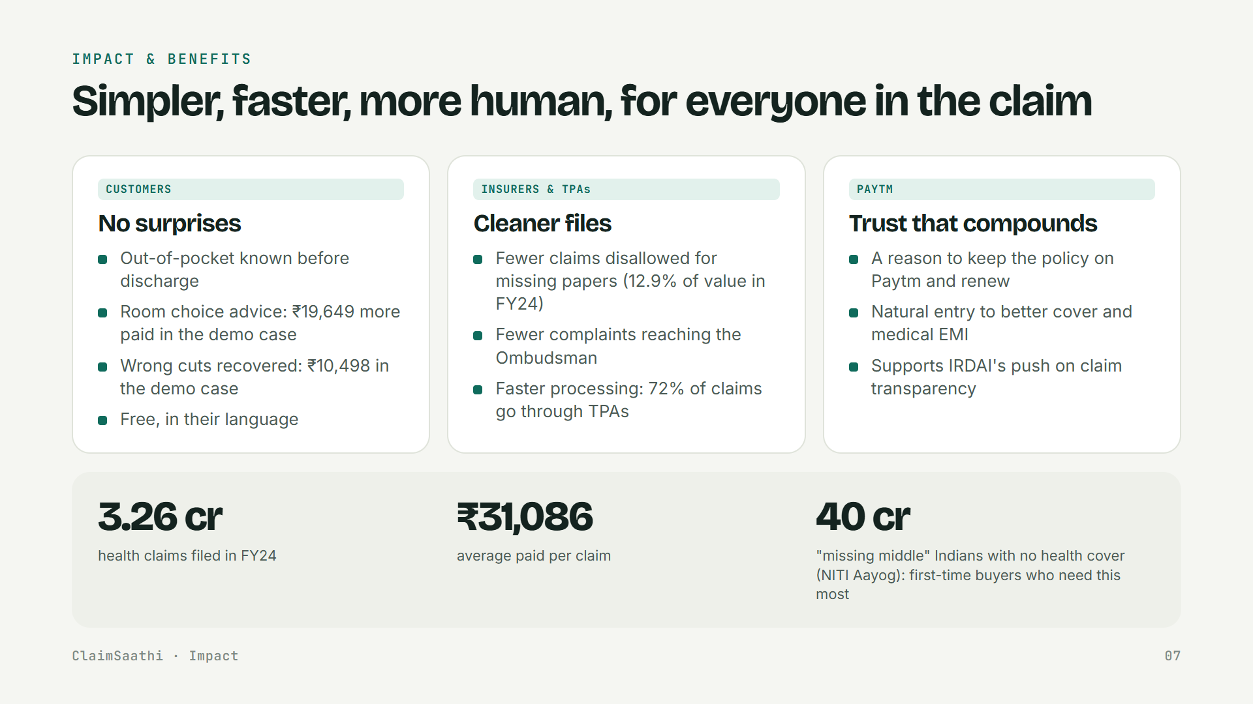
Notes:
Impact: customers know their out-of-pocket before discharge and recover wrong cuts. Insurers and TPAs get cleaner files, fewer disallowed claims and fewer Ombudsman complaints. For Paytm, it is a trust moment that keeps the policy and drives renewal. 3.26 crore health claims are filed a year.

Slide 8
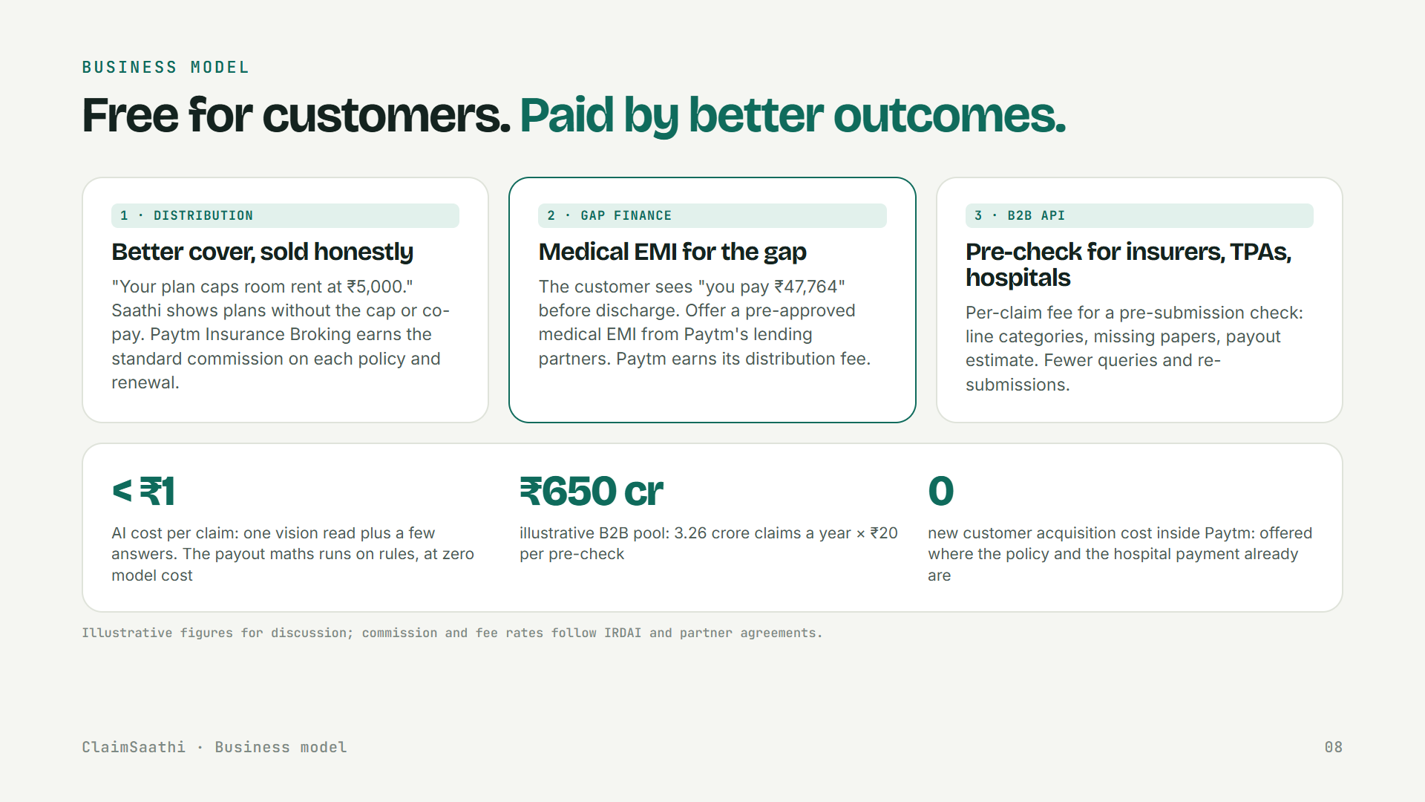
Notes:
Business model: free for customers. Paytm earns from honest distribution of better cover, medical EMI for the gap through lending partners, and a B2B pre-check API for insurers, TPAs and hospitals. AI cost is under a rupee per claim because the maths runs on rules. Figures are illustrative.

Slide 9
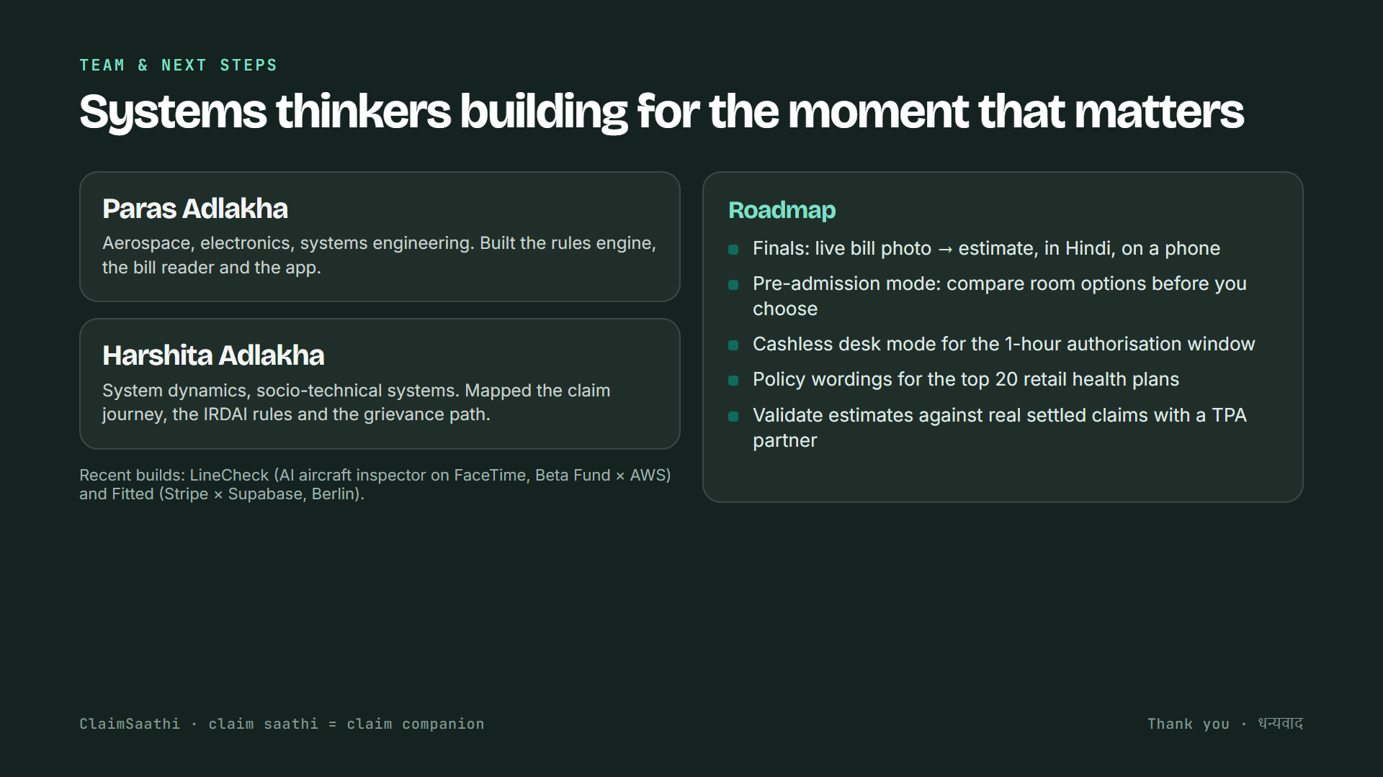
Notes:
We're systems engineers: Paras built the engine and app, Harshita mapped the journey, the IRDAI rules and the grievance path. At the finals we'll show a live bill photo to estimate in Hindi on a phone. Thank you. Dhanyavaad.

