Slide 1
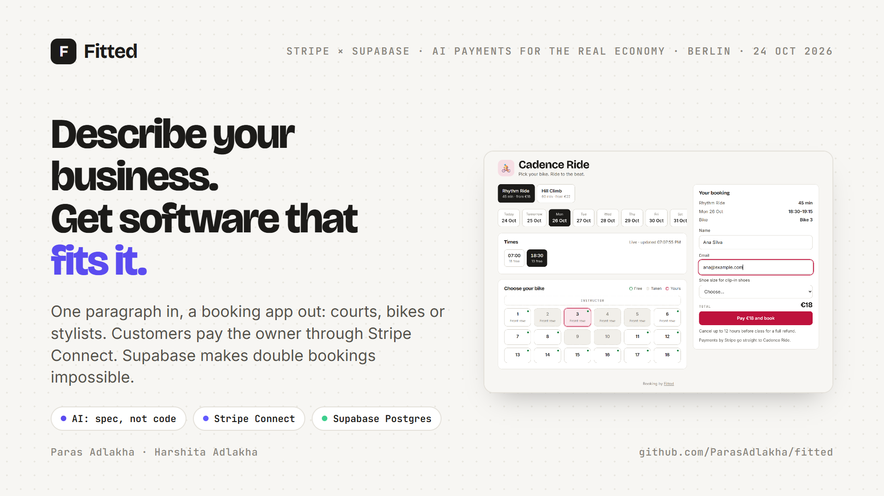

Notes:
Hi, we're Paras and Harshita. Fitted: a small-business owner describes their business in one paragraph and gets booking software that fits it, with payments through Stripe Connect and Supabase underneath.

Slide 2
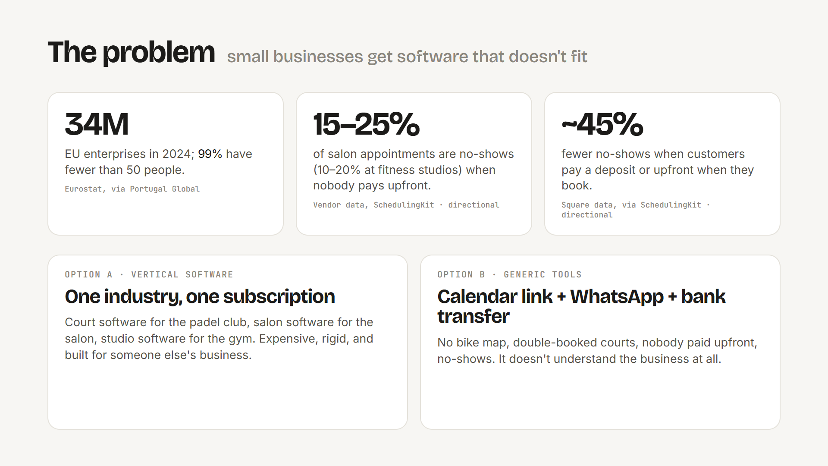
Notes:
The problem: small businesses either pay for vertical software built for one industry, or make do with a calendar link, WhatsApp and bank transfers. That means double bookings, no upfront payment, and no-shows.

Slide 3
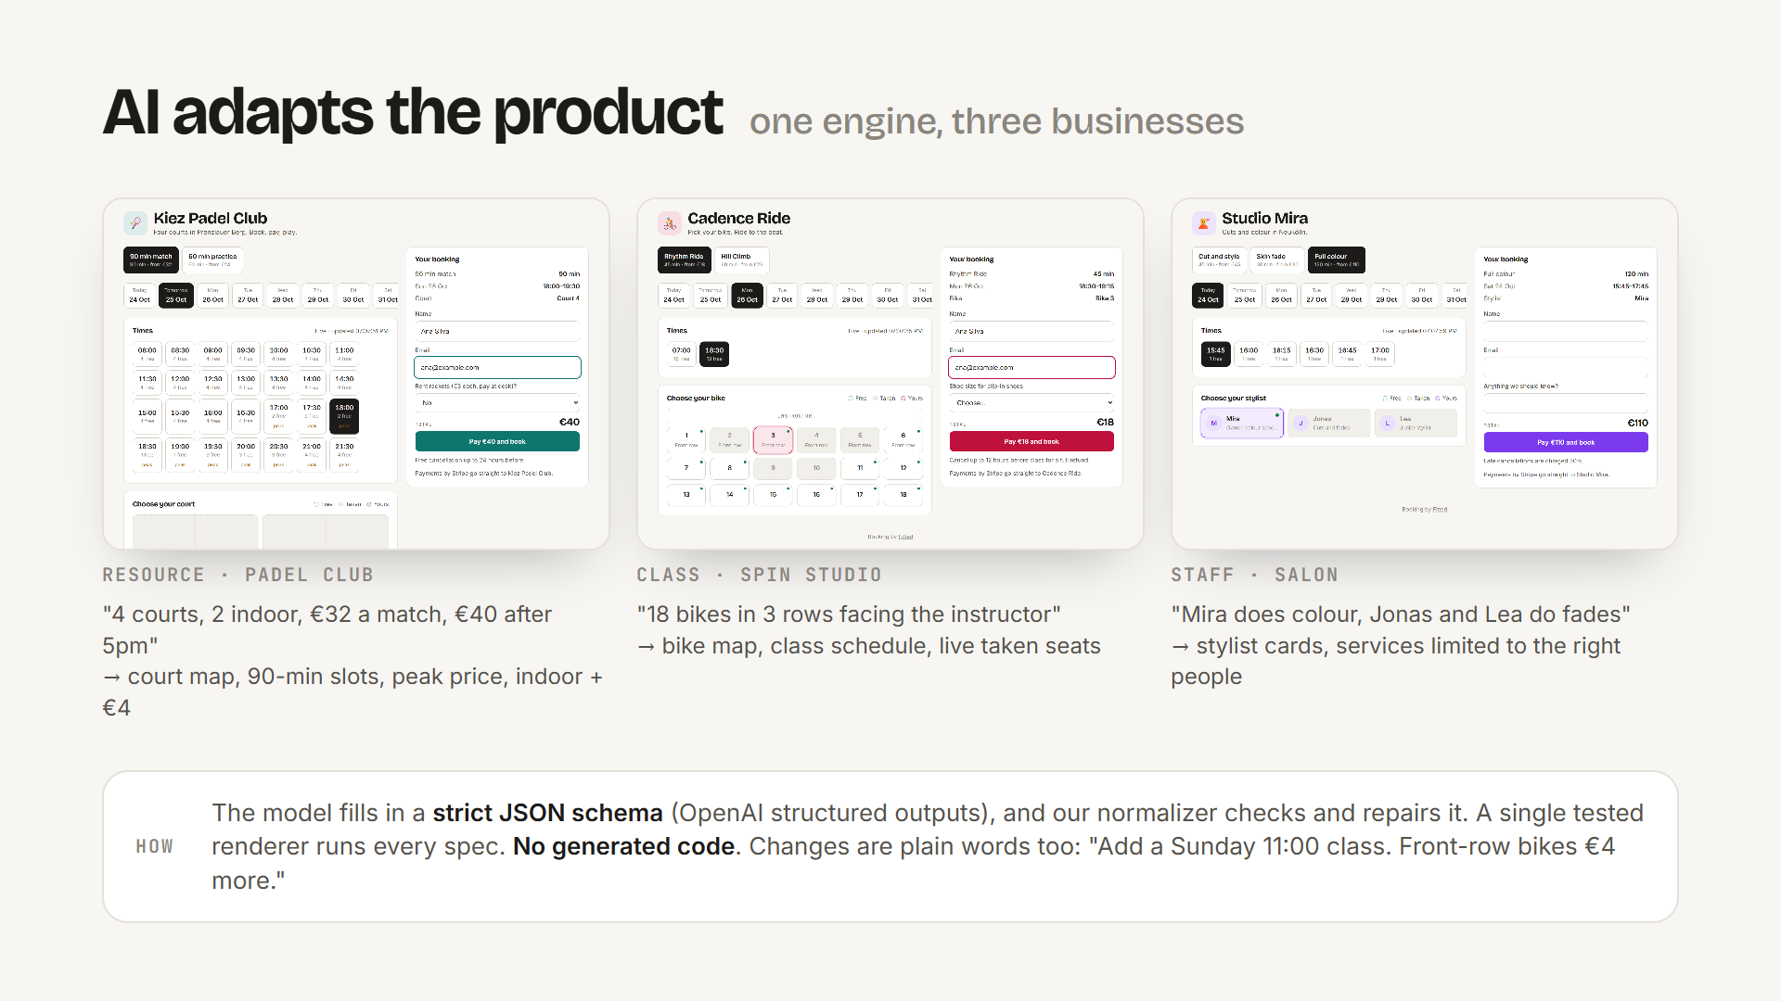
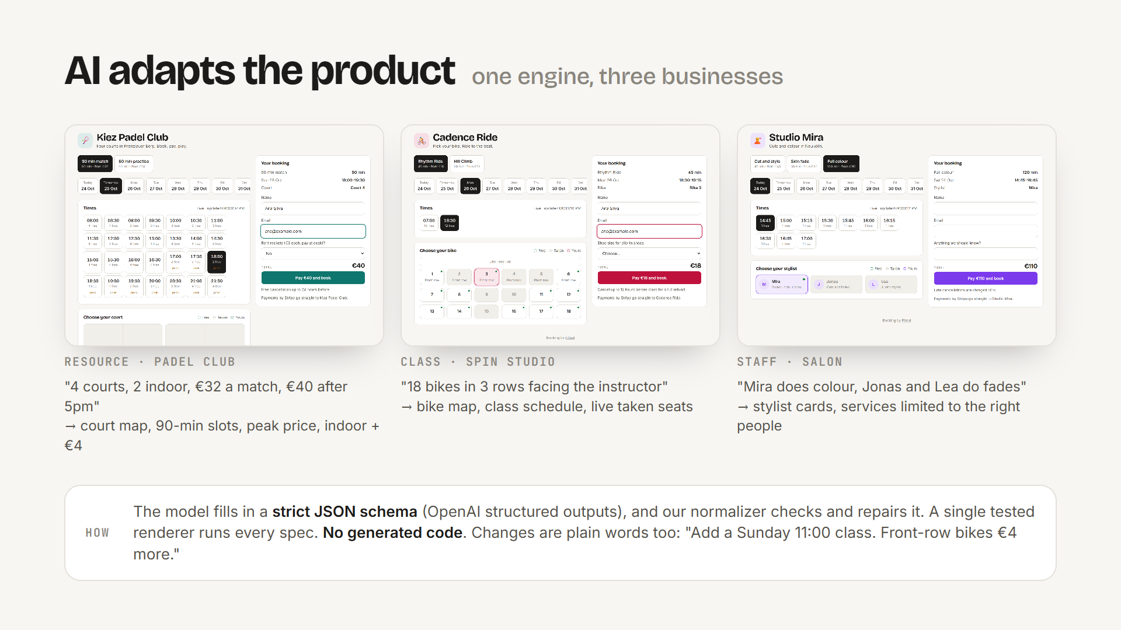
Notes:
LIVE DEMO: paste the spin studio paragraph, Generate. One AI call, about $0.002, returns a spec: an 18-bike map, a class schedule, a shoe-size question. Publish. Then show the padel club and the salon: the same engine and the same tables. The AI fills in a strict schema, so no code is generated.

Slide 4
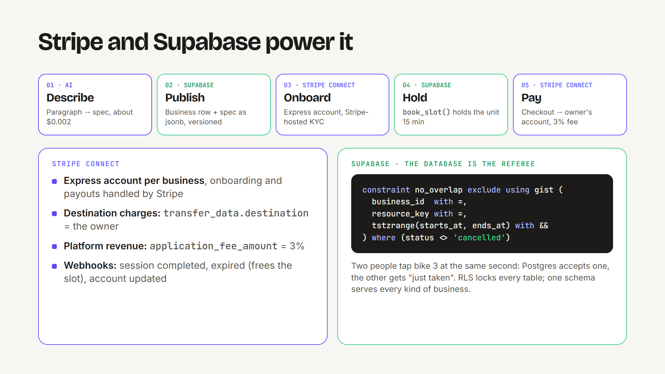
Notes:
Connect Stripe: an Express account, Stripe-hosted onboarding. Book bike 3 and pay with 4242. It's a destination charge, so the money goes to the studio and Fitted keeps 3% as an application fee. Then try to book bike 3 again: Postgres's exclusion constraint rejects the overlap.

Slide 5
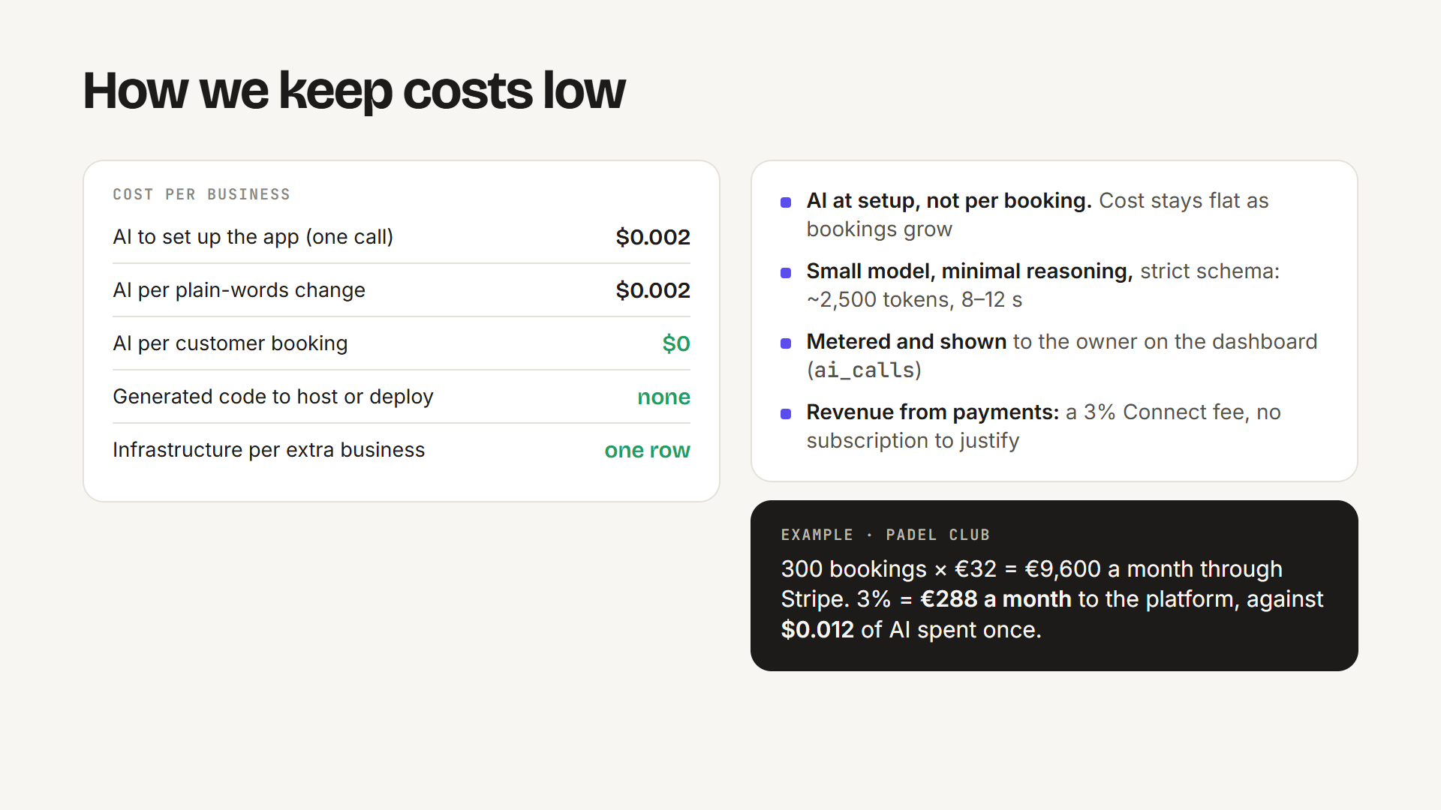
Notes:
Costs: AI runs only at setup and on changes, about $0.002 per call. Bookings never call a model. Each business is a row plus JSON. No deploys. Revenue comes from the Connect fee.

Slide 6
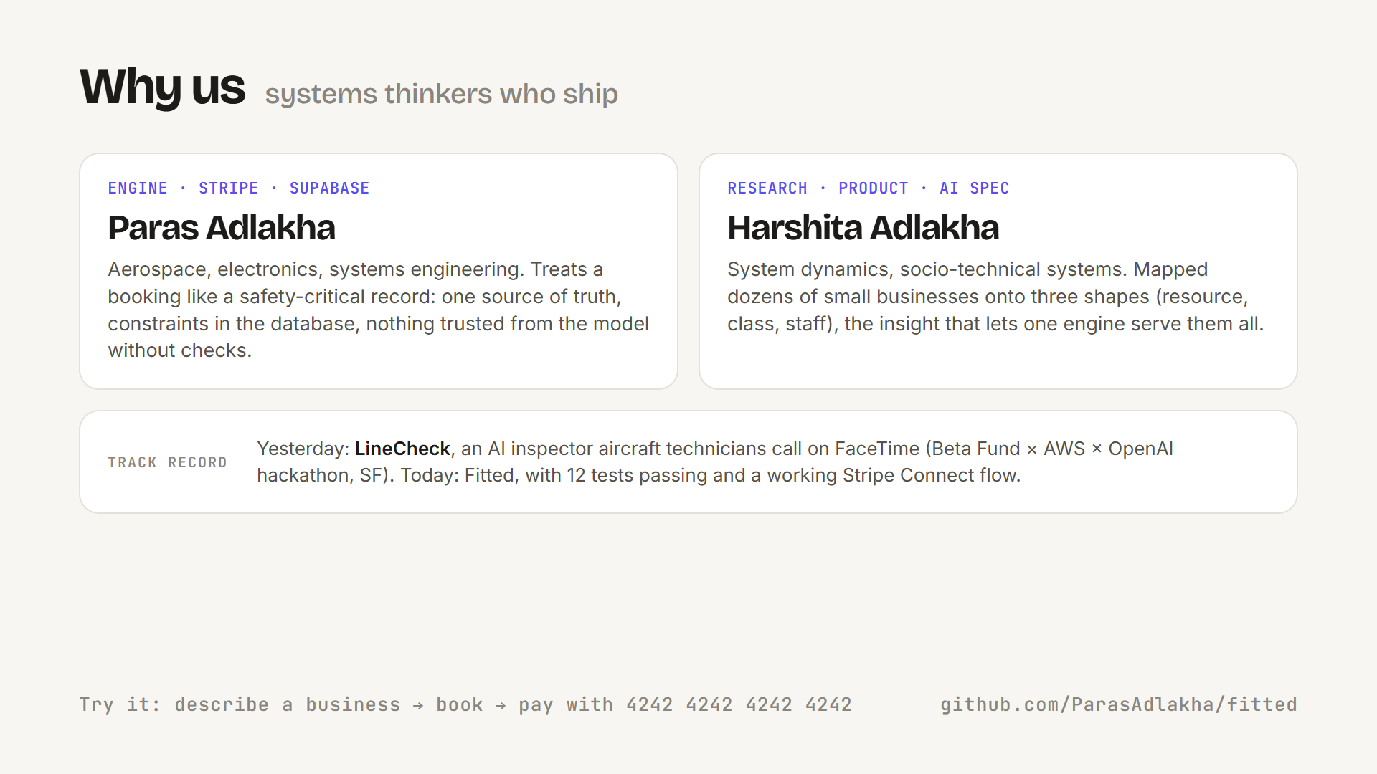
Notes:
Paras: systems engineering, the engine, Stripe and Supabase. Harshita: system dynamics, mapped businesses to three shapes. Yesterday we shipped LineCheck at the Beta Fund x AWS hackathon. Thank you.

