Slide 1
LineCheck / Who we are
An AI inspector aircraft technicians call on FaceTime.
It sees the part, cites the FAA manual, checks history and directives, and drafts the work order. The certificated mechanic signs.
TEAM MEMBER
Paras Adlakha
[Cornell University]
Aerospace, electronics, systems engineering
Agent, vision and data pipeline
https://www.linkedin.com/in/parasadlakha/?isSelfProfile=true
TEAM MEMBER
Harshita Adlakha
[Blue Marble Space]
System dynamics, socio-technical systems
Research, human factors and product
https://www.linkedin.com/in/harshita-adlakha-48981235b/?isSelfProfile=true
TRACK Multi-Modal Agents BUILT WITH Chert FaceTime · LiveKit · OpenAI Realtime + vision · Keenable

Slide 2
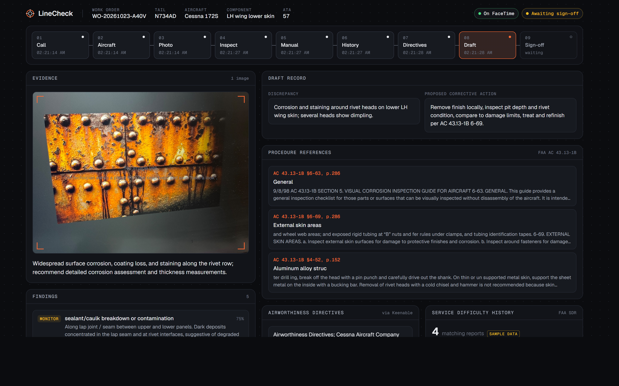
LineCheck / What we are solving
PROBLEM
43,000 to 47,000
aircraft technician shortfall projected by 2027 (Oliver Wyman). Less experience on every shift.
96% of 619 maintenance safety occurrences involved technician actions; memory lapses tracked fatigue.
Hobbs & Williamson, Human Factors, 2003
SOLUTION: ONE CALL, SEVEN STEPS
FaceTime
Photo
Inspect
Manual
History
ADs
Sign
DEMO:https://drive.google.com/file/d/1wq2pN7yee1tdY1iSsQFbBKWGquCcIYFc/view?usp=sharing
REPO https://github.com/HarshitaAdlakha/linecheck.git
LIVE FaceTime +1 628 278 8831 during the demo slot
Linkedin post: https://www.linkedin.com/feed/update/urn:li:activity:7519509933067747328/
Demo replay: LineCheck Demo Replay
MODALITIES voice · camera · PDF manual · web search · structured record

Slide 3
LineCheck / Why our team
Aerospace
We speak the domain: ADs, SDRs, return to service, AC 43.13-1B.
Electronics
Wiring, connector and avionics faults are a large share of write-ups.
SYSTEM DYNAMICS: THE EXPERIENCE DRAIN
Senior techs retire
Systems engineering
A hard boundary: LineCheck assists and documents; the human decides and signs.
Socio-technical
Errors come from fatigue and time pressure, so it is hands-free on the phone techs carry.
Burnout and attrition
R1
reinforcing
Less experience per shift
More errors and rework
UNFAIR ADVANTAGE
Grounded in peer-reviewed human-factors evidence and real FAA data, and already working end to end on a live FaceTime line.
LineCheck cuts the link from less experience to more errors.

