Slide 1
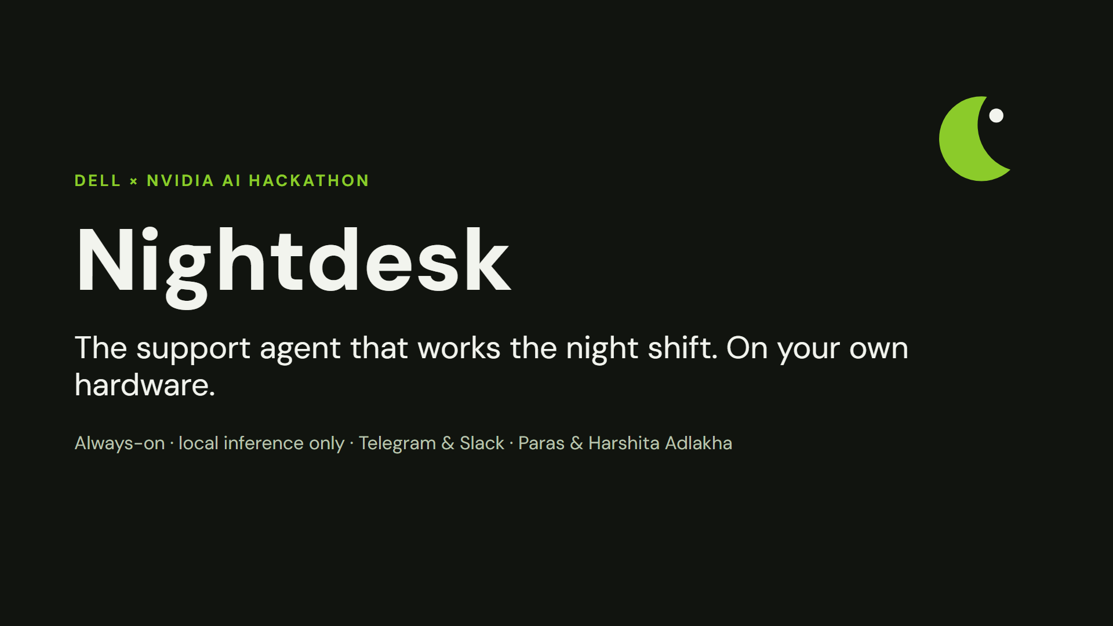
Notes:
Nightdesk: the support agent that works the night shift, on your own hardware.

Slide 2
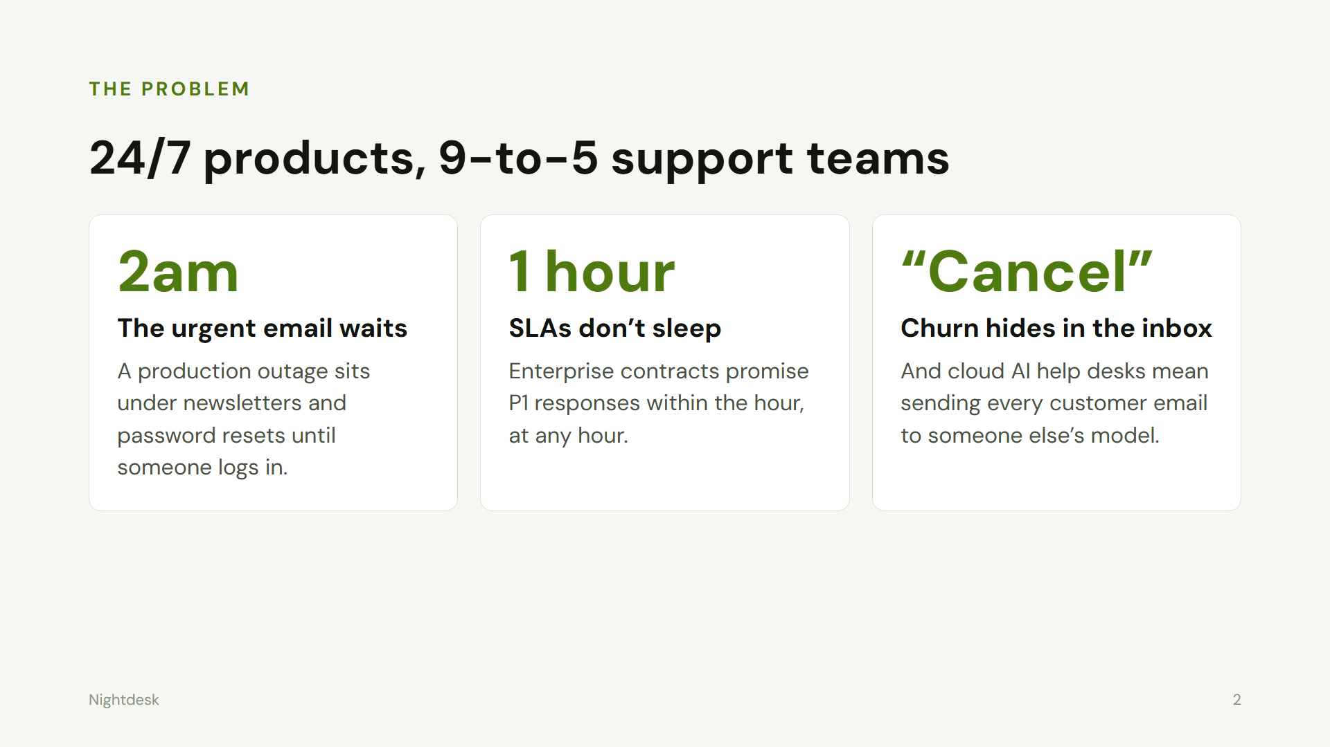
Notes:
Problem: 24/7 products, 9-to-5 support. Urgent emails wait, SLAs are missed, churn hides, cloud AI is not an option for many.

Slide 3
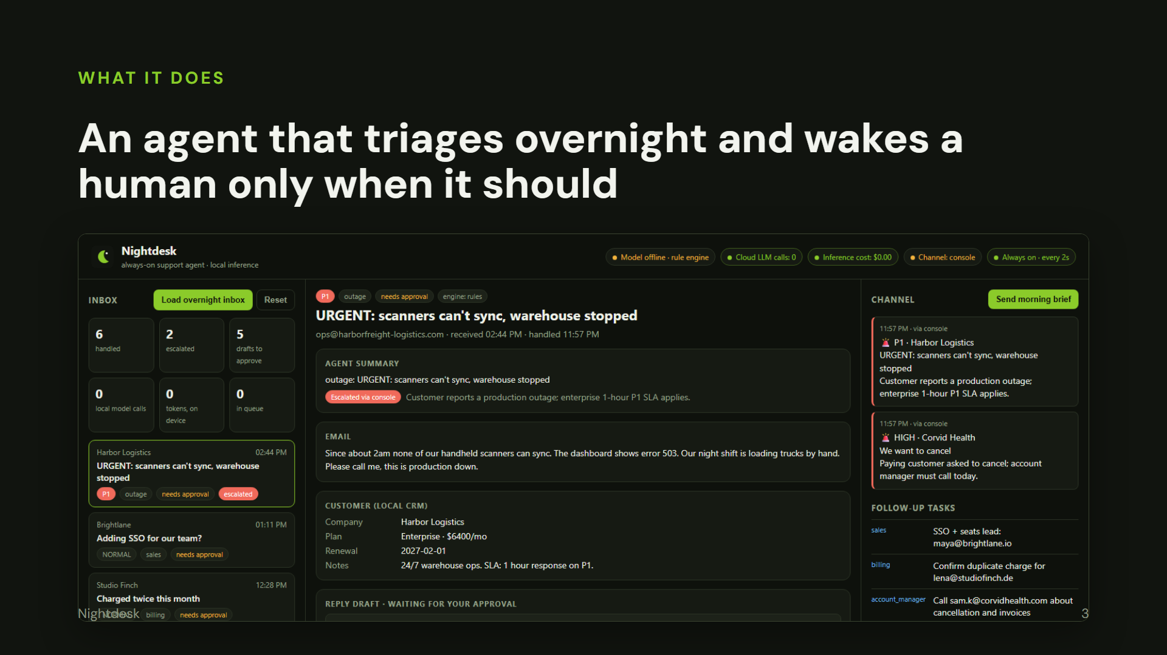
Notes:
Demo: the dashboard after a night of email. Outage escalated with the full tool-call trace.

Slide 4
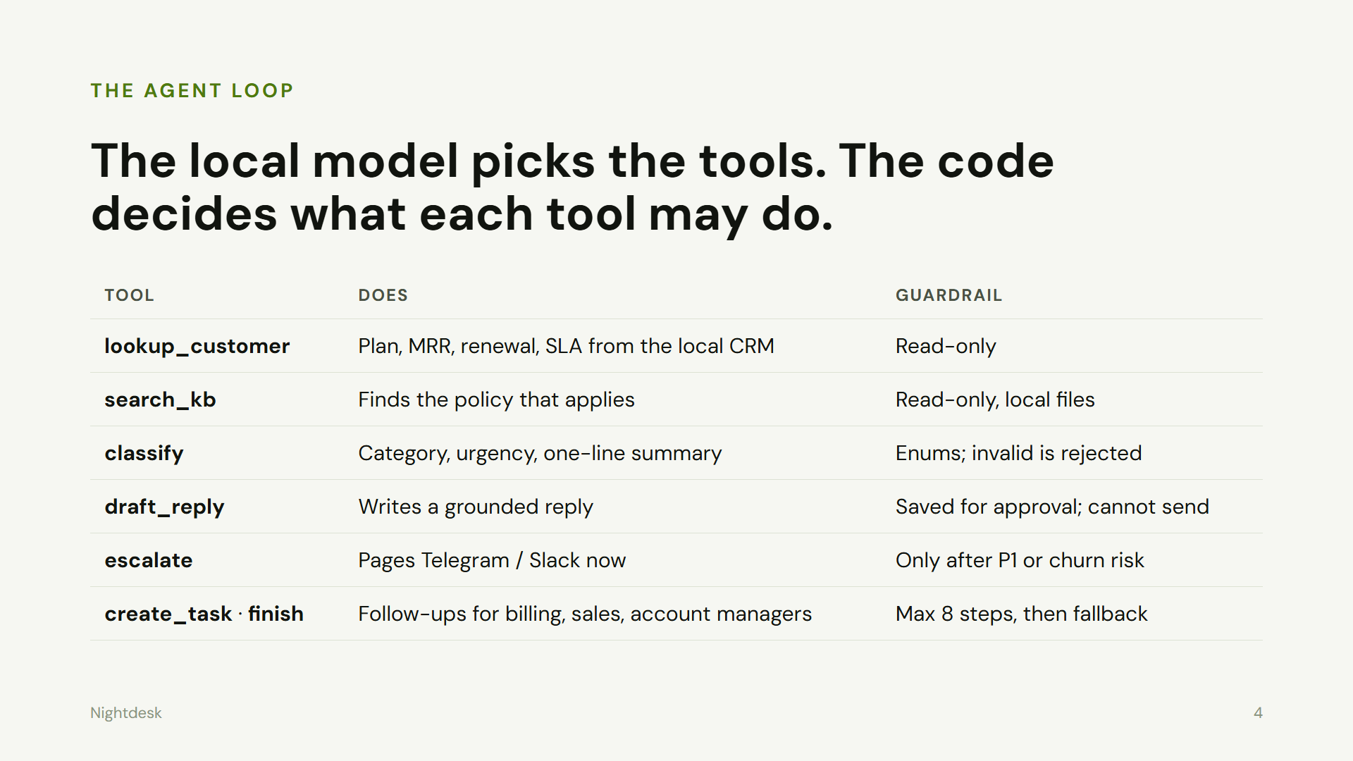
Notes:
The local model picks tools; the code enforces what each may do. Drafts never send. Escalation gated.

Slide 5
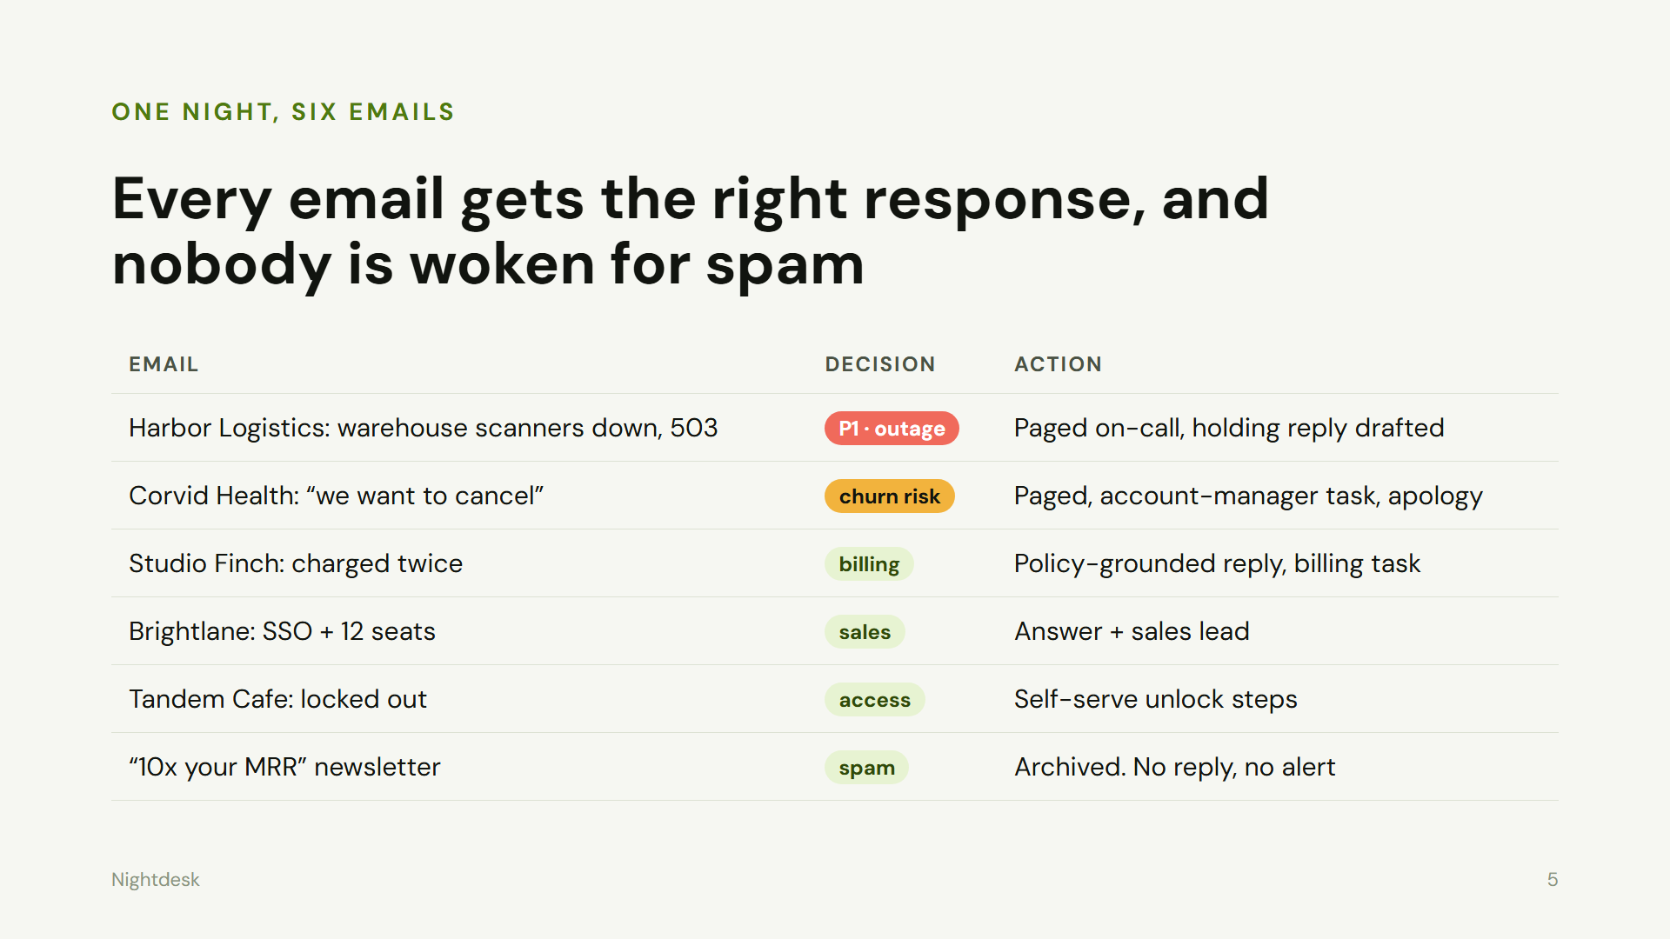
Notes:
Six emails, six right responses, from paging on-call to archiving spam.

Slide 6
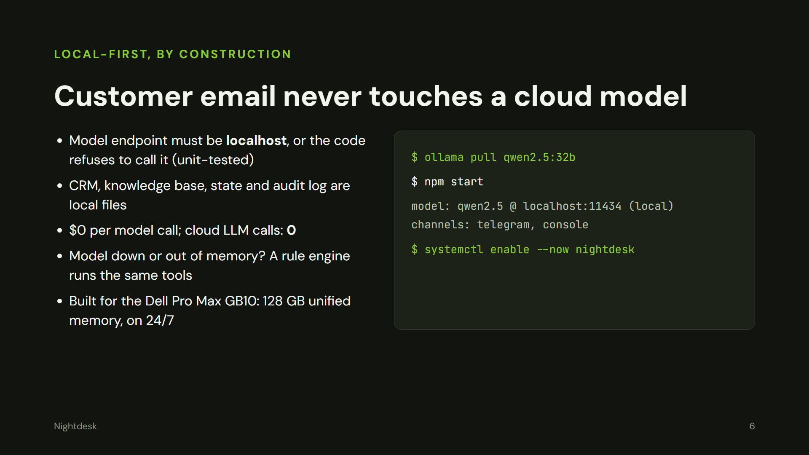
Notes:
Local-first by construction: non-local model URL refused in code and tested; rule-engine fallback.

Slide 7
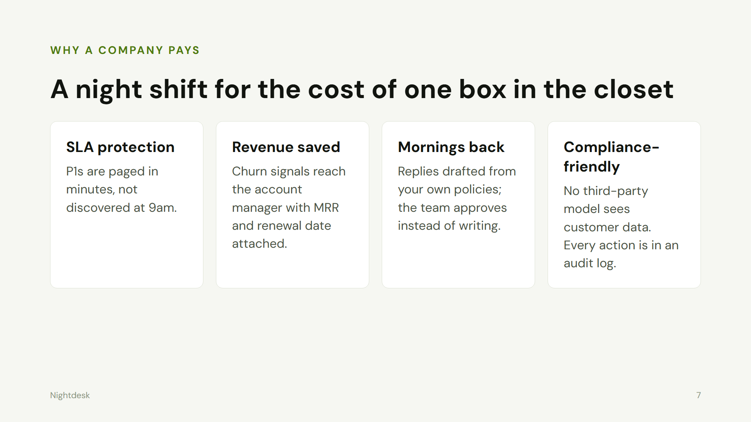
Notes:
Business value: SLA protection, revenue saved, mornings back, compliance-friendly.

Slide 8
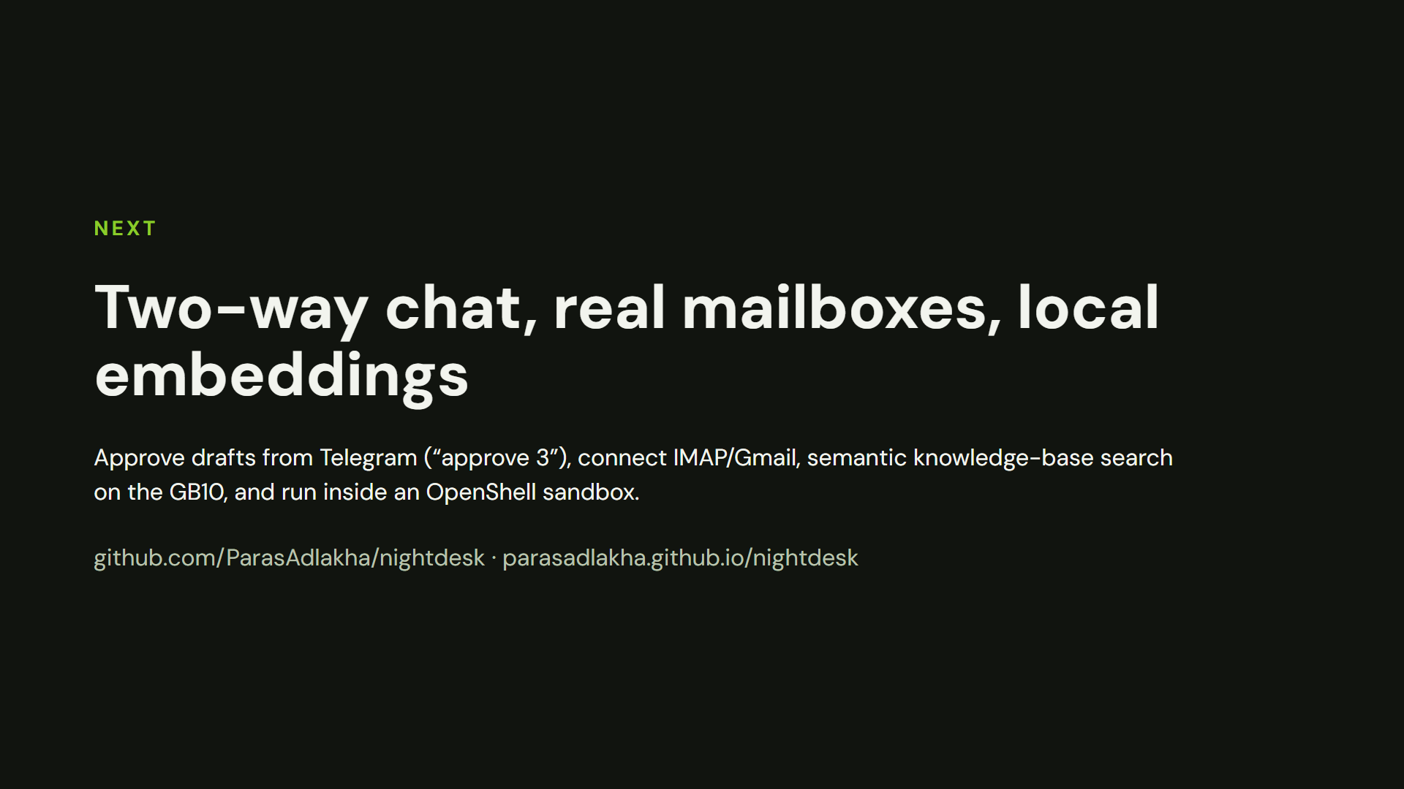
Notes:
Next: two-way Telegram, IMAP/Gmail, local embeddings on GB10, OpenShell sandbox.

