Slide 1

PROJECT TITLE- Catch The Flamingo
Guided by- Submitted by-
Mr. Nitin Kumar Paras (1502913059)
Akansha Jain (1502913007)
Pooja Agarwal (1502931102)
Group No. : G5
DEPARTMENT OF INFORMATION TECHNOLOGY,
KIET GROUP OF INSTITUTIONS, GHAZIABAD, UTTAR PRADESH
(AFFILIATED TO DR. A.P.J. ABDUL KALAM TECHNICAL UNIVERSITY, LUCKNOW, UTTAR PRADESH, INDIA)

Slide 2
Why a Big Data Project ?
Big Data is one of the emerging technologies.
Curious to analyze and do basic exploration of large, complex datasets.
To be able to discover useful and hidden knowledge from the Big Data efficiently and effectively.
One of the best skills to have.

Slide 3
INTRODUCTION
In this project :
Build a big data ecosystem using various tools and methods.
Analyze a data set simulating big data generated from a large number of users who are playing our imaginary game "Catch the Pink Flamingo".
Then, walk through the typical big data science steps for acquiring, exploring, preparing, analyzing, and reporting.

Slide 4
BRIEF DESCRIPTION ABOUT OUR IMAGINARY GAME
It’s a multi-user game.
The players have to catch Pink Flamingos randomly pop up on a gridded world map based on missions that change in real-time.
After the initial sign up, a player (user) is asked to play the Level 1 individually without joining any team.
Here, the user gets trained as a player and starts building a game history.
Level 1 is an easy entry to the game composed of only 64 (8x8) grid cells and longer, more obvious, fun missions.
After Level 1, the player gets asked if he wants to play in a team or alone.

Slide 5
Continued…
At the beginning of each level, the game creates a brand new map with more cells than the level before.
The complexity of the missions also increases.
The missions change more frequently as the levels increase.
The players keep in touch via chat boards assigned to the teams and also via social media, e.g., Twitter.

Slide 6
Objectives
We will extract and analyze the following type of queries:-
Player chat behavior to find ways of improving the game.
Can pin-point the countries who have the most no. of players.
Analyze their playing habits like how many hours they spend every week online, the popular time during which the most of the players are online both during a day and a week.
And much more………!!

Slide 7
TOOLS AND TECHNOLOGIES
Apache Spark
Knime
Neo4j
Splunk
Gephi
MongoDB
Jupyter Notebook
Apache Hadoop
Cloudera Virtual Machine
Apache Lucene
Pandas

Slide 8
Planning Of Work
In the beginning, we will be introduced to the data set and will guide ourselves through some exploratory analysis using tools such as Splunk and Open Office.
Then we will move into more challenging big data problems requiring the more advanced tools that we have learned including KNIME, Spark's MLLib and Gephi.
Finally, we will bring it all together to create engaging and compelling reports and slide presentations.

Slide 9
Introduction to Big Data
About the course:
Introduction to one of the most common frameworks i.e. Hadoop.
Big Data landscape including the three key sources of Big Data: people, organizations and sensors.
6 V’s of Big Data (volume, velocity, variety, veracity, valence, and value).
Summarize the features and value of core Hadoop stack components.
Install and run a program using Hadoop!

Slide 10
Big Data Modeling & Management Systems
About the course:
Apply techniques to handle streaming data.
Differentiate b/w traditional DBMS and a Big Data Management System.
Recognize different data elements in your own work.
Identify the frequent data operations required for various types of data.
Select a data model to suit the characteristics of your data.

Slide 11
Big Data Integration & Processing
About the course:
Retrieve data from example database and big data management systems.
Describe the connections between data management operations and the big data processing patterns needed to utilize them in large-scale analytical applications.
Identify when a big data problem needs data integration.
Execute simple big data integration and processing on Hadoop and Spark platforms.

Slide 12
Machine Learning with Big Data
About the course:
Design an approach to leverage data using the steps in the machine learning process.
Apply machine learning techniques to explore and prepare data for modeling.
Identify the type of machine learning problem in order to apply the appropriate set of techniques.
Construct models that learn from data using widely available open source tools.
Analyze big data problems using scalable machine learning algorithms on Spark.

Slide 13
Graph Analytics for Big Data
About the course:
To understand your data network structure and how it changes under different conditions.
To know how to identify closely interacting clusters within a graph.
New ways to model, store, retrieve and analyze graph-structured data.
Gives a broad overview of the field of graph analytics.

Slide 14
Description of Tools
Apache Spark : It is a fast, in-memory data processing engine with elegant and expressive development APIs to allow data workers to efficiently execute streaming, machine learning or SQL workloads that require fast iterative access to datasets.
Neo4j : It is a graph database management system with native graph storage and processing.
Gephi : It is an open-source network analysis and visualization software package written in Java on the NetBeans platform.
Apache Lucene : It is a free and open source information retrieval software library written completely in Java.

Slide 15
Continued…
Cloudera Virtual Machine : Cloudera provides a scalable, flexible, integrated platform that makes it easy to manage rapidly increasing volumes and varieties of data in your enterprise.
Cloudera VM provide everything you need to try CDH, Cloudera Manager, Impala, and Cloudera Search.
MongoDB : It is an open source database management system (DBMS) that uses a document-oriented database model which supports various forms of data.
Instead of using tables and rows as in relational databases, the MongoDB architecture is made up of collections and documents.

Slide 16
Continued…
Jupyter Notebook : It is an open-source web application that allows you to create and share documents that contain live code, equations, visualizations and narrative text.
Uses include: data cleaning and transformation, numerical simulation, statistical modeling, data visualization, machine learning, and much more.
Apache Hadoop : It is a collection of open-source software utilities that facilitate using a network of many computers to solve problems involving massive amounts of data and computation.

Slide 17
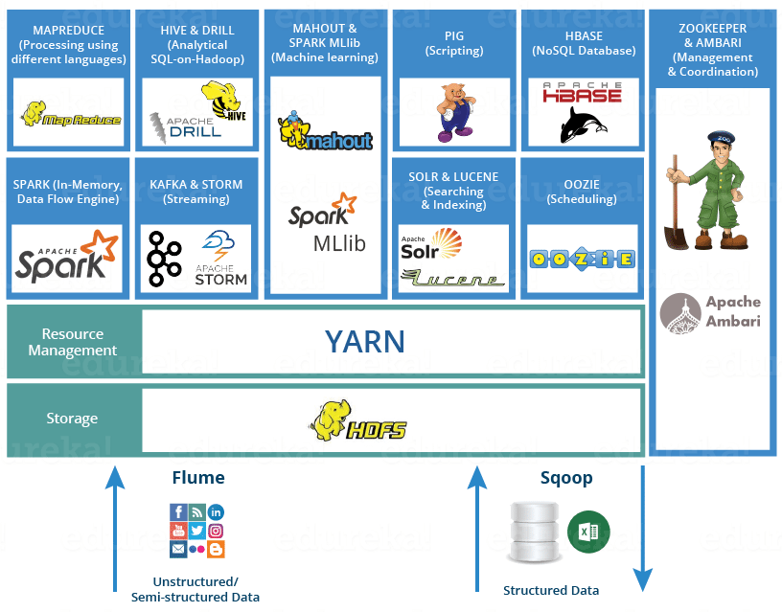
Hadoop Ecosystem

Slide 18
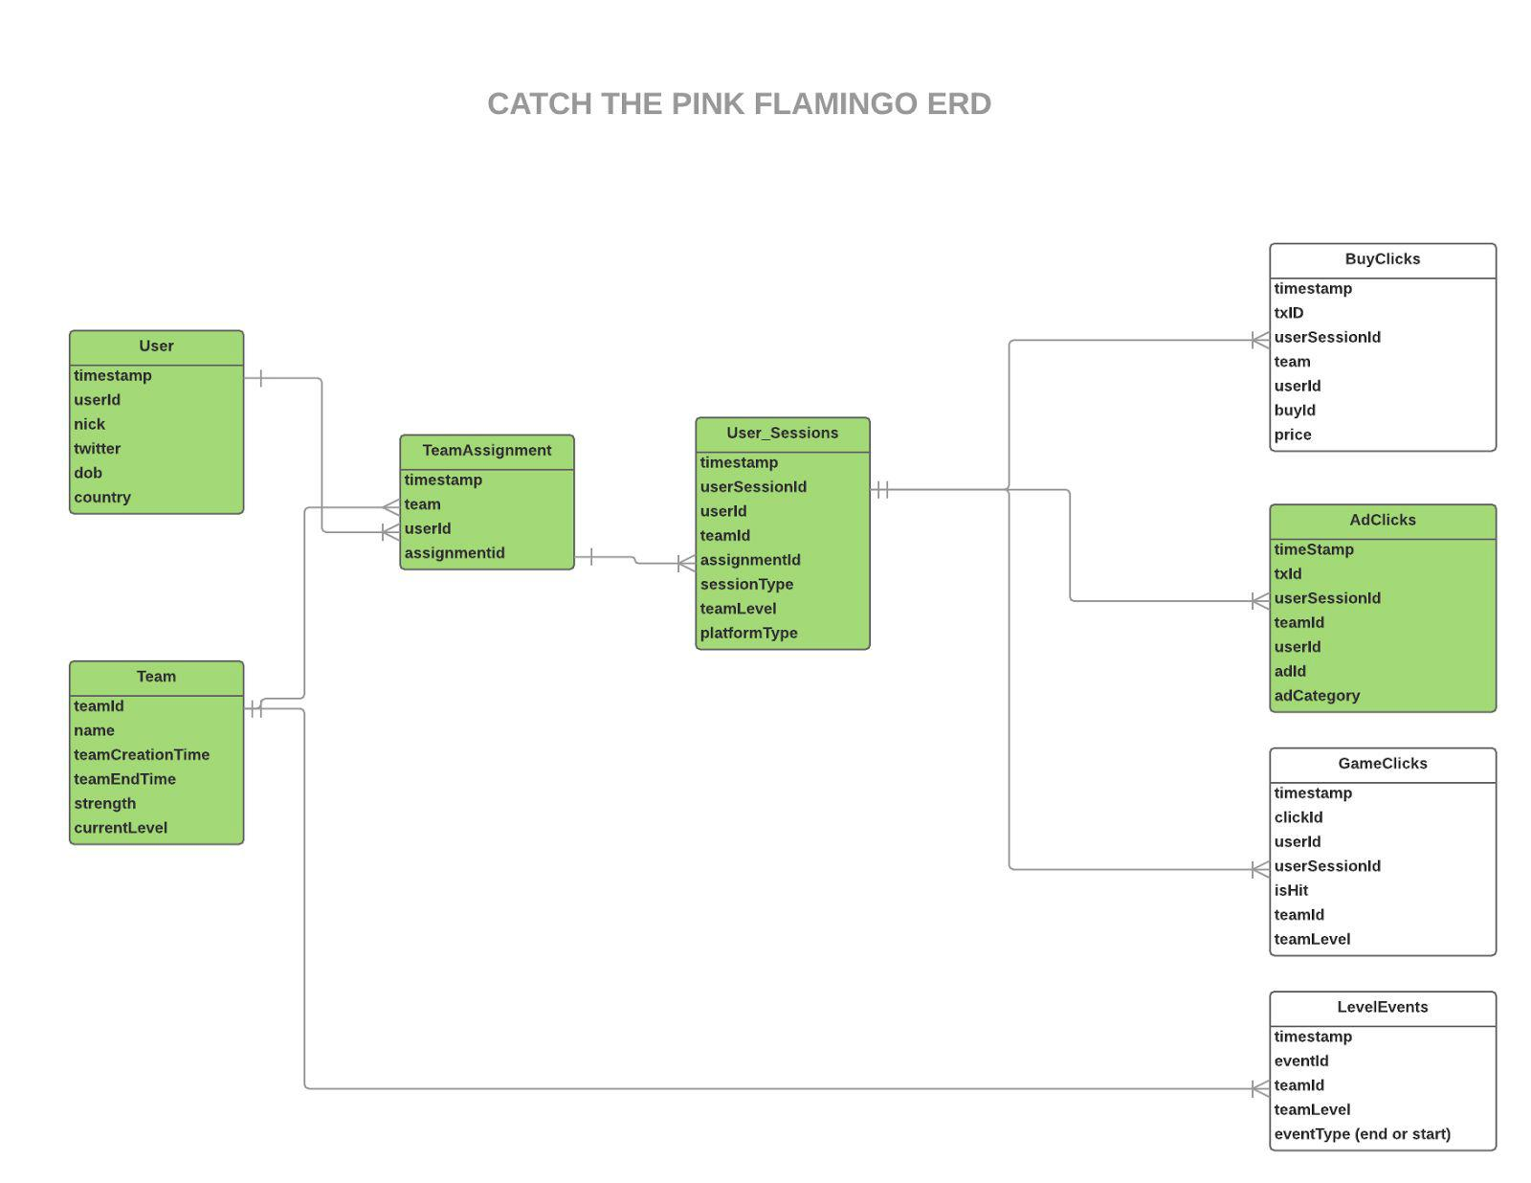
E-R Diagram

Slide 19
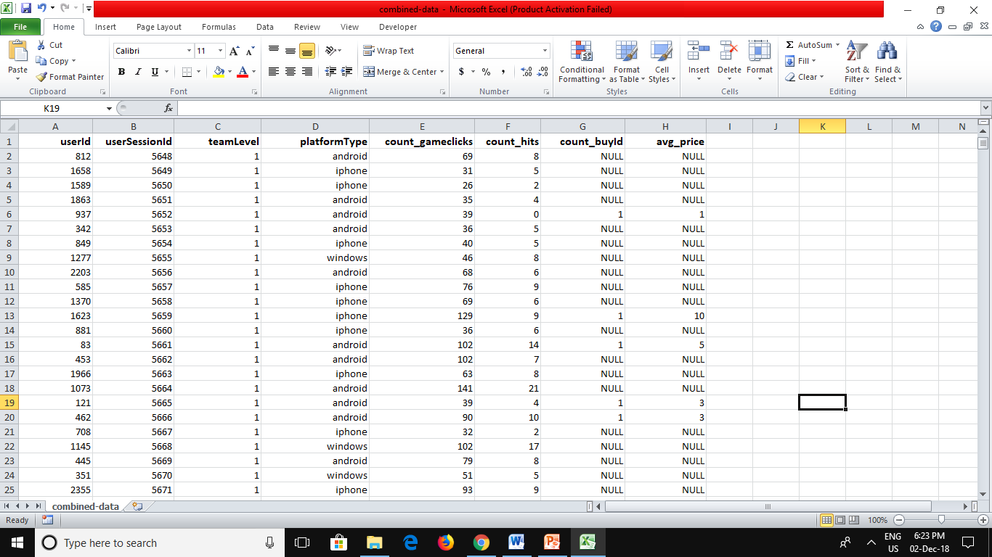
Data-Set for project

Slide 20
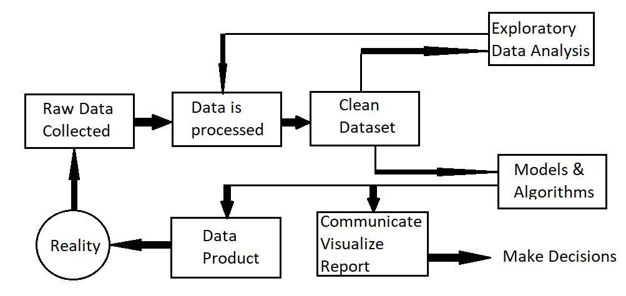
Flow Chart

Slide 21
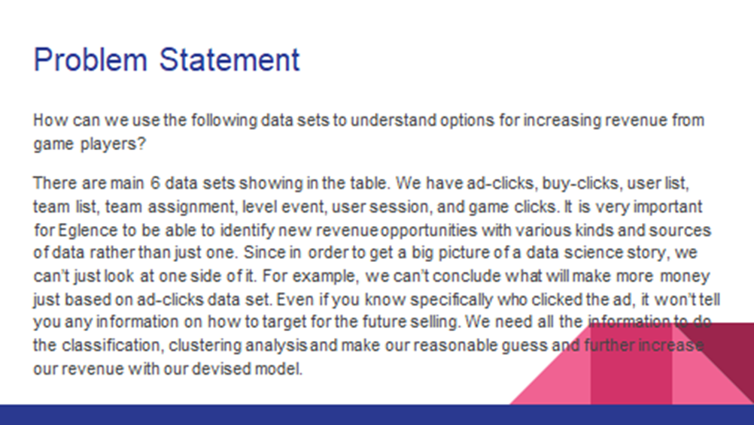

Slide 22
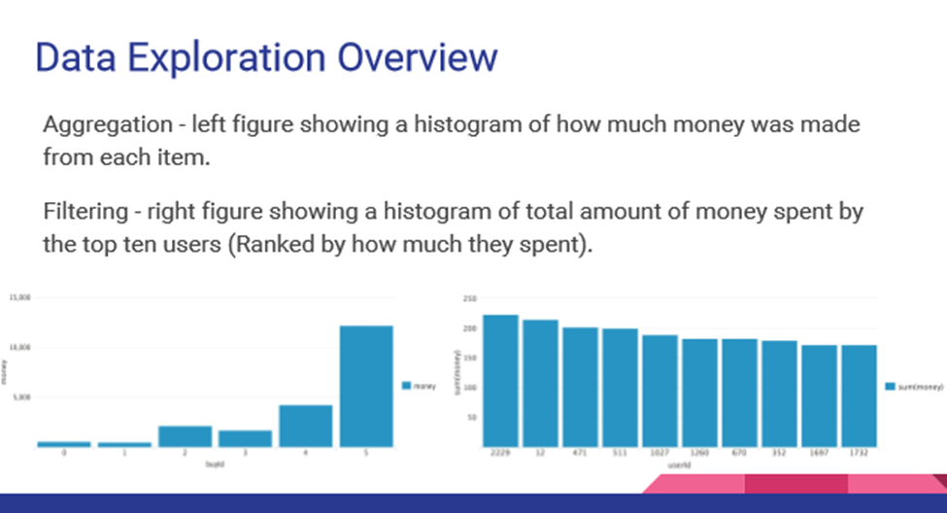

Slide 23
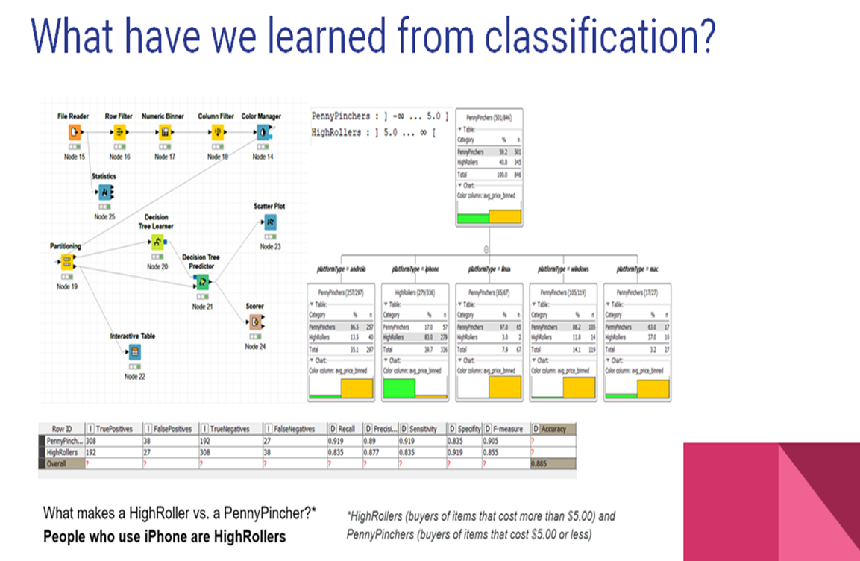

Slide 24
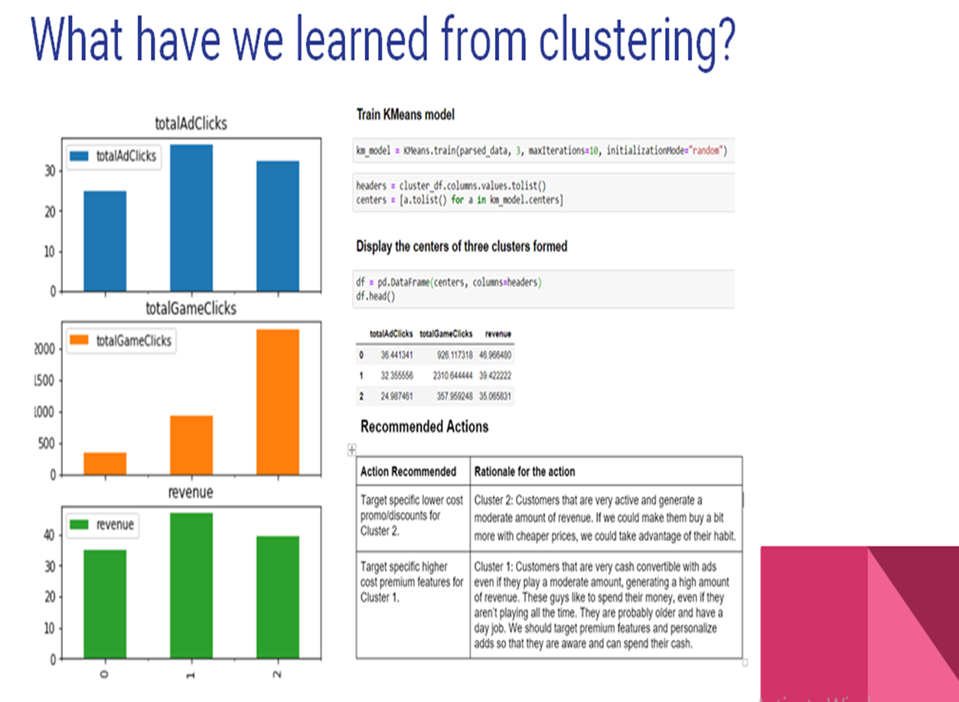

Slide 25
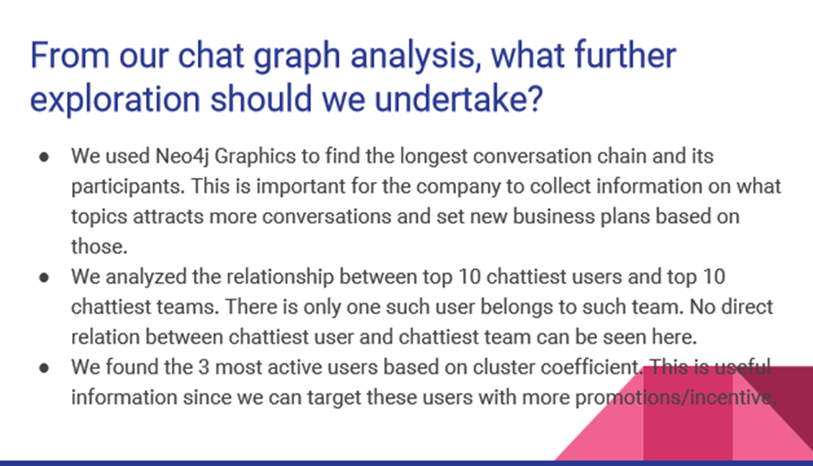

Slide 26
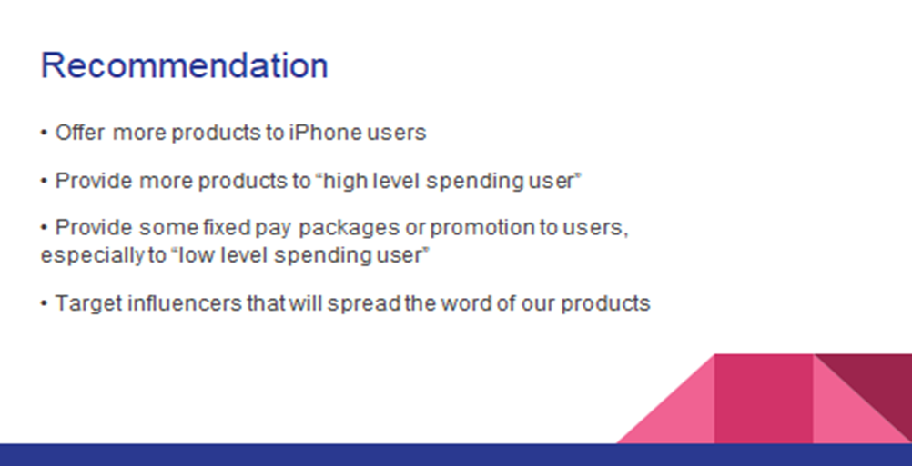

Slide 27
REFERENCES
Coursera
Knime Community
Stack Overflow
Splunk Documents
Neo4j Online Community
Cloudera Community

Slide 28


