Slide 1
SwitchBall
(A Dodgeball hybrid)
Submitted By: Paras Garg Roll No: 2310992173 Group: G 30

Slide 2
Overview
A modern mini-variant of Dodgeball for 4 players.
Played in a straight-line setup (A – B – A - B).
Core thrill: Along with dodging & catching, switching roles between attack & defend at the perfect time is the most important aspect.

Slide 3
Player Requirements
4 Players divided into 2 Teams:
• Team A: Positions 1 & 3
• Team B: Positions 2 & 4
Layout → A – B – A – B

Slide 4
Game Field Setup
Straight line marked with 4 player spots.
A – B – A – B
Players remain fixed on their line (but can duck/move horizontally to defend).
Attackers throw from ends, defenders dodge in between (alternate placings).

Slide 5
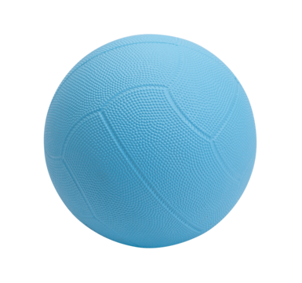

Required Equipments
1 soft lightweight ball.
Any Small area – suitable for hostels or classrooms.
Large Areas – suitable for hosting tournaments.

Slide 6
Basic Gameplay
One team starts as attackers, the other as defenders.
Defenders dodge (movements restricted to duck/left and right).
Roles can instantly switch on a perfect catch/on being hit.
Successful hits add to team points

Slide 7
Scoring System
Body Hit = +1 point for attacking team.
Perfect Catch = instant role switch.
The team with more points over the span of the match wins.

Slide 8
Match Formats
A Target score to complete
A period of time with no limit to points
Best of 3 rounds can be played for tournaments.

Slide 9
Mechanics and Rules
Defenders must stay on their line (can bend, sway, jump & move horizontally).
Attackers aim to pin opponents using speed & strategy.
Catch must be clean – no slips or rebounds.
Game ends when either one team scores the max points or the time runs out.

Slide 10
Core Strategies
Attackers: Speed variation, Timed-strategy and teamwork.
Defenders: Stay agile, time the perfect catch.
Both teams: Communicate and anticipate opponent moves. Also try to trick them by catching and switching instantly.

Slide 11
THANK YOU

