Slide 1
THE LAST RESISTANCE
Design Story Board
Made By: Paras Garg
Roll No.: 2310992173

Slide 2
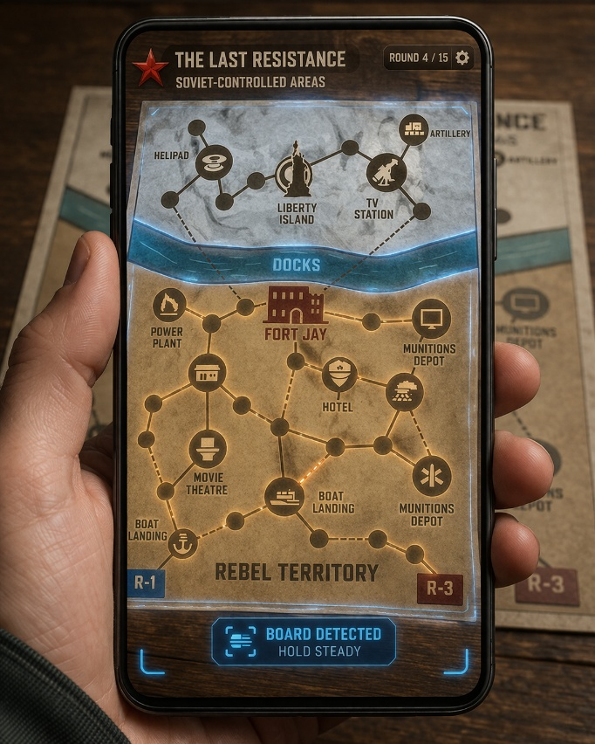
STEP – 1: SETUP
Players gather around the physical board placed on a flat surface.
Each player uses their mobile device to scan and initialize the AR system.
The game begins as a shared tabletop experience, ready to transform into AR.

Slide 3

STEP – 2: SCANNING THE BOARD
Players scan the board using their mobile devices to detect the surface.
The AR system recognizes the board layout and locks onto it.
A digital overlay is initialized, preparing the transition into the AR experience.

Slide 4
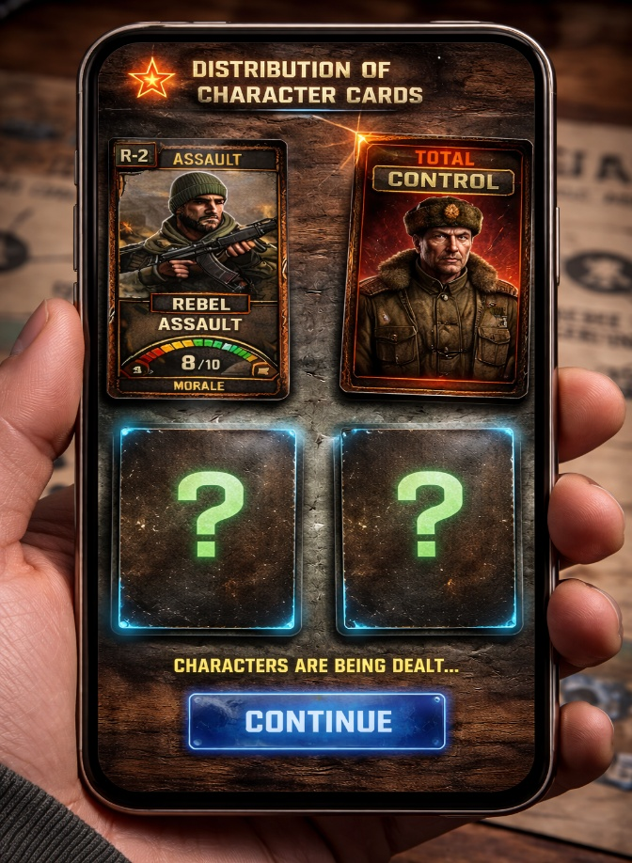
STEP – 3: CHARACTER DISTRIBUTION
Each player receives a hidden character role through their personal device.
Only their own role is visible, maintaining secrecy and tension.
This ensures asymmetry, where every player has unique abilities and powers.

Slide 5
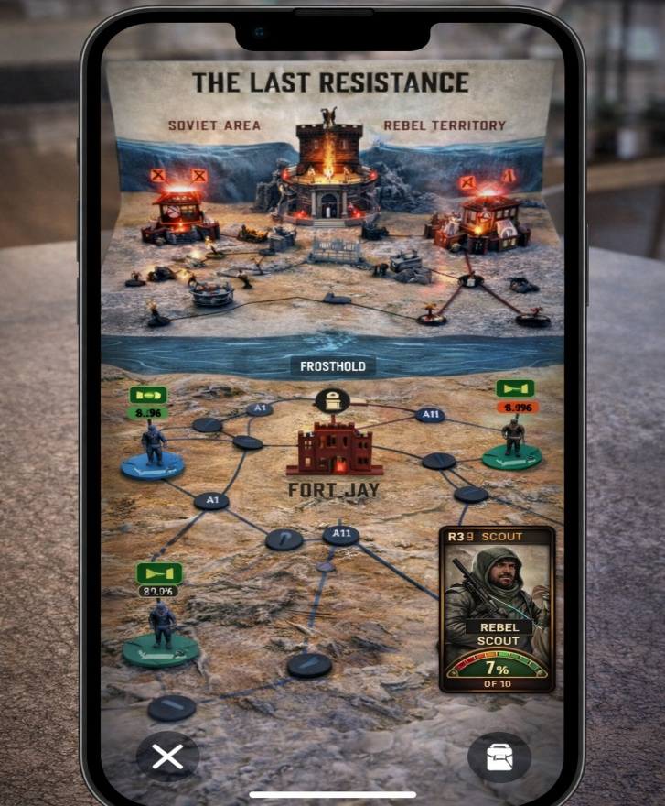
STEP – 4: MID GAME CHAOS
Players execute actions as events trigger unexpected shifts across the battlefield.
Alliances form and break as hidden roles begin to influence decisions.
Tension peaks as strategy, uncertainty and betrayal collide in real time.

Slide 6
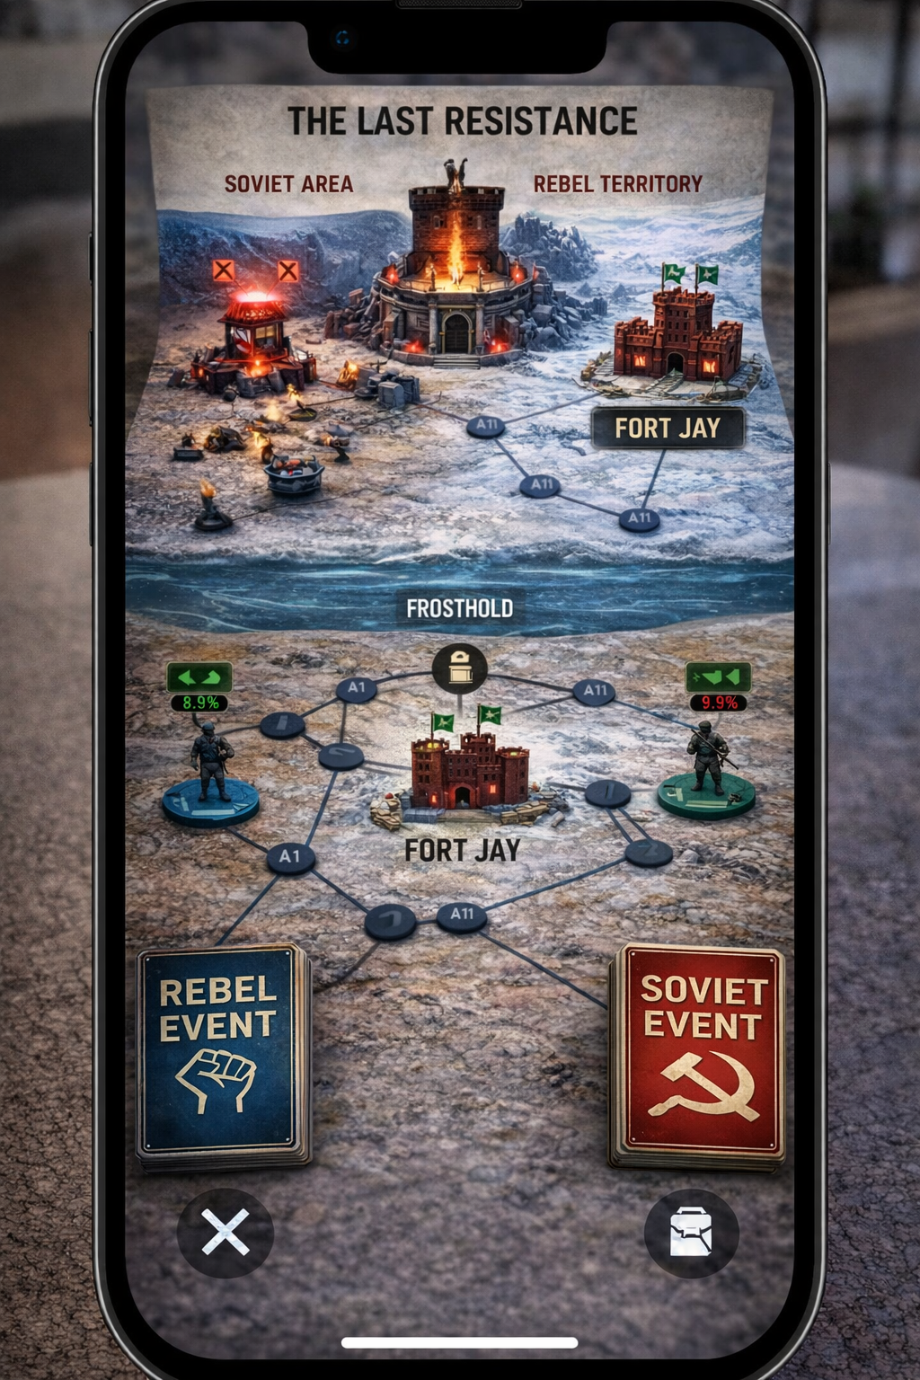
STEP – 4: MID GAME CHAOS
Both sides have their own event cards, which they have to draw in each turn.
These events affect the player stats on each step of the game, adding some fun.
Tension peaks as strategy, uncertainty and betrayal collide in real time.

Slide 7
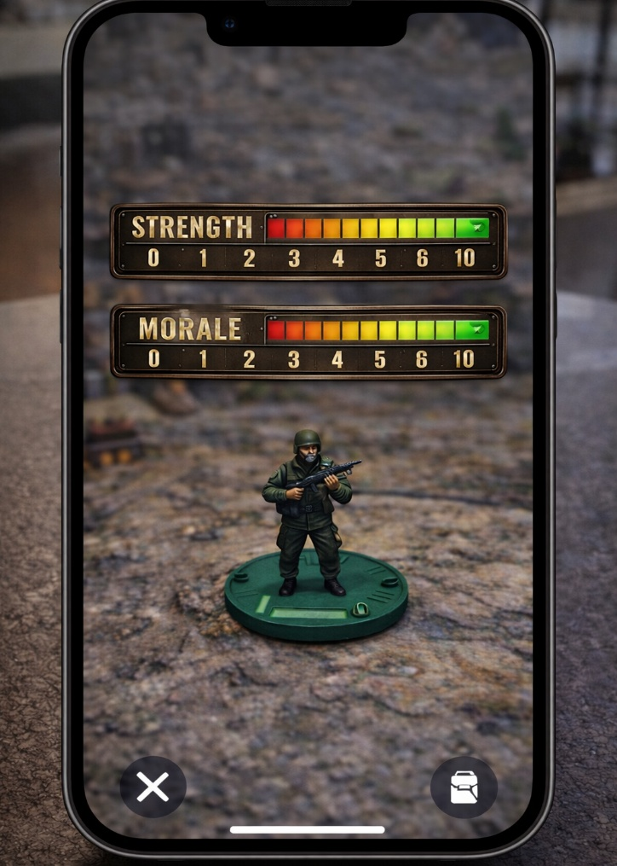
STEP – 4: MID GAME CHAOS
All the Rebels have to maintain their stats in the whole game (Strength & Morale).
Maintaining these stats is the most important thing to balance on the way to victory.
Tension peaks when the Hidden Betrayal takes place.

Slide 8
Gameplay Story Board

Slide 9
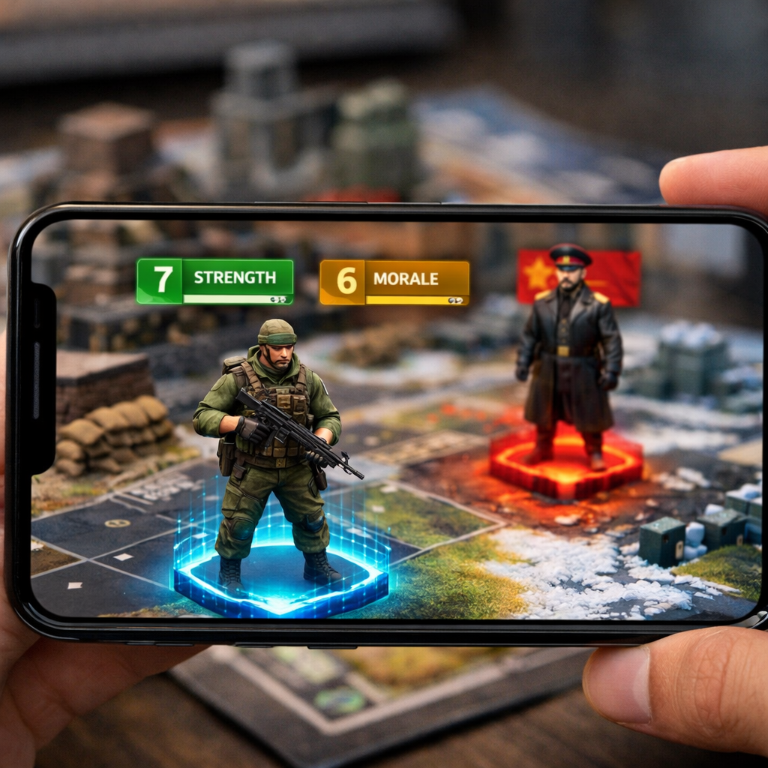
SETTING OF PLAYER TOKENS
Every player scans the board and get’s assigned a role/character.
The rebel tokens get an initial value for ‘Strength’ & ‘Morale’ at the start. The core loop contains maintaining these meters throughout the game.

Slide 10
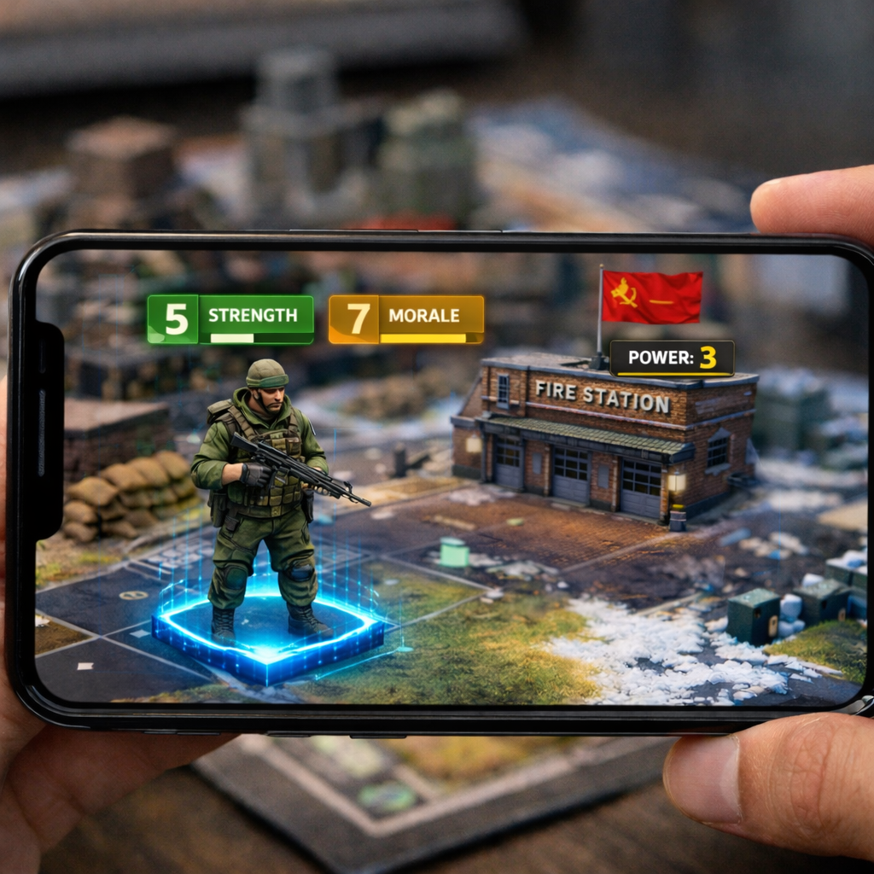
PLAN ATTACKS ON ENEMY BUILDINGS
There are some Buildings / Checkpoints that are already under the control of the enemy.
Each Building has a specific Power, defined by the number of enemy forces stationed there.
The rebels got to coordinate their attacks and free these buildings from the Enemy’s control accordingly.

Slide 11
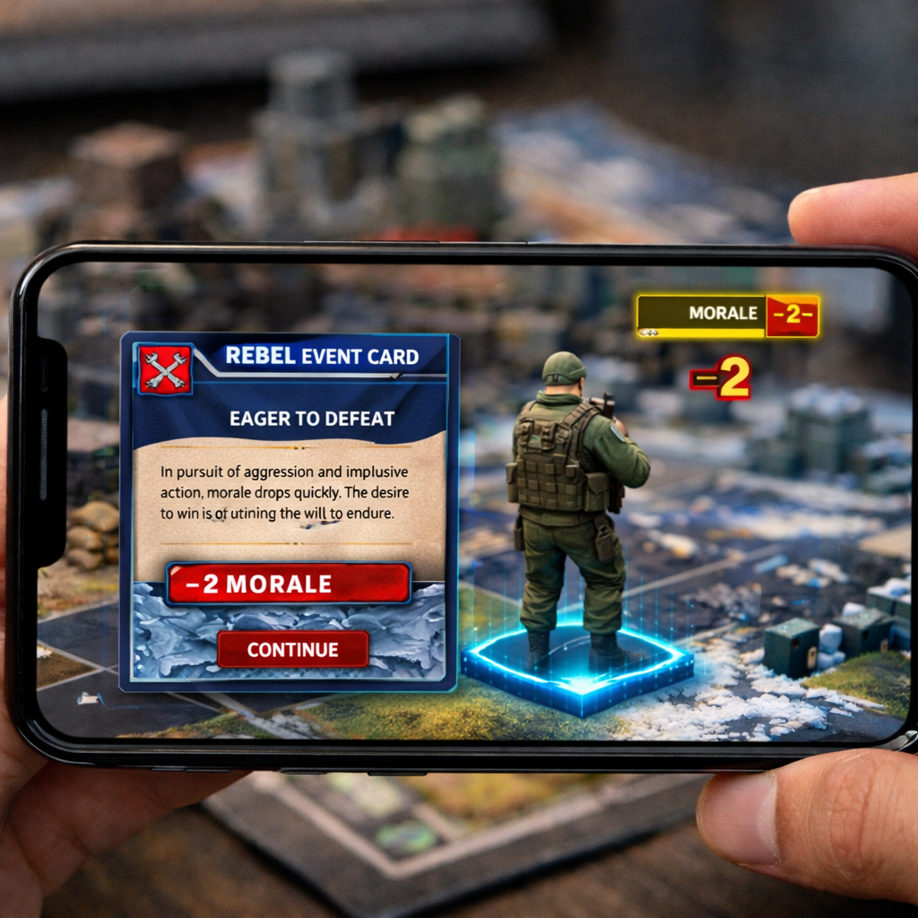
TRIGGER EVENTS ALONG THE WAY
As the players move towards their objective tile-by-tile, some tiles trigger an ‘Event’ and they have to draw a card.
These Event cards affect the stats of the characters (both buffs and debuffs), altering their strength or morale.
Random cards add a sense of probability and eventfulness throughout the game, maintaining the factor of Fun.

Slide 12
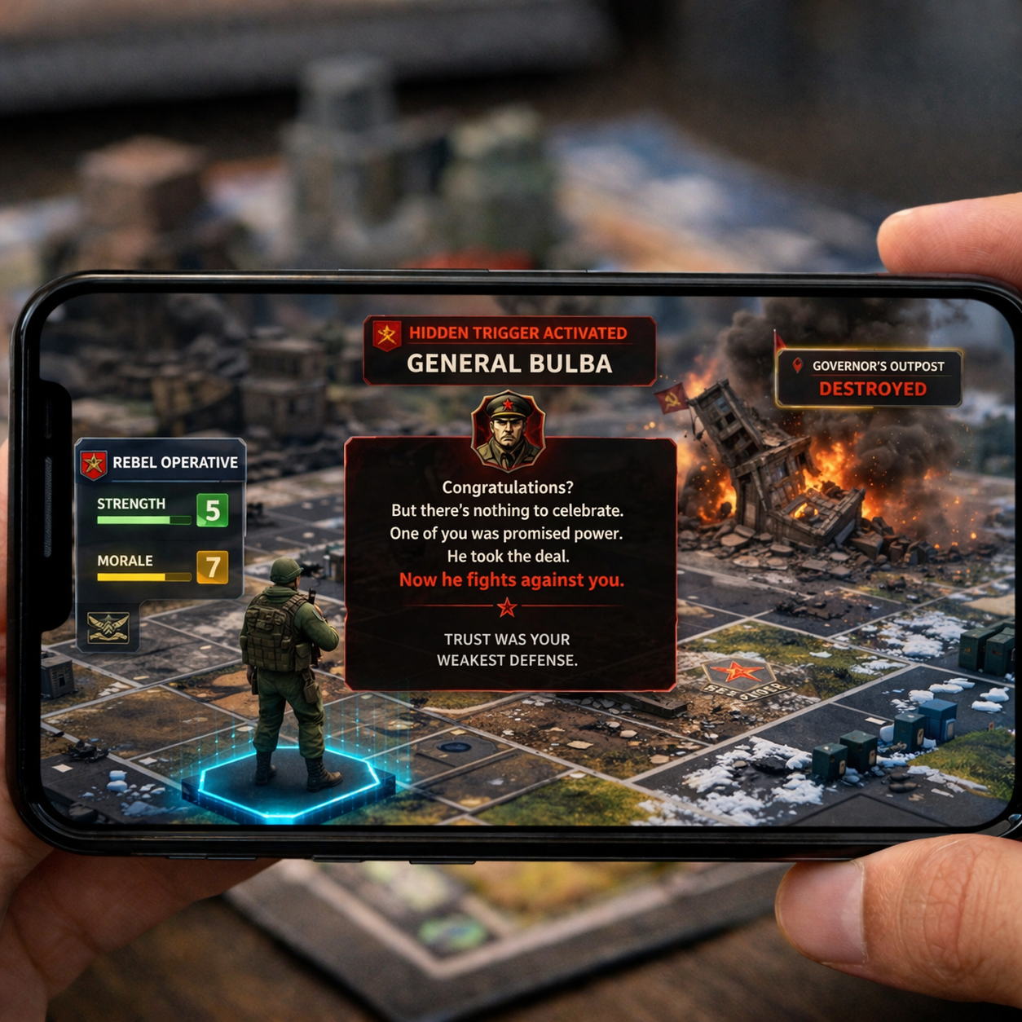
HIDDEN TRIGGER
At a critical moment in the game, a hidden trigger activates, secretly turning one Rebel into the enemy’s ally.
While other players witness destruction and chaos, one player receives a different reality - revealing their transformation into ‘General Bulba’.
Trust breaks instantly, forcing players to question every move and alliance.

Slide 13
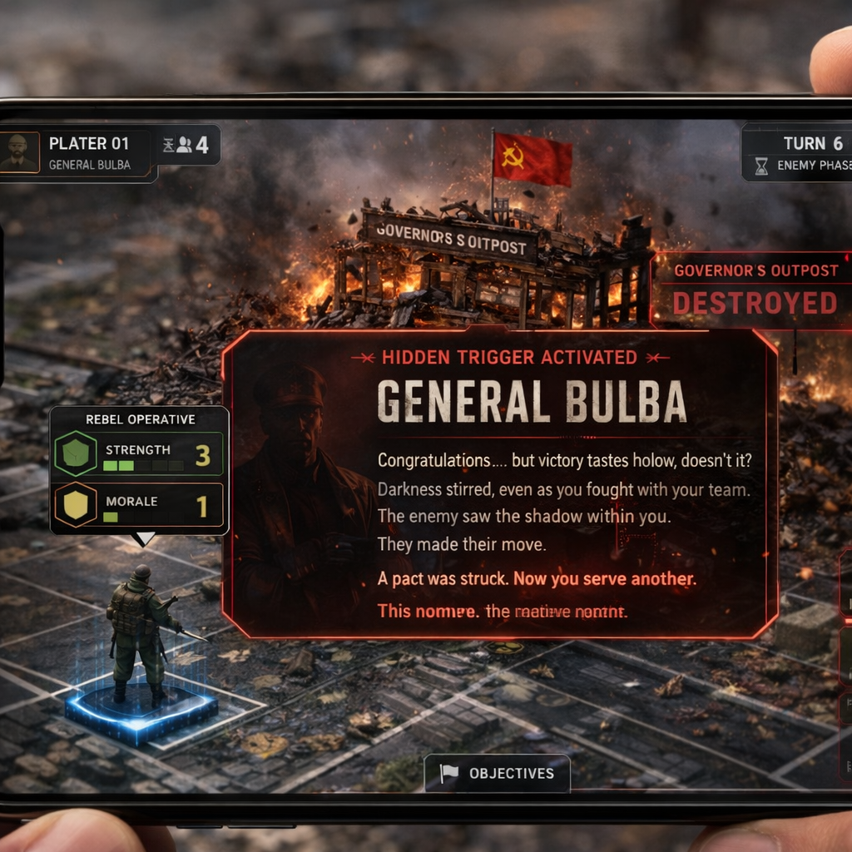
HIDDEN TRIGGER
The Rebel being offered the Deal receives a different message.
This mechanic introduces asymmetry in perception, where each player experiences the same event differently.
This moment defines the game, transforming it from strategy into a psychological battle of deception and survival.

Slide 14
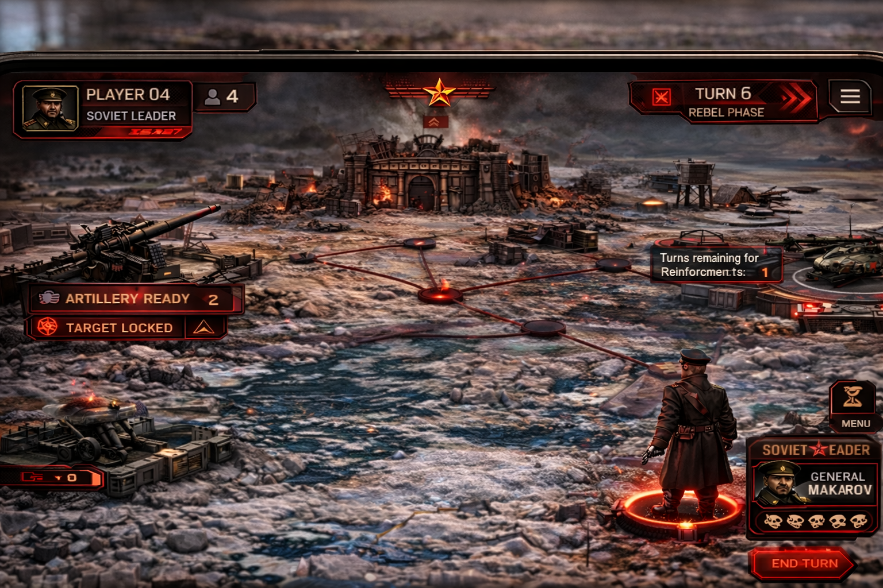
Enemy’s POV
The fourth player takes control as the Soviet Leader, viewing the battlefield with a strategic and authoritative perspective.
The fourth player takes control as the Soviet Leader, viewing the battlefield with a strategic and authoritative perspective.
This creates asymmetrical gameplay, where one player commands power while others fight for survival. This creates asymmetrical gameplay, where one player commands power while others fight for survival.

Slide 15
THANK YOU

