Slide 1
FreshRoute — Food Bank Optimizer Model (for India)
Artificial Intelligence & Machine Learning (24CSE0316)
TEAM DETAILS:
Member 1 — Name, Roll No. • Member 2 — Name, Roll No.
Member 3 — Name, Roll No. • Member 4 — Name, Roll No.
CE-1 • AI/ML 24CSE0316 • B.E. CSE 5th Sem
Department of Computer Science & Engineering
Chitkara University Institute of Engineering and Technology, Chitkara University, Punjab, India

Slide 2
PROJECT OVERVIEW
• What: predicts redistribution_priority (Low / Medium / High) for each surplus donation — who should get it first.
• Users: food banks, langars / messes / wedding halls (donors), NGOs & shelters (receivers), volunteers.
• Inputs → output: donor + food type + qty + shelf-life + storage + distance + demand → priority + ranked destination.
• CE-1 scope: dataset refined, cleaned (618×25, 0 missing), encoded (618×45), analysed — model training in CE-2.

Slide 3
PROBLEM STATEMENT
• Real problem: surplus is perishable & scattered (cooked meals ~8h); donors don't know which food bank has need/capacity.
• Result: edible food spoils while nearby shelters face shortages — especially at festivals/weddings & langar surplus peaks.
• ML fix: learn priority from supply × urgency × logistics × demand instead of fixed rules; CE-2 adds dispatch ranking.
• CE-1 frames it as supervised classification with frozen X/y contract and audited bias (73% Medium).

Slide 4
OBJECTIVES
1. Build India-relevant dataset: 600+ records, 7 donor types, 7 food types, 5 food banks (Pb + Chd + Delhi + Jaipur).
2. Deliver zero-missing, de-duplicated data with group-aware imputation — ready for train_test_split.
3. Encode correctly (One-Hot nominals, Label target) + engineer 5 features; freeze X (44) / y contract.
4. EDA with 6 figures + observations to justify features and expose imbalance for CE-2 mitigation.

Slide 5
DATASET COLLECTION & DESCRIPTION
File | Shape | Note
raw | 636 × 20 | seed-42 synthetic, Jan–Mar 2026; 18 dups + errors injected
cleaned | 618 × 25 | 0 missing; +5 engineered features
encoded | 618 × 45 | 29 dummies + label y; X=44, stratify needed
target y | M456/H122/L40 | Medium 73.8% — imbalanced by design

Slide 6
DATA PREPARATION:DATA CLEANING
• Duplicates: 18 exact rows removed (636 → 618), verified in cleaning_report.json.
• Dropped irrelevant: donor_contact_number, remarks (PII/noise).
• Normalised: city/food/transport/priority casing (amritsar→Amritsar, y→Yes, med→Medium).
• Fixed incorrect → NaN → imputed: –ve qty/dist, shelf 0/500h, temp 60°C; available>donated capped.
• Types: donation_date → datetime + month/weekday; counts cast to int.

Slide 7
HANDLING MISSING VALUES
Column | Was missing | Treatment
storage_temp_C | 49 (7.9%) | Median BY storage_condition (Cold≠Room)
quantity_available_kg | 29 | Global median (robust)
shelf_life_hours | 18 | Global median
beneficiaries_count | 13 | Median → int
transport_available | 30 | Mode = Yes
After | 0 total | Verified: isna().sum()==0

Slide 8
DATA TRANSFORMATION:CATEGORICAL DATA ENCODING
• One-Hot (drop_first, int): city, state, donor_type, food_type, storage_condition, foodbank_id, transport_available → 29 dummies.
• Why: all nominal (no order); drop_first avoids dummy trap.
• Label target only: High→0, Low→1, Medium→2 (saved in cleaning_report.json); use F1-macro, not accuracy.
• Dropped from X: donation_id, donation_date (kept month/weekday). Scaling deferred to CE-2 pipeline.

Slide 9
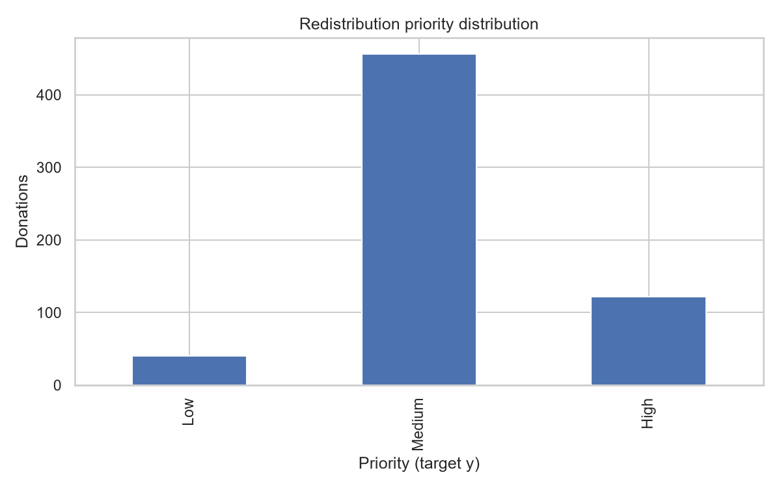
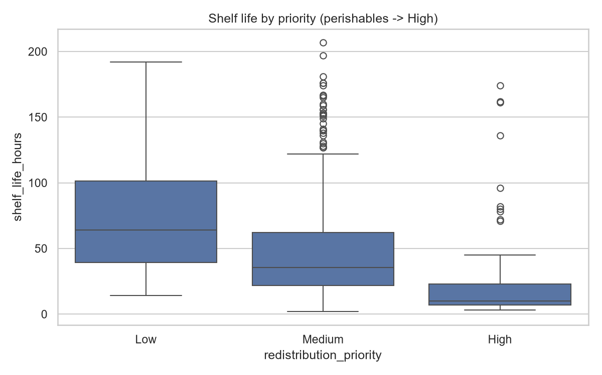
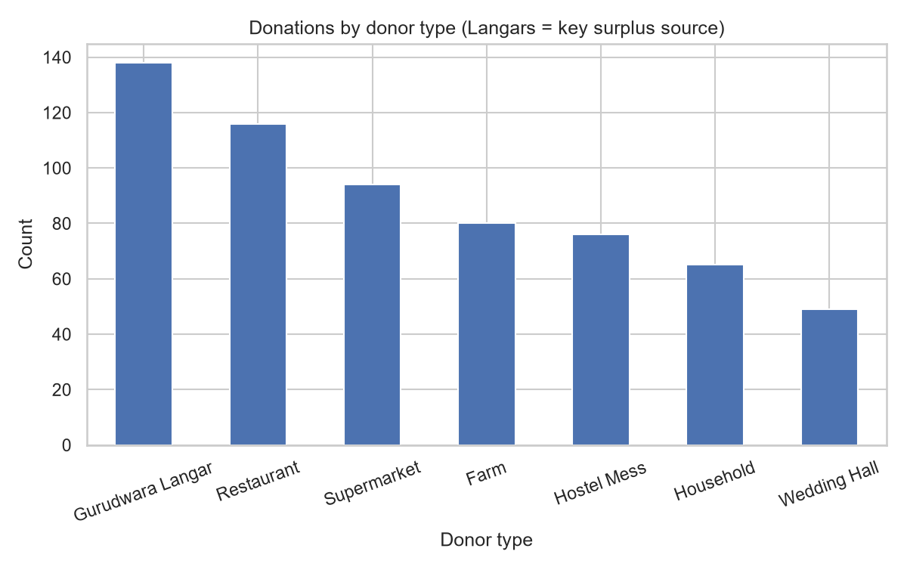
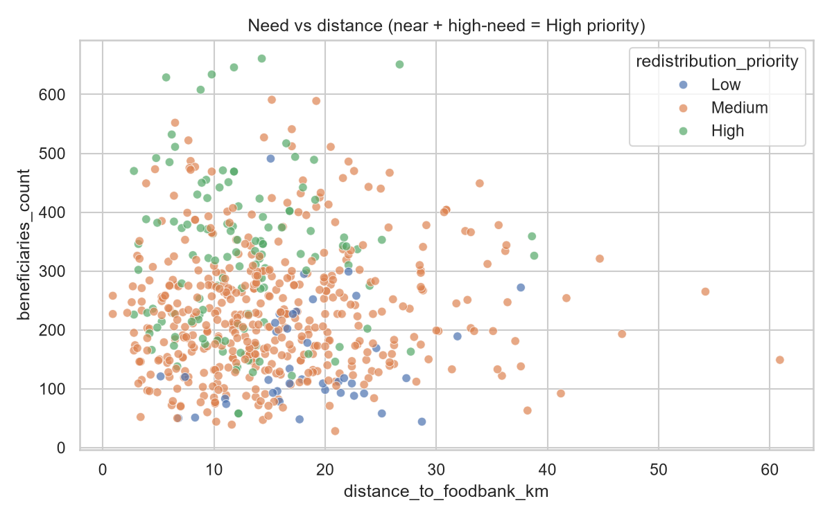
EXPLORATORY DATA ANALYSIS & VISUALIZATION
Obs: High = short shelf (~8–12h) + near + high-need; Langar/Restaurant dominate; 73% Medium → stratify + class weights. Full 6 figs in reports/figures/.

Slide 10
FEATURE SELECTION ENGINEERING
• Engineered: stock_pressure, surplus_ratio, need_per_km (=bene/(dist+1)), is_perishable (<24h), cold_chain_ok.
• Corr check: no |r|>0.85 — keep all; CE-2 selects via RF importance / mutual-info.
• X = 44 cols (15 numeric/eng + 29 dummies) | y = redistribution_priority (0/1/2).
• Contract: train_test_split(stratify=y, random_state=42) mandatory. Full X list in cleaning_report.json.

Slide 11
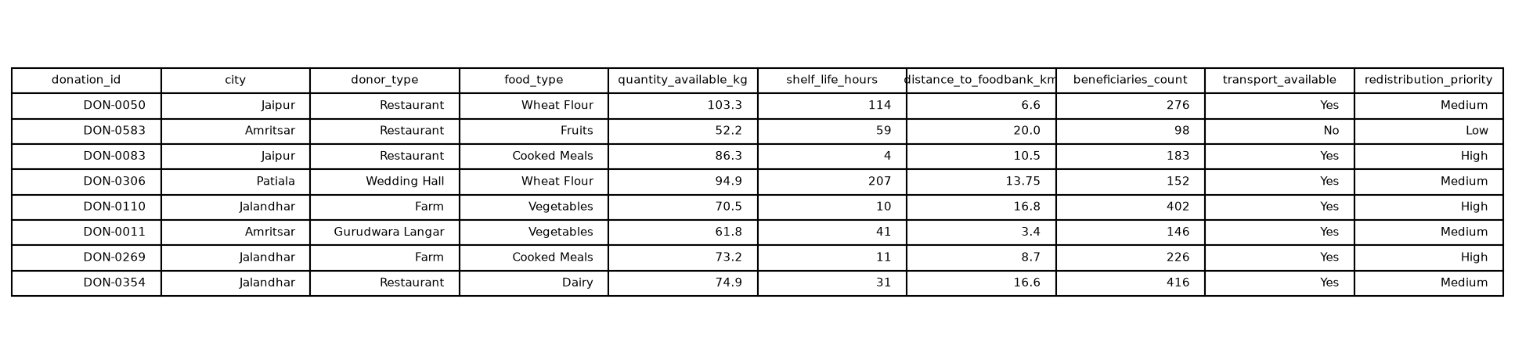
PRE-PROCESSING DATASET SCREENSHOT
Cleaned 618×25, missing=0 • Encoded 618×45 • y: Medium 456 / High 122 / Low 40 • Reproduce: python scripts/generate_dataset.py → python scripts/clean_dataset.py

Slide 12
CONCLUSION
• CE-1 done: messy 636×20 → clean 618×25 → encoded 618×45, frozen X/y, 6 EDA figs, scripts + Colab notebook.
• Finding: priority driven by perishability × need-per-km, not quantity alone.
• Biases logged: imbalance + langar dominance + winter-only dates → mitigations in CE-2.

Slide 13
PROJECT PLANNING & FUTURE SCOPE
• CE-2 models: Logistic / RandomForest / XGBoost on F1-macro; stratified split; class weights/SMOTE; per-donor audit + SHAP.
• Routing layer: priority + need_per_km + stock_pressure → ranked food-bank / dept / shelter + volunteer dispatch.
• App + pilot logs (FSSAI/state data), summer data, cold-chain IoT later.

Slide 14

Thank You — Viva Ready (10 min)
FreshRoute CE-1 • 618-row ML-ready dataset • 6 EDA observations • Live demo: raw → cleaned → encoded

