Slide 1
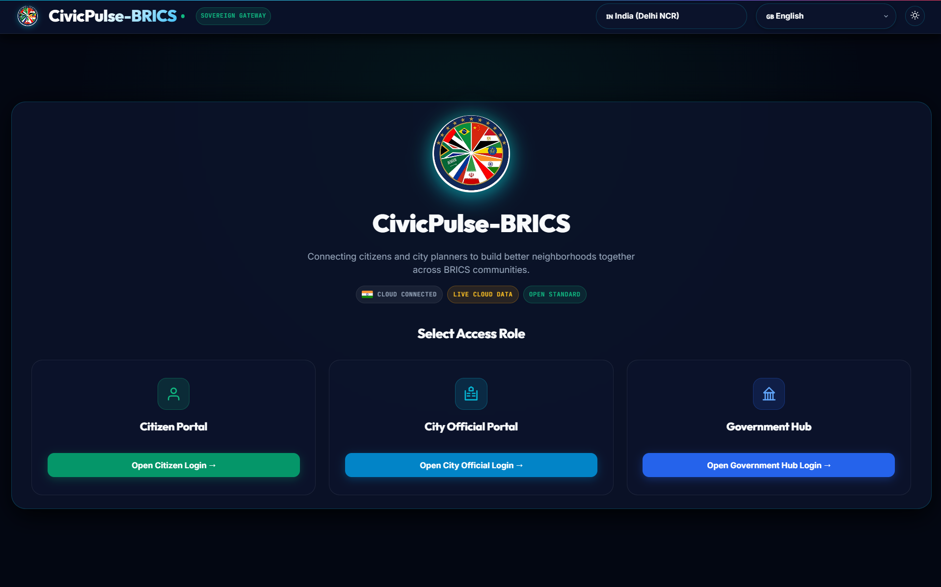

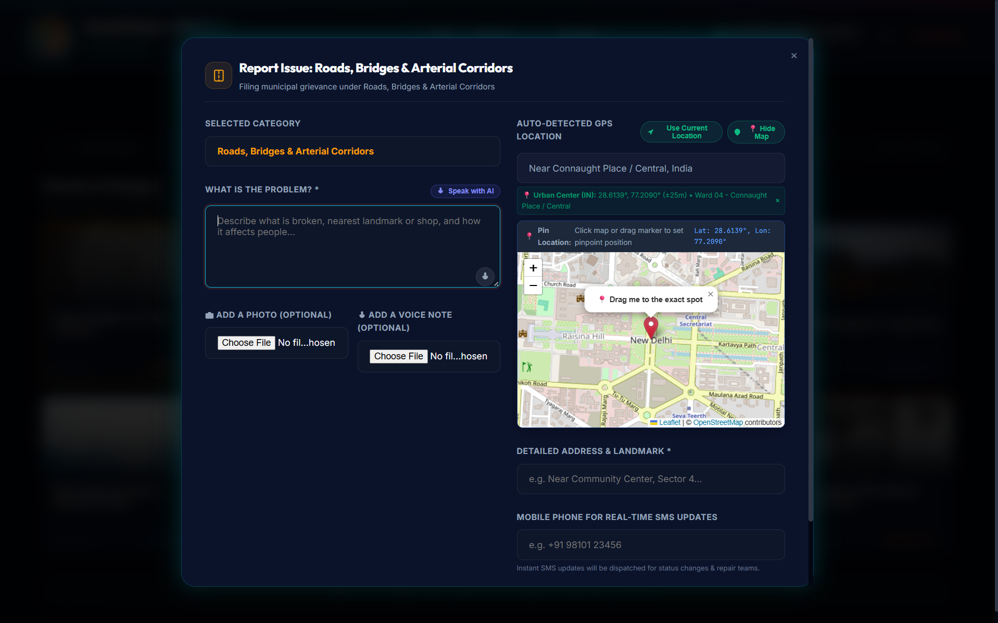
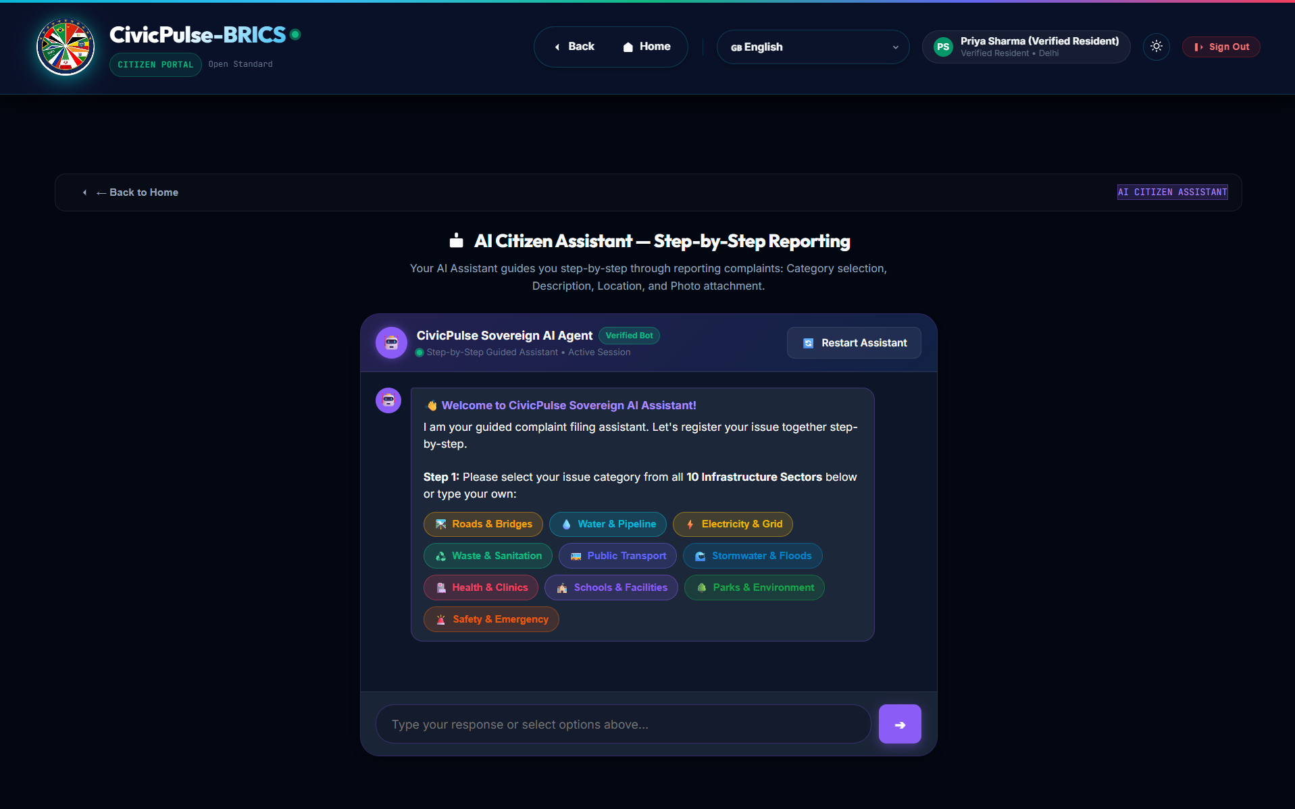
Build with AI: Code for Communities
CivicPulse-BRICS
AI-Powered Infrastructure Governance & Citizen Triage
By Team Syntax Error

Slide 2
The Problem
Fragmented feedback & blind spots in municipal infrastructure
02 / 12
Fragmented Citizen Reporting
Citizens have no unified, multilingual platform to report broken infrastructure (potholes, water lines). Reports get lost in bureaucracy.
Manual Triage Bottlenecks
City planners receive unstructured text and unverified photos, lacking the resources to accurately prioritize critical hazards.
Misaligned Capital Spending
Budgets are allocated without correlating real-time citizen demand, leading to neglected hotspots and inefficient resource use.
Language & Accessibility Barriers
Diverse populations in BRICS nations are excluded from participatory budgeting due to language barriers and complex apps.

Slide 3
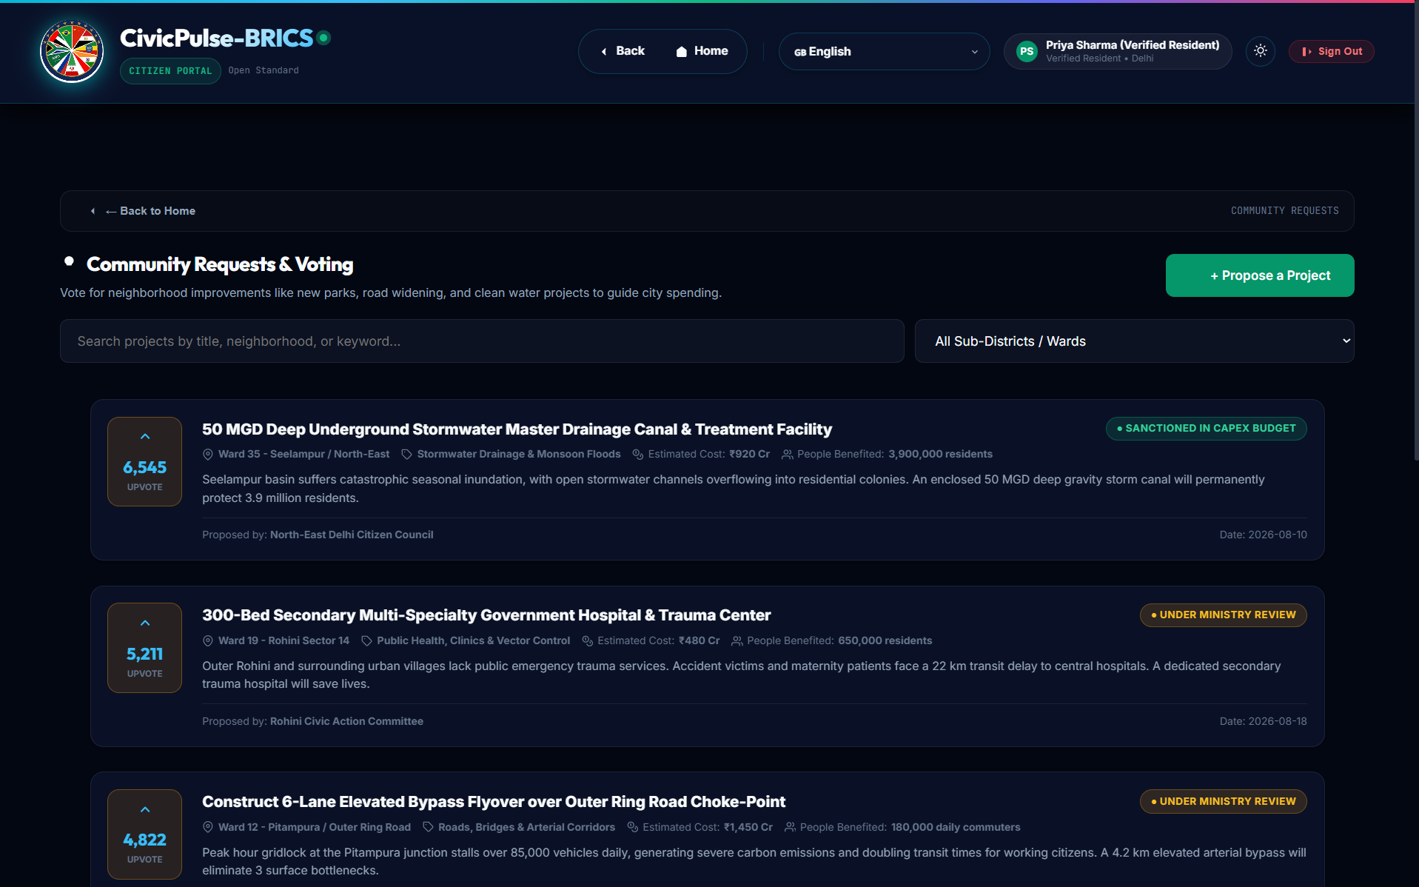
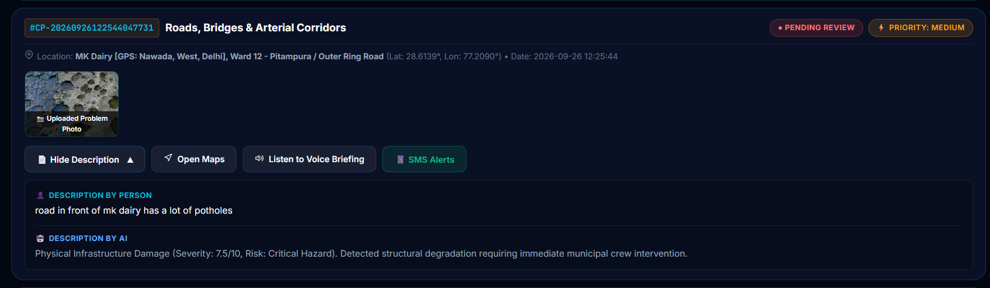
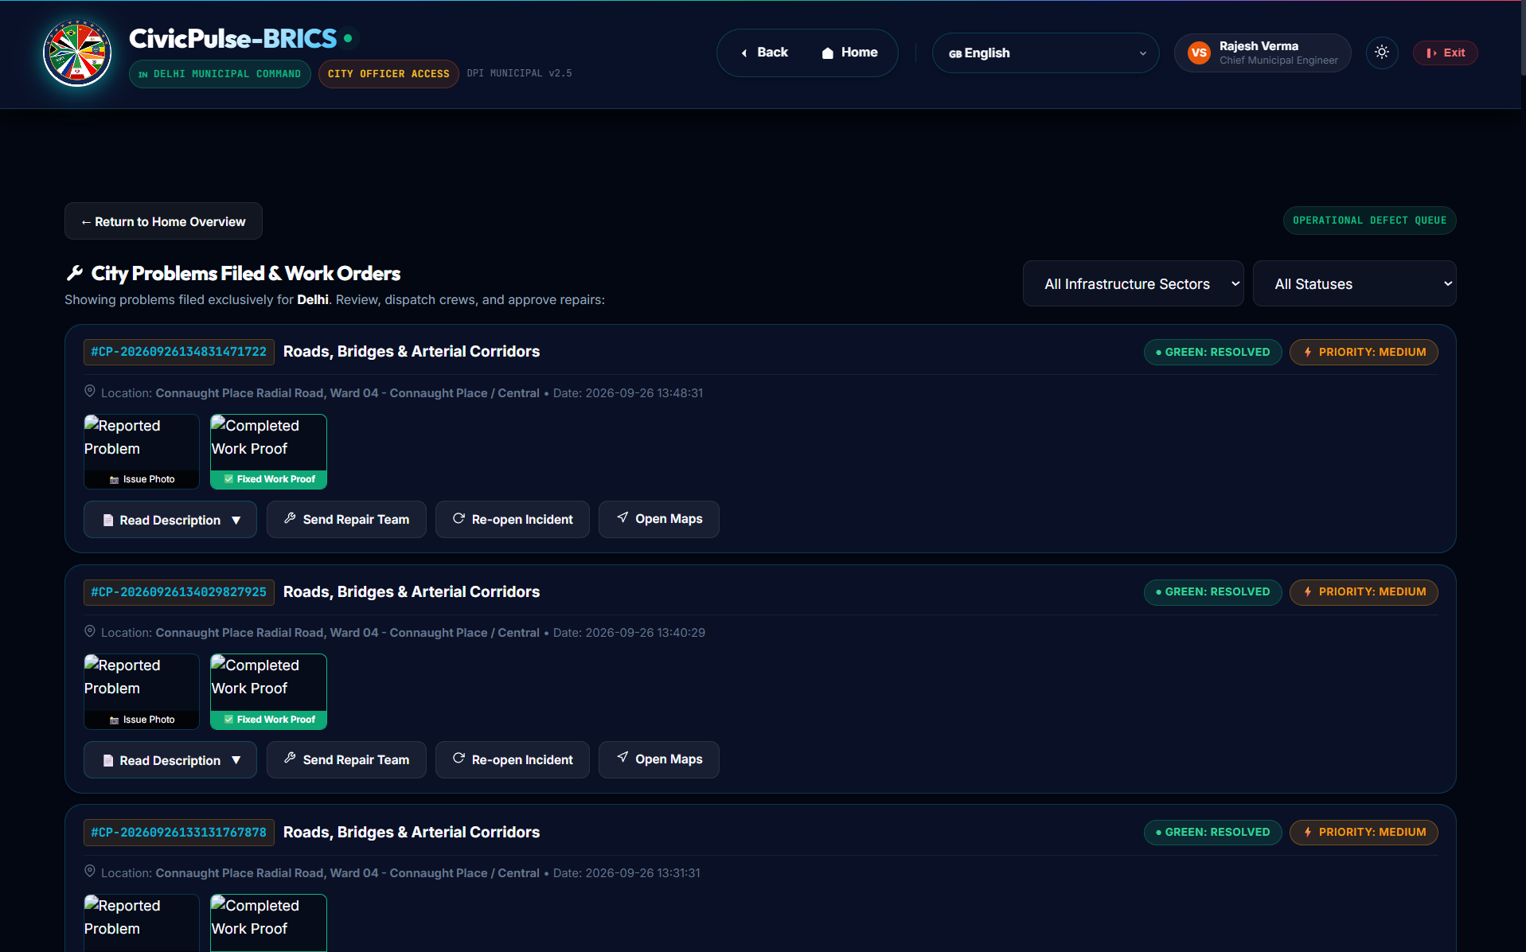
The Solution: CivicPulse-BRICS
A sovereign Digital Public Good for infrastructure planning
03 / 12
1. Multimodal Citizen App
Citizens can report issues using photos, voice notes, and GPS. Community demands can be upvoted for participatory budgeting.
2. AI Defect Triage
Our backend instantly analyzes uploaded photos and voice notes using AI to assess severity, defect type, and structural hazard.
3. Official Command Center
Provides city officials with an auto-prioritized repair queue, GIS heatmaps, and a CapEx budget misalignment matrix.

Slide 4
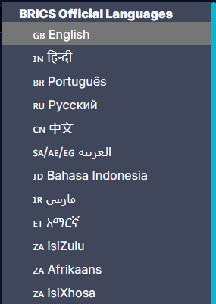
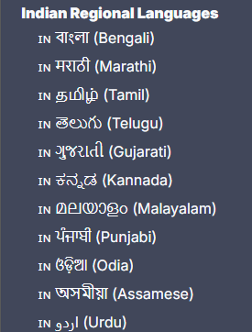
Our AI Approach (Google Gemini)
How we process unstructured citizen petitions into actionable data
04 / 12
Gemini Vision: Infrastructure Defect Analysis
When a citizen uploads a photo of broken infrastructure, we prompt Google Gemini to analyze the image. It returns a structured JSON assessing the defect category, severity score (1-10), and potential public risk.
Gemini Text: Multilingual Translation & Policy Generation
We use AI to transcribe and translate local dialects into standard English for officials. Gemini is also used to generate strategic 'Mega Plans' by analyzing aggregated complaint data against municipal budgets.

Slide 5
Who It Serves
Designed for the entire civic ecosystem
05 / 12
Citizens
Empowers locals to report public infrastructure issues seamlessly in their native language and upvote community demands.
Municipal Crews
Provides field teams with a prioritized, severity-ranked repair queue and direct Google Maps routing to incidents.
National Policymakers
Grants macro-level visibility into regional CapEx budget misalignment and generates high-level infrastructure investment directives.

Slide 6
App Feature: Citizen Gateway
What we built for the public
06 / 12
Implemented Citizen Portal Features:
• GPS Auto-Detection: Instantly captures the precise location of the reported issue.
• Multimodal Uploads: Citizens can upload photos of the defect and provide descriptions.
• Community Demands Wall: A dedicated tab where citizens can propose and upvote macro-projects (e.g., new flyovers).
• Live Tracking: A tracking hub to see if their submitted complaint is 'Under Review' or 'En Route'.
• Themed UI: Fully responsive interface that works flawlessly on mobile devices.

Slide 7
App Feature: City Official Command Center
What we built for government administrators
07 / 12
Implemented City Planner Features:
• Live Repair Queue: Automatically ingests citizen complaints and displays them with AI-assigned severity ratings.
• CapEx Misalignment Matrix: A data table cross-referencing citizen demand volumes against planned municipal budgets.
• GIS Map Integration: Leaflet.js map integration for plotting incident coordinates.
• Node Federation: Ability to toggle perspectives between different BRICS nations (India, Brazil, SA).

Slide 8
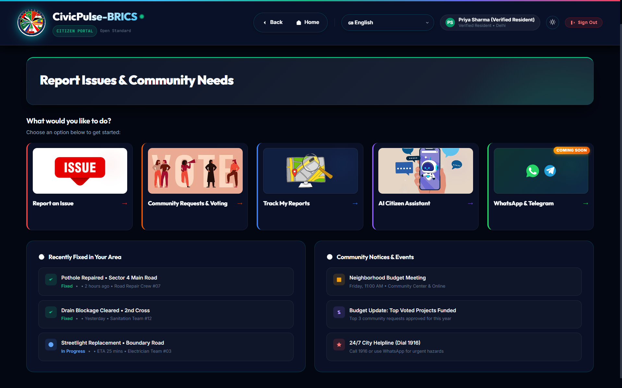
Demo: Citizen Gateway
Screenshot of the Multimodal Citizen App
08 / 12

Slide 9
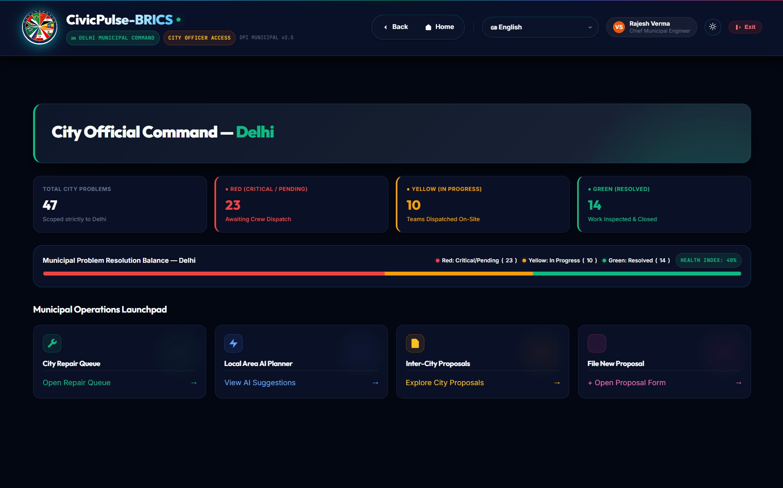
Demo: City Official Command Center
Screenshot of the AI Repair Queue & GIS Tools
09 / 12

Slide 10
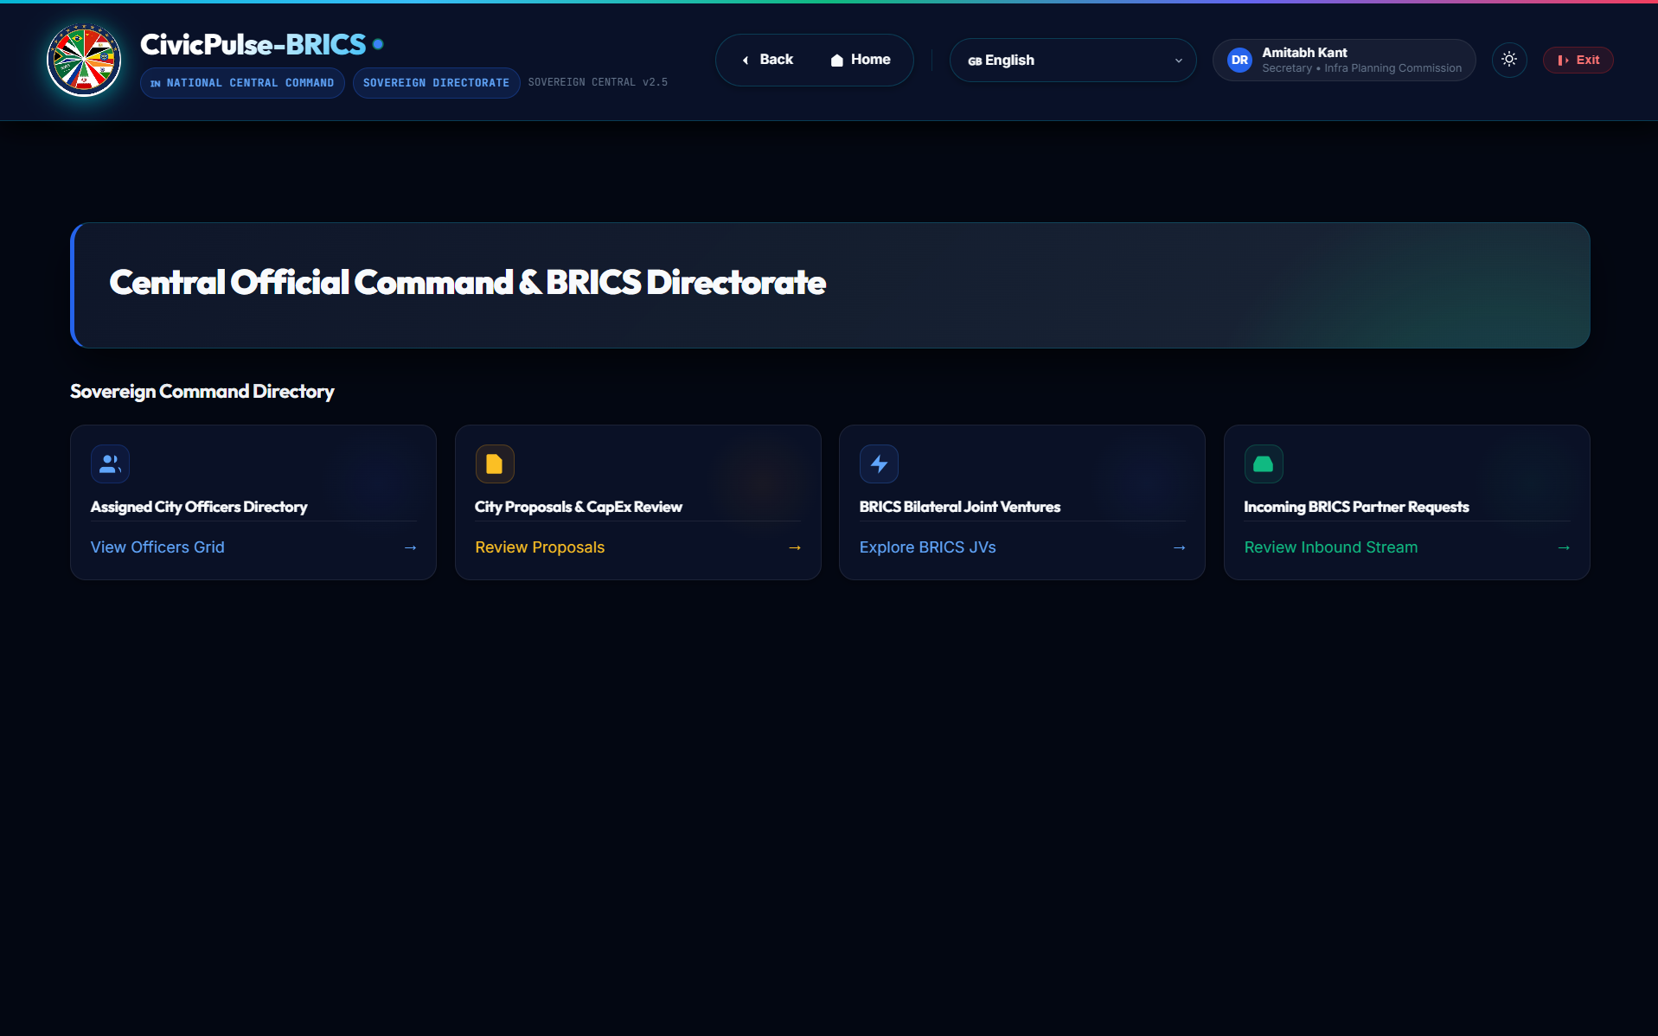
Demo: Sovereign Node Federation
Screenshot of Multi-Nation CapEx Overview
10 / 12

Slide 11
Deployability & How It Scales Across India
Ready for real-world municipal adoption
11 / 12
Technical Foundation
• Zero-Setup Backend: Built on standard Python with a lightweight SQLite database, requiring no complex infrastructure to run.
• Container Ready: Includes a Dockerfile and cloudbuild.yaml for 1-click deployment to Google Cloud Run.
• API-First: Designed with standard webhook endpoints to easily integrate with WhatsApp/Telegram bots in the future.
Scaling Across India
• Localized Deployment: Any municipality can spin up their own 'node' of the system.
• Low Latency AI: Uses Gemini Flash for instant triage of thousands of daily complaints.
• Open Digital Public Good: Adheres to DPG principles, ensuring transparent data schemas that integrate with data.gov.in.

Slide 12
Thank You!
Team Syntax Error
Paras Singh
Team Lead & Full-Stack
Project concept, AI system design, and core platform development.
Aradhara Pal
Frontend & UI/UX Designer
Designed website layouts, mobile screens, and dashboards.
Anshika Anand
Backend Developer
Set up the server, database integration, and Render hosting.
Himanshi
Product Research & Testing
Researched city budget data, tested user workflows, and documentation.

