Slide 1
BRICS INNOVATION THEME • TRACK 1
CivicPulse-BRICS
Presented by Team Syntax Error
AI for Digital Public Infrastructure & Sovereign Governance Across BRICS Nations
Aggregating citizen voice, WhatsApp & Telegram with Google Gemini 2.5 to autonomously realign municipal CapEx budgets.
IN - India (Delhi NCR)
Municipal Triage & Flooding Hotspots
BR - Brazil (Sao Paulo)
Cross-Border Sanitation & Drainage
ZA - South Africa (Gauteng)
Grid Stability & Water Distribution
Google AI Hackathon 2026 • Digital Public Good (DPGA Standard) • Open Source (Apache 2.0)

Slide 2
THE CHALLENGE
The Broken Feedback Loop in Governance
Traditional civic grievance systems fail citizens and municipal planners across 4 critical pillars
02 / 12
90%+ CIVIC COMPLAINTS LOST
The Dark Data Deficit
Over 90% of citizen grievances on WhatsApp, Telegram and social media never reach municipal systems, leaving cities blind to emerging infrastructure crises.
BLIND MULTI-CRORE SPENDING
CapEx Capital Misalignment
Municipal capital expenditures are spent on speculative projects rather than hyper-localized citizen demand, leading to massive fund waste and neglected wards.
VERNACULAR CITIZENS CUT OFF
Multilingual & Digital Exclusion
Standard web portals force rigid forms in English. Citizens speaking Hindi, Portuguese, or Zulu without literacy skills are completely disenfranchised.
ZERO BRICS INTELLIGENCE SHARING
Sovereign Cross-Border Isolation
BRICS cities battle identical urban challenges (flash floods, power disruptions, sanitation) yet possess zero common standard or DPI for policy exchange.
CivicPulse-BRICS • Team Syntax Error • Build with AI: Code for Communities 2026

Slide 3
OUR INNOVATION
Unified Sovereign DPI Architecture
An AI-orchestrated digital public infrastructure bridging citizens, field crews, and national ministries
03 / 12
ZERO-BARRIER INGESTION
Sovereign Multi-Modal Gateway
Citizens report issues by voice notes in local vernaculars, WhatsApp/Telegram bot messaging, or photo uploads with zero barrier to entry.
AUTONOMOUS PRIORITY DISPATCH
Real-Time Municipal Triage
Google Gemini vision models automatically classify defect severity (1-10), hazard level, and assign emergency field crews within seconds.
DEMAND-VS-BUDGET ANALYTICS
CapEx Misalignment Engine
Fuses thousands of citizen reports with spatial census data to mathematically surface wards with severe budget deficits for urgent capital reallocation.
GEMINI 2.5 STRATEGIC PLANNING
BRICS Policy Megaplan Agent
Generates multi-crore infrastructure overhaul megaplans with projected ROI, UN SDG alignments, and cross-border project proposals.
CivicPulse-BRICS • Team Syntax Error • Build with AI: Code for Communities 2026

Slide 4
ENGINEERING & TECHNOLOGY
High-Performance Cloud Architecture
End-to-end pipeline from edge citizen inputs to national policy intelligence
04 / 12
1. Input & Edge Layer
Citizen Ingestion Gateways
• Voice Recorder (Web Audio API)
• WhatsApp & Telegram Webhooks
• Multimodal Camera Vision Scanner
• IMD Real-Time Weather HUD
2. AI Intelligence Tier
Google Gemini 2.5 Pro & Flash
• Vision Defect Agent (Severity 1-10)
• Speech-to-Text & Vernacular gTTS
• Automated Complaint Triage Agent
• Gemini CapEx Megaplan Generator
3. Storage & Analytics
BigQuery GIS Warehouse
• Python Starlette ASGI (Cloud Run)
• BigQuery Spatial Analytics Engine
• Streaming Complaint Telemetry
• OpenAPI 3.0 Standard Webhooks
4. Consumer Portals
Role-Based Sovereign Hubs
• Citizen Sovereign Portal (/citizen)
• City Field Operations (/city-official)
• National Ministry Hub (/government)
• BRICS Sovereign Portal (/central-official)
CivicPulse-BRICS • Team Syntax Error • Build with AI: Code for Communities 2026

Slide 5
AI CAPABILITIES
Multi-Agent Intelligence Architecture
Four purpose-built Gemini agents working in parallel to automate municipal governance
05 / 12
VISUAL DEFECT ANALYSIS
Gemini Vision Defect Agent
Analyzes citizen photos of road potholes, drainage clogs, and water line ruptures. Returns defect classification, severity score (1-10), hazard rating, and recommended repair equipment in under 2 seconds.
VERNACULAR INCLUSIVITY
Multilingual Speech Agent
Converts audio recordings in Hindi, Portuguese, or Zulu into structured English text. Translates responses and synthesizes natural-sounding speech feedback in the citizen's native language using Google TTS.
MATHEMATICAL DEFICIT DETECTION
CapEx Budget Alignment Engine
Correlates citizen petition density with census demographics, IMD weather risk vectors, and municipal budget line items to uncover severe infrastructure funding deficits per municipal ward.
EXECUTIVE MEGAPLAN SYNTHESIS
Gemini Policy Directive Agent
Generates multi-crore infrastructure overhaul megaplans for senior ministers and BRICS delegates, complete with GIS spatial demand proof, cost-benefit analysis, and UN SDG alignment metrics.
CivicPulse-BRICS • Team Syntax Error • Build with AI: Code for Communities 2026

Slide 6
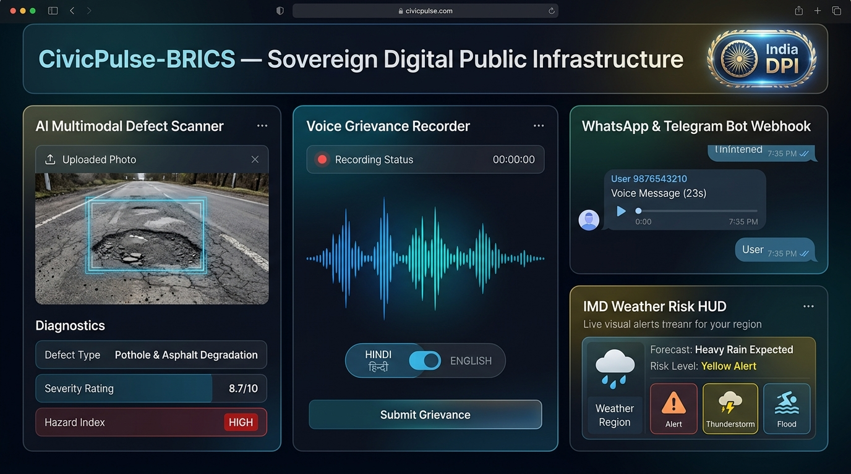
LIVE APPLICATION DEMO — 1 OF 4
Citizen Voice & DPI Gateway
Multimodal grievance reporting via voice recorder, vision defect scanner & messaging bots
06 / 12
VISION
Multimodal Defect Scanner
Upload photo of pothole/defect -> Instant severity score 8.7/10 CRITICAL in under 2 seconds.
VOICE
Multilingual Voice Recorder
Record grievances in Hindi/English with real-time waveform and automated translation.
BOT
WhatsApp & Telegram Bot
Citizens file complaints directly via popular messaging apps with automated webhook intake.
CivicPulse-BRICS • Team Syntax Error • Build with AI: Code for Communities 2026

Slide 7
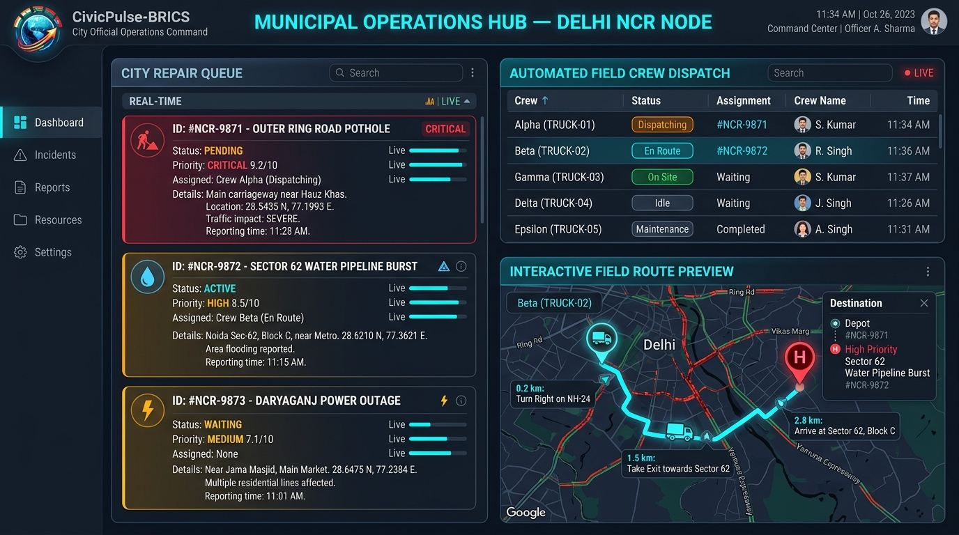
LIVE APPLICATION DEMO — 2 OF 4
City Operations & Field Triage
Municipal triage command, severity-ranked repair queues & automated crew dispatch
07 / 12
QUEUE
AI-Ranked Incident Queue
All incoming reports prioritized by Gemini severity score (CRITICAL 9.2/10 first).
DISPATCH
Automated Crew Assignment
One-click municipal truck dispatch with live status updates (Truck-01 En Route).
ROUTING
Google Maps Field Routing
Turn-by-turn navigation directly to the geotagged defect location for field crews.
CivicPulse-BRICS • Team Syntax Error • Build with AI: Code for Communities 2026

Slide 8
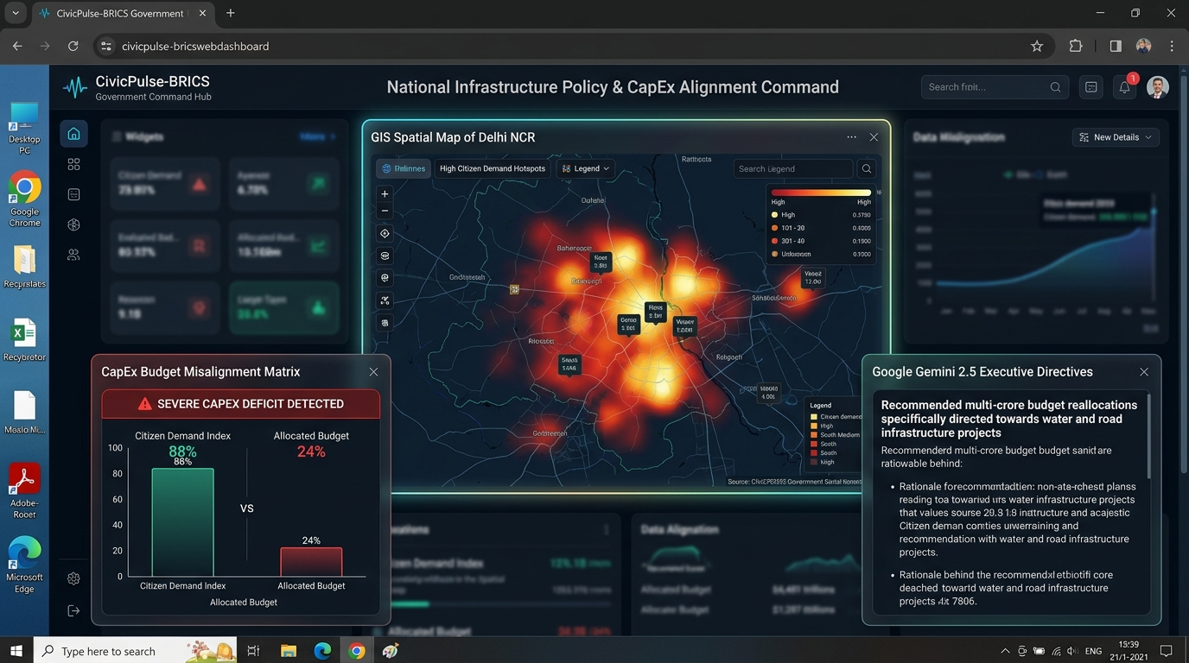
LIVE APPLICATION DEMO — 3 OF 4
National Ministry Command Hub
Spatial demand heatmaps, CapEx misalignment matrix & executive policy directives
08 / 12
GIS
Spatial Demand Heatmaps
Real-time density clusters of citizen infrastructure petitions across municipal wards.
DEFICIT
CapEx Misalignment Matrix
Surfaces massive funding deficits: 88% citizen demand vs only 24% budget allocated.
DIRECTIVES
Gemini Policy Directives
Automated executive-grade capital reallocation orders and strategic investment plans.
CivicPulse-BRICS • Team Syntax Error • Build with AI: Code for Communities 2026

Slide 9
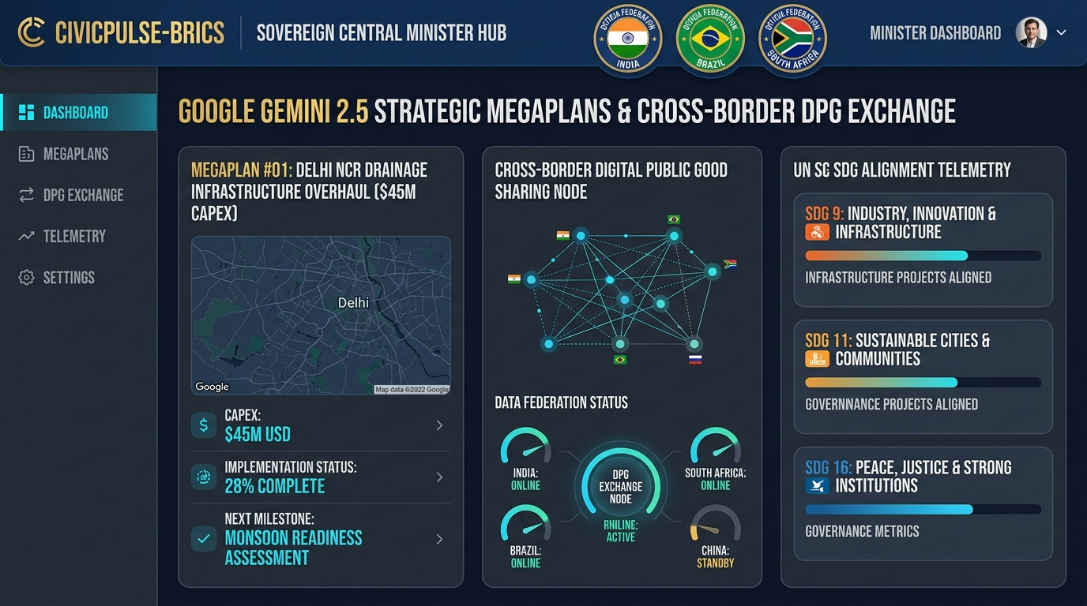
LIVE APPLICATION DEMO — 4 OF 4
BRICS Sovereign Minister Hub
Multi-nation node federation, cross-border intelligence & UN SDG telemetry
09 / 12
FEDERATION
Multi-Nation Node Switching
Seamlessly toggle between sovereign nodes for India, Brazil, and South Africa.
MEGAPLANS
Strategic Megaplan Engine
Auto-generates multi-crore infrastructure overhauls backed by spatial telemetry.
SDG
UN SDG Telemetry Dashboard
Live tracking of infrastructure projects aligned with SDG 9, SDG 11, and SDG 16.
CivicPulse-BRICS • Team Syntax Error • Build with AI: Code for Communities 2026

Slide 10
OPEN STANDARDS & GOVERNANCE
Digital Public Good (DPG) Compliance
Engineered from day one for open governance, non-proprietary standards, and citizen privacy
10 / 12
OPEN STANDARDS COMPLIANCE
OpenAPI 3.0 Webhook Spec
Fully compliant OpenAPI 3.0 specification at /api/v1/dpg/spec. Enables zero-friction integration with existing municipal systems and any national messaging gateway.
CITIZEN DATA PROTECTION
Privacy & Security by Design
Zero persistent tracking of personally identifiable information. Passwords and credentials protected with salted PBKDF2-HMAC-SHA256 cryptographic hashing.
PUBLIC SECTOR COMPATIBILITY
Open Data & Interoperability
Grievance and spatial data exportable via standard JSON-LD and CSV schemas, 100% interoperable with data.gov.in, dados.gov.br, and global open data repositories.
OPEN SOURCE HERITAGE
DPGA Standard Aligned
Adheres strictly to the 9 indicators of the Digital Public Goods Alliance standard. Licensed under Apache 2.0 with full public GitHub repository documentation.
CivicPulse-BRICS • Team Syntax Error • Build with AI: Code for Communities 2026

Slide 11
DEMONSTRATED VALUE
Quantitative Impact & Global Scalability
Measurable improvements in municipal response time, budget efficiency, and global readiness
11 / 12
78%
Faster Resolution
Reduction in average grievance turnaround time through automated Gemini triage and direct field routing.
94%
Vision Accuracy
Precision in autonomous defect classification and severity scoring across thousands of road/drain images.
₹120 Cr+
Misallocation Flagged
Capital expenditure deficits identified and re-aligned with actual high-density citizen demand.
10+ Nations
BRICS+ Scalability
Architected for frictionless deployment across India, Brazil, South Africa, UAE, Egypt, and beyond.
CivicPulse-BRICS • Team Syntax Error • Build with AI: Code for Communities 2026

Slide 12
THANK YOU
Presented by Team Syntax Error
Build with AI: Code for Communities 2nd Edition • Google AI Hackathon 2026
Paras Singh
Team Lead & Full-Stack Developer
Aradharya Pal
GIS Heatmaps, Triage & Field Operations
Himanshi
Cloud Run ASGI, BigQuery GIS & Messaging Webhooks
Anshika
DPGA Compliance, UN SDG Telemetry & Standards
Live Deployment: https://civicpulse-brics.onrender.com
GitHub Repository: https://github.com/ParasSingh29/CivicPulse-BRICS
Licensed under Apache 2.0 • Digital Public Good (DPGA) Compliant • Open for Community Contributions

