Slide 1
jQuery
jQuery is a small, light-weight and fast JavaScript library

Slide 2
What is jQuery
Query is a small, fast and lightweight JavaScript library.
jQuery is platform-independent.
jQuery means "write less do more".
jQuery simplifies AJAX call and DOM manipulation.

Slide 3
jQuery Features
HTML manipulation
DOM manipulation
DOM element selection
CSS manipulation
Effects and Animations
Utilities
AJAX
HTML event methods
JSON Parsing
Extensibility through plug-ins

Slide 4
Why jQuery is required
It is very fast and extensible.
It facilitates the users to write UI related function codes in minimum possible lines.
It improves the performance of an application.
Browser's compatible web applications can be developed.
It uses mostly new features of new browsers.

Slide 5
Many of the biggest companies on the web use jQuery.
Some of these companies are:
Microsoft
Google
IBM
Netflix

Slide 6
jQuery Selectors
jQuery Selectors are used to select and manipulate HTML elements. They are very important part of jQuery library.
With jQuery selectors, you can find or select HTML elements based on their id, classes, attributes, types and much more from a DOM.

Slide 7
All jQuery selectors start with a dollor sign and parenthesis e.g. $().
It is known as the factory function.

Slide 8
The $() factory function
Every jQuery selector start with thiis sign $().
This sign is known as the factory function.
It uses the three basic building blocks while selecting an element in a given document.

Slide 9
1) Tag Name: It represents a tag name available in the DOM.
For example: $('p') selects all paragraphs'p'in the document.
2) Tag ID: It represents a tag available with a specific ID in the DOM.
For example: $('#real-id') selects a specific element in the document that has an ID of real-id.
3) Tag Class: It represents a tag available with a specific class in the DOM.
For example: $('real-class') selects all elements in the document that have a class of real-class.

Slide 10
Example.1 Using Selectors
!DOCTYPE html>
<html>
<head>
<title>First jQuery Example</title>
<script type="text/javascript" src="http://ajax.googleapis.com/ajax/libs/jquery/2.1.3/jquery.min.js">
</script>
<script type="text/javascript" language="javascript">
$(document).ready(function() {
$("p").css("background-color", "pink");
});
</script>
</head>
<body>
<p>This is first paragraph.</p>
<p>This is second paragraph.</p>
<p>This is third paragraph.</p>
</body>
</html>

Slide 11
OutPut
This is first paragraph.
This is second paragraph.
This is third paragraph.

Slide 12
jQuery Effects
jQuery enables us to add effects on a web page.
jQuery effects can be categorized into fading, sliding, hiding/showing and animation effects.

Slide 13
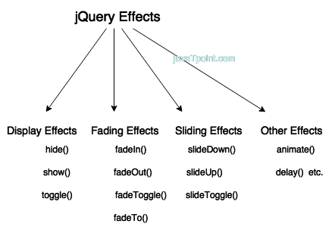

Slide 14
jQuery hide()
The jQuery hide() method is used to hide the selected elements.
Syntax:
$(selector).hide();
$(selector).hide(speed, callback);
$(selector).hide(speed, easing, callback);
speed: It is an optional parameter. It specifies the speed of the delay. Its possible vales are slow, fast and milliseconds.
easing: It specifies the easing function to be used for transition.
callback: It is also an optional parameter. It specifies the function to be called after completion of hide() effect.

Slide 15
<!DOCTYPE html>
<html>
<head>
<script src="http://ajax.googleapis.com/ajax/libs/jquery/1.11.2/jquery.min.js"></script>
<script>
$(document).ready(function(){
$("#hide").click(function(){
$("p").hide();
});
});
</script>
</head>
<body>
<p>
<b>This is a little poem: </b><br/>
Twinkle, twinkle, little star<br/>
How I wonder what you are<br/>
Up above the world so high<br/>
Like a diamond in the sky<br/>
Twinkle, twinkle little star<br/>
How I wonder what you are
</p>
<button id="hide">Hide</button>
</body>
</html>

Slide 16
Output:
This is a little poem:
Twinkle, twinkle, little star
How I wonder what you are
Up above the world so high
Like a diamond in the sky
Twinkle, twinkle little star
How I wonder what you are
Hide

Slide 17
jQuery Effects
jQuery EffectsjQuery hide()
open linkjQuery show()
jQuery toggle()
jQuery fadeIn()
jQuery fadeOut()
jQuery fadeToggle()
jQuery fadeTo()
jQuery slideDown()
jQuery slideUp()
jQuery slideToggle()
jQuery animate()
jQuery delay()
Source:https://www.javatpoint.com/jquery-effects

Slide 18
jQuery Events
jQuery events are the actions that can be detected by your web application.
They are used to create dynamic web pages.
An event shows the exact moment when something happens.
These are some examples of events.
A mouse click
An HTML form submission
A web page loading
A keystroke on the keyboard
Scrolling of the web page etc.

Slide 19
Mouse Events
click
dblclick
mouseenter
mouseleave
Keyboard Events
keyup
keydown
keypress
Form Events
submit
change
blur
focus
Document/Window Events
load
unload
scroll
resize

Slide 20
jQuery click()
When you click on an element, the click event occurs and once the click event occurs it execute the click () method or attaches a function to run.

Slide 21
<!DOCTYPE html>
<html>
<head>
<script src="http://ajax.googleapis.com/ajax/libs/jquery/1.11.2/jquery.min.js"></script>
<script>
$(document).ready(function(){
$("p").click(function(){
alert("This paragraph was clicked.");
});
});
</script>
</head>
<body>
<p>Click on the statement.</p>
</body>
</html>

Slide 22
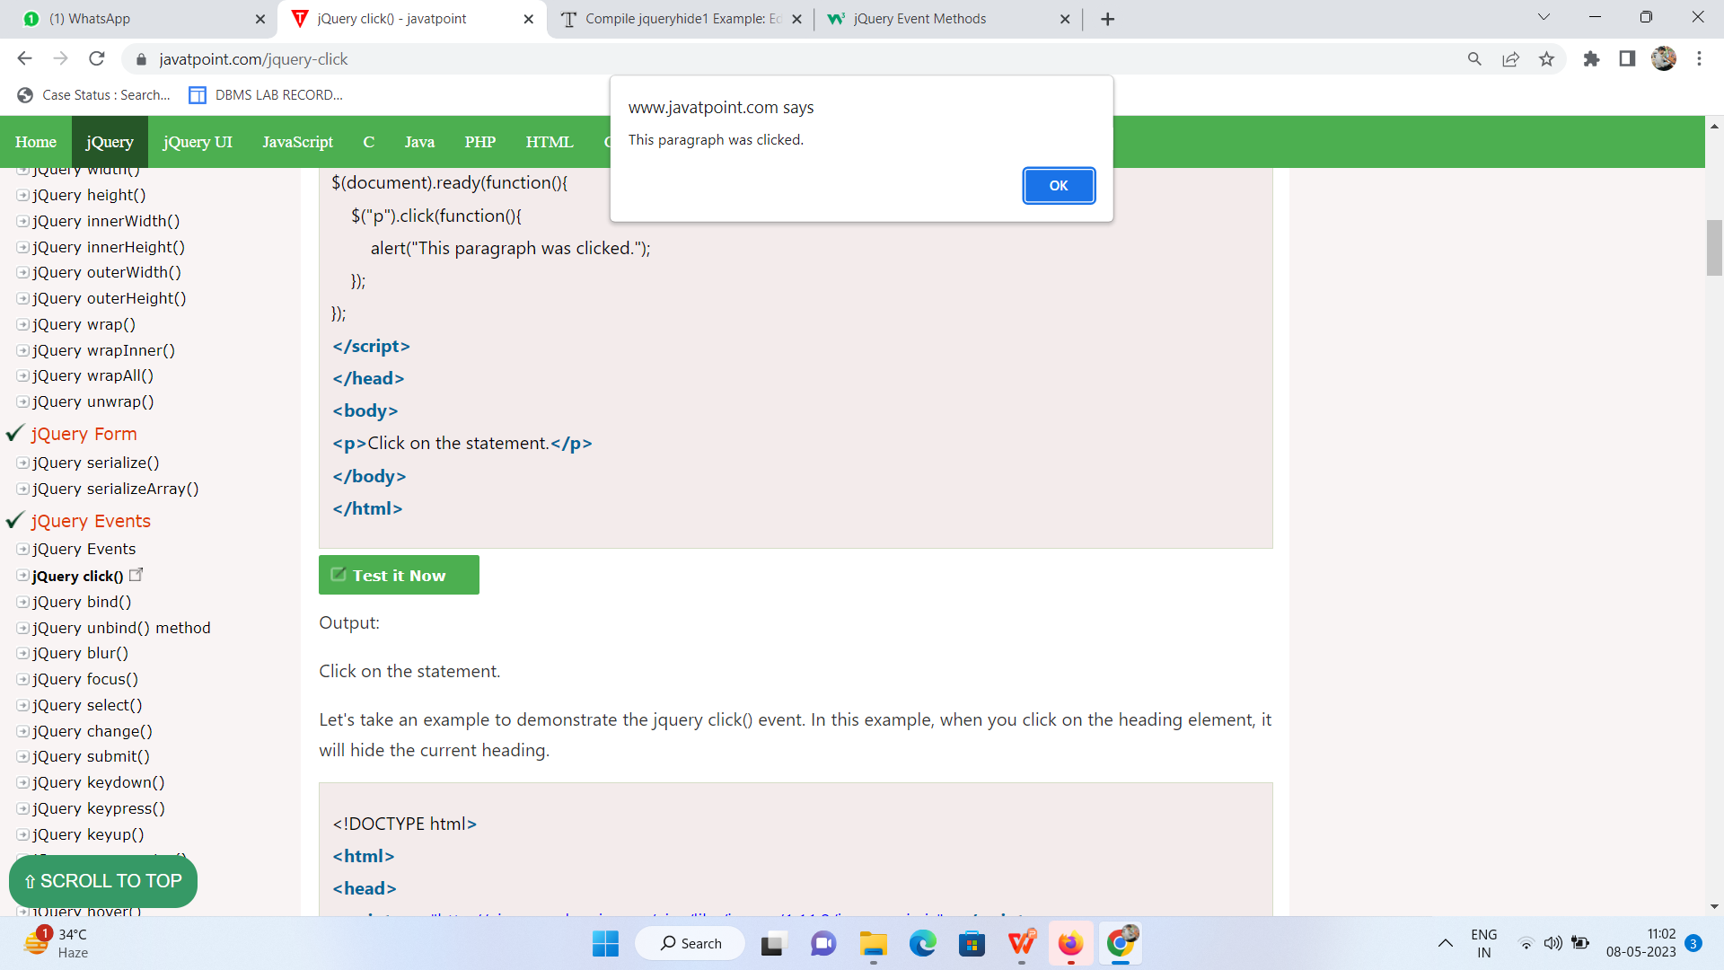
OutPut
Click on the statement.

Slide 23
jQuery Events
jQuery EventsjQuery click()
open linkjQuery bind()
jQuery unbind()
methodjQuery blur()
jQuery focus()jQuery select()
jQuery change()
jQuery submit()
jQuery keydown()
jQuery keypress()
jQuery keyup()
jQuery mouseenter()
jQuery mouseleave()
jQuery hover()
jQuery mousedown()
jQuery mouseup()
jQuery mouseover()
jQuery mouseout()
jQuery load()
jQuery unload()
jQuery delegate()

Slide 24
jQuery Traversing Methods
add()
addBack()
andSelf()
addBack()
children()
closest()
contents()
each()
end()
eq()
filter()
find()

Slide 25
first()
has()
is()
last()
map()
next()
nextAll(),nextUntil(),not(),offsetParent() ,parent(),parents() parentsUntil() ,prev() ,prevAll() ,prevUntil() siblings() ,slice()

Slide 26
jQuery - Plugins
Plugins are the section of code and these codes are written in a JavaScript file.
These JavaScript files are used to provide jQuery methods that work together with jQuery library methods.
You can download jQuery plug-in from https://jquery.com/plugins

Slide 27


