Slide 1
Bootstrap
Unit-5 Part-1

Slide 2
What is Bootstrap
Bootstrap is the most popular HTML, CSS and JavaScript framework for developing a responsive and mobile friendly website.
It is absolutely free to download and use.
It is a front-end framework used for easier and faster web development.
It includes HTML and CSS based design templates for typography, forms, buttons, tables, navigation, modals, image carousels and many others.
It can also use JavaScript plug-ins.
It facilitates you to create responsive designs.

Slide 3

What is Bootstrap

Slide 4
Why use Bootstrap
It is very easy to use. Anybody having basic knowledge of HTML and CSS can use Bootstrap.
It facilitates users to develop a responsive website.
It is compatible on most of browsers like Chrome, Firefox, Internet Explorer, Safari and Opera etc.

Slide 5
What is a responsive website
A website is called responsive website which can automatically adjust itself to look good on all devices, from smart phones to desktops etc.

Slide 6
What Bootstrap package contains
Scaffolding: Bootstrap provides a basic structure with Grid System, link styles, and background.
CSS: Bootstrap comes with the feature of global CSS settings, fundamental HTML elements style and an advanced grid system.
Components: Bootstrap contains a lot of reusable components built to provide iconography, dropdowns, navigation, alerts, pop-overs, and much more.
JavaScript Plugins: Bootstrap also contains a lot of custom jQuery plugins. You can easily include them all, or one by one.
Customize: Bootstrap components are customizable and you can customize Bootstrap's components, LESS variables, and jQuery plugins to get your own style.

Slide 7
What is Bootstrap 4?
Bootstrap is the newest and latest version of Bootstrap. It is the most popular HTML, CSS, JavaScript framework for developing responsive, mobile first websites.

Slide 8
Bootstrap Container
In Bootstrap, container is used to set the content's margins dealing with the responsive behaviors of your layout. It contains the row elements and the row elements are the container of columns (known as grid system).
The container class is used to create boxed content.
There are two container classes in Bootstrap:
container
container-fluid

Slide 9
<html>
<body>
<div class="container">
<div class="row">
<div class="col-md-xx"></div>
...
</div>
<div class="row">
<div class="col-md-xx"></div>
...
</div>
</div>
</body>
</html>

Slide 10
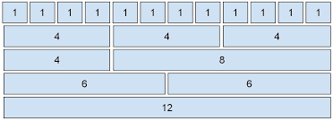
Bootstrap Grids Bootstrap's grid system allows up to 12 columns across the page.

Slide 11
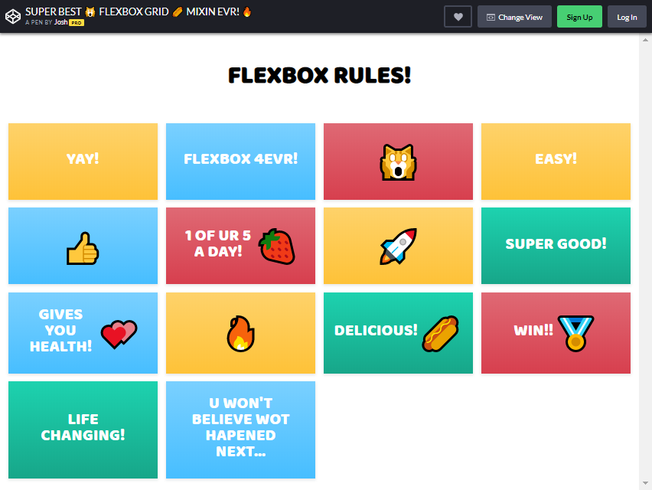
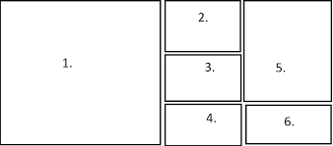

Slide 12
Grid Classes
The Bootstrap grid system has four classes:
xs (for phones - screens less than 768px wide)
sm (for tablets - screens equal to or greater than 768px wide)
md (for small laptops - screens equal to or greater than 992px wide)
lg (for laptops and desktops - screens equal to or greater than 1200px wide)
The classes above can be combined to create more dynamic and flexible layouts.

Slide 13
Bootstrap container example
<!DOCTYPE html>
<html lang="en">
<head>
<title>Job</title>
<link rel="stylesheet" href="https://maxcdn.bootstrapcdn.com/bootstrap/3.3.6/css/bootstrap.min.css"/>
</head>
<body>
<div class="container">
<h1>Container</h1>
<p>container content</p>
</div>
<div class="container-fluid">
<h1>Container-fluid</h1>
<p>container-fluid content</p>
</div>
<script src="https://ajax.googleapis.com/ajax/libs/jquery/1.11.3/jquery.min.js"></script>
<script src="https://maxcdn.bootstrapcdn.com/bootstrap/3.3.5/js/bootstrap.min.js"></script>
</body>
</html>

Slide 14
OutPut
Container
container content
Container-fluid
container-fluid content

Slide 15
Bootstrap Jumbotron
A Bootstrap jumbotron specifies a big box for getting extra attention to some special content or information.
It is displayed as a grey box with rounded corners.
It can also enlarge the font sizes of the text inside it.

Slide 16
<!DOCTYPE html>
<html lang="en">
<head>
<title>Bootstrap Example</title>
<meta charset="utf-8">
<meta name="viewport" content="width=device-width, initial-scale=1">
<link rel="stylesheet" href="https://maxcdn.bootstrapcdn.com/bootstrap/3.3.6/css/bootstrap.min.css">
</head>
<body>
<div class="container">
<div class="jumbotron">
<h1>This is Jumbotron inside container!</h1>
<p>Jumbotron specifies a big box for getting extra attention to some special content or information.</p>
</div>
<p>This is some text.</p>
<p>This is another text.</p>
</div>
<script src="https://ajax.googleapis.com/ajax/libs/jquery/1.12.0/jquery.min.js"></script>
<script src="https://maxcdn.bootstrapcdn.com/bootstrap/3.3.6/js/bootstrap.min.js"></script>
</body>
</html>

Slide 17
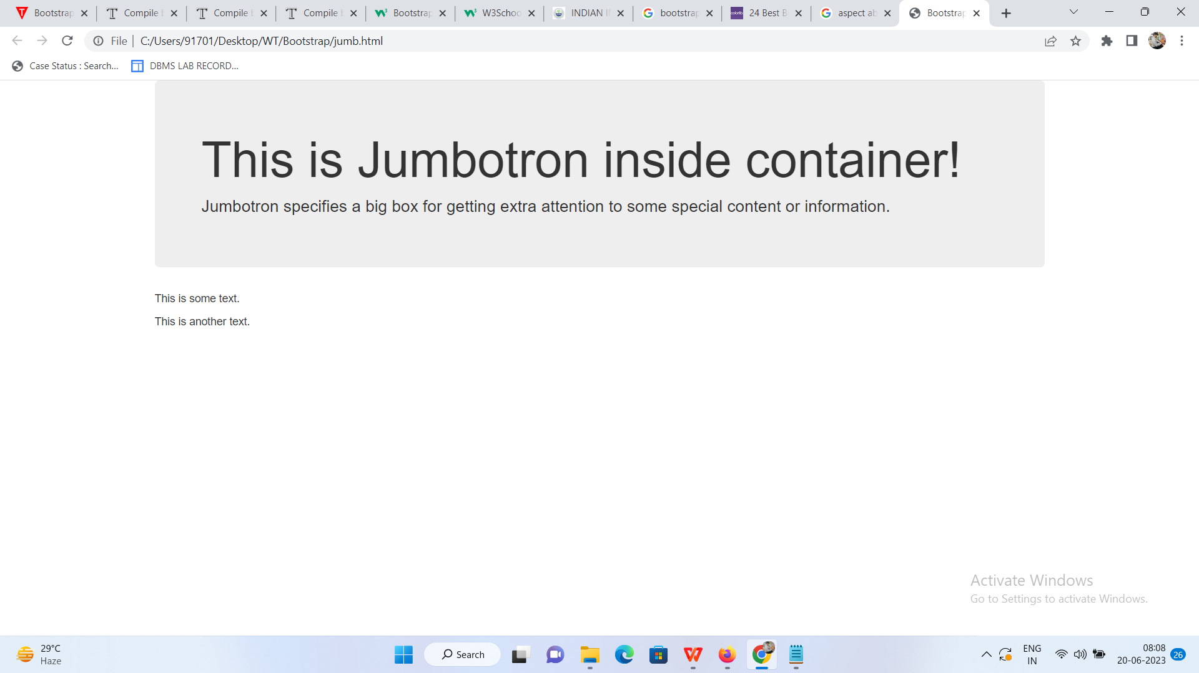

Slide 18
Bootstrap Buttons There are seven styles to add a button in Bootstrap. Use the following classes to achieve the different button styles:
.btn-default
.btn-primary
.btn-success
.btn-info
.btn-warning
.btn-danger
.btn-link

Slide 19
<!DOCTYPE html>
<html lang="en">
<head>
<title>Job</title>
<link rel="stylesheet" href="https://maxcdn.bootstrapcdn.com/bootstrap/3.3.6/css/bootstrap.min.css"/>
</head>
<body>
<h1>Button Example!</h1>
<button class="btn btn-default">default</button>
<button class="btn btn-primary">primary</button>
<button class="btn btn-danger">danger</button>
<button class="btn btn-success">success</button>
<button class="btn btn-info">info</button>
<button class="btn btn-warning">warning</button>
<button class="btn btn-link">Link</button>
<script src="https://ajax.googleapis.com/ajax/libs/jquery/1.11.3/jquery.min.js"></script>
<script src="https://maxcdn.bootstrapcdn.com/bootstrap/3.3.5/js/bootstrap.min.js"></script>
</body>
</html>

Slide 20
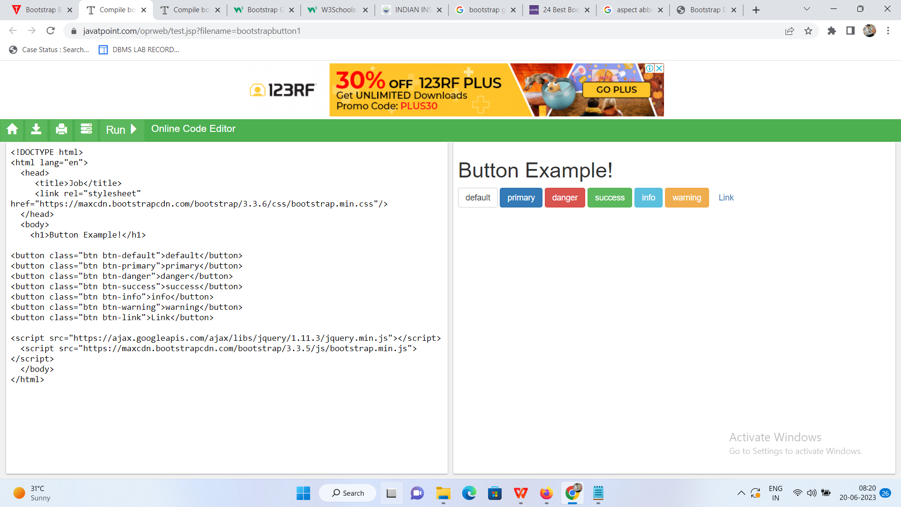

Slide 21
Bootstrap Tables We can create different types of Bootstrap tables by using different classes to style them.
<!DOCTYPE html>
<html lang="en">
<head>
<title>Job</title>
<link rel="stylesheet" href="https://maxcdn.bootstrapcdn.com/bootstrap/3.3.6/css/bootstrap.min.css"/>
</head>
<body>
<div class="container">
<h1>Basic Table Example</h1>
<table class="table">
<tr><th>Id</th><th>Name</th><th>Age</th></tr>
<tr><td>101</td><td>Rahul</td><td>23</td></tr>
<tr><td>102</td><td>Umesh</td><td>22</td></tr>
<tr><td>103</td><td>Max</td><td>29</td></tr>
<tr><td>104</td><td>Ajeet</td><td>21</td></tr>
</table>
</div>
<script src="https://ajax.googleapis.com/ajax/libs/jquery/1.11.3/jquery.min.js"></script>
<script src="https://maxcdn.bootstrapcdn.com/bootstrap/3.3.5/js/bootstrap.min.js"></script>
</body>
</html>

Slide 22
Basic Table Example
Id Name Age
101 Rahul 23
102 Umesh 22
103 Max 29
104 Ajeet 21

Slide 23
Bootstrap Alerts
Bootstrap Alerts are used to provide an easy way to create predefined alert messages.
Alert adds a style to your messages to make it more appealing to the users.
There are four classes that are used within <div> element for alerts.
.alert-success
.alert-info
.alert-warning
.alert-danger

Slide 24
<!DOCTYPE html>
<html lang="en">
<head>
<title>Bootstrap Example</title>
<meta charset="utf-8">
<meta name="viewport" content="width=device-width, initial-scale=1">
<link rel="stylesheet" href="https://maxcdn.bootstrapcdn.com/bootstrap/3.3.6/css/bootstrap.min.css">
<script src="https://ajax.googleapis.com/ajax/libs/jquery/1.12.0/jquery.min.js"></script>
<script src="https://maxcdn.bootstrapcdn.com/bootstrap/3.3.6/js/bootstrap.min.js"></script>
</head>
<body>
<div class="container">
<h2>Alerts</h2>
<div class="alert alert-success">
<strong>Success!</strong> This alert box indicates a successful or positive action.
</div>
<div class="alert alert-info">
<strong>Info!</strong> This alert box indicates a neutral informative change or action.
</div>
<div class="alert alert-warning">
<strong>Warning!</strong> This alert box indicates a warning that might need attention.
</div>
<div class="alert alert-danger">
<strong>Danger!</strong> This alert box indicates a dangerous or potentially negative action.
</div>
</div>
</body>
</html>

Slide 25
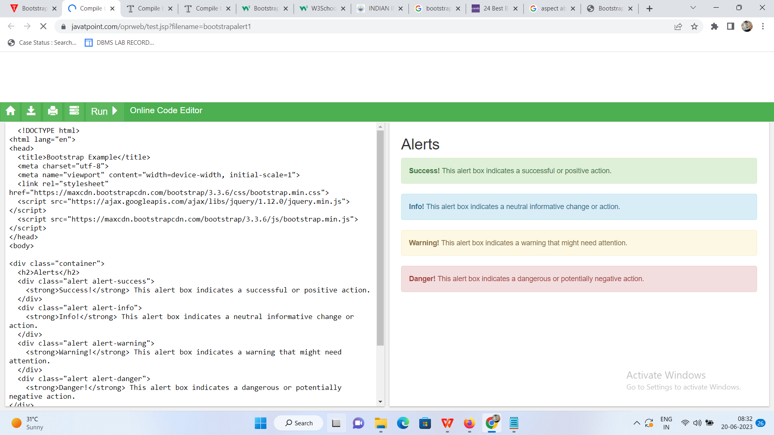

Slide 26
Bootstrap Forms
In Bootstrap, there are three types of form layouts:
Vertical form (this is default)
Horizontal form
Inline form

Slide 27
<!DOCTYPE html>
<html lang="en">
<head>
<title>Bootstrap example</title>
<link rel="stylesheet" href="https://maxcdn.bootstrapcdn.com/bootstrap/3.3.6/css/bootstrap.min.css"/>
</head>
<body>
<div class="container">
<h1>Vertical Form Example</h1>
<form style="width:300px">
<div class="form-group">
<label for="exampleInputEmail1">Email address</label>
<input type="email" class="form-control" id="exampleInputEmail1" placeholder="Email">
</div>
<div class="form-group">
<label for="exampleInputPassword1">Password</label>
<input type="password" class="form-control" id="exampleInputPassword1" placeholder="Password">
</div>
<button type="submit" class="btn btn-default">Login</button>
</form>
</div>
<script src="https://ajax.googleapis.com/ajax/libs/jquery/1.11.3/jquery.min.js"></script>
<script src="https://maxcdn.bootstrapcdn.com/bootstrap/3.3.5/js/bootstrap.min.js"></script>
</body>
</html>

Slide 28
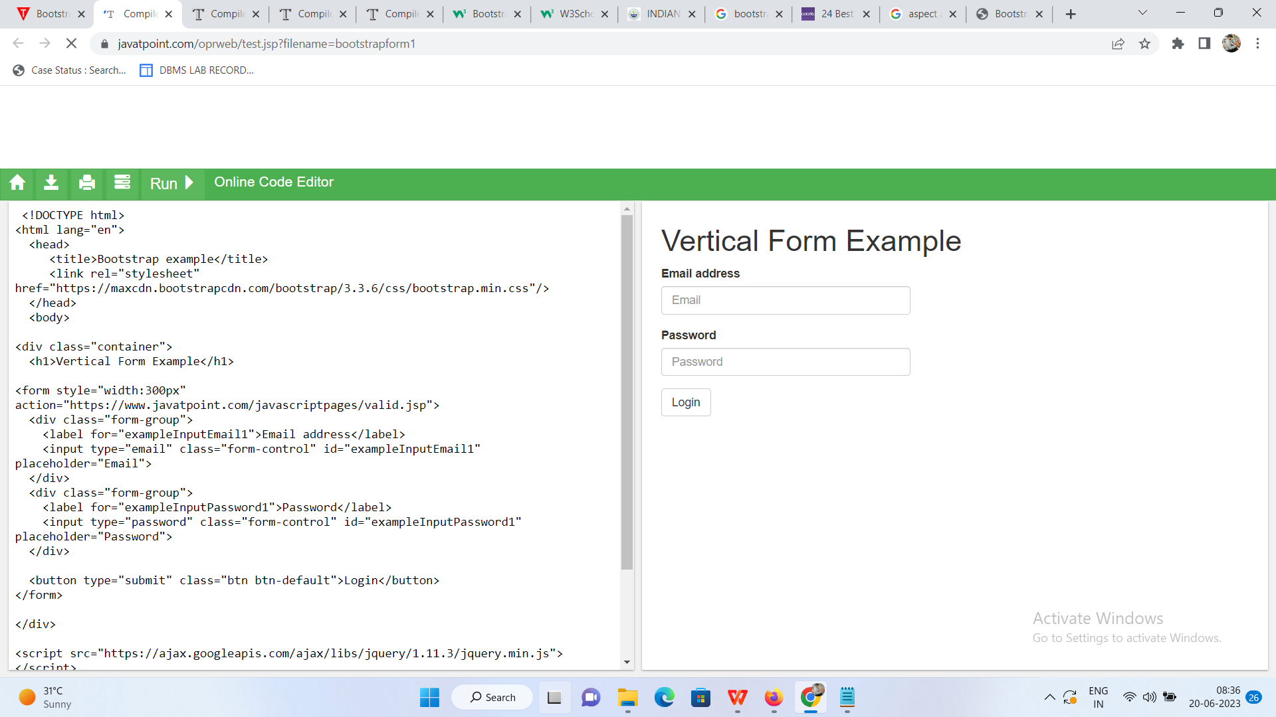

Slide 29
Bootstrap Examples
Bootstrap Jumbotron
Bootstrap Button
Bootstrap Grid
Bootstrap Table
Bootstrap Form
Bootstrap Alert
Bootstrap Wells
Bootstrap Badge & Label
Bootstrap Panels
Bootstrap Pagination
Bootstrap Pager
Bootstrap Image
Bootstrap Glyphicon
Bootstrap Carousel
Bootstrap Progress Bar
Bootstrap List Group
Bootstrap Dropdown
Bootstrap Collapse

