Slide 1
COMPUTER ORGANIZATION
AND ARCHITECTURE
T Narasimhappadu
MCA.,M.Tech.,MBA.,(PhD)
Asst.Professor
Dept of CSE
IIIT-Srikakulam Campus
Ph 9492638410

Slide 2
COMPUTER ORGANIZATION
AND ARCHITECTURE
What is Computer Organization:
Computer Organization is concerned with the structure and behavior of a computer system as seen by the user.
What is Computer Architecture:
Computer Architecture is concerned with the way hardware components are connected together to form a computer system.

Slide 3
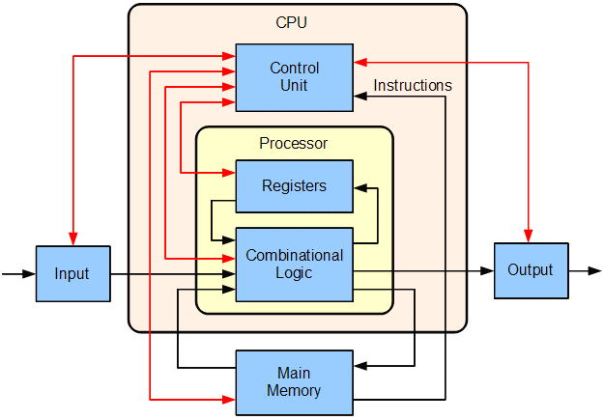

Slide 4
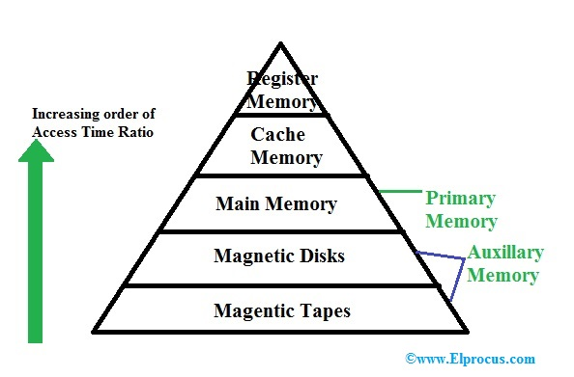
Memory

Slide 5
Computer Architecture | Computer Organization
It acts as the interface between hardware and software. | It deals with the components of a connection in a system.
Computer Architecture helps us to understand the functionalities of a system. | Computer Organization tells us how exactly all the units in the system are arranged and interconnected.
A programmer can view architecture in terms of instructions, addressing modes and registers. | Whereas Organization expresses the realization of architecture.
While designing a computer system architecture is considered first. | An organization is done on the basis of architecture.
Computer Architecture deals with high-level design issues. | Computer Organization deals with low-level design issues.
Architecture involves Logic (Instruction sets, Addressing modes, Data types, Cache optimization) | Organization involves Physical Components (Circuit design, Adders, Signals, Peripherals)

Slide 6
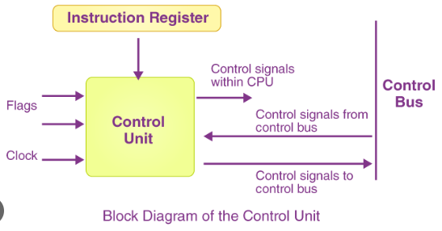
Control Unit
A control unit, or CU, is circuitry within a computer’s processor that directs operations. It instructs the memory, logic unit, and both output and input devices of the computer on how to respond to the program’s instructions. CPUs are examples of devices that use control units

Slide 7
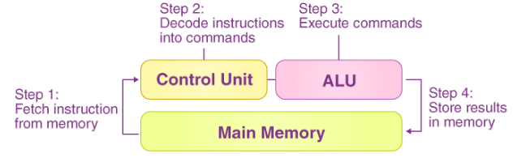
HOW CU Works!!
The control unit’s job is to instruct the computer’s arithmetic/logic unit, memory, and input and output devices on how to respond to the instructions supplied to the processor.

Slide 8
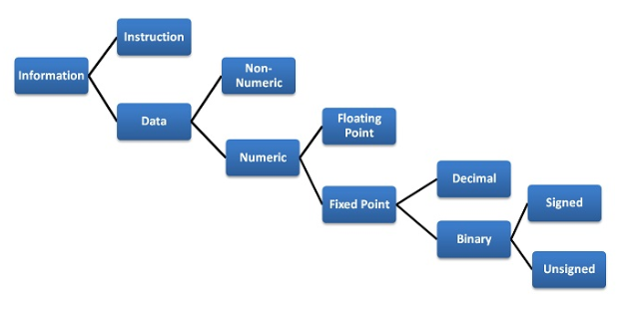
Data Representation

Slide 9
fixed point representations
Unsign number representation
Signed number representation
1’s Complement
2’s Complement

Slide 10
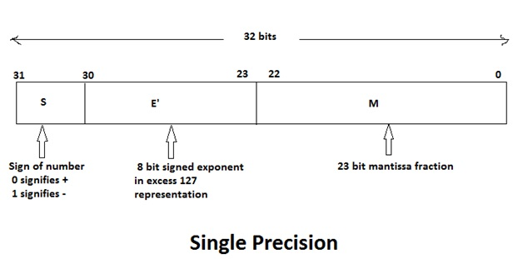
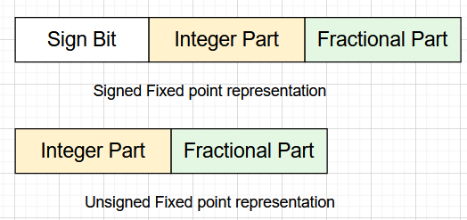
floating point representations

Slide 11
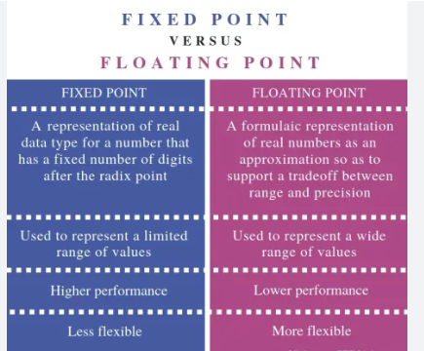

Slide 12
Character Representation
Another data type is non-numeric and is largely character sets. We use a human-understandable character set to communicate with computer i.e. for both input and output. Standard character sets like EBCDIC and ASCII are chosen to represent alphabets, numbers and special character

Slide 13
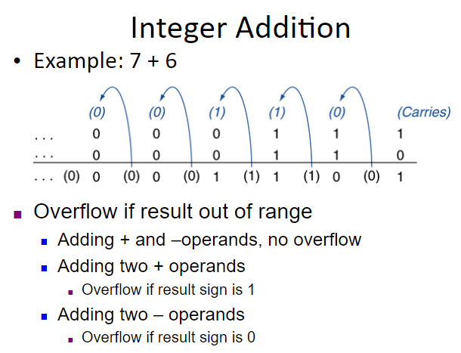

Slide 14
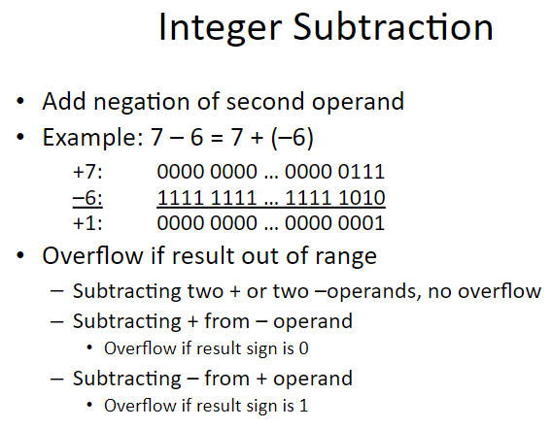

Slide 15
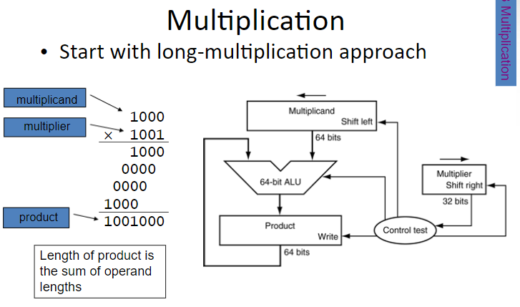

Slide 16
Addressing Modes
The addressing modes help us specify the way in which an operand’s effective address is represented in any given instruction. Some addressing modes allow referring to a large range of areas efficiently, like some linear array of addresses along with a list of addresses. The addressing modes describe an efficient and flexible way to define complex effective addresses.
The programs are generally written in high-level languages, as it’s a convenient way in which one can define the variables along with the operations that a programmer performs on the variables. This program is later compiled so as to generate the actual machine code. A machine code includes low-level instructions.
A set of low-level instructions has operands and opcodes. An addressing mode has no relation with the opcode part. It basically focuses on presenting the address of the operand in the instructions.

Slide 17
Addressing Modes Types
The addressing modes refer to how someone can address any given memory location. Five different addressing modes or five ways exist using which this can be done.
showing the various kind of addressing modes:
Implied Mode
Immediate Mode
Register Mode
Register Indirect Mode
Autodecrement Mode
Autoincrement Mode
Direct Address Mode
Indirect Address Mode
Indexed Addressing Mode

Slide 18
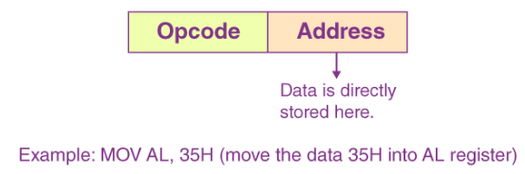
Implied Mode
In the implied mode, the operands are implicitly specified in the definition of instruction. For instance, the “complement accumulator” instruction refers to an implied-mode instruction. It is because, in the definition of the instruction, the operand is implied in the accumulator register. All the register reference instructions are implied-mode instructions that use an accumulator.

Slide 19
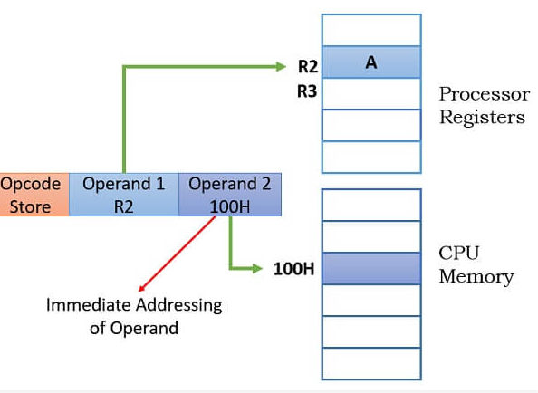
Immediate Mode
In the immediate mode, we specify the operand in the instruction itself. Or, in simpler words, instead of an address field, the immediate-mode instruction consists of an operand field. An operand field contains the actual operand that is to be used in conjunction with an operation that is determined in the given instruction. The immediate-mode instructions help initialize registers to a certain constant value.
Add R2, #100
Store R2, 100H

Slide 20
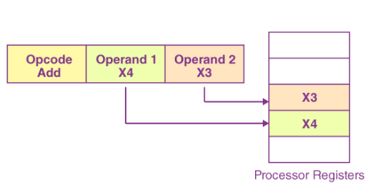
Register Addressing Mode
register to represent the operands refer to the instructions that are in the register addressing mode.
The effective address here refers to the register in which the value of an operand is present. Here:
EA = R
To represent register addressing mode, here are two instructions below as examples:
Add X4, X3
Load X3, X2

Slide 21
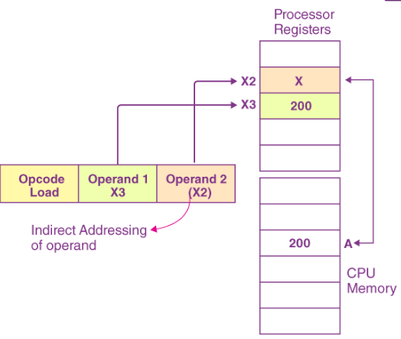
Register Indirect Addressing Mode
We use a processor register to hold a memory location’s address wherever the operand has been placed. This addressing mode would allow the execution of a similar set of instructions for various different memory locations. It can be done if we increment the content of the register and, thereby, point to the new location every single time.
Here, for instance:
Load X3, (X2) // Load X2, A
Here, the Load instruction will ultimately load the values that are present at the memory locations that are contained by the X2 register in the X3 register. The figure given below shows how the X3 register is loaded with the value that is stored in a memory location held by the X2 register

Slide 22
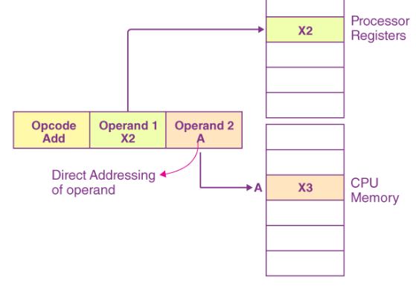
Direct Addressing Mode
The other name for the direct addressing mode is the absolute addressing mode. In this case, the instruction possesses the address of the actual location in the memory wherever the value of the given operand is stored.
Ex:-Add R2, A
Store R2, B

Slide 23
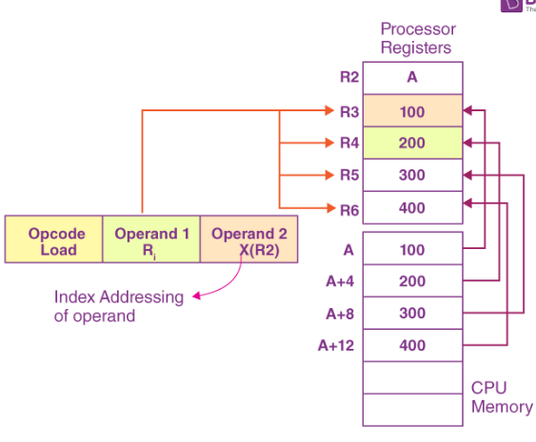
Index Addressing Mode
The index addressing mode is pretty helpful whenever the instructions in a program access an array or large ranges of memory addresses. The effective address, in such a mode, is generated when we add a constant to the content of the register. The register content does not ever change
Load R2, A
Load R3, (R2)
Load R4, 4(R2)
Load R5, 8(R2)
Load R6, 12(R2)

Slide 24
RISC:-
RISC stands for Reduced Instruction Set Computer. In Reduced Instruction Set Computer (RISC) architecture, the instruction set of the computer is simplified to reduce the execution time. RISC has a small set of instructions, which generally include register-to-register operations.
Thus, data is stored in processor registers for computations, and results of the computations are transferred to the memory using store instructions. All operations are performed within the registers of the CPU. In RISC, all instructions have simple register addressing and hence use less number of addressing modes.
RISC uses relatively a simple instruction format and is easy to decode. Here, the instruction length can be fixed and aligned on word boundaries. The RISC processors can execute one instruction per clock cycle.

Slide 25
Features of RISC Processor
There are various features of CISC Processor that are as follows −
It can relatively few instructions.
It can relatively few addressing modes.
It is used for memory access limited to load and store instructions.
All operations are done within the registers of the CPU.
It can fixed-length, easily decoded instruction format.
It is used for single-cycle instruction execution.
It can be hardwired rather than micro-programmed control.

Slide 26
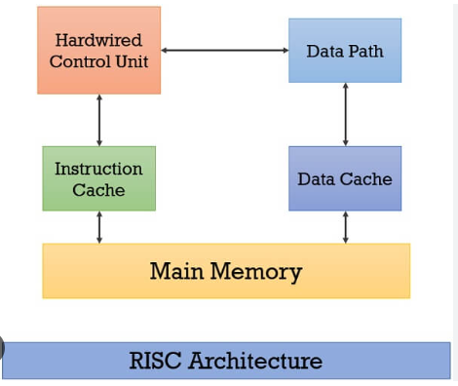

Slide 27
Example – Suppose we have to add two 8-bit numbers:
CISC approach: There will be a single command or instruction for this like ADD which will perform the task.
RISC approach: Here programmer will write the first load command to load data in registers then it will use a suitable operator and then it will store the result in the desired location.
Creating a RISC instruction set for the above instruction will be.
Load R1, B
Load R2, C
Add R3, R2, R1
Store R3, C

Slide 28
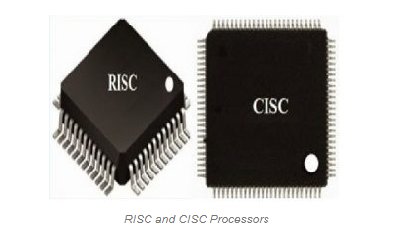

Slide 29
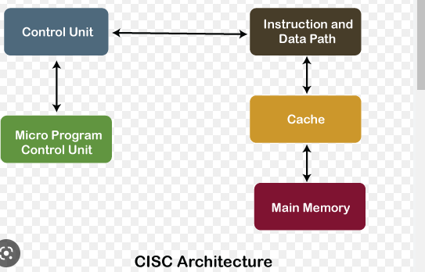
CISC ARCHITECTURE

Slide 30
CPU Design
A CPU is decomposed into two main parts: data path & control unit.
Data path consists of registers, arithmetic blocks and interconnections.
The flow of data between registers & arithmetic operations are performed in the data path.

Slide 31
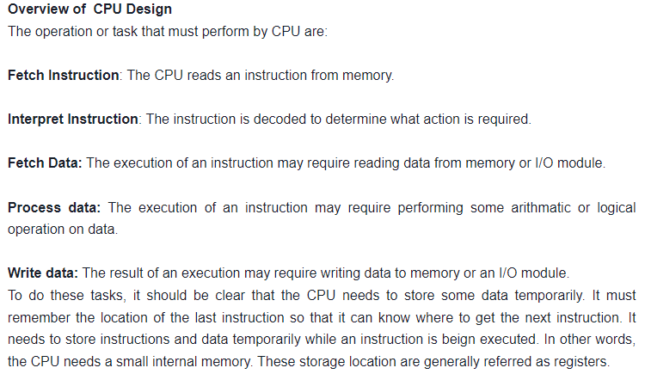

Slide 32
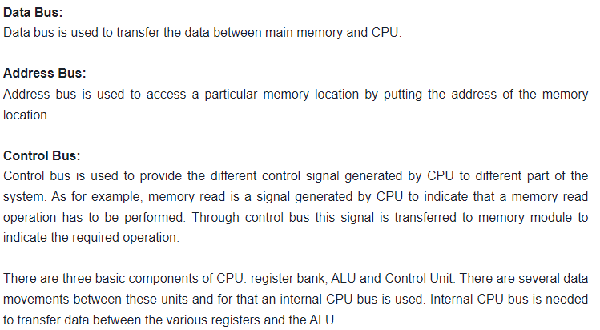

Slide 33
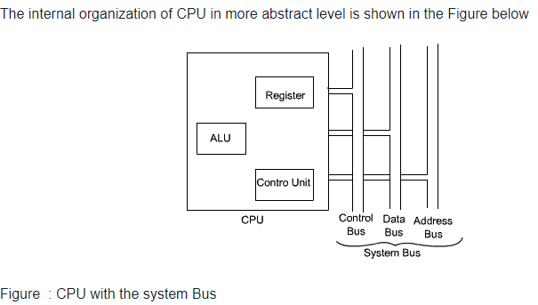

Slide 34
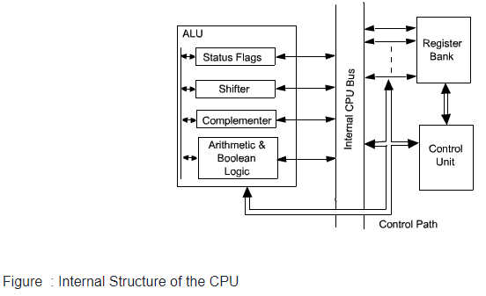
Conti..…….

